Slide 1

Mole Mash Game

Slide 2
Mole Mash Game Description
In our version of whack a mole, you will have thirty seconds to try and get the highest score you can. If your total score after the thirty seconds is high enough, you will be able to collect bonus points by shaking your device! Final Scores are then displayed on another we will call the ScoreScreen. On the ScoreScreen page, the high score is displayed along with the score from the previous game.

Slide 3
Android & Computer Science Concepts Covered in Mole Mash Game
This Android App will include the following Computer Science concepts and Android principles:
The Android accelerometer sensor
Android event handling
How conditional and control statements are used
Data structures and Abstractions
Parameter passing and Data Storage
High level languages translated into low level languages.

Slide 4
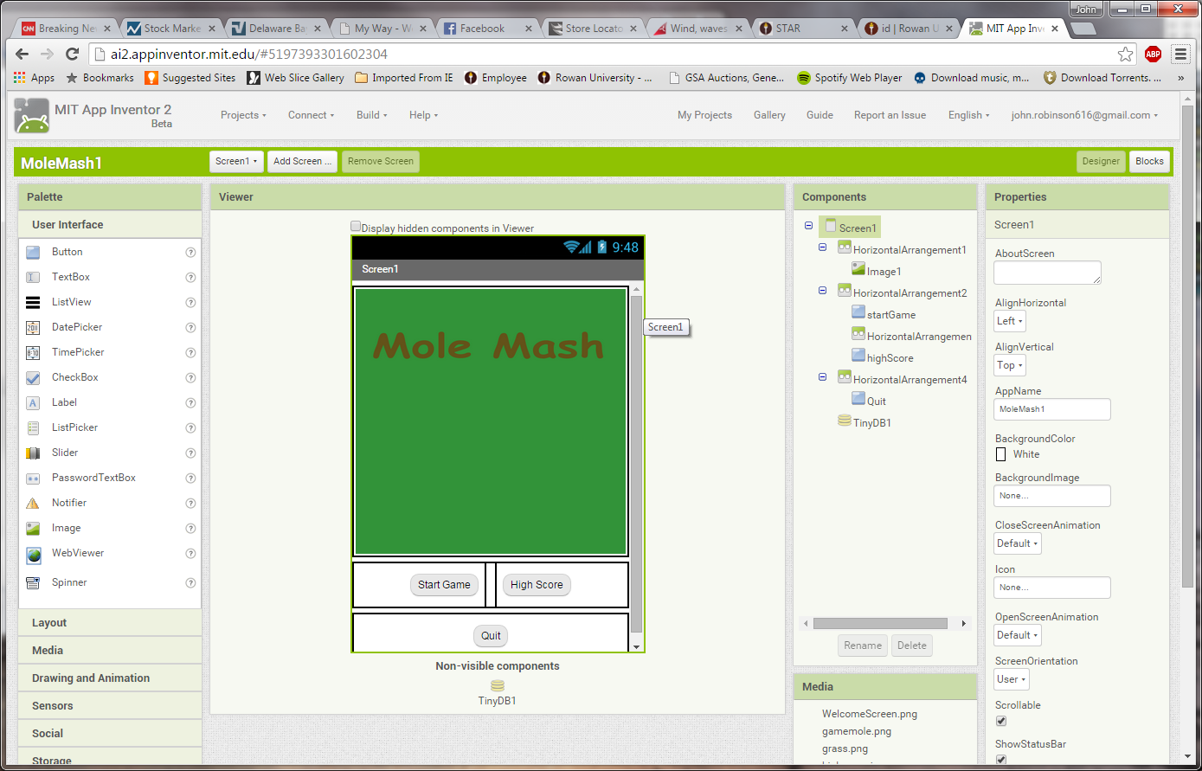
Screen 1
Notes:
HZL1 – width – fill parent, height - 310 pixels
HZL2 – width – fill parent, height - 50 pixels
HZL3 – width – 10 pixels, height – fill parent

Slide 5
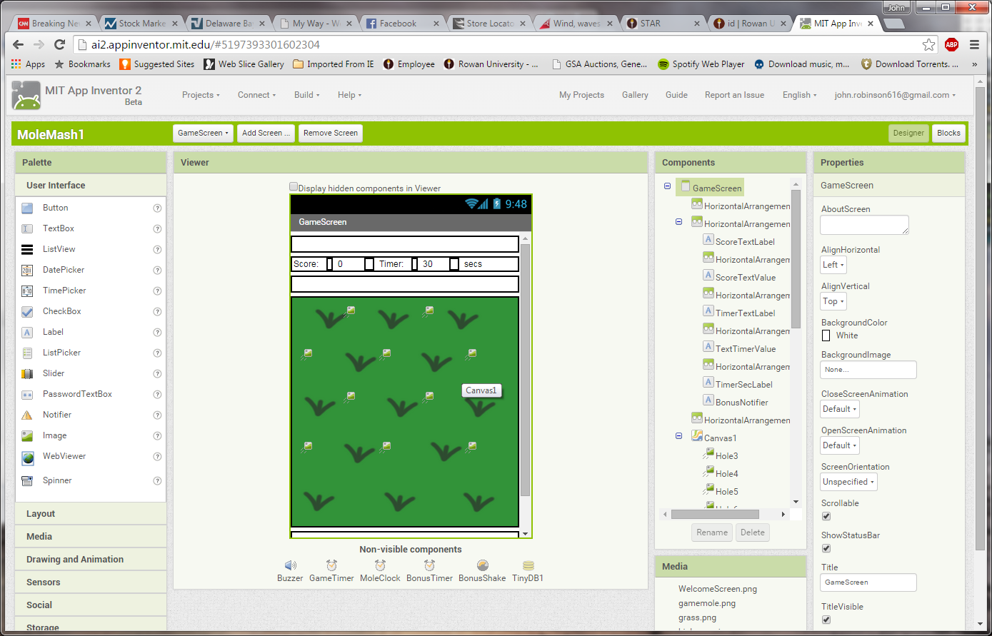
Game Screen top
Notes:
HZL1 – width – fill parent, height - 20 pixels
HZL2 – width – fill parent, height – automatic
HZL3 – width – 5 pixels, height - fill parent
HZL4 – width – 10 pixels , height - fill parent
HZL5 – width – 5 pixels, height - fill parent
HZL6 – width – 10 pixels, height – fill parent
HZL7 – width – fill parent, height - 20 pixels
CANVAS - width – fill parent, height - 320 pixels

Slide 6
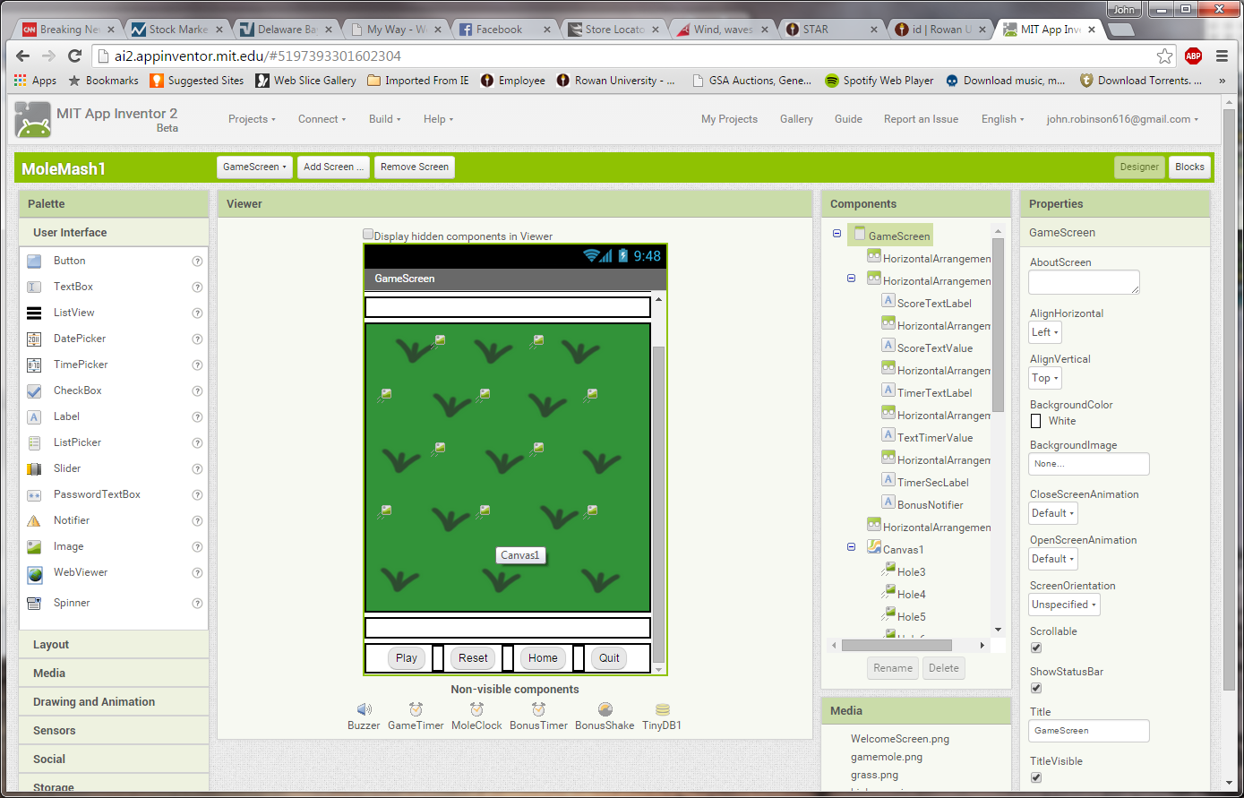
Game Screen bottom
Notes:
HZL8 – width – fill parent, height - 20 pixels
HZL9 – width – fill parent, height - 20 pixels
HZL8 – width –10 pixels, height - fill parent

Slide 7
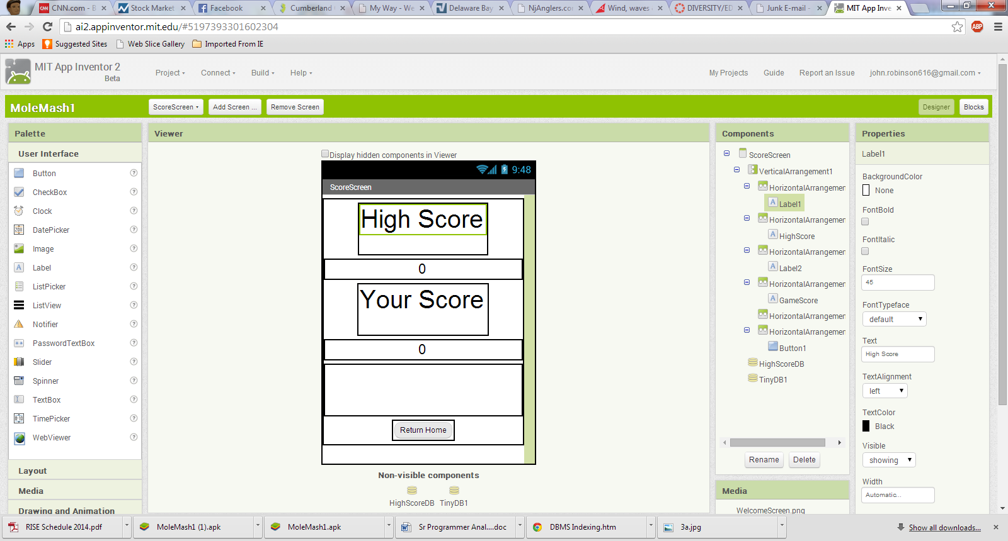
Score Screen
Notes:
VERTL1 – width – fill parent, height - fill parent
HZL2 – width – automatic, height – 80 pixels
HZL3 – width – fill parent, height – automatic
HZL4 – width – automatic, height – 80 pixels
HZL5 – width – fill parent, height – automatic
HZL6 – width – automatic, height – 80 pixels
HZL7 – width – automatic, height – fill parent

Slide 8
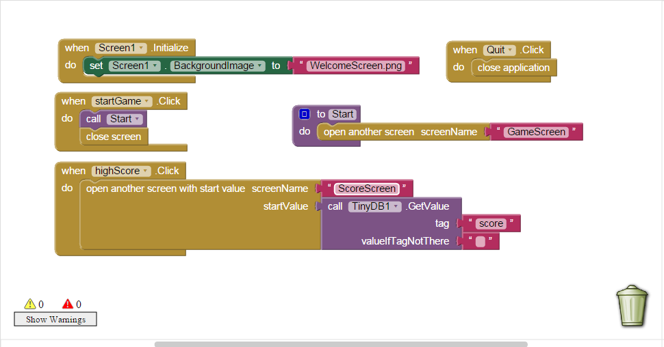
Screen 1 Logic

Slide 9
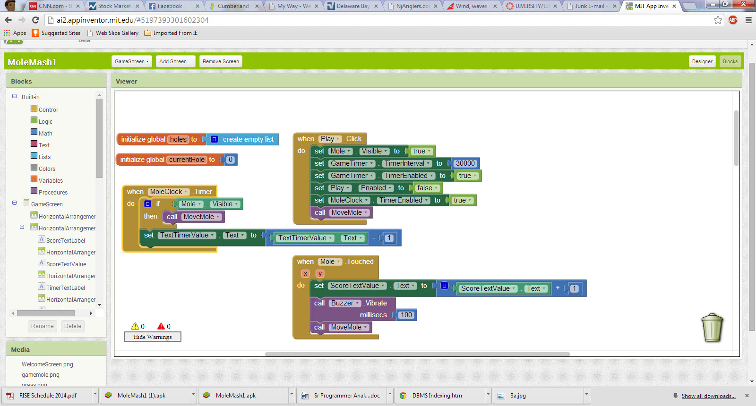
Game Screen Logic

Slide 10
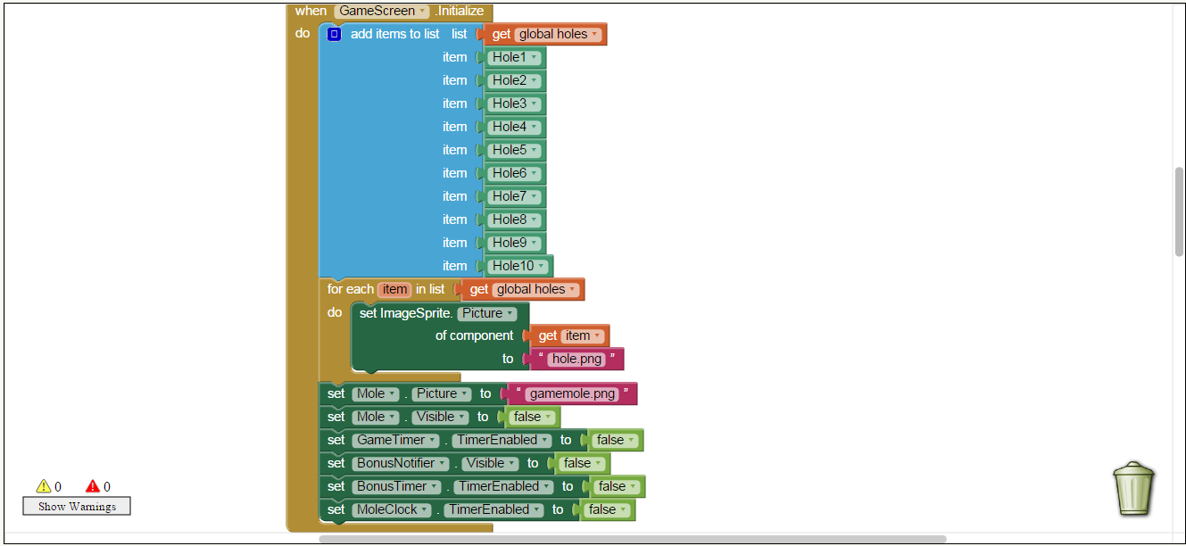
Game Screen Logic

Slide 11
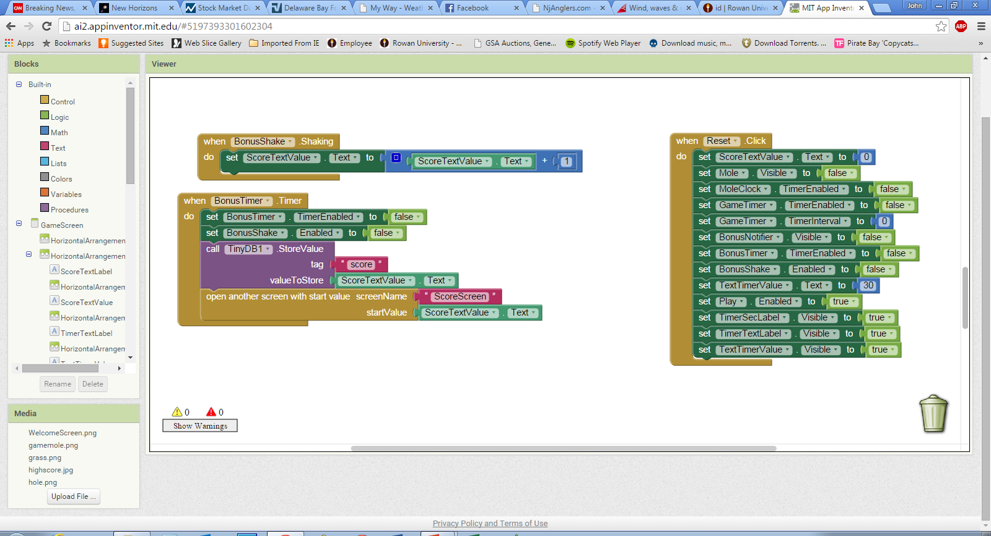
Game Screen Logic

Slide 12
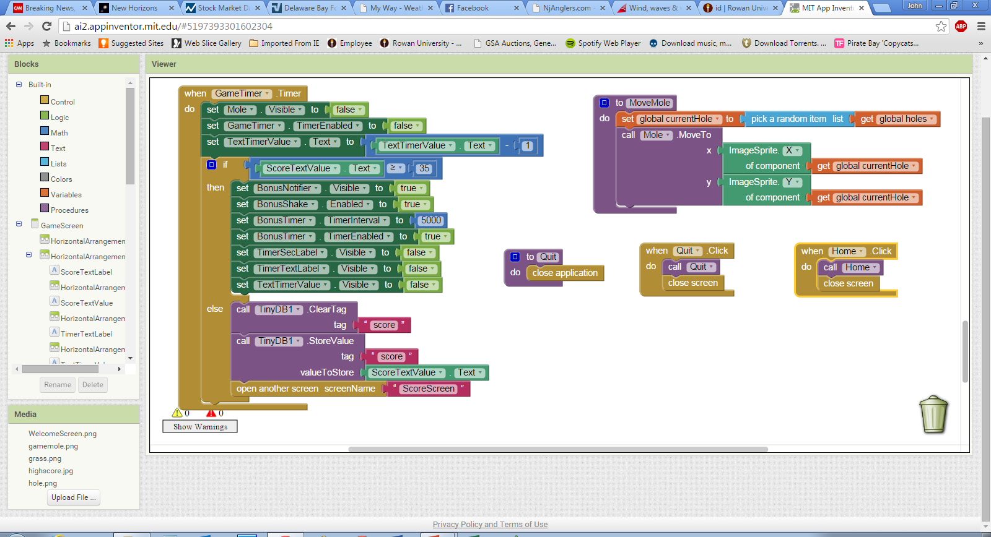
Game Screen Logic

Slide 13
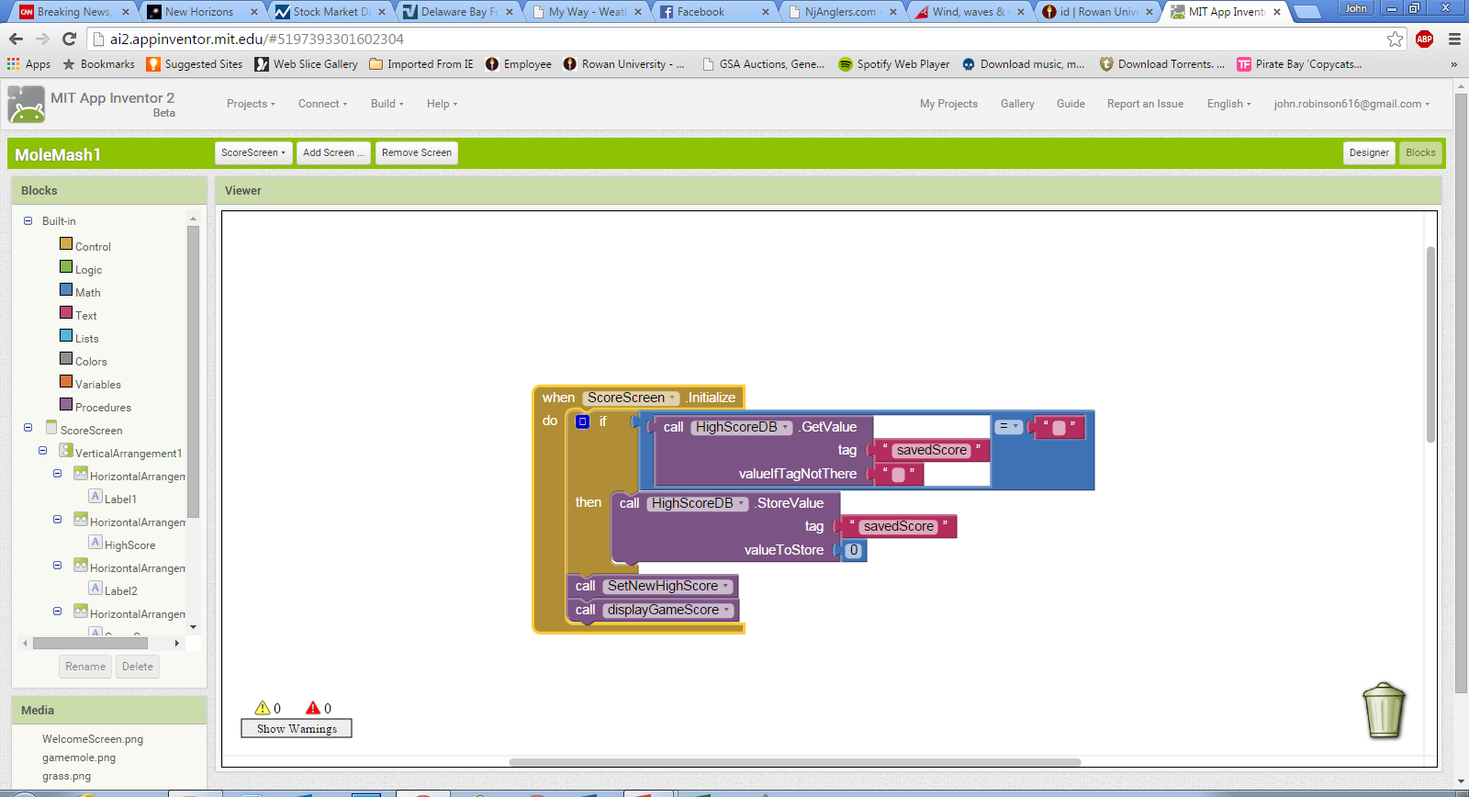
Score Screen Logic

Slide 14
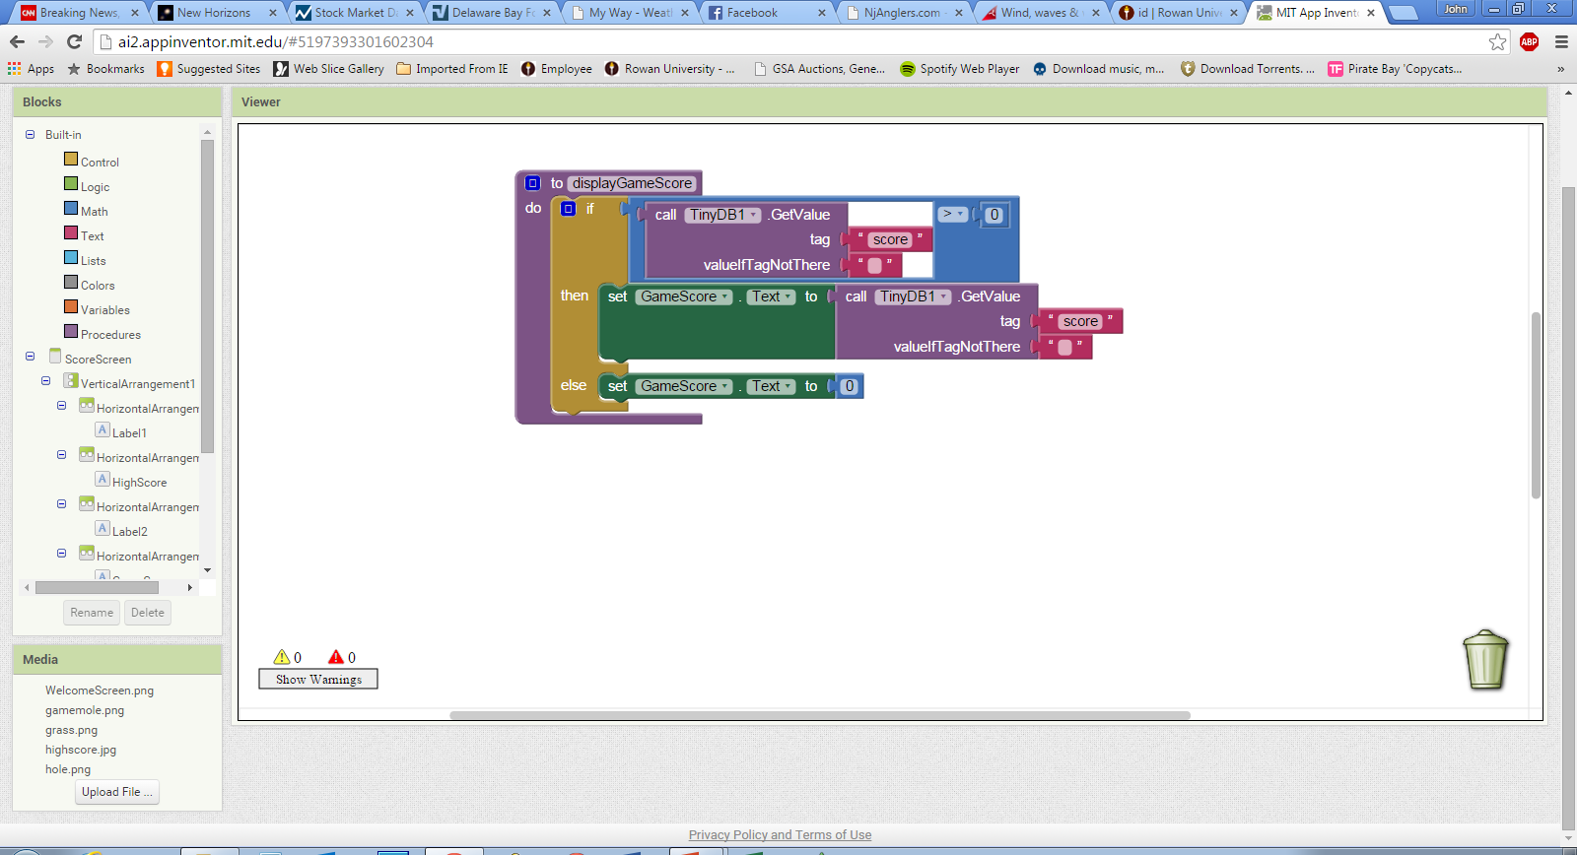
Score Screen Logic

Slide 15
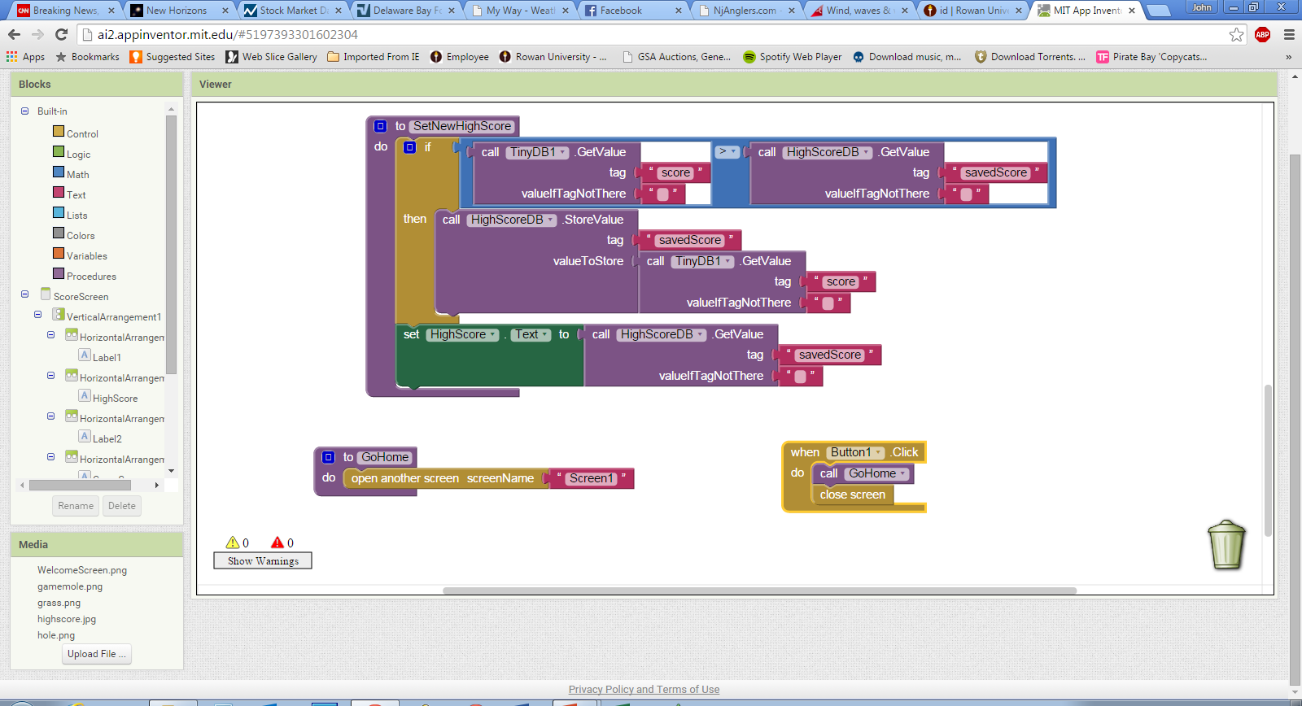
Score Screen Logic

