Slide 1
PHP

Slide 2
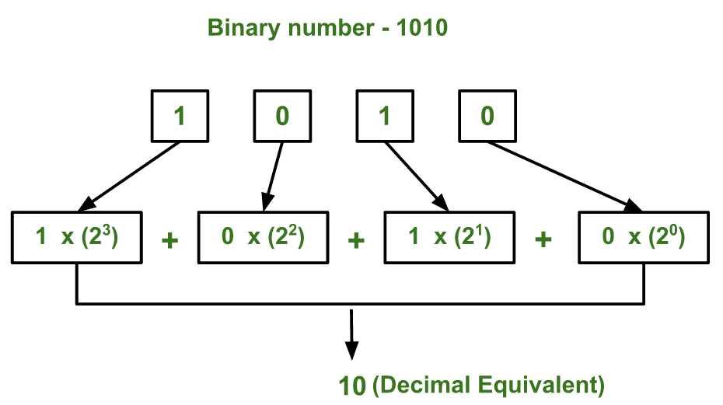
DECIMAL TO BINARY

Slide 3
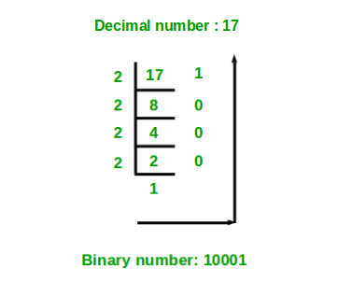
BINARY TO DECIMAL
Dividere il numero decimale per 2. Se la divisione torna resto, allora il risultato sarà 1, se non torna resto sarà 0.

Slide 4
BITWISE
- SHIFT LEFT
<?php
$var1 = 8;
$var2 = 2;
echo $var1 << $var2;
?>
L’utilizzo dell’operatore Shift left sulla variabile a cui è stato associato un valore pari a “8”, produrrà in output la cifra “32”,
infatti,con “<<” i bits appartenenti ad $var1 vengono spostati sulla sinistra di un numero di passi pari al valore associato a $var2;
dato che $var2 vale “2” e ogni passo equivale ad una moltiplicazione per “2”, il risultato sarà quindi pari a “8 * 2 * 2 = 32”.
- SHIFT RIGHT
echo $var1 >> $var2;
l risultato sarebbe stato invece pari a “2”, in quanto i due gradini successivi all'”8″ sono appunto il “4” e il “2” (“(8/2)/2 = 2”).

Slide 5
Type hinting
Define the type of a parameters / return type of a function.
e.g: function (string $hello) {}
The declare(strict_types=1), make the type hint strict.
The possible types are:
Class/Interface name
Self (The parameter must be an instanceof the same class as the one the method is defined on. This can only be used on class and instance methods.)
Array
Callbale
Bool
Float
Int
String
Iterable
Object

Slide 6
Strings
Strings are a series of bytes and does not contain any information on how those bytes character should be translated.
A string that contains a single quote echo ‘hello’ is a simple string.
A string that contains a double quote like echo “hello” is a complex string that parse the content. E.g: echo “hello $variable”

Slide 7
Strings – HEREDOC & NOWDOC
Heredoc: add strings containing multilines
<?php
Echo <<<HEREDOC
hello
hello2
HEREDOC;
NOWDOC: is the same of HEREDOC, with one difference: you should wrapper the word NOWDOC with single quote. The $variables in the NOWDOC are not evaluated.
E.G:
<?php
Echo <<<‘NOWDOC’
hello
Hello $variable
NOWDOC;
//output
// hello
// hello $variable

Slide 8
String function
The string function ALWAYS search in this way: function($haystack, $needle)

Slide 9
ARRAY
There are 3 types of array:
Indexes
Associative
Multidimensional
ARRAY OPERATORS
In the comparison, array are the same if they have the same key and value pairs, in the same order and key-value are of the same type.

Slide 10
ARRAY – OPERATORS
Union operator
$a = [‘a’ => ‘hello’, ‘b’ => ‘world]
$b = [‘a’ => ‘hi’, ‘c’ => ‘cruel’]
Implode(‘ ‘, $a + $b); // hello world cruel
$b is append to $a. If $b has the same key like ‘a’, the value from $a is get.
Equality $a == $b // TRUE if $a and $b have the same key-value pairs
Identity $a === $b // TRUE if $a and $b have the same key-value pairs, same types and same order
Inequality $a != $b or $a <> $b // TRUE if $a is not equal to $b
Non-Identity $a !== $b // TRUE if $a is not identical to $b

Slide 11
ARRAY – KEYS
The array keys could be:
Strings // $arr = [‘4’ => ‘int’]; output [4 => ‘int’]
Integers
Floats // $arr = [ 128.55 => ‘float’]; ouput -> [128 => ‘float’]
Binary
Hexadecimal
Null //empty string $arr = [ null => ‘null’]; output -> [ [] => ‘null’]
Boolean // true will be converted to 1 and false to 0

Slide 12
Filling up array
Range() function.
Array_fill(index_start, how_many_items, value_to_insert);
Array_fill_keys(keys, value) // you could specify which keys
array_shift($array) skip the first element
array_unshift($array, $elements_to_add …. ) $queue = array("orange", "banana"); array_unshift($queue, "apple", "raspberry"); print_r($queue);
Array ( [0] => apple [1] => raspberry [2] => orange [3] => bananArray
(
[0] => apple
[1] => raspberry
[2] => orange
[3] => banana
)

Slide 13
Filling up array
Array_pop($array) // remove the last element from $array
Array_push($array, $elements_to_add…)

Slide 14
Comparing array
Array_diff($array1, $array2) // return the values of $array2 not in $array1
Array_diff_assoc($array1, $array2) // it is the same but it consider the keys also
Array_intersect($array1, $array2) // return the element available in both array.
Array_intersect_assoc($array1, $array2)
Array_udiff($arr, $arr2, callback) // The comparison function must return an integer less than, equal to, or greater than zero if the first argument is considered to be respectively less than, equal to, or greater than the second.

Slide 15
Object-oriented - Inheritance
CONCEPT | SYNTAX | LIMITATION
Inherit from a class | Class A extends A_Parent | Class may have only one parent
Interface inheritance | Interface A extends B,C | Interface can inherit multiple interfaces
Inherit from an abstract class | Interface A extends B,C | Interface can inherit multiple interfaces
Implement interface | Class A implements A_Interface | Class can implement multiple interfaces
Trait | Class A { use A_trait; } | Class can use multiple traits

Slide 16
Object oriented
Object assignment is always by reference

Slide 17
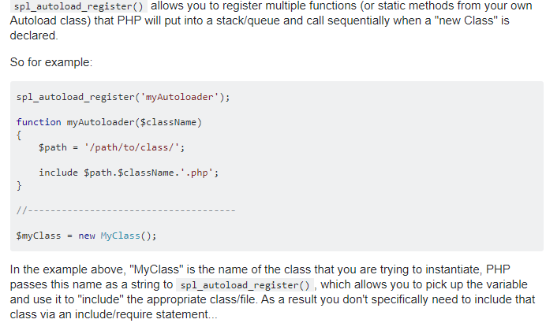
Object oriented - autoload

Slide 18
Object oriented – Shallow & Deep copy
In a Deep Copy everything is duplicated and all values are copied into a new instance. In this case all members are stored as a reference. When there are pointers, new pointers are created to the new data. Any changes of references will not affect the referenced object of other copies of the object. Fully replicated objects are deep copied. In PHP the "Copy" keyword is performed as a Shallow Copy by default. In PHP5 all objects are assigned by reference. It calls the object's "__clone()" method.

Slide 19
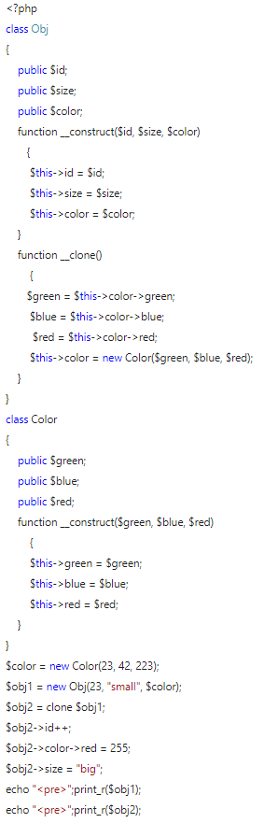
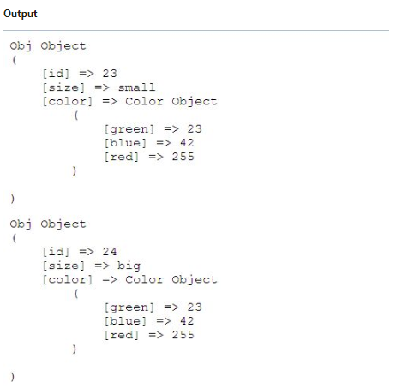
Object oriented –Deep copy

Slide 20
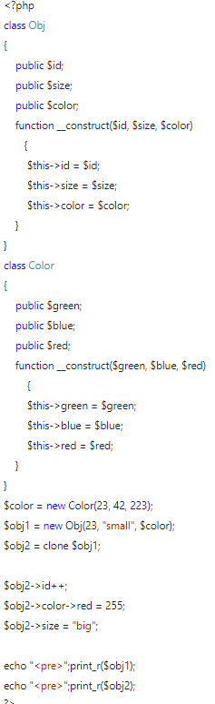
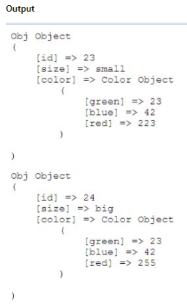
Object oriented –Shallow copy
A Shallow Copy copies duplicates as little as possible. A Shallow Copy copies all the values and references into a new instance. In a Shallow Copy any change of a reference member affects both the methods.

