Slide 1
Programming Course Python
Elia Rühle & Anna Bothin

Slide 2
Contact

Slide 3
Unit 3 – Control Flow: Statements & Functions
Statements
IF – Statements
Loops:
WHILE- Statement
FOR- Statement
MATCH- Statement
Functions

Slide 4
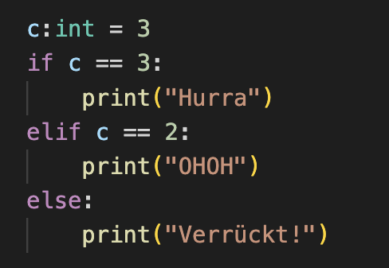
IF- Statement
conditional execution of code
possible to set alternate code
if condition :
statement
elif condition :
statement
else :
statement

Slide 5
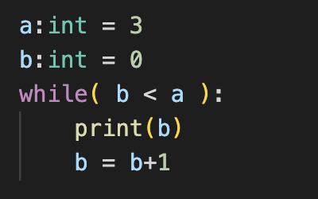
LOOPS – WHILE-Statement
repeated code execution
depending on a condition
break
ends whole while-loop
continue
ends current loop run
while condition :
statement

Slide 6
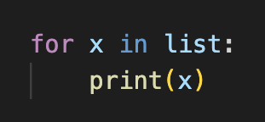
LOOPS – FOR-Statement
iteration over a collection
break
ends whole while-loop
continue
ends current loop run
for x in iterable :
statement

Slide 7
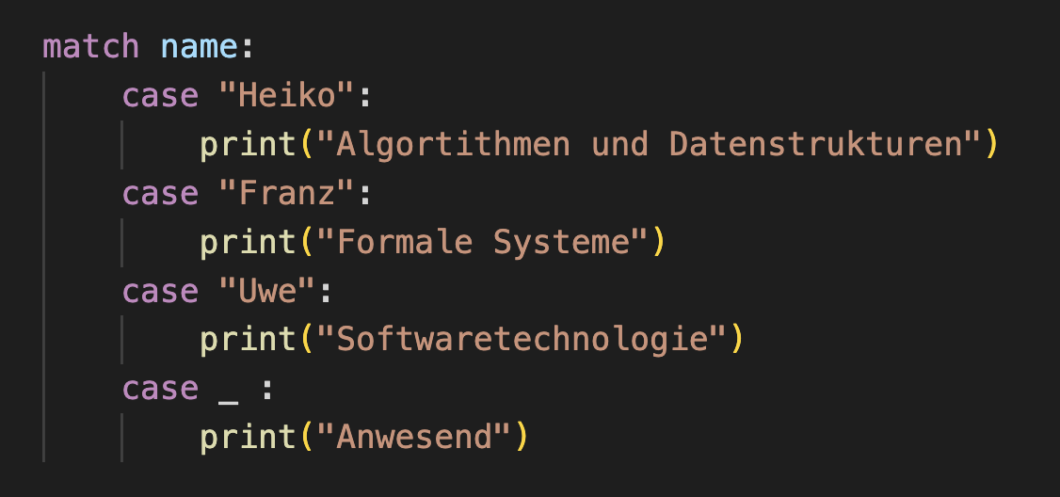
MATCH-Statement
selective code execution
depending on value of a variable
match variable :
case case1 :
statement1
case case2 :
statement2
…

Slide 8
Functions
outsourcing of code to reuse it
only runs when called
def function_name( parameter1,… ) :
statements
return
function_name (argument1,…)

Slide 9
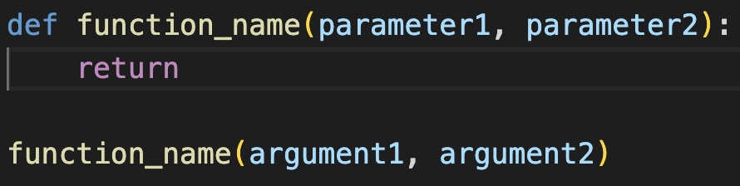
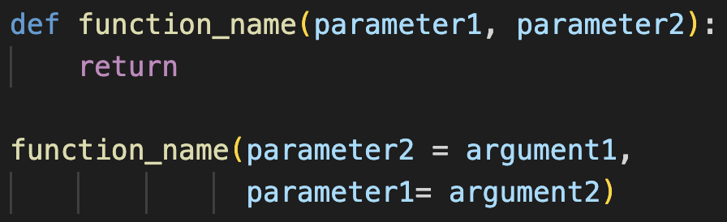
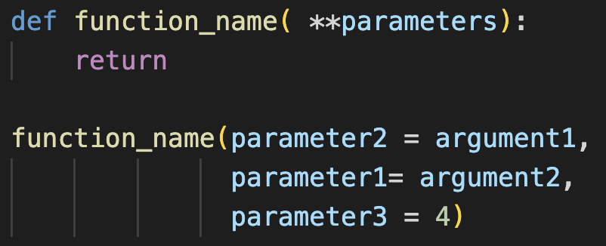
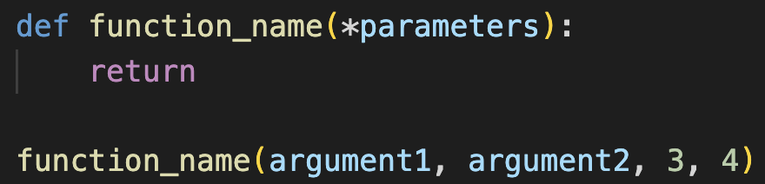
Functions
 |  | Identifikation der Parameter durch
 |  | sequence | name of parameters
Number of Parameters | known
 | unknown | = tuple of parameters | =dictionary of parameters

Slide 10
Exercises
to be continued

Slide 11
Python Documentation
https://docs.python.org/3/tutorial/controlflow.html

