Slide 1
Programming Course Python
Elia Rühle & Anna Bothin

Slide 2
Contact
Contact
Anna: anna-maria.bothin@mailbox.tu-dresden.de
Elia: elia.ruehle@mailbox.tu-dresden.de

Slide 3
Unit 4: Object Oriented Programming
What is object oriented programming?
Basic Concepts
Classes
Objects
Interacting Classes
Inheritance
Exercises

Slide 4
What is object oriented programming (OOP)?
programming paradigm
interpretation/ abstraction of the real world
interacting objects
classification of these objects
Almost everything in python is an object.

Slide 5
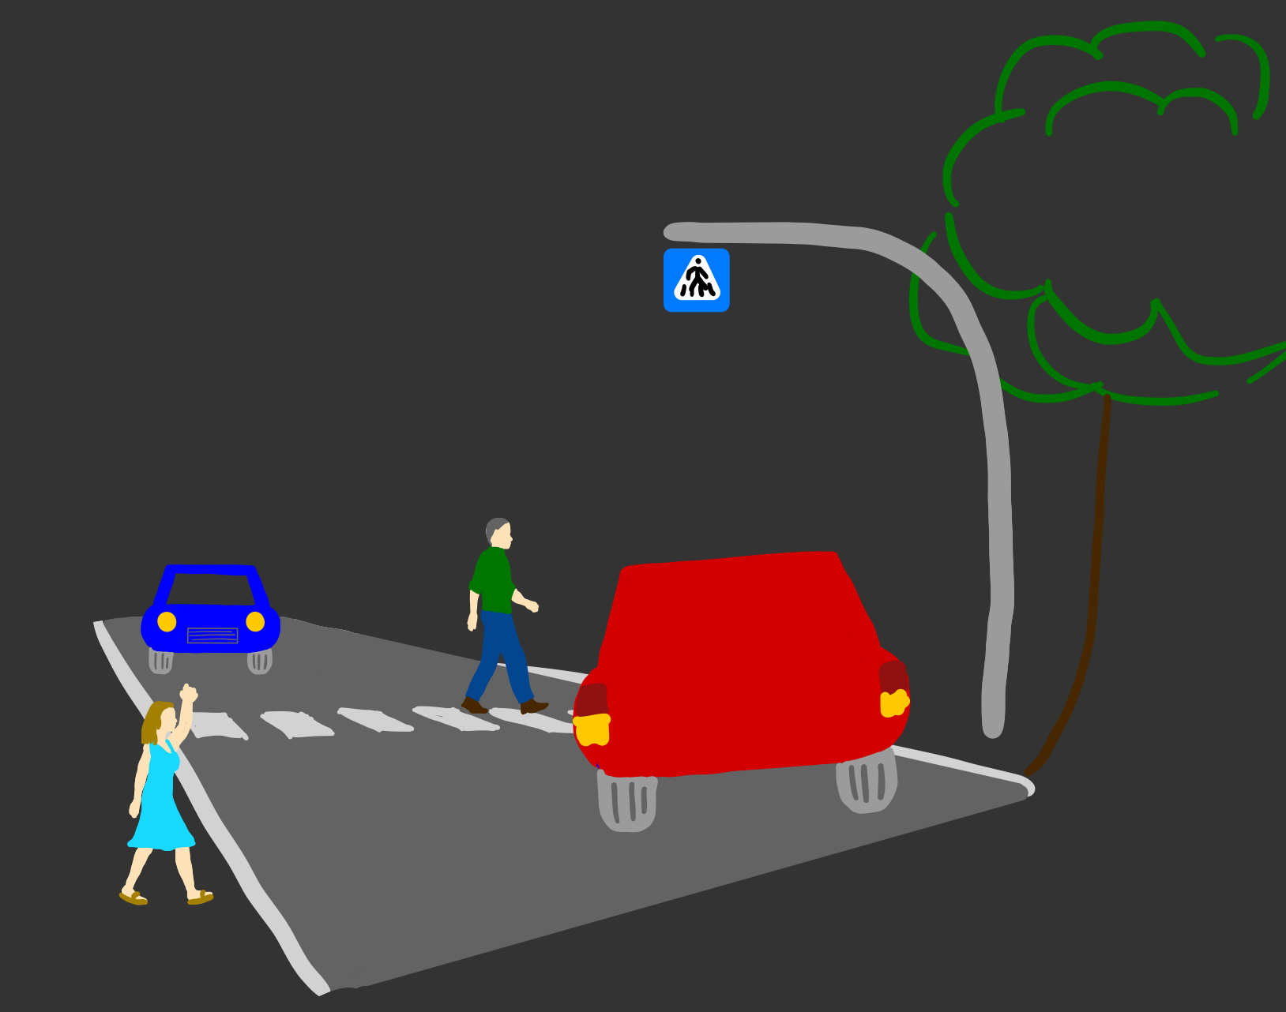
OOP-Example
road traffic:
different persons, cars, cyclists,…

Slide 6
Basic Concepts - Classes
blueprints for objects
attributes = state
methods = behaviour
Cars
attributes:
color
performance
behaviour:
drive
hoop
Persons
attributes:
hair-color
height
behaviour:
walk
talk

Slide 7
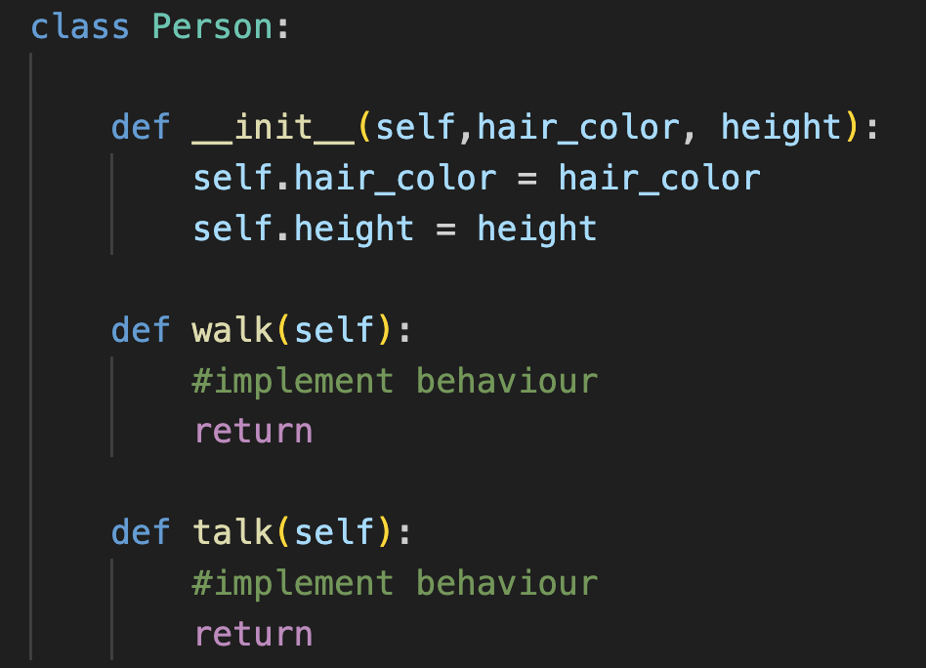
Basic Concepts - Classes
keyword class + ClassName :
__init__() – function:
defining attributes
automatically called when creating an object
assigning values to attributes
everything necessary when creating an object
behaviour
defining functions inside the class
Classes build their own scopes!

Slide 8
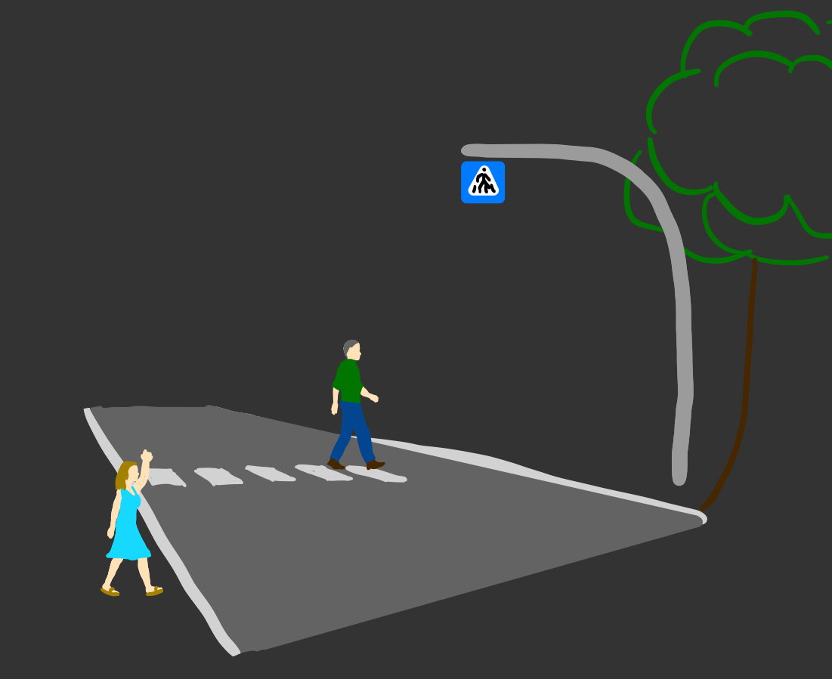
Basic Concepts - Objects
instances of classes
attributes -> concrete values
created at runtime
Person A
attributes:
hair-color: graye
height: 1.89 m
Person B
attributes:
hair-color: blonde
height: 1.71 m

Slide 9
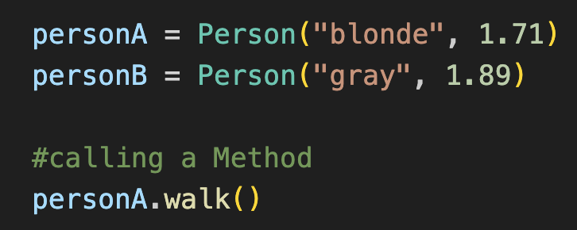
Basic Concepts - Objects
creating an object
name object to access it later
creating an object using a class
concrete values for this objects properties
calling a method
object, that should do sth
executed method
arguments
depending on method definiton
object_name = ClassName( attribute1, attribute2 ,…)
object_name.method_name(argument1, argument2, …)

Slide 10
Interacting Classes

Slide 11
Inheritance
defining classes using other classes as a blueprint
Parent Class
like a blueprint
needs to be defined
Child Class
new class
inherits all methods and attributes of the parent class

Slide 12
Inheritance- Example
continue former road-example:
taxi as a special kind of car
all attributes and methods cars have got
still can be specified
has mor methods, attributes,…

Slide 13
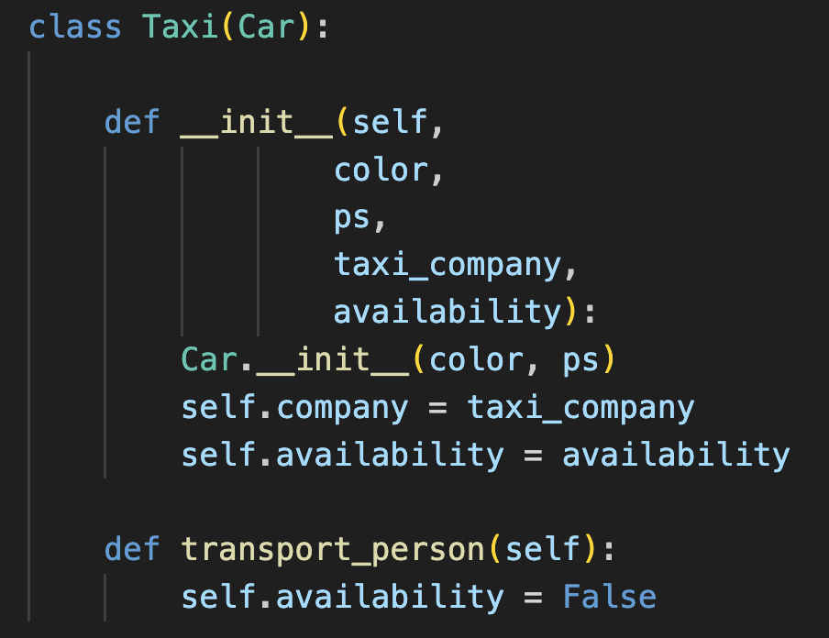
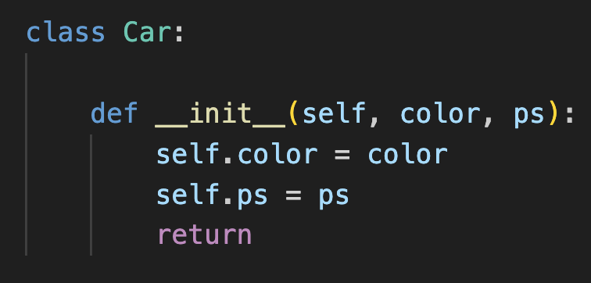
Inheritance
class ChildClassName ( ParentClassName ):
Defining a parent class.
Defining the child class
init()-function:
overrides parent class init()- function
still inherit:
call parent´s init()-function to still inherit attributes
or
super().__init__(attribute1, attribute2,…)
add attributes
add methods

