Slide 1
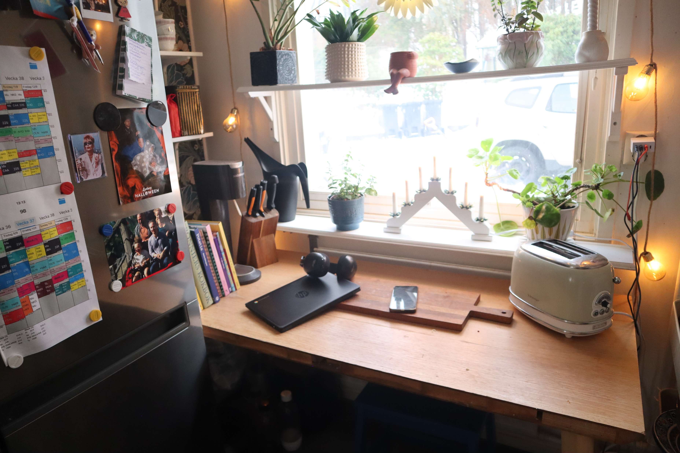
Hur många mikroprocessorer ser vi på bilden?
mikroprocessor, definition:
A microprocessor is an integrated circuit that contains a central processing unit, executing instructions to perform arithmetic, logic, control, and input–output operations.

Slide 2
Maskinorienterad Programmering
Lektion 1 - Introduktion
Notes:
Welcome to this course in Machine Oriented Programming!

Slide 3
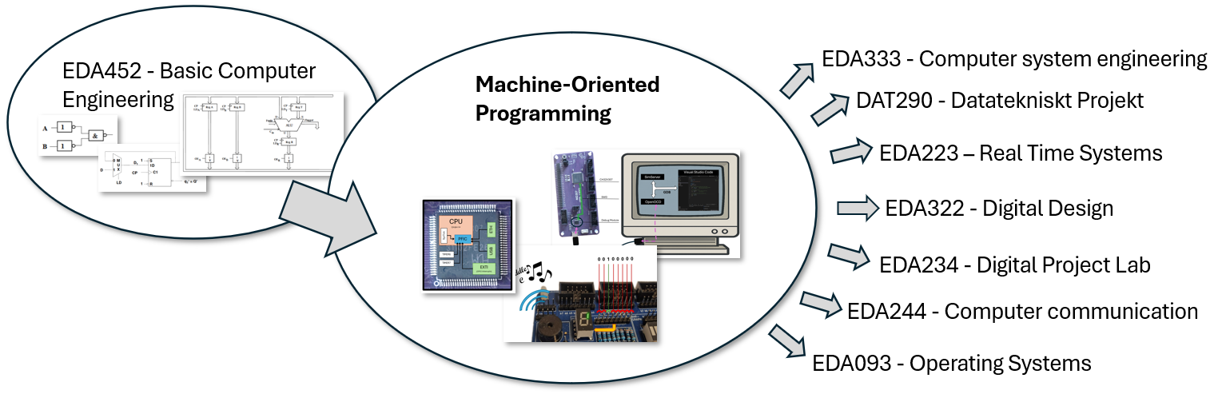
Maskinorienterad Programmering
Notes:
In a previous course, you have seen how simple logic gates can be combined to create an ALU, a data path, and finally a complete working tiny processor. In this course you will build on this knowledge and learn how to program a real, modern, off-the-shelf microcontroller ¹. You will develop programs for this device using assembly and C and you will learn how to communicate with peripheral devices (lights, buttons, displays and a tiny speaker).
As illustrated in the image below, the course is also a prerequisite for several upcoming courses.

Slide 4
Min bil? ~100?
allt möjligt
USB Laddare: 1-3? manage voltage regulation, current limiting, thermal protection, and fault handling.
Frys/Kyl, 20? temperature control, inverter drive, frost cycles, valve actuation, ...
Bluetoothlurar ~10? power management, battery charging, audio, Bluetooth, ...
Laptop ~50 mikroprocessorer
A modern laptop typically contains dozens of microprocessors (often between 30 and 100), most of which are microcontrollers (MCUs) embedded in subsystems such as power management, battery control, keyboard and touchpad controllers, storage devices, display interfaces, networking hardware, cameras, and security modules.
Telefon ~30 mikroprocessorer power management, battery charging, touch sensing, cameras, audio, wifi, ...
Brödrost!? Åtminstone en (timing)
Notes:
Welcome to this course in Machine Oriented Programming! In a previous course, you have seen how simple logic gates can be combined to create an ALU, a data path, and finally a complete working tiny processor. In this course you will build on this knowledge and learn how to program a real, modern, off-the-shelf microcontroller ¹. You will develop programs for this device using assembly and C and you will learn how to communicate with peripheral devices (lights, buttons, displays and a tiny speaker).
JOBS!

Slide 5
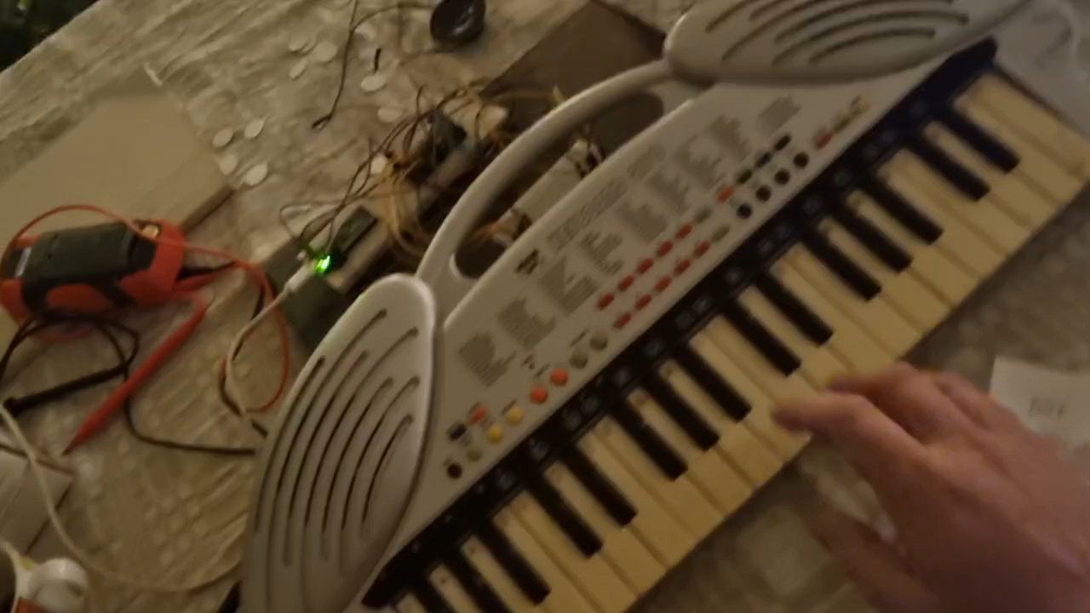
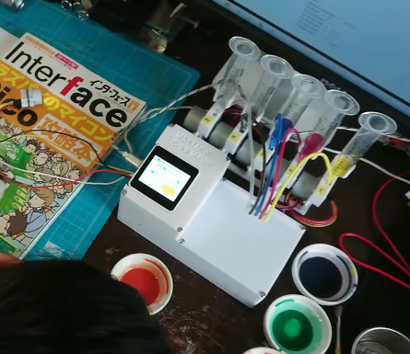

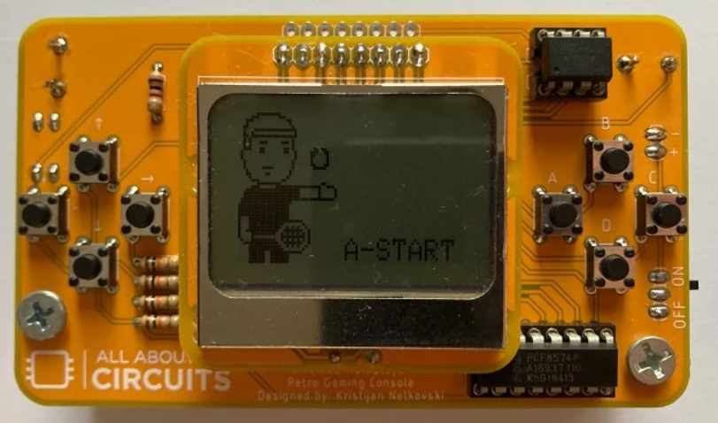
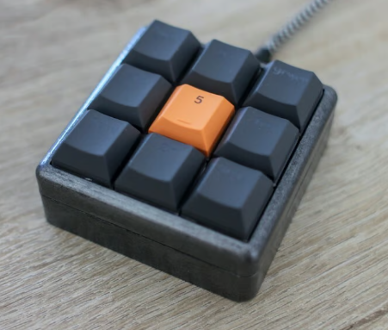
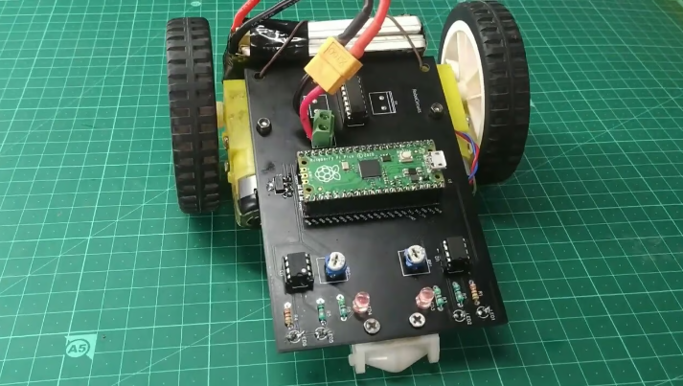
”The Maker Community”
Efter den här kursen kommer ni kunna programmera en mikrokontroller
Internet är proppfullt av roliga projekt som folk gör med sina mikrokontrollers:
https://www.seeedstudio.com/blog/2021/03/26/10-raspberry-pi-pico-projects/
https://projecthub.arduino.cc/
https://www.allaboutcircuits.com/projects/category/embedded/microcontroller/
...

Slide 6

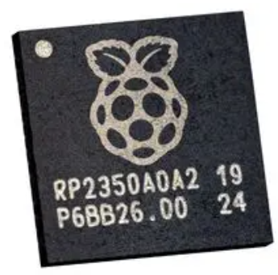
Vad är en mikrokontroller?
Mikrokontroller
Desktop CPU
(ARM) Instruction Set Architecture (ISA) defines:
Assembly instructions, Registers, Execution model, Memory model, Exception and privilege architecture
I.e., how you program the processor
Usually programmed to do a single task (e.g. control the compressor motor in a fridge).
No virtual memory, and very little memory on SRAM or FLASH, no or little cache.
Designed to be very cheap and energy efficient and "as fast as needed" ~(1-50SEK, ~150mW, 150MFLOPS)
(ARM) Instruction Set Architecture (ISA) defines:
Assembly instructions, Registers, Execution model, Memory model, Exception and privilege architecture
I.e., how you program the processor
Usually runs an operating system that in turn can run any number of programs simultaneously.
Multi level cache hierarchy, on chip. Virtual memory support. Huge external DRAM memory, off chip.
Designed to be as fast as you can afford. ~(5000SEK, 150W, 150GFLOPS)

Slide 7

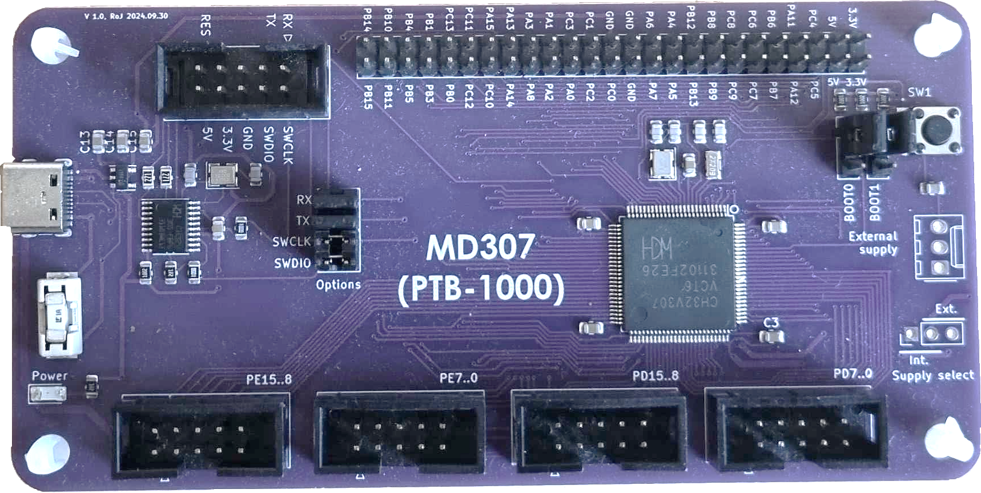

Vår "labbdator"
MD307 – Development Board
CH32V307 microcontroller
Debug Interface with USB port
General Purpose I/O pins

Slide 8
Hur programmerar man en mikrokontroller utan OS, IDE, skärm, skärm, eller keyboard?
Notes:
Kod I Visual Studio
Tryck på play
Korskompilera till .elf fil
Visual Studio (via gdb) skickar filen till mikrokontrollerns minne
Visual Studio (via dgb) säger åt mikrokontrollen att resetta, och starta programmet
Programmet kör tills den når en breakpoint
Visual studio visar vart vi står

Slide 9
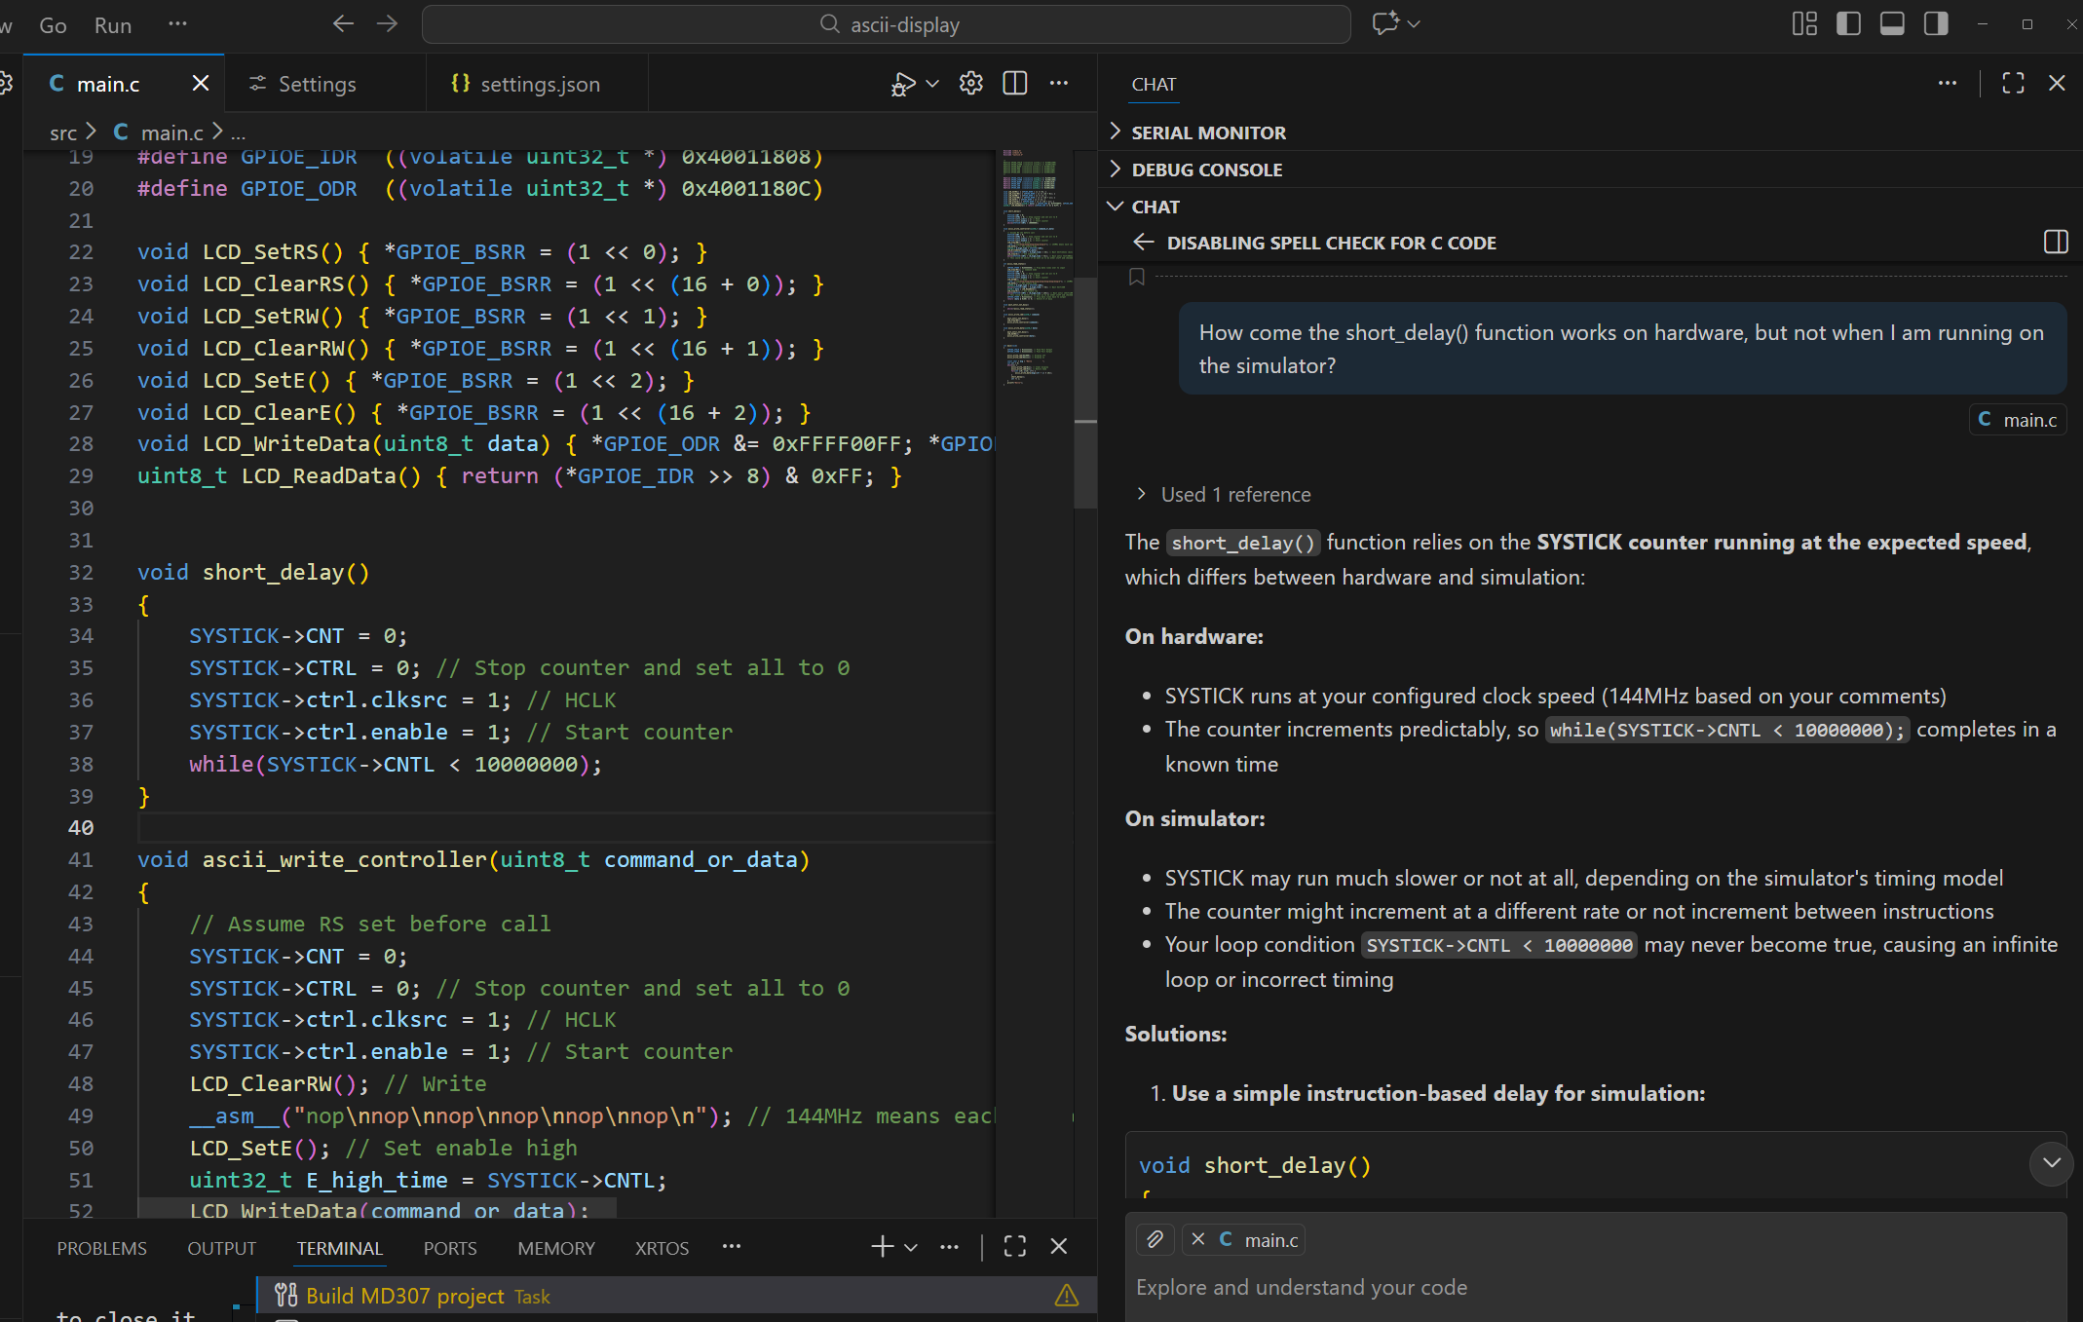
AI: The good, the bad, and the ugly
Asking questions from an AI can be very useful.
If you don't quite understand the answer, you can ask again, until you do.
Being able to use AI to help your own learning is becoming a "required skill"

Slide 10
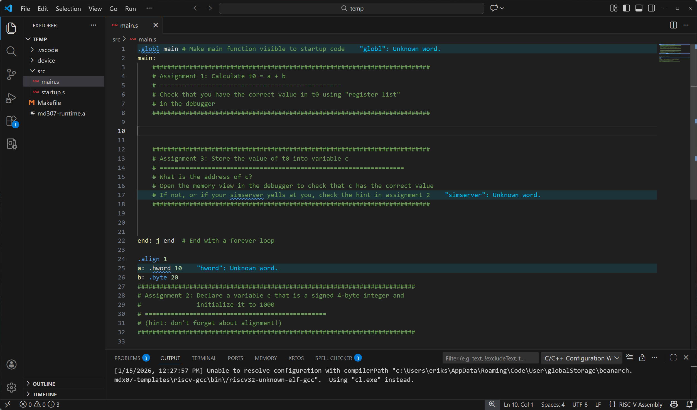
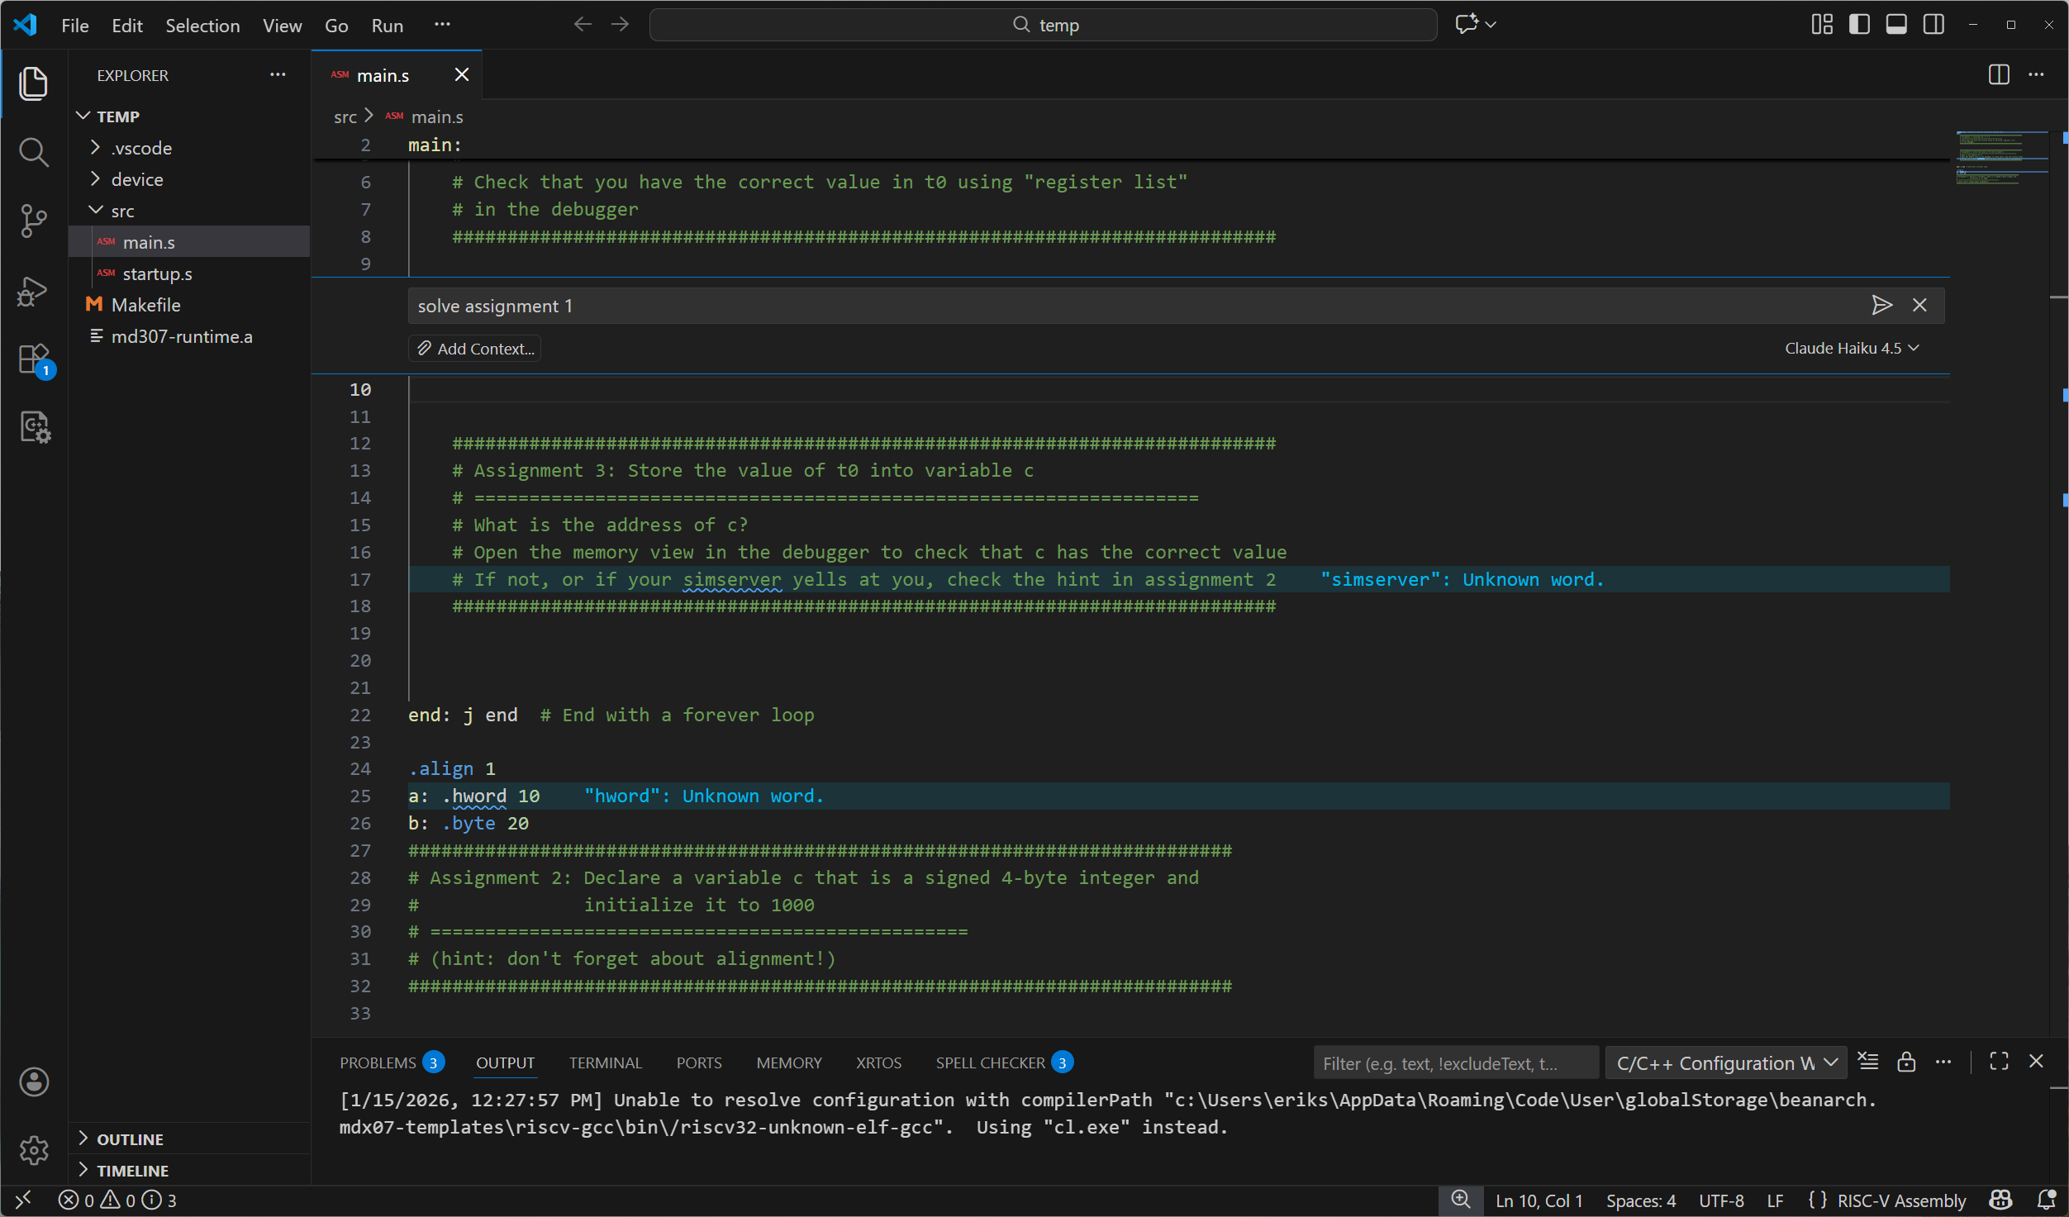
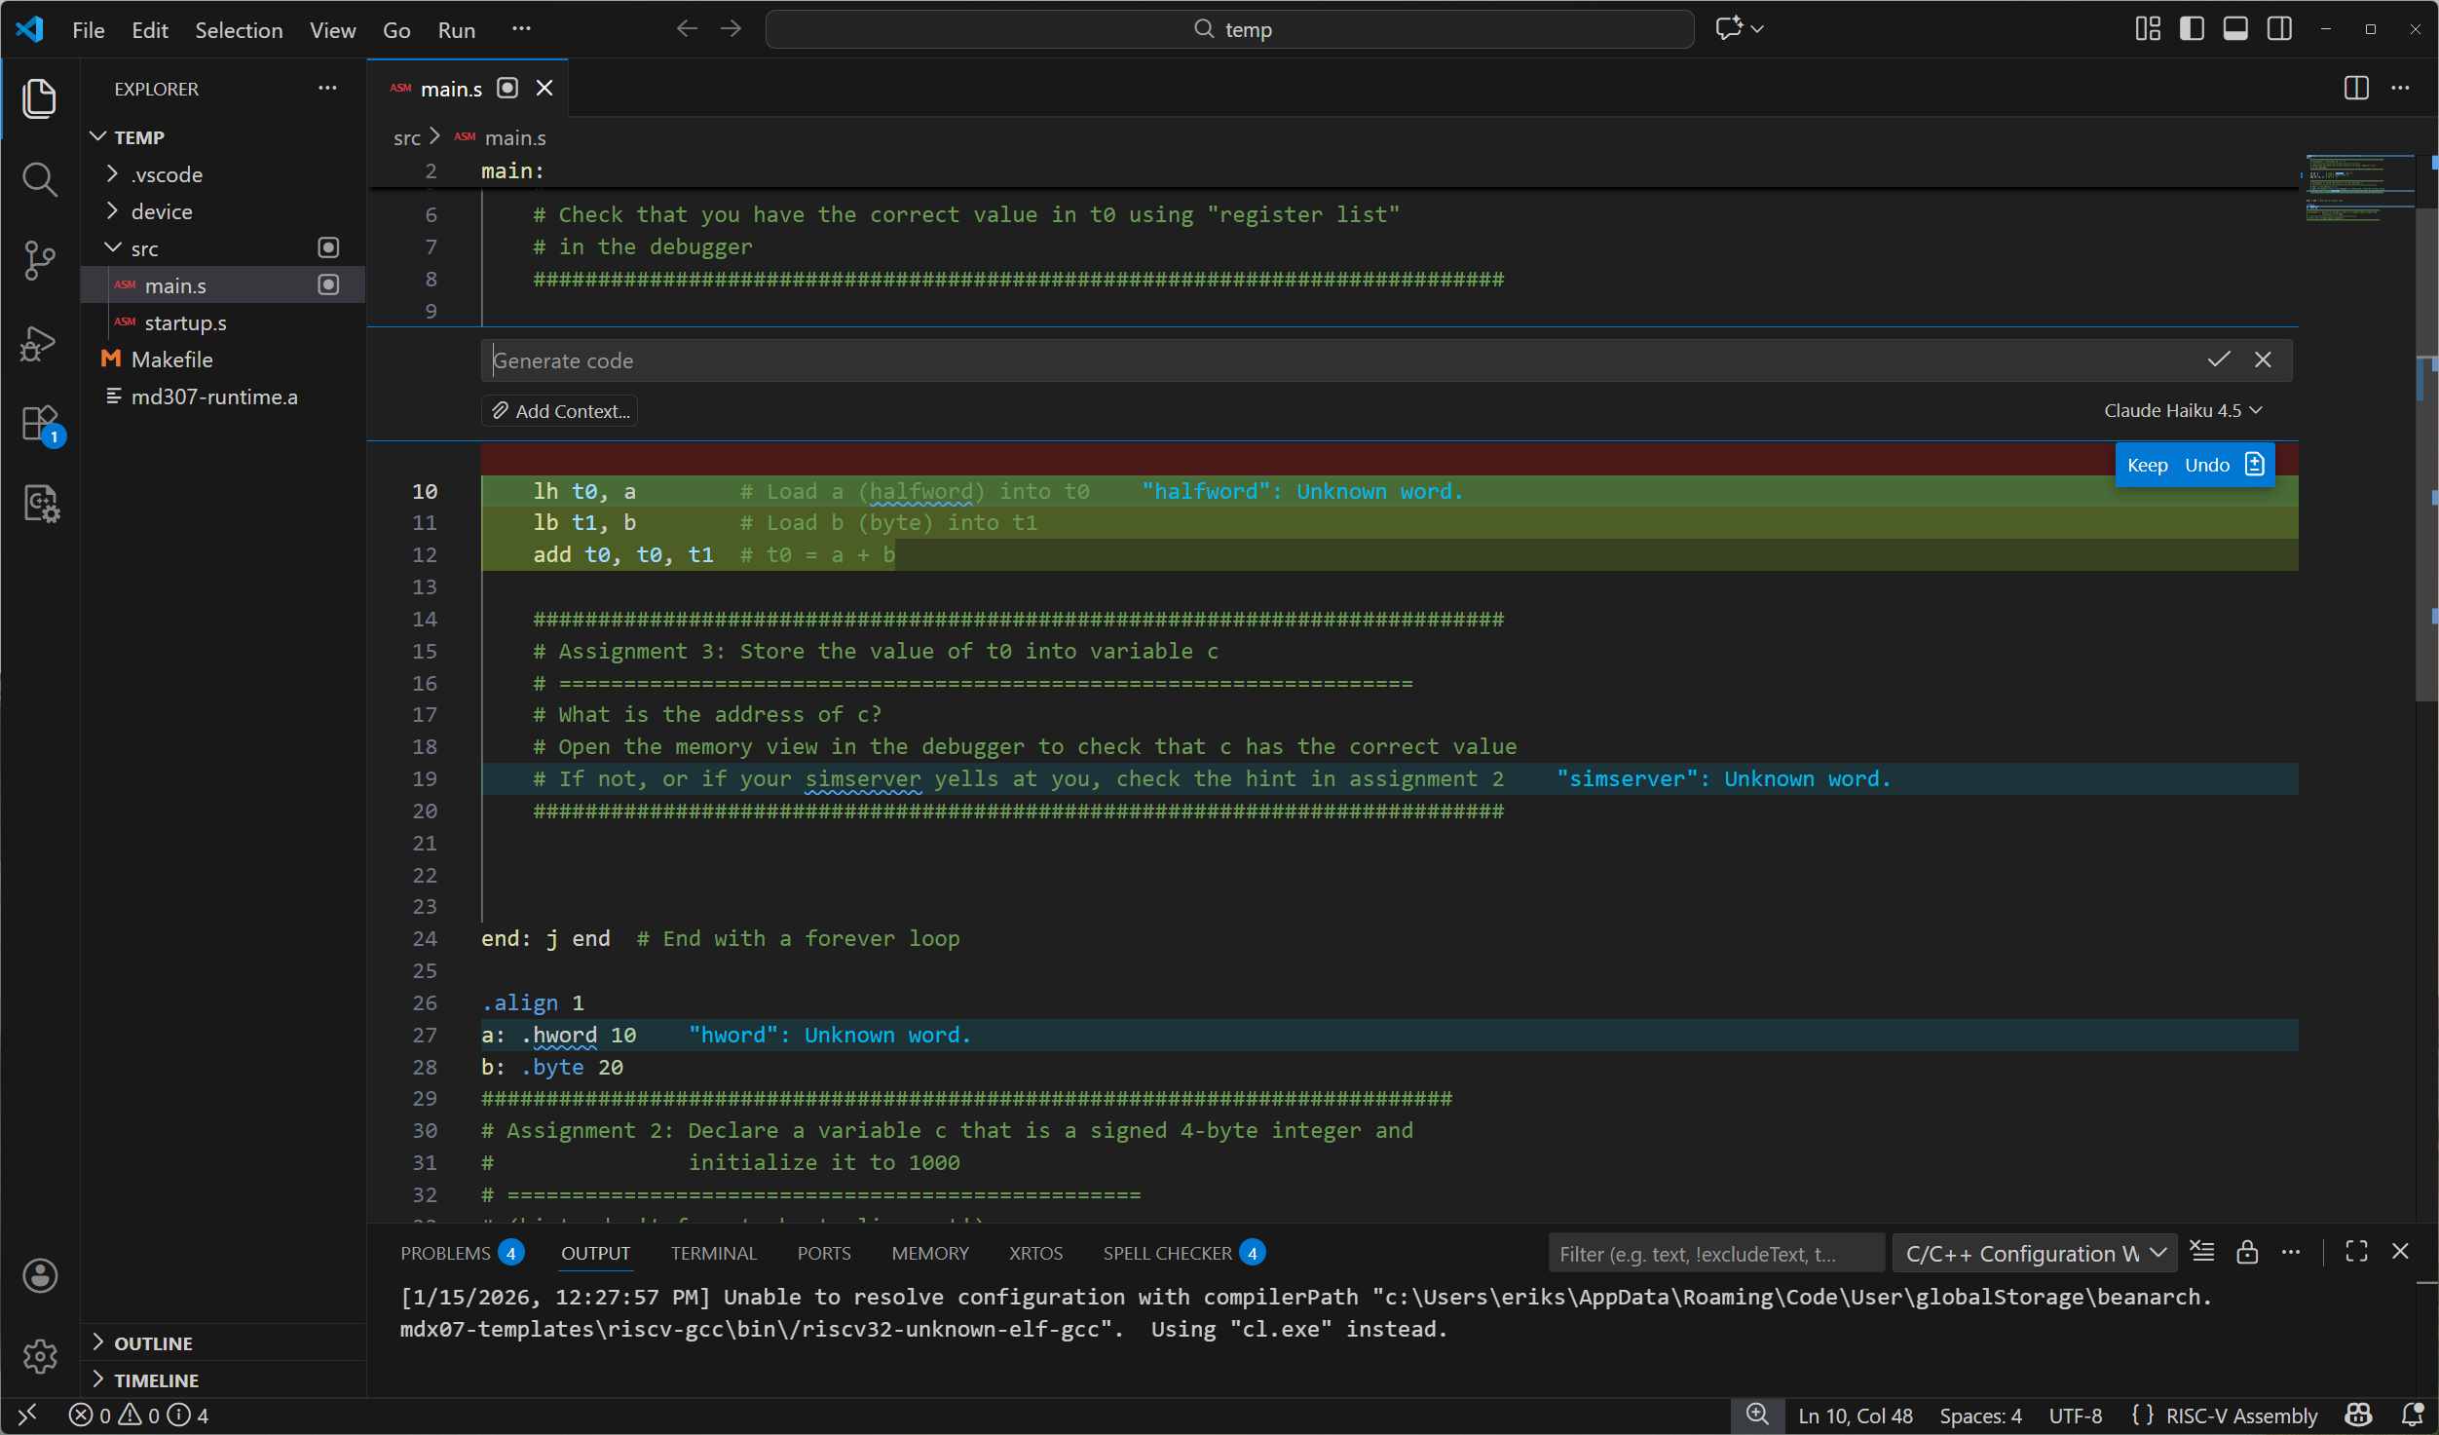
AI: The good, the bad, and the ugly
It is fully possible to let the AI solve most of the assignments.
You learn by writing code and solving problems.
The AI might learn from this, but you learn nothing!

Slide 11
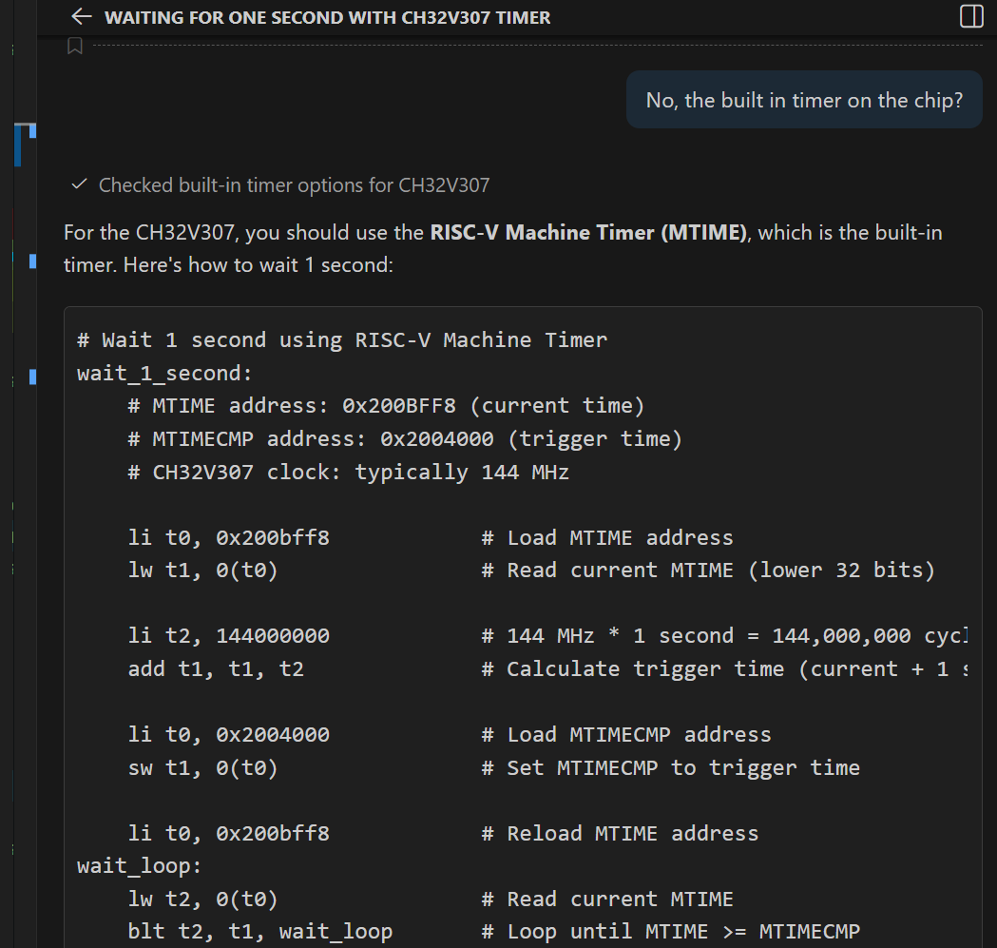
AI: The good, the bad, and the ugly
Beware that none of the current AIs are especially good at the CH32V307.
But they are very convincing.
Don't trust them blindly.

