Slide 1




BEER SALES AND DISTRIBUTION SYSTEM FOR BGI ETHIOPIA

Slide 2
Introduction
Ethiopia’s beer market has been steadily growing for the past decade. Beer companies have their way of distribution mechanism for the high demand from customers. Among them, BGI Ethiopia is one of the beer companies in Ethiopia that have four bottle beer products namely St. George, castle, Doppel, and Senq’ along with other products. BGI Ethiopia does not sell its products directly to end-users. Mass production, consumption, and distribution rely on agents, representatives, retailers, brokers, or some combination of these intermediaries to distribute their products.
In this project, we will try to solve the problems faced in the distribution and sales process by developing a web-based beer sales and distribution system.

Slide 3
THE OBJECTIVE
THE GENERAL OBJECTIVE
Developing a beer sales and distribution system for BGI Ethiopia.
SPECIFIC OBJECTIVES
Gathering the required data about how the current system works from agents and promoters of BGI Ethiopia located at Adama district.
Understanding the current system based on the acquired data.
Selecting a way to improve the current system.
Identifying the main role player of the improved system(proposed system).
Selecting the appropriate tools.
Design a database and UI using the selected tools.
Implement, test, validate and deploy the system

Slide 4
STATEMENT OF THE PROBLEM
❖Absence of a well-integrated and comprehensive approach to product availability and distribution coverage.
❖Time delay because of the queues at the company #time consuming
❖Paper-based and unorganized report generation #energy consuming
❖Manual payment system #teft volnurebility
❖Ineffective communication between agent and customer
❖Improper management of sales and distribution mechanisms.

Slide 5
SIGNIFICANCE OF THE PROJECT
The current growing beer sales and distribution environment is becoming more complex and dynamic. Our project somehow minimizes the complexity in the following ways.
➢The company can get their products faster to the customers
Order schedule will avoid the queue
Minimize hard currency transaction
Higher volume of sale and customer satisfaction
➢Provide more controls over the agents
➢Build a strong relationship between beer company and agent

Slide 6

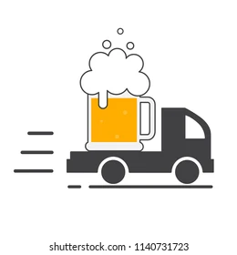
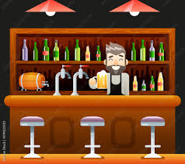
BENEFICIARIES OF THE PROJECT
Company
Agents(distributors)
Customers
BGI Ethiopia
Agents
Restaurant, grocery, cafe, hotel, shop...
company Admin
Agents driver
finace Admin
Store Manager

Slide 7


FUNCTIONAL REQUIREMENT
1
Users can manage their personal accounts.
2
The Company admin can manage agents:
Add new agents,
Update agent contracts,
Deactivate agents
Remove agents permanently.
3
The Company can manage
staff,
stores,
regions,
products.
generate reports post advertisement.
manage Adis
The company schedules the agent orders.
15

Slide 8
FUNCTIONAL REQUIREMENT
4
Agents can
view orders
assign drivers to respective orders
make orders from company
make online payments via Yenepay gateway
manage their customers and drivers
view list of transactions they have committed
send messages to the company admin.
generate reports of transactions
Customers can
make online payments.
Make order
Send delivery status
generate reports of transactions.
5
16

Slide 9

THANK YOU !
BEER SALES AND DISTRIBUTION SYSTEM FOR BGI ETHIOPIA

