Slide 1

Before we start: you and AI
Five quick questions on Menti — answers stay on screen and we come back to them at the end.
1
Be honest: did AI help with your last university assignment?
POLL
Yes · a bit · no · I plead the fifth
2
If building cost nothing — what would you build?
WORD CLOUD
3
Will a one-person company be worth $1 billion before 2030?
POLL
PLACEHOLDER
Yes · no · it already happened
Interactive Menti survey
4
What worries you more about AI and your career?
POLL
menti.com · code [ ____ ]
QR code + live results
It takes my job · I don't use it well enough · nothing
5
After graduation, would you rather…
POLL · REPEAT
Start my own company · join a startup · join a corporate
Notes:
Interactive Menti survey (placeholder — insert join code and QR). Run the five questions back to back, about 60 seconds each. Read out one surprising answer per question. Save the results: questions marked “repeat” are asked again at the end.
1. Be honest: did AI help with your last university assignment? Options: Yes · a bit · no · I plead the fifth
2. If building cost nothing — what would you build?
3. Will a one-person company be worth $1 billion before 2030? Options: Yes · no · it already happened
4. What worries you more about AI and your career? Options: It takes my job · I don't use it well enough · nothing
5. After graduation, would you rather… Options: Start my own company · join a startup · join a corporate

Slide 2




Live: AI linking millions of data points
Emidio demonstrates a highly complex AI workflow we developed — turning millions of data points into a go / no-go for a new business idea.
Millions of data points
Many sources linked in one model
PLACEHOLDER · LIVE DEMO
Multiple AI agents
Emidio · AI workflow on screen
Research, matching and scoring in one flow
From data to decision
The output is a recommendation, not a dashboard
Notes:
PLACEHOLDER — live demo by Emidio (approx. 5–7 minutes). The workflow connects millions of data points from many sources into one decision. Frame it with the lecture's lens: turning millions of data points into a go / no-go for a new business idea.
Afterwards ask the room: what would this have taken a team ten years ago? Bridge to the title slide.

Slide 3
From Idea to Market: Building an AI-Native Business
Why building is no longer the hard part — and what is.
Rome, October 2026
Notes:
Title after the opening demo. Promise: in the next hour we show why building a product has become almost free — and why that makes one skill more valuable than ever: knowing what is worth building. The room builds and tests one idea live.

Slide 4
ChatGPT: 1 million users in just 5 days
Time it took to reach 1 million users
Netflix
3.5 years
5
days
Airbnb
2.5 years
from launch to one million users — faster than any consumer product before it.
Twitter
2 years
For founders: your market — and your competitors — can now move this fast too.
ChatGPT
5 days
Source: Statista, based on company announcements. ChatGPT launched on 30 November 2022.
Notes:
AI impulse 1 — adoption speed. Netflix needed 3.5 years, Airbnb 2.5, Twitter 2. ChatGPT needed five days (launch Nov 30, 2022). The bar for ChatGPT is barely visible — that is the point. For founders: customers adopt new tools this fast — and so do your competitors.

Slide 5
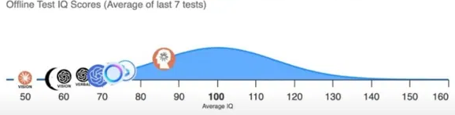
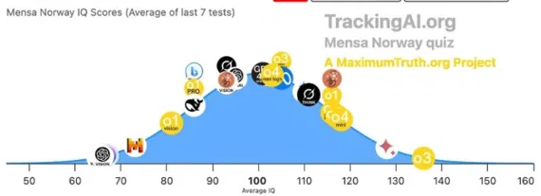
AI's IQ: from 96 to 136 in one year
Best AI model on standardised IQ tests — one year apart
2024
2024
IQ 96
Best model, offline test
2025
2025
IQ 136
Best model, Mensa Norway test
Source: TrackingAI.org (MaximumTruth.org) — IQ scores, average of last 7 tests. Average human = 100.
Notes:
AI impulse 2 — capability speed. In 2024 the best model scored around 96 on an offline IQ test (not in any training data). In 2025 the best model (o3) reached 136 on the Mensa Norway test — roughly the top 1% of people. Caveat to say out loud: IQ tests measure pattern reasoning, not judgement or experience. Ask: if the AI in your pocket outscores most people on reasoning tests, what is still your job as a founder?

Slide 6




Why AI is (still) hardly replacing jobs
Capability is rising fast — but real work is messy
So far, hardly any job losses from AI
AI's ability to automate jobs is constrained by task “messiness”
AI task success rate by messiness of the task (%)
AI hits its limits in complex, dynamic workflows
Office and routine work stable so far — despite automation risk
Demand for AI skills is growing sharply
For you: AI takes the clean tasks. Building a company is messy work — that is where you add value.
Tasks taking a human professional ≤ 1 hour. Source: METR / Measuring AI Ability (values read from published chart).
Notes:
AI impulse 3 — reality check. METR measured AI success on tasks that take a human professional one hour or less. On clean, well-defined tasks success went from ~0 to ~95% within three years; on messy tasks — unclear goals, many tools, changing context — it is around 60%. Most real jobs are messy. For students: AI raises the bar on clean tasks; the edge is in messy work — ambiguity, customers, judgement.

Slide 7
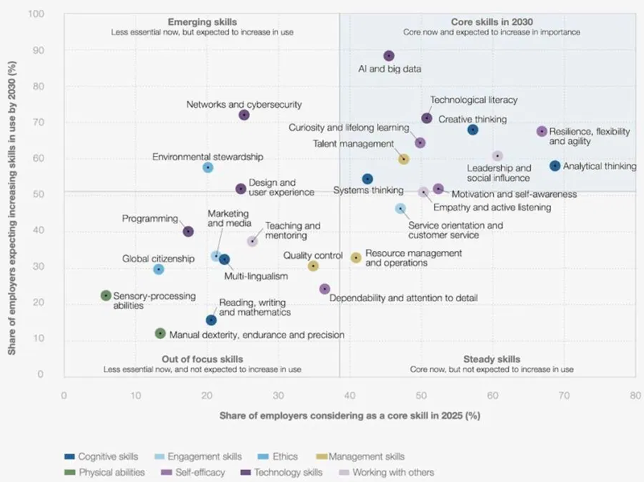
Core skills in 2030
Share of employers calling a skill core today (x) vs expecting it to grow by 2030 (y)
1
AI and big data
the fastest-growing skill of all — almost 9 in 10 employers expect it to grow
2
Thinking skills stay core
analytical thinking, creative thinking, systems thinking
3
Human skills rise with AI
resilience, curiosity and lifelong learning, leadership
The founder profile of 2030: AI-literate, analytical, creative — and curious enough to test.
Source: World Economic Forum, Future of Jobs Report 2025, Figure 3.6.
Notes:
AI impulse 4 — what becomes valuable. Top right quadrant = core now and growing: AI and big data leads by far, followed by technological literacy, creative and analytical thinking, resilience, curiosity and lifelong learning. Programming sits lower than people expect — AI writes code. Link to their studies: analytical thinking, AI literacy and curiosity are the founder's skill set.

Slide 8
“Augmented Intelligence”
Not human or machine — the value sits in the overlap
HUMAN
Judgement, context, trust, responsibility
AI
Human
Intelligence
Augmented
Intelligence
Artificial
Intelligence
Speed, scale, pattern recognition, tireless testing
AUGMENTED — FOUNDERS
A founder who lets AI research, build and test — and keeps judgement on what is worth building.
Notes:
AI impulse 5 — the bridge to today's topic. Human intelligence brings judgement, context, trust and responsibility. Artificial intelligence brings speed, scale and pattern recognition. Augmented intelligence is the overlap — and that is where the rest of this lecture lives. undefined

Slide 9
2015 vs. 2026: what it takes to launch
Same idea, same goal — first real customer signal
ILLUSTRATIVE
2015
Research
6 weeks
Prototype
3 months
Launch
4 weeks
First feedback
2 months
2026
The whole loop: one weekend. Research 30 min · prototype 3 h · launch 1 h · first signal 48 h
TEAM
BUDGET
TIME TO FIRST SIGNAL
5 people
€100,000+
~ 6 months
1 founder + agents
< €500
1 weekend
Notes:
Illustrative, but realistic orders of magnitude. 2015: weeks of research, an agency or a developer for months, a launch campaign, then waiting for feedback. 2026: one founder with AI agents does the whole loop in a weekend. Let the 2026 bar sink in — it is almost invisible. Ask: what does this do to the value of an idea? (Answer: ideas got cheaper; validated ideas did not.)

Slide 10
Tiny teams, giant outcomes
The first generation of AI-native companies — reported figures
Lovable
Cursor
Midjourney
Sweden · AI app builder
USA · AI code editor
USA · AI image generation
$100M
$100M
~$200M
annual recurring revenue about 8 months after launch
annual recurring revenue in roughly a year, with a small team
revenue in 2023 with a team of around 40, no outside funding
REPORTED
REPORTED
REPORTED
What they share: AI is not only in the product — it runs the company. Small teams, agents everywhere, shipping every day.
Sources: company statements and press reports, 2023–2025. Figures as reported, not audited.
Notes:
Reported figures from company statements and press coverage (2023–2025) — verify the latest numbers before the lecture. The point is not the exact number but the ratio: revenue per employee that used to need hundreds of people. All three are AI products — but more importantly they run AI-native: small teams, agents in every function, shipping daily.

Slide 11




What we mean by “AI-native”
AI-native is not using more AI tools — it is building the company around them
AI-ENABLED
Agents do the work, humans set direction
Founders choose what to test — agents research, build and run it
The old process, plus an AI tool
ChatGPT writes the pitch deck, the copy and the business plan. The steps and the decisions stay the same — just faster.
Every decision is a hypothesis
“Students will pay for this” is an assumption with a kill criterion
AI-NATIVE
Every loop makes the system smarter
The process redesigned around what AI makes cheap
Each experiment sharpens the next — learning compounds
Agents research, build and test continuously; founders set hypotheses and decide on evidence. Small teams do what took 20 people.
Evidence beats opinion
A click, sign-up or payment outweighs any AI-generated forecast
In one line: an AI-native company does not just generate answers faster — it tests its assumptions faster than anyone else.
Notes:
Definition used for the rest of the session. Contrast: an AI-enabled startup writes its pitch deck with ChatGPT; an AI-native startup has agents that research, build, test and report every week — and the founders decide on evidence.

Slide 12
Build – Measure – Learn, AI edition
Lean Startup (Ries, 2011): AI collapses “build” — “learn” becomes the bottleneck
35%
Build
months → hours
of failed startups name “no market need” as a reason — they built something nobody wanted.
Source: CB Insights, startup post-mortems (2021).
Learn
Measure
The new founder question
still human — the new bottleneck
weeks → days
Not “can we build it?” — “what is the cheapest test that could prove us wrong this week?”
Notes:
Academic anchor: Eric Ries' build–measure–learn loop and Steve Blank's customer development. AI shrinks Build from months to hours and Measure from weeks to days. Learn — deciding what the evidence means and what to do next — is still human. The CB Insights post-mortems show the real killer: no market need. When building is almost free, the scarce skill is knowing what is worth building.

Slide 13




Live: from your idea to a tested product
The room picks the idea — AI builds it and puts it in front of you
1
2
3
4
You pick the idea
AI builds it
You visit it
We measure
Top answer from Menti question 2
Landing page and two value propositions
QR code — every phone in the room
Clicks on “Get early access”, live
LIVE DEMO · CLAUDE CODE
THE PROMPT ON STAGE
You ask, the product changes. Name a change — a new audience, a new headline, a third variant. Claude Code builds it into the running page in minutes. We open the result, not the code.
Build a landing page for [idea]. Create variant A and B with two different value propositions, each with a measurable “Get early access” button. Show clicks per variant in a live dashboard.
Notes:
Prepared base: landing page, two variants, QR code, click tracking, live dashboard. Take the top answer from Menti question 2 (“If building cost nothing…”) as the idea. A student names a change — new audience, new headline, a third variant. Claude Code makes it in the running page; open the result in the browser, not the code. Leave the page live: the clicks feed the “Said vs. did” slide later.

Slide 14
How we validate at AI speed: five engines
Our system for the “learn” step — three kinds of evidence in one ledger
ENGINE · AI MECHANISM
WHAT IT DOES
FOR YOUR STARTUP
E4
Context Engine
Reads competitor sites, reviews, regulation and news — extracts only what sources state
Who are the competitors and what do they charge?
LLM RESEARCH AGENT
E5
Aggregate Research
Official statistics, TAM / SAM / SOM — top-down and bottom-up
How many people really have the problem?
STATISTICAL AGENT
E2
Simulated Mind
Predicts a segment's attention and valuation response to a message or price
Which message gets attention — before you spend?
NEURO-AI MODEL
E3
Market World
A synthetic market of buyer archetypes — trusted only once calibrated
How does the market react to a different price?
MULTI-AGENT SIMULATION
E1
Cold Email Engine
Finds, writes, sends, classifies replies — real behaviour, measured
Do real people sign up, book or pay?
AUTONOMOUS EXPERIMENT
Behaviour over opinion: interviews explain — only a real test shows whether people click, sign up or pay.
Notes:
This is what systematic, AI-native validation looks like — the professional version of what the groups will do by hand in the challenge.

Slide 15

The 10-Minute Startup Speed-Run
Groups of 3–4, AI on your phone — from a problem you know to a test you could run this week
2 min
3 min
3 min
2 min
Problem
Size it
Test it
Pitch
A problem someone in your group really has. Who else has it?
Let AI estimate the market and a price. Tag every number: researched or estimated.
Your riskiest assumption — and a 48-hour test with a kill criterion.
30 seconds: problem, customer, assumption, test, kill criterion.
WHAT EVERY GROUP HANDS IN (MENTI)
QR → data sheet + prompt
skeptical-investor prompt included
Problem
Customer
Riskiest assumption
48-hour test
Kill criterion
The best pitch is not the best idea — it is the cheapest test that could prove you wrong.
Notes:
Run a visible countdown. Rules: the problem must be one someone in the group has personally. In step 2 every number gets a tag (researched / estimated). In step 3 each group runs the skeptical-investor prompt from the QR. Two or three groups pitch; the rest submit via Menti. Best test design wins a coffee.

Slide 16
Said vs. did: your live result
What the room said in Menti vs. what the room clicked on the landing page
EXAMPLE VALUES — REPLACE WITH LIVE RESULT
The say–do gap
People are kind in surveys and honest with their clicks — and even more honest with their money. This gap is where most startups die.
Weight of evidence
What people say (Menti)
0.7
What people do (click)
1.0
Repeat Menti question 5: start your own company, join a startup or a corporate — did today change your answer?
Notes:
Fill in live: left bar = share who said in Menti they would sign up / use it; right bar = share of visitors who clicked “Get early access”. The gap is almost always large. Weight: statements 0.7, behaviour 1.0 — and even a click is not a payment. Then repeat Menti question 5 (start a company?) and compare with the first vote.

Slide 17



What this means for you
Four shifts for anyone who wants to build something in the next five years
You can start before you graduate
Your first hires may be agents
A product, a landing page, first customers — the barrier is no longer money or a dev team.
Research, design, code, outreach. Your job: direct them — and check their work.
Taste and judgement become the edge
Learn faster than the market
Anyone can build. Choosing the right problem and reading evidence honestly is what remains scarce.
The winner is not who builds fastest, but who learns fastest which idea really works.
Next step: take one assumption from your own project and design a 48-hour test with a kill criterion.
Notes:
Close the rethink with the students' own future. Ask: which of these shifts scares you, which excites you? Then the closing slide.

Slide 18

AI can generate a strategy. Evidence tells you whether it works.
The advantage is not generating answers faster — it is testing assumptions faster.
01
02
03
04
Identify
Quantify
Experiment
Decide
Find the opportunity
Build the business case
Collect real evidence
Go, iterate or stop
WHO WE ARE
WORK WITH US
EE-Partner (Milan) and asuno (Singapore) build AI-native systems for B2B companies — process automation for the DACH Mittelstand, and the Business Model Validator: an AI validation layer between idea and investment.
Thesis topics, internships and pilot participation for students.
Contact: [e-mail / LinkedIn]
Notes:
One slide, no pitch. Q&A. Photograph the Menti results and the say–do chart for the follow-up post.

