Slide 1

Before we start: you, customers and AI
Five quick questions on Menti — answers stay on screen and we come back to them at the end.
1
One word: what is a CRM to you today?
WORD CLOUD
2
Who will manage customer relationships in 2030?
POLL
People · AI agents · both, with clear rules
3
Would you let an AI agent answer a customer complaint without human review?
POLL
PLACEHOLDER
Yes · only small cases · never
Interactive Menti survey
4
How much do you trust companies with your personal customer data?
SCALE 1–5
menti.com · code [ ____ ]
QR code + live results
5
As CMO with €1M for CRM — where does it go first?
POLL · REPEAT
Data quality · AI agents · new software · people
Notes:
Interactive Menti survey (placeholder — insert join code and QR). Run the five questions back to back, about 60 seconds each. Read out one surprising answer per question. Save the results: questions marked “repeat” are asked again at the end.
1. One word: what is a CRM to you today?
2. Who will manage customer relationships in 2030? Options: People · AI agents · both, with clear rules
3. Would you let an AI agent answer a customer complaint without human review? Options: Yes · only small cases · never
4. How much do you trust companies with your personal customer data?
5. As CMO with €1M for CRM — where does it go first? Options: Data quality · AI agents · new software · people

Slide 2
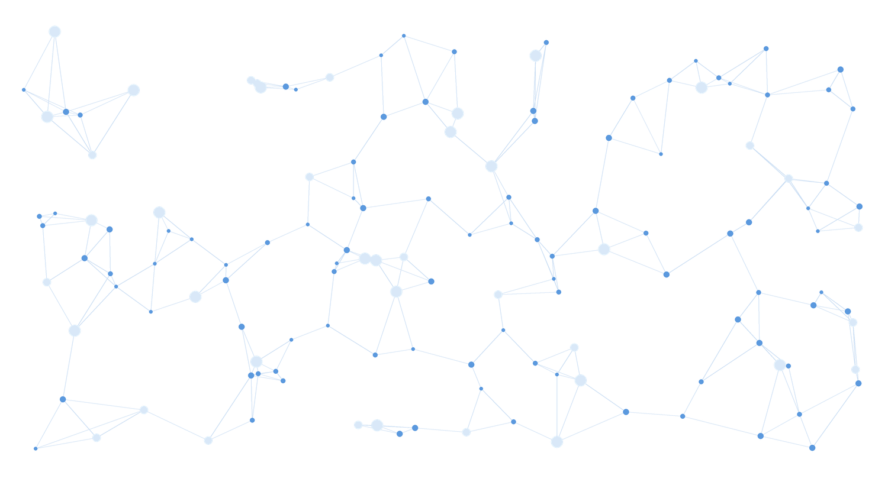



Live: AI linking millions of data points
Emidio demonstrates a highly complex AI workflow we developed — applied to customers: millions of interactions turned into one customer view and a next best action.
Millions of data points
Many sources linked in one model
PLACEHOLDER · LIVE DEMO
Multiple AI agents
Emidio · AI workflow on screen
Research, matching and scoring in one flow
From data to decision
The output is a recommendation, not a dashboard
Notes:
PLACEHOLDER — live demo by Emidio (approx. 5–7 minutes). The workflow connects millions of data points from many sources into one decision. Frame it with the lecture's lens: applied to customers: millions of interactions turned into one customer view and a next best action.
Afterwards ask the room: what would this have taken a team ten years ago? Bridge to the title slide.

Slide 3
The Future of CRM: AI-Native Customer Relationships
How CRM systems will work, how AI gets into them — and what still holds from the textbook.
Rome, October 2026
Notes:
Promise: three questions for the hour. How will CRM work in 2030? What does such a system look like and how do companies get there? And which of the theories you study still hold — spoiler: most of them, but the execution changes completely.

Slide 4
ChatGPT: 1 million users in just 5 days
Time it took to reach 1 million users
Netflix
3.5 years
5
days
Airbnb
2.5 years
from launch to one million users — faster than any consumer product before it.
Twitter
2 years
For CRM: customers now ask an AI assistant before they ask your brand — a new touchpoint.
ChatGPT
5 days
Source: Statista, based on company announcements. ChatGPT launched on 30 November 2022.
Notes:
AI impulse 1 — adoption speed. Netflix needed 3.5 years, Airbnb 2.5, Twitter 2. ChatGPT needed five days (launch Nov 30, 2022). The bar for ChatGPT is barely visible — that is the point. For CRM: customers now ask an AI assistant before they ask your brand — a new touchpoint nobody owns yet.

Slide 5
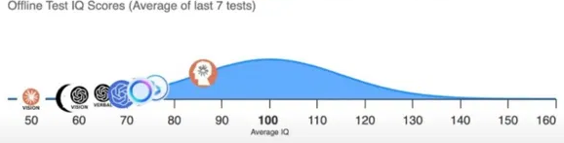
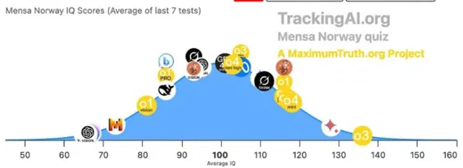
AI's IQ: from 96 to 136 in one year
Best AI model on standardised IQ tests — one year apart
2024
2024
IQ 96
Best model, offline test
2025
2025
IQ 136
Best model, Mensa Norway test
Source: TrackingAI.org (MaximumTruth.org) — IQ scores, average of last 7 tests. Average human = 100.
Notes:
AI impulse 2 — capability speed. In 2024 the best model scored around 96 on an offline IQ test (not in any training data). In 2025 the best model (o3) reached 136 on the Mensa Norway test — roughly the top 1% of people. Caveat to say out loud: IQ tests measure pattern reasoning, not judgement or experience. Ask: if AI reasons this well, why do most customer service interactions still feel like 2010?

Slide 6




Why AI is (still) hardly replacing jobs
Capability is rising fast — but real work is messy
So far, hardly any job losses from AI
AI's ability to automate jobs is constrained by task “messiness”
AI task success rate by messiness of the task (%)
AI hits its limits in complex, dynamic workflows
Office and routine work stable so far — despite automation risk
Demand for AI skills is growing sharply
For you: Answering a standard question is a clean task. Rescuing a relationship is messy — that stays human.
Tasks taking a human professional ≤ 1 hour. Source: METR / Measuring AI Ability (values read from published chart).
Notes:
AI impulse 3 — reality check. METR measured AI success on tasks that take a human professional one hour or less. On clean, well-defined tasks success went from ~0 to ~95% within three years; on messy tasks — unclear goals, many tools, changing context — it is around 60%. Most real jobs are messy. For CRM: answering a standard question is a clean task; repairing a damaged relationship is messy. That is where people stay.

Slide 7
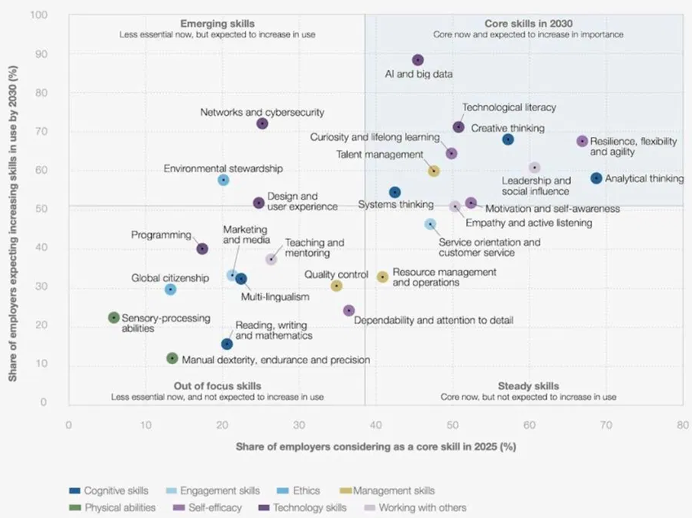
Core skills in 2030
Share of employers calling a skill core today (x) vs expecting it to grow by 2030 (y)
1
AI and big data
the fastest-growing skill of all — almost 9 in 10 employers expect it to grow
2
Thinking skills stay core
analytical thinking, creative thinking, systems thinking
3
Human skills rise with AI
resilience, curiosity and lifelong learning, leadership
The CRM profile of 2030: AI and data skills plus empathy and service orientation.
Source: World Economic Forum, Future of Jobs Report 2025, Figure 3.6.
Notes:
AI impulse 4 — what becomes valuable. Top right quadrant = core now and growing: AI and big data leads by far, followed by technological literacy, creative and analytical thinking, resilience, curiosity and lifelong learning. Programming sits lower than people expect — AI writes code. CRM roles move to AI and big data plus empathy and service orientation — technology and human skills together.

Slide 8
“Augmented Intelligence”
Not human or machine — the value sits in the overlap
HUMAN
Judgement, context, trust, responsibility
AI
Human
Intelligence
Augmented
Intelligence
Artificial
Intelligence
Speed, scale, pattern recognition, tireless testing
AUGMENTED — CRM
Agents handle millions of routine interactions — people own the relationships that matter and set the rules.
Notes:
AI impulse 5 — the bridge to today's topic. Human intelligence brings judgement, context, trust and responsibility. Artificial intelligence brings speed, scale and pattern recognition. Augmented intelligence is the overlap — and that is where the rest of this lecture lives. undefined

Slide 9
Rethinking CRM
The classic CRM types — how they worked, what AI does today, what AI-native means
BEFORE
NOW, WITH AI
AI-NATIVE
Operational CRM
Sales, service and marketing records typed in by hand
Auto-logging, AI-written emails and call summaries
Agents run service, sales and marketing tasks end-to-end
Analytical CRM
Monthly reports and RFM segments
Predictive scores: churn, CLV, propensity
A segment of one — models update with every interaction
Collaborative CRM
Silos between departments and partners
Shared dashboards across teams
One customer context shared by people, agents and partners
Strategic CRM
CRM as an IT project
AI pilots on top of the CRM
The CRM as the company's learning system
The taxonomy from your course still holds. What changes is who does the work — and how fast the system learns.
Notes:
Use the taxonomy the students know from the course: operational, analytical, collaborative CRM — plus CRM as strategy. Walk left to right. Middle column = most companies in 2026: AI features on top of the same CRM. Right column = AI-native: the work itself is done by agents, the CRM becomes the company's learning system.

Slide 10
Back to the textbook: the theory holds
Four concepts from your CRM course — and what AI changes about them
CONCEPT
WHAT IT SAYS
WHAT AI CHANGES
Customer lifetime value
Invest in customers according to their future value, not past revenue
CLV predicted per customer, updated daily — and acted on by agents
Kumar & Reinartz
Strategic CRM framework
Strategy, value creation, multichannel integration, information management, performance
Information management and channel integration become largely automated
Payne & Frow, 2005
Customer journey
Experience is created across touchpoints — many outside the firm's control
Journeys orchestrated in real time — including the customer's own AI assistant
Lemon & Verhoef, 2016
Commitment–trust theory
Relationships rest on commitment and trust
When AI speaks for the brand, trust becomes the scarce asset
Morgan & Hunt, 1994
Takeaway: AI does not replace CRM theory — it finally makes it executable at scale.
Notes:
Academic anchor slide. Kumar & Reinartz on customer lifetime value; Payne & Frow's strategic CRM framework (Journal of Marketing, 2005); Lemon & Verhoef on customer experience across the journey (Journal of Marketing, 2016); Morgan & Hunt's commitment–trust theory (Journal of Marketing, 1994). Message: the concepts are not outdated — AI makes them executable at scale. Ask: which of the four becomes MORE important with AI? (Answer: trust.)

Slide 11



The CRM of 2030: a system that acts
What a future CRM system looks like — from storing data to taking action
INTERACTION
GOVERNANCE & TRUST
GDPR · AI Act · consent · audit trail
WHAT IS NEW
Every channel: web, app, email, chat, voice — and the customer's own AI assistant
1
From records to context
Most customer knowledge is text — LLMs make it usable.
AGENTS
Service, sales and marketing agents act within guardrails — people handle the exceptions
2
From dashboards to actions
INTELLIGENCE
The system does not only show the next best action — it takes it.
Predictive models (churn, CLV, next best action) + LLMs that read emails, calls and reviews
3
From one channel owner to many agents
DATA
Unified, consented customer data — linked to ERP, e-commerce and service systems
Including agents that act for the customer.
From system of record to system of action: the CRM stops waiting for input and starts doing the work.
Notes:
Walk bottom-up. Data: unified, consented first-party data, connected to ERP, commerce and service systems — ideally without copying it around. Intelligence: classic predictive models plus LLMs that understand unstructured data (emails, calls, reviews — most customer information is text). Agents: software that acts within rules. Interaction: every channel, including the customer's own AI assistant. Governance runs through every layer: GDPR, consent, EU AI Act, audit trail, human escalation.

Slide 12





A day in the CRM of 2030
One complaint, five steps, a few minutes — case: a European online fashion brand
1
2
3
4
5
Signal
Understand
Decide
Act
Learn
A loyal customer writes an angry email: second late delivery
Agent reads tone, order history and CLV: high-value, churn risk up
Rule: compensation under €50 is autonomous, above needs a human
Apology, voucher and priority shipping — ERP updated, reason logged
Did she buy again? The outcome trains the churn model
ILLUSTRATIVE
Today The ticket waits in a queue, a service agent opens three systems, the customer waits two days — and may be gone.
2030 Answered in minutes, within clear rules. People handle the cases above the threshold — and the relationships that matter.
Notes:
Illustrative flow. Today: the ticket waits in a queue, a service agent opens three systems, the customer waits two days and may be gone. 2030: the agent understands the context (high CLV, second late delivery), acts within a clear rule (compensation below €50 autonomous, above that a human approves), and the outcome flows back into the churn model. Ask: where would you set the threshold — and who decides?

Slide 13
How AI gets into an existing CRM
Four integration patterns — from switching on a feature to building your own layer
EFFORT ●○○○ → ●●●●
01
02
03
04
Built-in copilots
Workflow automation
AI agents with connectors
Data platform + own models
Switch on the AI of your CRM vendor
CRM events trigger AI steps via APIs
Agents read and write the CRM through APIs or MCP
CRM, ERP and web data in one warehouse, own models
e.g. Agentforce, HubSpot Breeze, Dynamics 365 Copilot
e.g. Make, Zapier, n8n
One agent across CRM, ERP, email
Results written back to the CRM
Fast start · limited to the platform's data
Quick wins · needs maintenance
Flexible · needs clear permissions
Most control · highest effort
THE ROADMAP — THE SAME IN EVERY CASE
Clean data
One use case
Human in the loop
Measure
Scale
Notes:
Practical slide. Most companies start with 1 or 2 and move toward 3 and 4 as they learn. Examples are illustrative, not recommendations: built-in copilots such as Salesforce Agentforce, HubSpot Breeze or Microsoft Dynamics 365 Copilot; workflow tools such as Make, Zapier or n8n; agents that use the CRM's API or a standard connector protocol such as MCP; a data platform (warehouse) with own models, results written back into the CRM. The roadmap at the bottom is the same in every case: data quality first.

Slide 14




Live: an AI agent inside the CRM
Pattern 03 on stage — an agent reads, analyses and writes back to a CRM
1
2
3
4
Sandbox CRM
Connect
Analyse
Write back
Synthetic customers, orders and tickets
Claude Code via API or MCP connector
Find falling order frequency, estimate CLV
Draft emails as tasks — a person approves
LIVE DEMO · CLAUDE CODE
THE PROMPT ON STAGE
You set the rules. Change the segment or add a guardrail — for example “only customers who agreed to marketing emails” — and the agent reruns in seconds.
Find customers whose order frequency dropped by half in the last 90 days. Estimate their CLV. For the top 10, draft a personal win-back email and create a review task. Do not send anything.
Notes:
Prepared base: a sandbox CRM with synthetic customers, connected to Claude Code via the CRM's API (or an MCP connector). Run the prompt, show the agent querying, computing and writing tasks back into the CRM — open the CRM, not the code. Then let the room add a guardrail or change the segment (e.g. “only customers who agreed to marketing emails”). Point out: nothing is sent — people review.

Slide 15
Beyond your own data: five AI engines
Your CRM knows today's customers — BMV adds evidence about the ones you don't have yet
ENGINE · AI MECHANISM
WHAT IT DOES
WHAT IT ADDS TO THE CRM
E4
Context Engine
Reads competitor sites, reviews, regulation and news — extracts only what sources state
What competitors offer your customers — prices, reviews, rules
LLM RESEARCH AGENT
E5
Aggregate Research
Official statistics, TAM / SAM / SOM — top-down and bottom-up
How many potential customers exist per segment
STATISTICAL AGENT
E2
Simulated Mind
Predicts a segment's attention and valuation response to a message or price
How a segment reacts to a new offer — before the campaign
NEURO-AI MODEL
E3
Market World
A synthetic market of buyer archetypes — trusted only once calibrated
Simulated customers test a new loyalty or pricing model
MULTI-AGENT SIMULATION
E1
Cold Email Engine
Finds, writes, sends, classifies replies — real behaviour, measured
Real reactions from prospects to a new offer
AUTONOMOUS EXPERIMENT
Behaviour over opinion: your CRM explains today's customers — real tests reveal tomorrow's.
Notes:
BMV complements the CRM: own data to serve existing customers; external, simulated and real-world evidence for decisions about new segments, offers or channels. All five write into one evidence ledger with weights — the same logic a good analytical CRM should follow.

Slide 16

Design an AI-native CRM for LUISS
Groups of 3–4, AI on your phone — your university is the company, you are the customer
3 min
3 min
2 min
2 min
Map
Design
Guard
Pitch
The lifecycle: applicant → student → alumnus → recruiter or donor. Where is data — where is it lost?
One agent at one moment of truth: what does it do, with which data?
One KPI and one guardrail: what may the agent never do without a human?
30 seconds: moment, agent, data, KPI, guardrail.
WHAT EVERY GROUP HANDS IN (MENTI)
QR → data sheet + prompt
Lifecycle template + prompt
Moment of truth
Agent use case
Data needed
KPI
Guardrail
Remember Morgan & Hunt: would you, as a student, trust this agent? If not, the design fails.
Notes:
Relatable case: LUISS itself. Customer lifecycle: applicant → student → alumnus → recruiter / donor. Lifetime value of an alumnus is a real concept (donations, recruiting, reputation). Each group picks one moment of truth (e.g. admission decision, first-semester drop-out risk, graduation, first job). Two or three groups pitch; the rest submit via Menti. Repeat Menti question 5 afterwards.

Slide 17




What this means for CRM — and for you
Four shifts for anyone working with customers in the next five years
From CRM user to agent manager
Data quality is strategy
You will configure, supervise and improve agents — not fill in fields.
Clean, consented first-party data is the moat. An agent is only as good as the data it acts on.
New KPIs
Trust is the differentiator
Next to CLV and retention: AI resolution rate, escalation rate — and how well forecasts match reality.
Commitment–trust still applies: customers stay with brands they trust with their data and with their agents.
Three statements: the theory holds · the CRM becomes a system of action · trust is the scarcest asset.
Notes:
Close with careers. Then repeat Menti question 5 (CMO budget) and compare with the first vote. Pair discussion option (2 min): which CRM role would you want in 2030?

Slide 18

AI can generate a strategy. Evidence tells you whether it works.
The advantage is not generating answers faster — it is testing assumptions faster.
01
02
03
04
Identify
Quantify
Experiment
Decide
Find the opportunity
Build the business case
Collect real evidence
Go, iterate or stop
WHO WE ARE
WORK WITH US
EE-Partner (Milan) and asuno (Singapore) build AI-native systems for B2B companies — process automation for the DACH Mittelstand, and the Business Model Validator: an AI validation layer between idea and investment.
Thesis topics on AI-native CRM, agents and customer data; pilot participation.
Contact: [e-mail / LinkedIn]
Notes:
Repeat Menti question 5 (CMO budget), compare with the first vote. Q&A.

