Slide 1

Before we start: your view on AI
Five quick questions on Menti — answers stay on screen and we come back to them at the end.
1
What is the hardest part of selling today?
WORD CLOUD
2
How many cold emails does a B2B seller need for one qualified meeting?
POLL · REPEAT
20 · 50 · 100 · 200+
3
Which sales task should AI take over first?
POLL
PLACEHOLDER
Research · first message · follow-ups · forecasting
Interactive Menti survey
4
Which part of selling should AI never take over?
OPEN TEXT
menti.com · code [ ____ ]
QR code + live results
5
By 2030, will companies employ more or fewer salespeople?
POLL
More · same · fewer · different profile
Notes:
Interactive Menti survey (placeholder — insert join code and QR). Run the five questions back to back, about 60 seconds each. Read out one surprising answer per question. Save the results: questions marked “repeat” are asked again at the end.
1. What is the hardest part of selling today?
2. How many cold emails does a B2B seller need for one qualified meeting? Options: 20 · 50 · 100 · 200+
3. Which sales task should AI take over first? Options: Research · first message · follow-ups · forecasting
4. Which part of selling should AI never take over?
5. By 2030, will companies employ more or fewer salespeople? Options: More · same · fewer · different profile

Slide 2
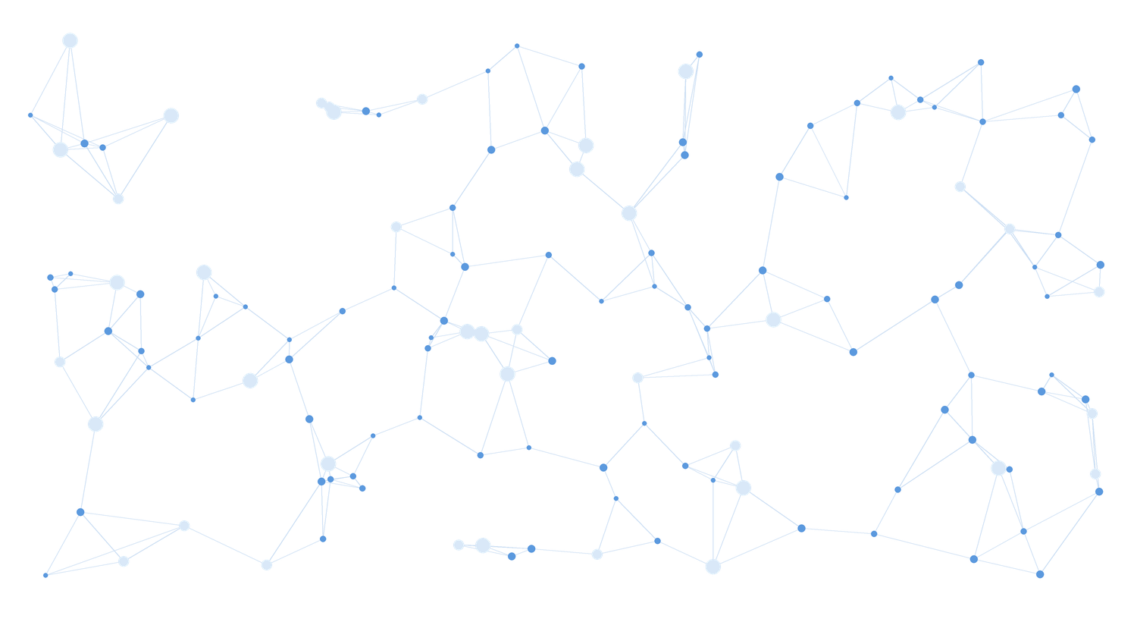



Live: AI linking millions of data points
Emidio demonstrates a highly complex AI workflow we developed — applied to sales: which companies have the pain, who to contact, with which message.
Millions of data points
Many sources linked in one model
PLACEHOLDER · LIVE DEMO
Multiple AI agents
Emidio · AI workflow on screen
Research, matching and scoring in one flow
From data to decision
The output is a recommendation, not a dashboard
Notes:
PLACEHOLDER — live demo by Emidio (approx. 5–7 minutes). The workflow connects millions of data points from many sources into one decision. Frame it with the lecture's lens: applied to sales: which companies have the pain, who to contact, with which message.
Afterwards ask the room: what would this have taken a team ten years ago? Bridge to the title slide.

Slide 3
The AI-Native Sales Organization
How to identify customers, quantify their problems, build a sales engine and validate real demand with AI.
Rome, October 2026
Notes:
Running case: an AI sales assistant for small businesses. Live case: one real, anonymised cold-email campaign.

Slide 4
ChatGPT: 1 million users in just 5 days
Time it took to reach 1 million users
Netflix
3.5 years
5
days
Airbnb
2.5 years
from launch to one million users — faster than any consumer product before it.
Twitter
2 years
For sales: your buyers adopted AI this fast too — they research you before you call them.
ChatGPT
5 days
Source: Statista, based on company announcements. ChatGPT launched on 30 November 2022.
Notes:
AI impulse 1 — adoption speed. Netflix needed 3.5 years, Airbnb 2.5, Twitter 2. ChatGPT needed five days (launch Nov 30, 2022). The bar for ChatGPT is barely visible — that is the point. For sales: buyers adopt AI this fast too — your next buyer researches you with an AI before you ever call.

Slide 5
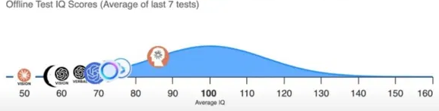
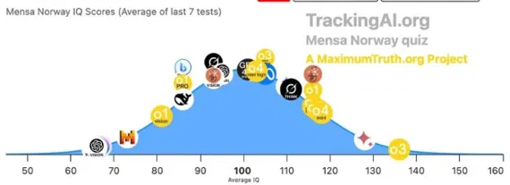
AI's IQ: from 96 to 136 in one year
Best AI model on standardised IQ tests — one year apart
2024
2024
IQ 96
Best model, offline test
2025
2025
IQ 136
Best model, Mensa Norway test
Source: TrackingAI.org (MaximumTruth.org) — IQ scores, average of last 7 tests. Average human = 100.
Notes:
AI impulse 2 — capability speed. In 2024 the best model scored around 96 on an offline IQ test (not in any training data). In 2025 the best model (o3) reached 136 on the Mensa Norway test — roughly the top 1% of people. Caveat to say out loud: IQ tests measure pattern reasoning, not judgement or experience. Ask: if AI can reason this well, which part of a sales conversation still needs a human?

Slide 6




Why AI is (still) hardly replacing jobs
Capability is rising fast — but real work is messy
So far, hardly any job losses from AI
AI's ability to automate jobs is constrained by task “messiness”
AI task success rate by messiness of the task (%)
AI hits its limits in complex, dynamic workflows
Office and routine work stable so far — despite automation risk
Demand for AI skills is growing sharply
For you: Research and first drafts are clean tasks. Trust, negotiation and judgement are messy — the seller's territory.
Tasks taking a human professional ≤ 1 hour. Source: METR / Measuring AI Ability (values read from published chart).
Notes:
AI impulse 3 — reality check. METR measured AI success on tasks that take a human professional one hour or less. On clean, well-defined tasks success went from ~0 to ~95% within three years; on messy tasks — unclear goals, many tools, changing context — it is around 60%. Most real jobs are messy. For sales: research and first drafts are clean tasks; negotiation and trust are messy. That is where sellers stay.

Slide 7
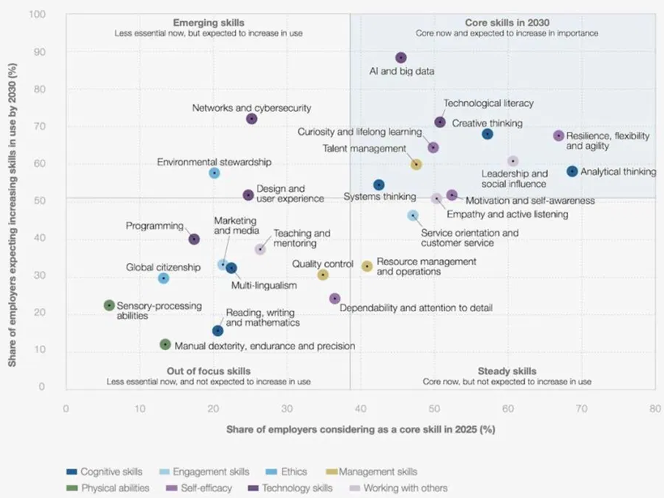
Core skills in 2030
Share of employers calling a skill core today (x) vs expecting it to grow by 2030 (y)
1
AI and big data
the fastest-growing skill of all — almost 9 in 10 employers expect it to grow
2
Thinking skills stay core
analytical thinking, creative thinking, systems thinking
3
Human skills rise with AI
resilience, curiosity and lifelong learning, leadership
The seller of 2030: AI-literate and analytical — with empathy and active listening as the differentiator.
Source: World Economic Forum, Future of Jobs Report 2025, Figure 3.6.
Notes:
AI impulse 4 — what becomes valuable. Top right quadrant = core now and growing: AI and big data leads by far, followed by technological literacy, creative and analytical thinking, resilience, curiosity and lifelong learning. Programming sits lower than people expect — AI writes code. Sales profile shifts to analytical thinking + empathy + AI literacy.

Slide 8
“Augmented Intelligence”
Not human or machine — the value sits in the overlap
HUMAN
Judgement, context, trust, responsibility
AI
Human
Intelligence
Augmented
Intelligence
Artificial
Intelligence
Speed, scale, pattern recognition, tireless testing
AUGMENTED — SALES
A seller who lets AI research, write and classify — and spends the time on diagnosis, trust and the deal.
Notes:
AI impulse 5 — the bridge to today's topic. Human intelligence brings judgement, context, trust and responsibility. Artificial intelligence brings speed, scale and pattern recognition. Augmented intelligence is the overlap — and that is where the rest of this lecture lives. undefined

Slide 9
Rethinking sales
How selling worked, what AI enables today — and what AI-native sales means
BEFORE
NOW, WITH AI
AI-NATIVE
Prospecting
Bought lead lists and cold calling
AI research on every account
Agents find who has the pain — before anyone is contacted
Messaging
One pitch for everyone
Personalised emails at scale
Every message tests a declared hypothesis
Pipeline
CRM as a contact list, manual reports
Auto-logging and reply classification
The pipeline as a learning system
The seller
Persuader, driven by volume
Seller with an AI assistant
Half analyst, half relationship builder
The trap in the middle column: AI makes it cheap to send more — not to sell better.
Notes:
Walk the rows. The middle column is most sales teams in 2026: same funnel, AI-generated emails at scale — which mainly produces more spam. The right column is the rethink: diagnosis first, every campaign an experiment.

Slide 10




What we mean by “AI-native”
AI-native sales is not sending more emails — it is diagnosing before persuading
AI-ENABLED
Agents do the work, humans set direction
Agents research, write and classify — the seller approves the hypothesis
The old process, plus an AI tool
AI writes the emails and the call notes. Same lead list, same pitch, same funnel — just more volume.
Every decision is a hypothesis
“Trades owners will reply to a time-saving angle” — tested, not assumed
AI-NATIVE
Every loop makes the system smarter
The process redesigned around what AI makes cheap
Every reply updates the segment, the message and the price
Agents research the market, simulate the buyer and run campaigns as experiments. The seller decides the hypothesis and owns the meeting.
Evidence beats opinion
A booked meeting outweighs any lead score
In one line: sell less, ask more — AI does the diagnosis, the human builds the trust.
Notes:
Definition for the session. AI-enabled: same funnel, more volume. AI-native: the funnel is redesigned — research and simulation decide whom to contact and with what; the seller approves the hypothesis and owns the conversation.

Slide 11
From market data to pain points
E4 Context Engine: AI extracts what sources state — it must not infer
CONTEXT ENGINE OUTPUT · AI SALES ASSISTANT FOR SMALL BUSINESSES
Stated vs inferred
Owners lose 6–8 h a week on follow-ups and quotes
ESTIMATED
Stated: a source says it, with a date and a sample. Grade it and keep it.
Inferred: sounds plausible, nobody said it. It becomes a hypothesis — never a fact on a slide.
forum sample, n ≈ 40
Comparable tools priced €49–€149 per month
RESEARCHED
6 vendor websites, Sept 2026
Top complaint in reviews: “too complex to set up”
RESEARCHED
review platforms, 120 reviews
Owners would pay for a tool that writes follow-ups
The difference between research and fiction.
INFERRED — NOT EVIDENCE
no source
Exercise · 4 min · three pain hypotheses for small-business owners — and the evidence you need before writing a single email.
Notes:
Demo or screenshot of the Context Engine. Groups of 3–4 (4 min): three pain hypotheses for small-business owners — and for each, the evidence you would need before writing a single email. Inferred lines are the ones that cost sales teams the most.

Slide 12




The AI-native sales engine
E1 Cold Email Engine: an autonomous experiment loop — every campaign tests a declared hypothesis
1
2
3
4
5
Find
Personalise
Send & track
Classify
Learn
List from the ICP: firmographics and signals
One message per company, public facts only
Email only, declared hypothesis, 14–21 days
Every reply on a fixed taxonomy
Reply and meeting rate per segment × variant
THE HYPOTHESIS FORMAT
REPLY TAXONOMY
“If we message [segment] about [pain] with [angle], at least X% will reply positively within 14 days.”
Interested
Not now
Wrong person
Unsubscribe
Objection: price / timing / trust / no need
Live demo · Claude Code: you give the ICP and two pain angles — the tool builds both campaign variants live.
Notes:
This is the Cold Email Engine explained as a sales process. Live demo with Claude Code: students give the ICP and two pain angles; the prospecting tool generates both campaign variants and a qualification checklist. Rehearse the live change twice.

Slide 13
Five AI engines behind AI-native sales
E1 is the one you see — four more decide where it is worth sending at all
ENGINE · AI MECHANISM
WHAT IT DOES
WHAT IT MEANS FOR SALES
E4
Context Engine
Reads competitor sites, reviews, regulation and news — extracts only what sources state
Which segment has the pain, which objections are public?
LLM RESEARCH AGENT
E5
Aggregate Research
Official statistics, TAM / SAM / SOM — top-down and bottom-up
How many in-target companies exist — the funnel ceiling
STATISTICAL AGENT
E2
Simulated Mind
Predicts a segment's attention and valuation response to a message or price
Which of two messages wins attention before the first send
NEURO-AI MODEL
E3
Market World
A synthetic market of buyer archetypes — trusted only once calibrated
Price elasticity and dealbreakers — your negotiation prep
MULTI-AGENT SIMULATION
E1
Cold Email Engine
Finds, writes, sends, classifies replies — real behaviour, measured
Reply, positive and meeting rate per segment × variant
AUTONOMOUS EXPERIMENT
Behaviour over opinion: simulation narrows the bet — only a real reply, meeting or contract proves it.
Notes:
Sales students see only E1 in most tools. The point: E4/E5 decide the list, E2/E3 decide the message and price, E1 proves it. All five write into one ledger.

Slide 14

The 10-Minute Sales Challenge
Groups of 3–4, AI on your phone — build the sales case: who buys, why, and how you would know
3 min
2 min
2 min
3 min
Quantify
Develop
Validate
Pitch
ICP size, customer ROI and the funnel to €100k ARR — every number tagged.
One outreach message and the single assumption it rests on.
Two messages per group go to Menti. The class votes and names the first objection.
45 seconds: ICP, ROI, funnel maths, evidence from the vote, next experiment.
WHAT EVERY GROUP HANDS IN (MENTI)
QR → data sheet + prompt
Segments: trades · agencies · e-commerce
ICP
Pain (quantified)
Message
Qualification
Success metric
Remember: a vote is what people say. A reply is what people do.
Notes:
Say explicitly: the vote is declarative evidence (weight 0.7), not behaviour. Two or three pitches; the rest submit via Menti.

Slide 15
What a real campaign looks like
What the room preferred vs. what real buyers did
ANONYMISED CAMPAIGN · REPLACE WITH REAL FIGURES
Answer to Menti question 2
≈ 170
emails per qualified meeting
Weight by kind of evidence
Real behaviour (replies)
1.0
Real statement (the vote)
0.7
Reply 4.0% · positive 1.2% · meeting 0.6% · cycle 14–21 days · top objections: timing, “we have a tool”, price
Simulated
0.4
The pipeline is a learning system, not a list: it feeds product, pricing and strategy.
Notes:
Replace the illustrative funnel with the real anonymised campaign (sample sizes!). Resolve Menti question 2 with the real emails-per-meeting figure. The pipeline is a learning system: it feeds product, pricing and strategy.

Slide 16



How AI-native will change sales
The seller of 2030: half analyst, half relationship builder
Agents run the top of the funnel
Buyers bring their own AI
List, research, first message, follow-ups and reply classification — done by AI, approved by humans.
Procurement agents compare offers before a human talks. Your data and claims must survive machine scrutiny.
Humans own trust and the deal
Paid for learning, not only volume
Diagnosis, the meeting, pricing judgement, negotiation — and saying no to bad-fit leads.
Teams are measured on documented insight per contact — every objection is data for product and pricing.
Three statements to take home: diagnose before you persuade · every campaign is an experiment · behaviour outweighs opinion.
Notes:
Sales force organisation and motivation: pay for documented learning per contact, not only for meetings. Recruit for curiosity and structure. Optional exercise (4 min): objection role play in pairs with real objections from the campaign dashboard. Then Menti question 2 resolved and closing.

Slide 17

AI can generate a strategy. Evidence tells you whether it works.
The advantage is not generating answers faster — it is testing assumptions faster.
01
02
03
04
Identify
Quantify
Experiment
Decide
Find the opportunity
Build the business case
Collect real evidence
Go, iterate or stop
WHO WE ARE
WORK WITH US
EE-Partner (Milan) and asuno (Singapore) build AI-native systems for B2B companies — process automation for the DACH Mittelstand, and the Business Model Validator: an AI validation layer between idea and investment.
Hypothesis format and reply taxonomy as a handout for your project work. Thesis topics and pilots.
Contact: [e-mail / LinkedIn]
Notes:
Q&A. Hypothesis format and reply taxonomy as a handout for project work.

