Slide 1

Before we start: your view on AI
Five quick questions on Menti — answers stay on screen and we come back to them at the end.
1
One word: what is a CRM to you today?
WORD CLOUD
2
Who holds the most valuable customer information?
POLL
Manufacturer · distributor · retailer · consumer
3
As CEO of a consumer brand, what would you invest in first?
POLL · REPEAT
PLACEHOLDER
Marketing · data integration · AI forecast
Interactive Menti survey
4
How much would you let an AI forecast decide your production plan?
SCALE 0–100%
menti.com · code [ ____ ]
QR code + live results
5
By 2030, who manages customer relationships?
POLL
People · AI agents · both
Notes:
Interactive Menti survey (placeholder — insert join code and QR). Run the five questions back to back, about 60 seconds each. Read out one surprising answer per question. Save the results: questions marked “repeat” are asked again at the end.
1. One word: what is a CRM to you today?
2. Who holds the most valuable customer information? Options: Manufacturer · distributor · retailer · consumer
3. As CEO of a consumer brand, what would you invest in first? Options: Marketing · data integration · AI forecast
4. How much would you let an AI forecast decide your production plan?
5. By 2030, who manages customer relationships? Options: People · AI agents · both

Slide 2
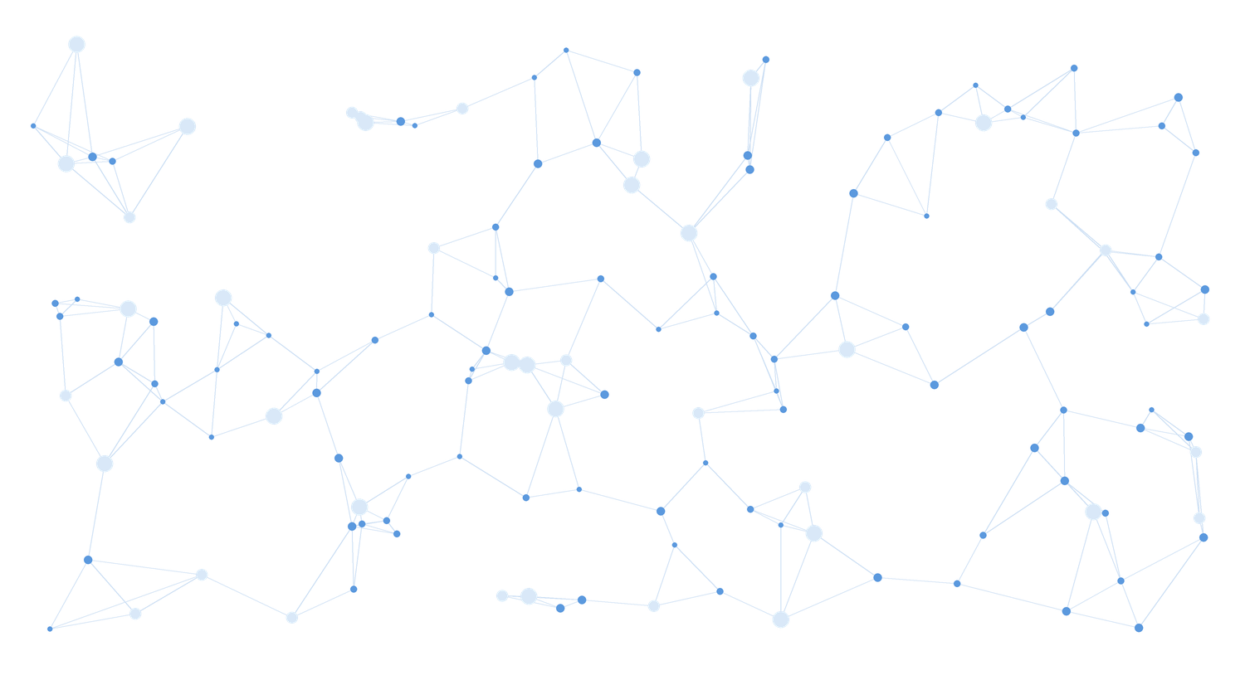



Live: AI linking millions of data points
Emidio demonstrates a highly complex AI workflow we developed — applied to a value chain: linking supply data and customer behaviour.
Millions of data points
Many sources linked in one model
PLACEHOLDER · LIVE DEMO
Multiple AI agents
Emidio · AI workflow on screen
Research, matching and scoring in one flow
From data to decision
The output is a recommendation, not a dashboard
Notes:
PLACEHOLDER — live demo by Emidio (approx. 5–7 minutes). The workflow connects millions of data points from many sources into one decision. Frame it with the lecture's lens: applied to a value chain: linking supply data and customer behaviour.
Afterwards ask the room: what would this have taken a team ten years ago? Bridge to the title slide.

Slide 3
The AI-Powered Customer Ecosystem
Connecting supply-side value chains with demand-side behaviour through CRM, data and artificial intelligence.
Rome, October 2026
Notes:
Running case: a fictional European sports-drink brand — produces, ships to distributors, sells through retailers and its own shop, barely knows its end customers.

Slide 4
ChatGPT: 1 million users in just 5 days
Time it took to reach 1 million users
Netflix
3.5 years
5
days
Airbnb
2.5 years
from launch to one million users — faster than any consumer product before it.
Twitter
2 years
For CRM: customers now ask an AI assistant before they ask your brand — a new channel.
ChatGPT
5 days
Source: Statista, based on company announcements. ChatGPT launched on 30 November 2022.
Notes:
AI impulse 1 — adoption speed. Netflix needed 3.5 years, Airbnb 2.5, Twitter 2. ChatGPT needed five days (launch Nov 30, 2022). The bar for ChatGPT is barely visible — that is the point. For CRM: customers now ask an AI assistant before they ask your brand — a new channel nobody owns yet.

Slide 5
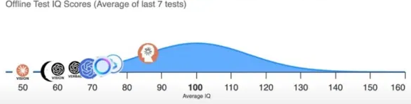
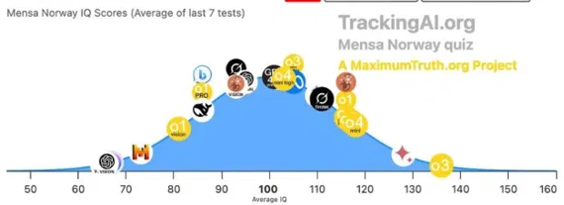
AI's IQ: from 96 to 136 in one year
Best AI model on standardised IQ tests — one year apart
2024
2024
IQ 96
Best model, offline test
2025
2025
IQ 136
Best model, Mensa Norway test
Source: TrackingAI.org (MaximumTruth.org) — IQ scores, average of last 7 tests. Average human = 100.
Notes:
AI impulse 2 — capability speed. In 2024 the best model scored around 96 on an offline IQ test (not in any training data). In 2025 the best model (o3) reached 136 on the Mensa Norway test — roughly the top 1% of people. Caveat to say out loud: IQ tests measure pattern reasoning, not judgement or experience. Ask: if AI reasons this well, why do most companies still decide production with spreadsheets?

Slide 6




Why AI is (still) hardly replacing jobs
Capability is rising fast — but real work is messy
So far, hardly any job losses from AI
AI's ability to automate jobs is constrained by task “messiness”
AI task success rate by messiness of the task (%)
AI hits its limits in complex, dynamic workflows
Office and routine work stable so far — despite automation risk
Demand for AI skills is growing sharply
For you: Forecasting is a clean task. Aligning manufacturer, distributor and retailer is messy — that is the CRM job.
Tasks taking a human professional ≤ 1 hour. Source: METR / Measuring AI Ability (values read from published chart).
Notes:
AI impulse 3 — reality check. METR measured AI success on tasks that take a human professional one hour or less. On clean, well-defined tasks success went from ~0 to ~95% within three years; on messy tasks — unclear goals, many tools, changing context — it is around 60%. Most real jobs are messy. For CRM: forecasting a clean data series is easy for AI; aligning four actors in a value chain is messy.

Slide 7
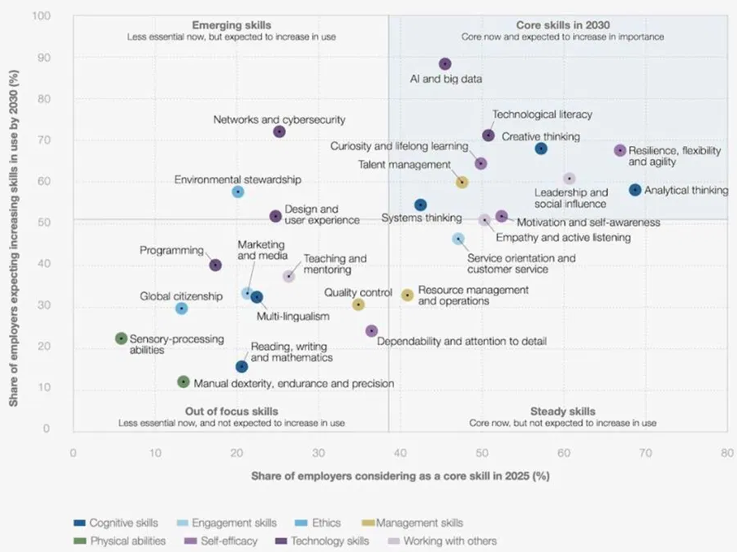
Core skills in 2030
Share of employers calling a skill core today (x) vs expecting it to grow by 2030 (y)
1
AI and big data
the fastest-growing skill of all — almost 9 in 10 employers expect it to grow
2
Thinking skills stay core
analytical thinking, creative thinking, systems thinking
3
Human skills rise with AI
resilience, curiosity and lifelong learning, leadership
The CRM role of 2030: AI and big data plus systems thinking — the top-right quadrant.
Source: World Economic Forum, Future of Jobs Report 2025, Figure 3.6.
Notes:
AI impulse 4 — what becomes valuable. Top right quadrant = core now and growing: AI and big data leads by far, followed by technological literacy, creative and analytical thinking, resilience, curiosity and lifelong learning. Programming sits lower than people expect — AI writes code. CRM roles move to AI and big data + systems thinking — exactly the top-right quadrant.

Slide 8
“Augmented Intelligence”
Not human or machine — the value sits in the overlap
HUMAN
Judgement, context, trust, responsibility
AI
Human
Intelligence
Augmented
Intelligence
Artificial
Intelligence
Speed, scale, pattern recognition, tireless testing
AUGMENTED — CRM
AI connects millions of signals along the chain — people decide what to share, whom to trust and what to do.
Notes:
AI impulse 5 — the bridge to today's topic. Human intelligence brings judgement, context, trust and responsibility. Artificial intelligence brings speed, scale and pattern recognition. Augmented intelligence is the overlap — and that is where the rest of this lecture lives. undefined

Slide 9
Rethinking CRM
How CRM worked, what AI enables today — and what an AI-native customer ecosystem means
BEFORE
NOW, WITH AI
AI-NATIVE
Data
Contact records in silos
Unified customer data, cleaned by AI
A shared evidence ledger across the value chain
Insight
Monthly manual reports
AI dashboards and forecasts
Real-time signals, each with a weight
Action
Reactive campaigns
Next-best-action suggestions
Agents act — humans set the guardrails
Relationship
Owned by whoever sells
Omnichannel journeys
Supply and demand side learn together
The trap in the middle column: AI on top of silos gives you faster reports — not a connected customer.
Notes:
Walk the rows. Middle column: most companies today — an AI layer on top of the same silos. Right column: the rethink — the CRM becomes a shared evidence structure across the value chain, with agents that act.

Slide 10




What we mean by “AI-native”
An AI-native CRM is not a smarter contact database — it is the structure that lets the whole chain learn
AI-ENABLED
Agents do the work, humans set direction
Agents forecast and propose — humans approve stock and campaign moves
The old process, plus an AI tool
An AI assistant on top of the CRM writes emails, scores leads and summarises reports. The silos stay where they were.
Every decision is a hypothesis
“Redistribute to South” is a hypothesis until next week's sell-out
AI-NATIVE
Every loop makes the system smarter
The process redesigned around what AI makes cheap
Every forecast is checked against reality — the model calibrates
Manufacturer, distributor, retailer and consumer signals flow into one structure. Agents forecast, detect gaps and propose actions.
Evidence beats opinion
Point-of-sale behaviour outweighs what a survey says
In one line: connect customer behaviour with supply decisions — and make every interaction part of a learning process.
Notes:
Definition for the session. Governance point early: integration rests on permitted access, suitable identifiers and clear governance. For most decisions, aggregate sales by product × region × week are enough — no person-level join needed.

Slide 11








Two worlds, disconnected
The brand knows it shipped 1,000 cases — not who bought them, or why
SUPPLY SIDE · WHAT THE COMPANY DECIDES
Production
›
Distribution
›
Retail
›
Inventory
Missing connection: shared customer intelligence. Two or three handovers where the signal is lost.
DEMAND SIDE · WHAT THE CUSTOMER DOES
Awareness
›
Purchase
›
Consumption
›
Loyalty
Lead question for today: how do we connect these two worlds — without pooling every piece of personal data?
Notes:
Menti open text option: in your last purchase, where did the manufacturer learn anything about you? Usually: nowhere. That is the gap. Two logics in one company: B2B upwards to the distributor, B2C downwards to the consumer.

Slide 12
Quantify the cost of disconnected data
Same product, same period, two regions — what would you recommend to the manufacturer?
ILLUSTRATIVE DATA · ZERO OPENING STOCK, NO RETURNS
North
South
Sell-through
40%
97%
Remaining stock
600
10
MENTI · How much revenue did South lose to the stockout?
0 · < €5k · €5–20k · > €20k · cannot know from this data
The lost demand in South is not in the data — the stockout hides it.
AI can only learn from what the chain shares: redistribution depends on cost, shelf life — and evidence you don't have yet.
Notes:
Likely answer: redistribute. Push back on cost, shelf life, expected demand. The correct Menti answer is “cannot know from this data” — that is the lesson. Students then estimate what better availability could be worth, tagged “estimated”.

Slide 13




From data to decisions — live
Integration pays off only when it changes a decision and an action
Demand forecasting
Inventory optimisation
Customer intelligence
Next-best action
Regional demand from history, seasonality, external factors
Detect imbalances, recommend redistribution
Buying behaviour across channels and regions
Campaign, assortment change or distributor action
KPI · FORECAST ERROR
KPI · STOCKOUT RATE
KPI · REPEAT PURCHASE
KPI · INCREMENTAL REVENUE
LIVE DEMO · CLAUDE CODE · CHANNEL INTELLIGENCE
AI RECOMMENDATION
You choose the new input: a third region, last year's demand, returns or a promotion calendar. Claude Code adds it to the prepared app — the dashboard recalculates and a new recommendation appears.
Investigate excess stock in North and stockout risk in South before deciding on replenishment.
1,300 shipped · 690 sold · 610 remaining
Notes:
Live demo with Claude Code: students choose the new input — a third region, last year's demand, returns or a promotion calendar. Claude Code adds it to the prepared app, the dashboard recalculates and a new recommendation appears. Synthetic data, one live change. Bridge: recommendation agents, IoT shelf sensors and RFID are further behavioural sources with weight 1.0.

Slide 14
Five AI engines along the value chain
Each engine produces data for the customer intelligence layer — three kinds of evidence, one ledger
ENGINE · AI MECHANISM
WHAT IT DOES
WHAT IT PRODUCES FOR THE CHAIN
E4
Context Engine
Reads competitor sites, reviews, regulation and news — extracts only what sources state
Competitor assortments, retail prices, reviews, regulation
LLM RESEARCH AGENT
E5
Aggregate Research
Official statistics, TAM / SAM / SOM — top-down and bottom-up
Points of sale and consumers per region — the demand ceiling
STATISTICAL AGENT
E2
Simulated Mind
Predicts a segment's attention and valuation response to a message or price
Consumer response to a pack, claim or price — before listing
NEURO-AI MODEL
E3
Market World
A synthetic market of buyer archetypes — trusted only once calibrated
Simulated distributors, retailers, consumers — channel elasticity
MULTI-AGENT SIMULATION
E1
Cold Email Engine
Finds, writes, sends, classifies replies — real behaviour, measured
Real reactions from trade partners to a new channel
AUTONOMOUS EXPERIMENT
Behaviour over opinion: a sell-out, a reorder or a partner's reply outweighs any forecast — and calibrates it.
Notes:
Each engine is a data producer for the shared structure. BMV complements the CRM: own data for serving today's customers, external and behavioural evidence for betting on new channels or categories.

Slide 15

The AI CRM Challenge
Groups of 3–4, AI on your phone — find the gap, price it, recommend an action
3 min
2 min
2 min
3 min
Quantify
Develop
Validate
Pitch
The key information gap between manufacturer, distributor and consumer — the opportunity in €, tagged.
One operational or marketing action, with the actor who executes it.
We release next week's sell-out by region. Does your recommendation survive?
45 seconds: gap, impact, action, did it survive, what you still need.
WHAT EVERY GROUP HANDS IN (MENTI)
QR → data sheet + prompt
Week 5 sell-out released at minute 5
Data gap
Financial impact
AI recommendation
Validation method
Repeat of Menti question 3 at the end: as CEO, what would you invest in first — and did your answer change?
Notes:
The hidden slice is a quick test of a recommendation, not market validation — say so. Two or three pitches; the rest via Menti.

Slide 16



How AI-native will change CRM
From a system of records to a system that acts — and learns
From records to agents
The consumer's AI is a new channel
The CRM no longer waits for input: agents forecast, detect gaps and propose the next action — humans approve.
Customers ask their AI assistant what to buy. Brands must be understandable to machines, not only to people.
Shared data, clear governance
New KPIs: calibration
Value comes from what the chain shares — permitted access and aggregates, not pooling every personal detail.
Not just revenue per customer — forecast error, stockout rate and how fast the model learns from reality.
Three statements: connect behaviour with supply decisions · make every interaction a learning loop · turn fragmented data into action.
Notes:
Close the rethink. Pair discussion (2 min): would you pay a key-account manager for a documented distributor objection the same as for an order? Then repeat Menti question 3 and the closing slide.

Slide 17

AI can generate a strategy. Evidence tells you whether it works.
The advantage is not generating answers faster — it is testing assumptions faster.
01
02
03
04
Identify
Quantify
Experiment
Decide
Find the opportunity
Build the business case
Collect real evidence
Go, iterate or stop
WHO WE ARE
WORK WITH US
EE-Partner (Milan) and asuno (Singapore) build AI-native systems for B2B companies — process automation for the DACH Mittelstand, and the Business Model Validator: an AI validation layer between idea and investment.
Thesis topics on channel intelligence and validation, pilot participation.
Contact: [e-mail / LinkedIn]
Notes:
Repeat Menti question 3, compare with the first vote. Q&A.

