Slide 1
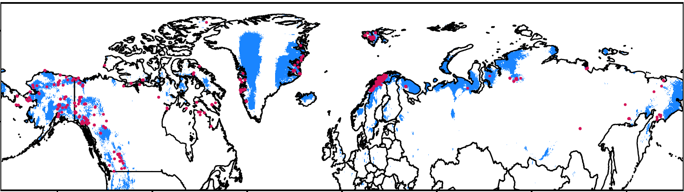
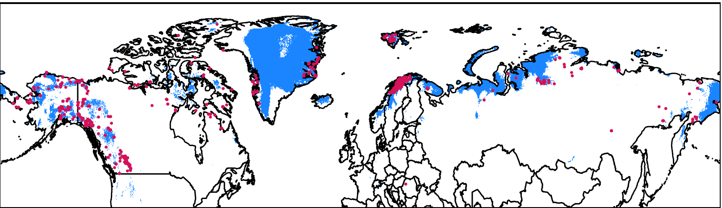
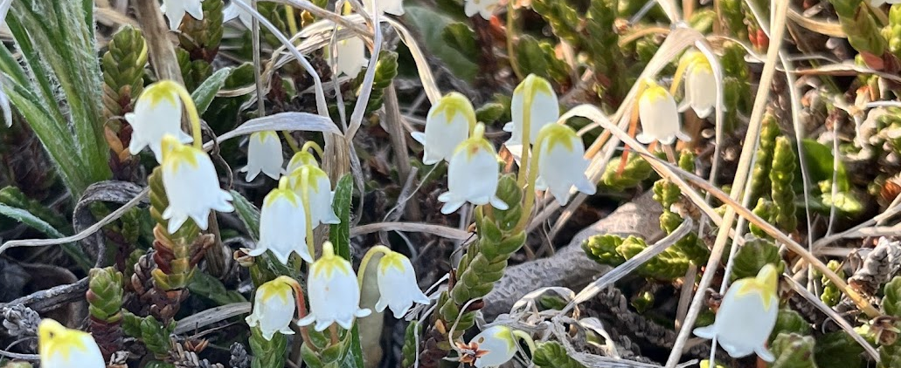
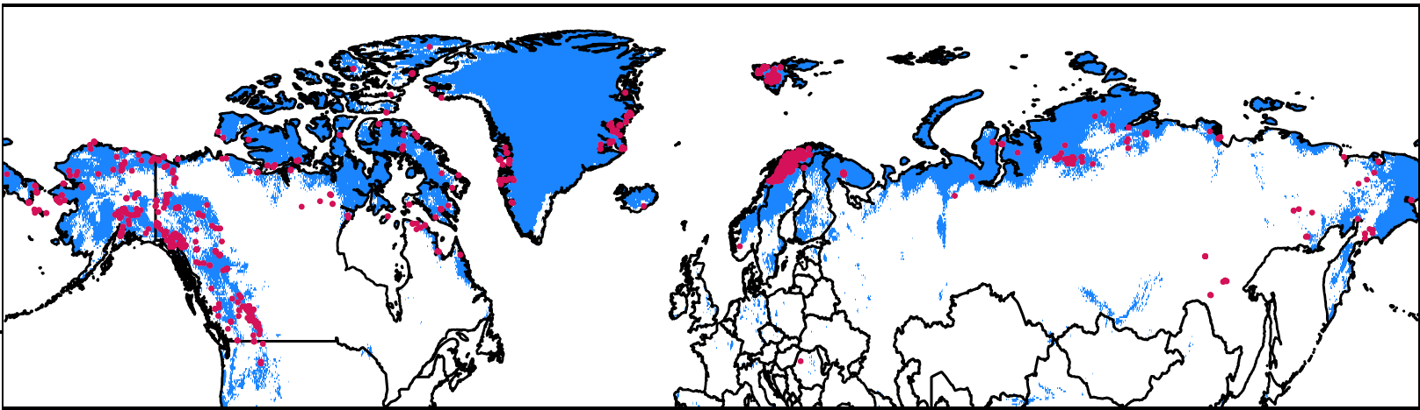
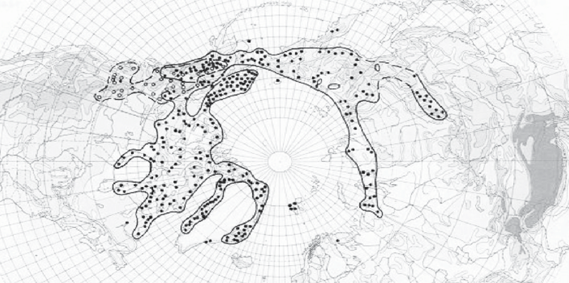
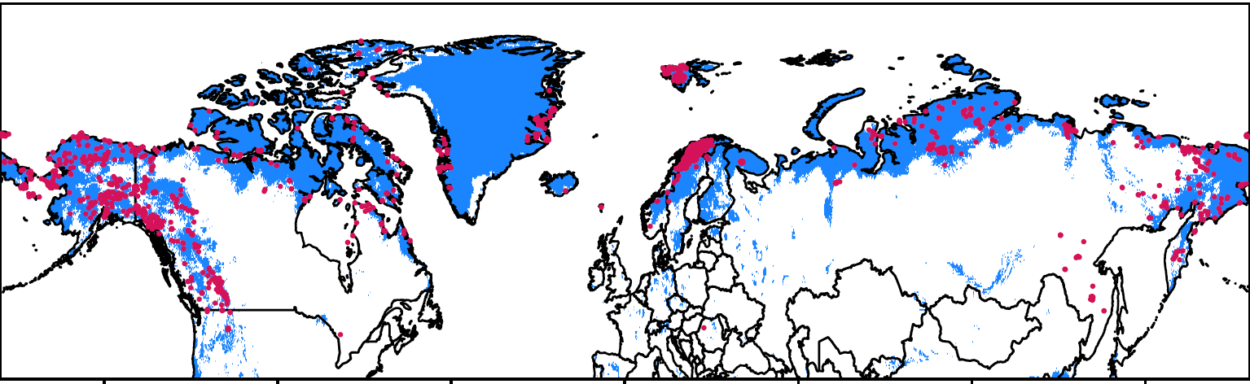
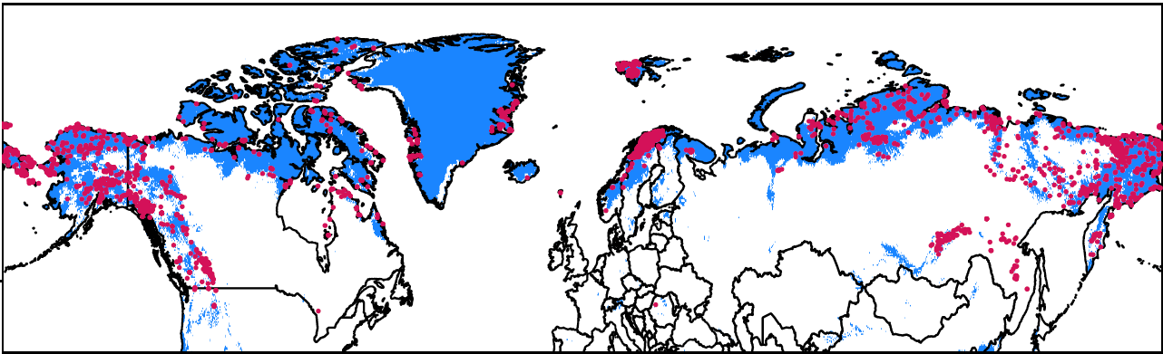
Does data quality impact the answers to biodiversity questions?
Cassiope tetragona Species Distribution Models
10m
Same model run based on 19 bioclimatic variables, on different coordinate accuracy thresholds
100m
1km
10km
Whats next?
Quantify differences between model thresholds
Compare to reference models
Complete for more species
100km
GBIF Observations: Predicted Suitable Habitat:

