Slide 1
Figure X1: Conceptual Diagram

Slide 2
Figure X2: Breeding Bird Survey and Variables Site Map
Map of North Slope (coastline length annotated)
Breeding Bird Survey Drawn Out (coastline length annotated)
Icemelt drop region polygon
Location of snowmelt and plant phenology transects
Komakuk breeding temperature site

Slide 3
Figure X3: ARU site map
Localization in the world
Map of ARU sites (dots and maybe rings of estimated catchment)
TOMST drawn with dashed lines connecting to ARUs?
Picture of ARU setups
Figure of ARU coverage (ie when recording)

Slide 4
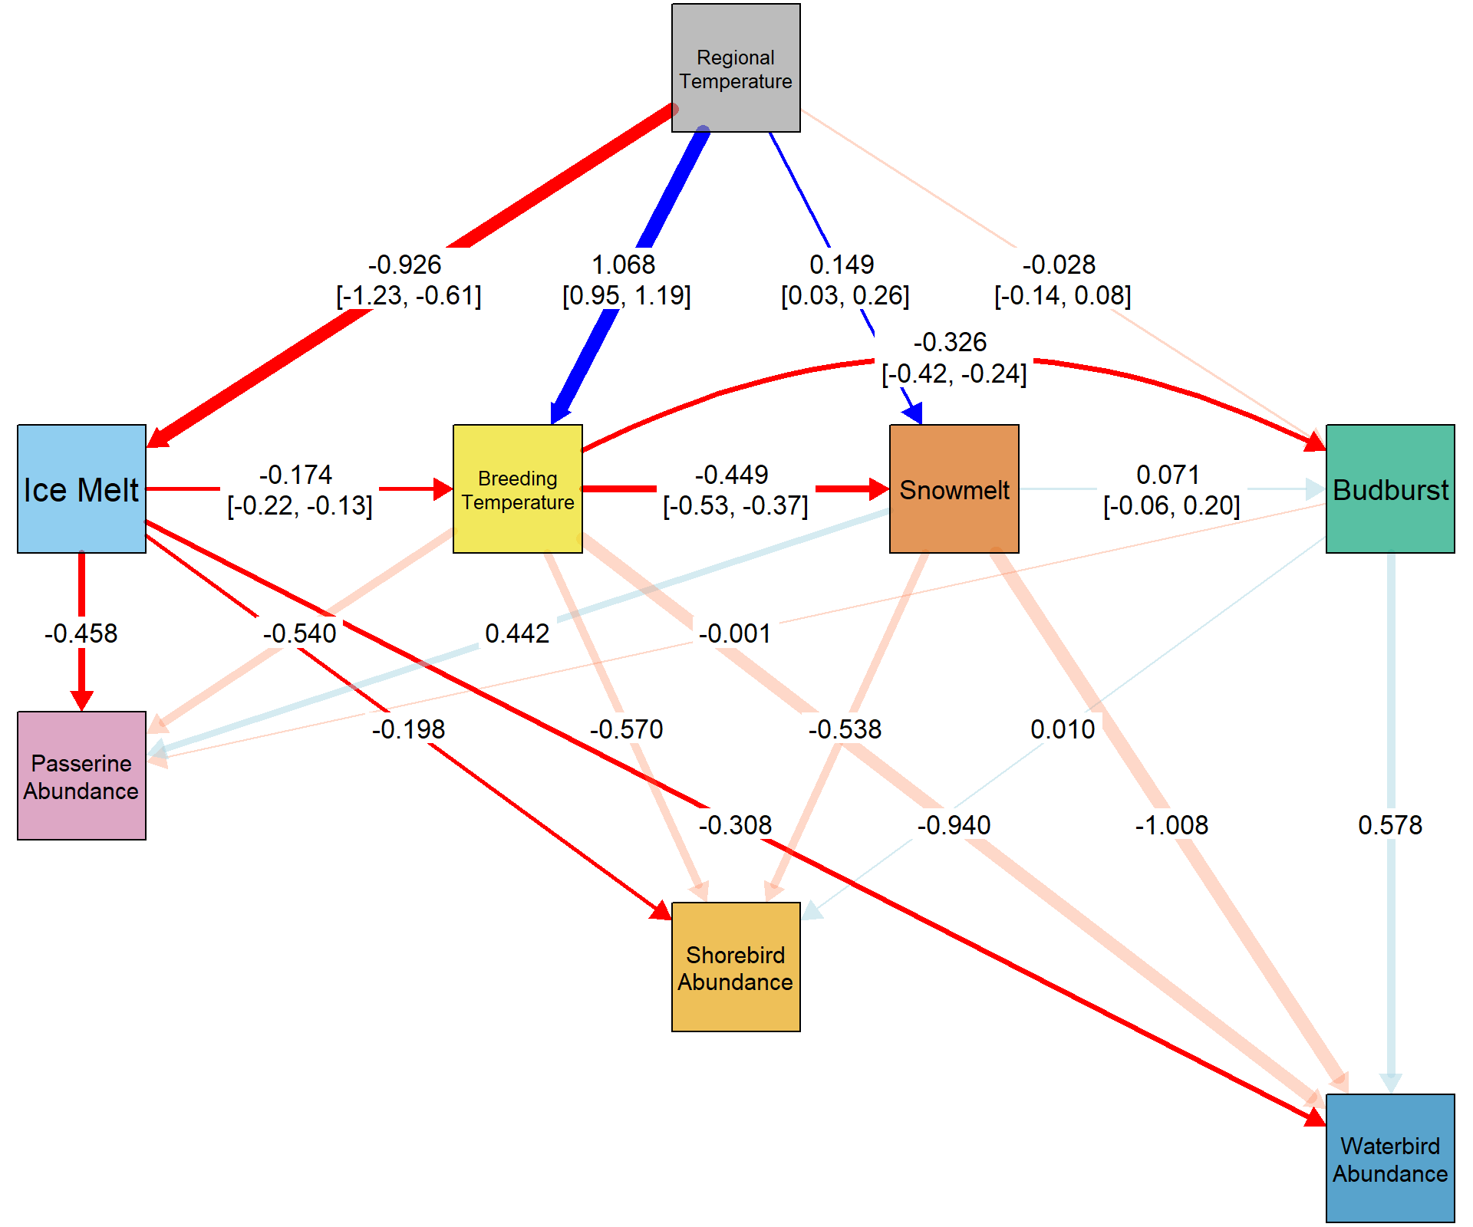
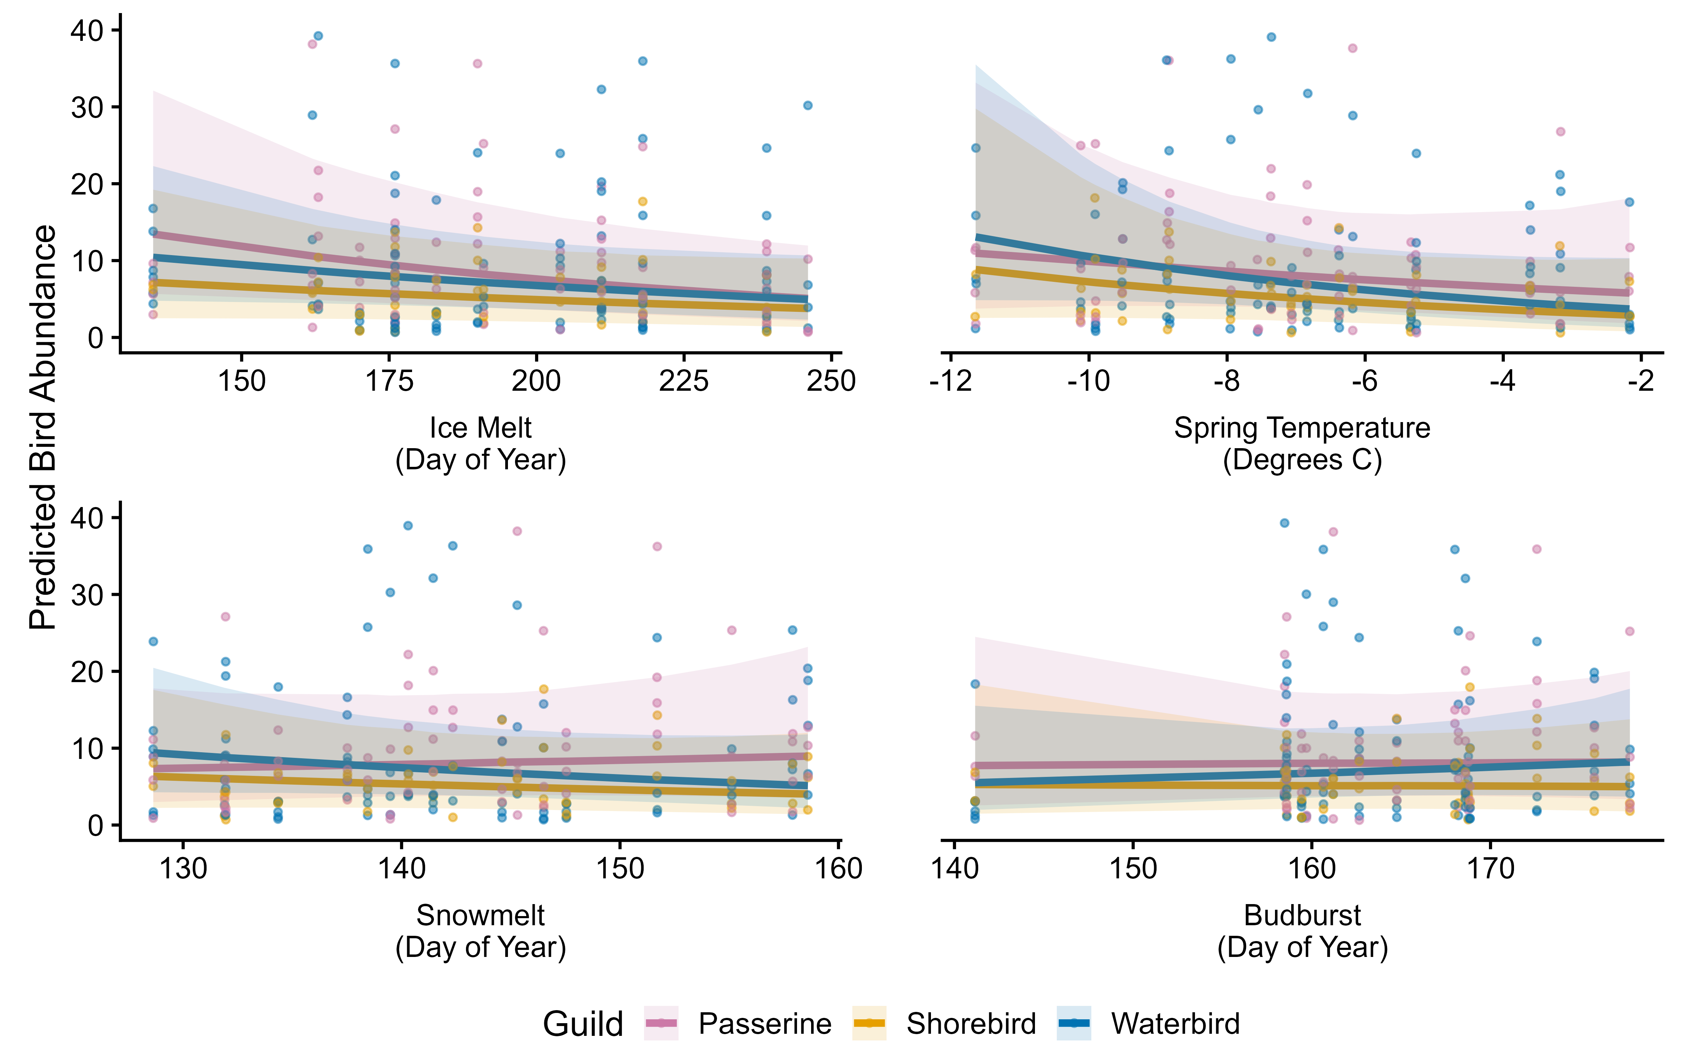
Figure X4: SEM
SEM plot
Predictions for each graph

Slide 5
Figure X5: ARU calling
Calling temp split plot
Regression
Colour coded picture of each bird

Slide 6
Figure X6: Variables
Regression plots for each of the variables over time

Slide 7
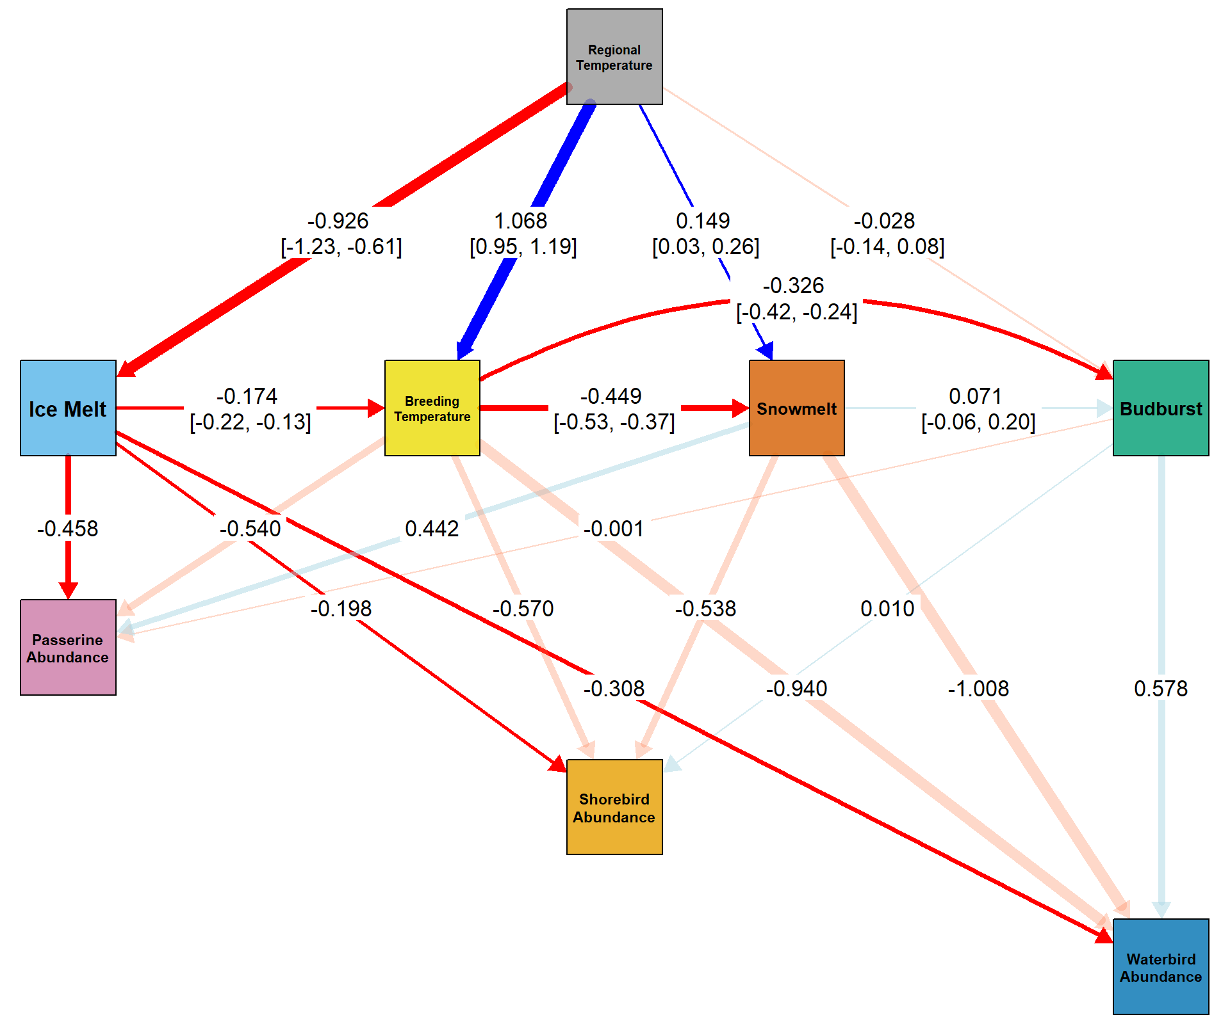
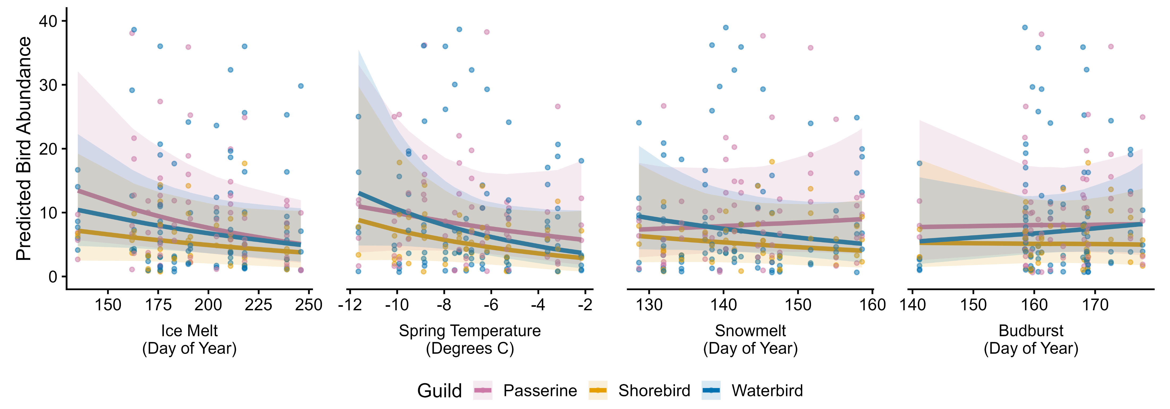
Figure X4: SEM
SEM plot
Predictions for each graph

Slide 8

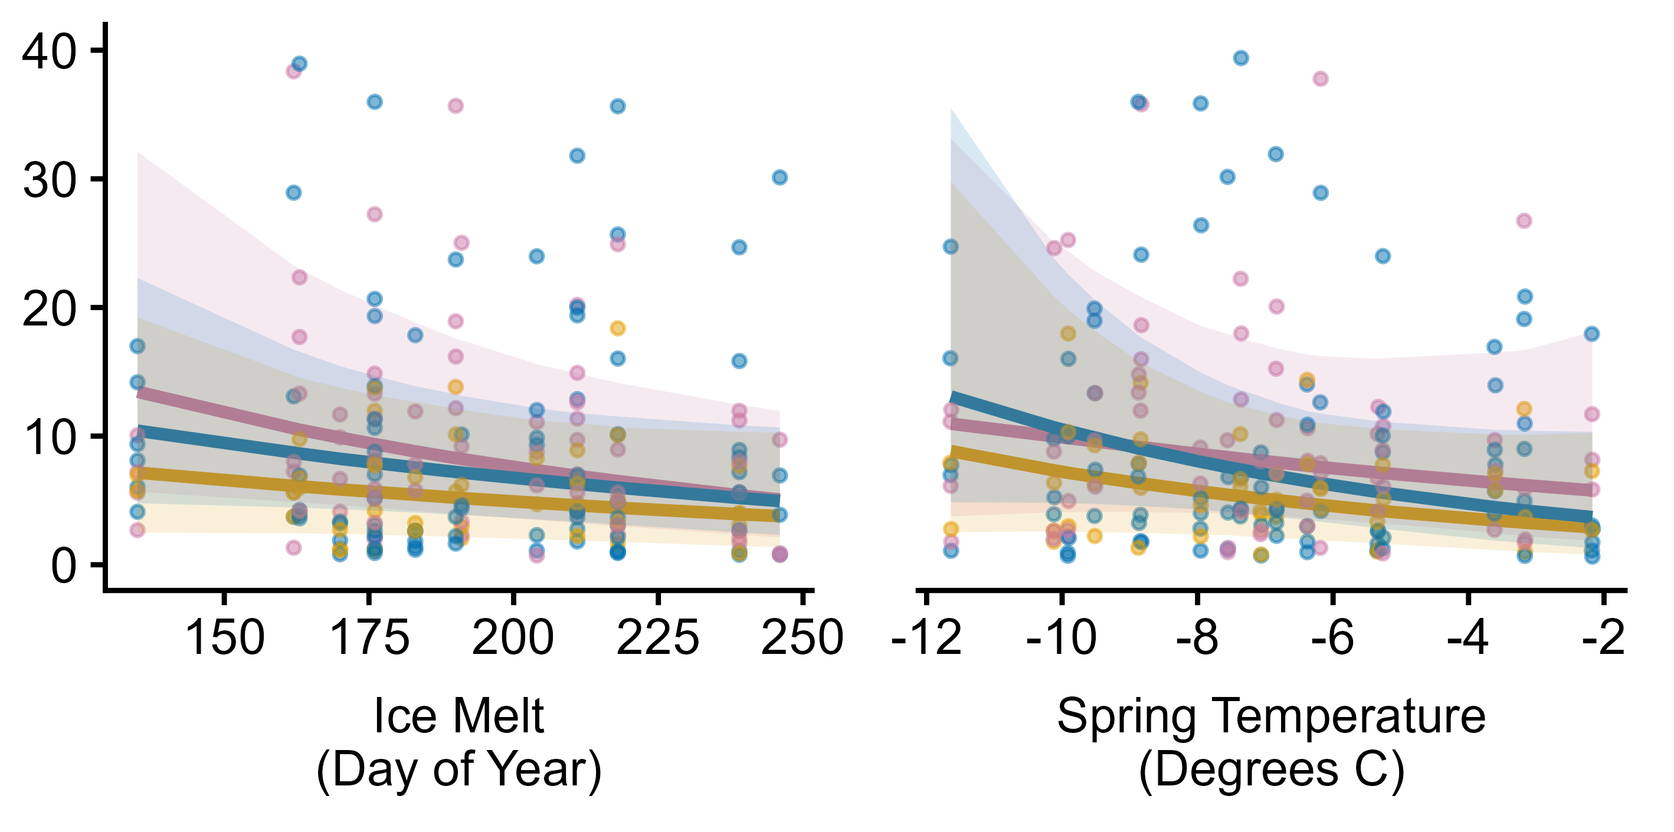

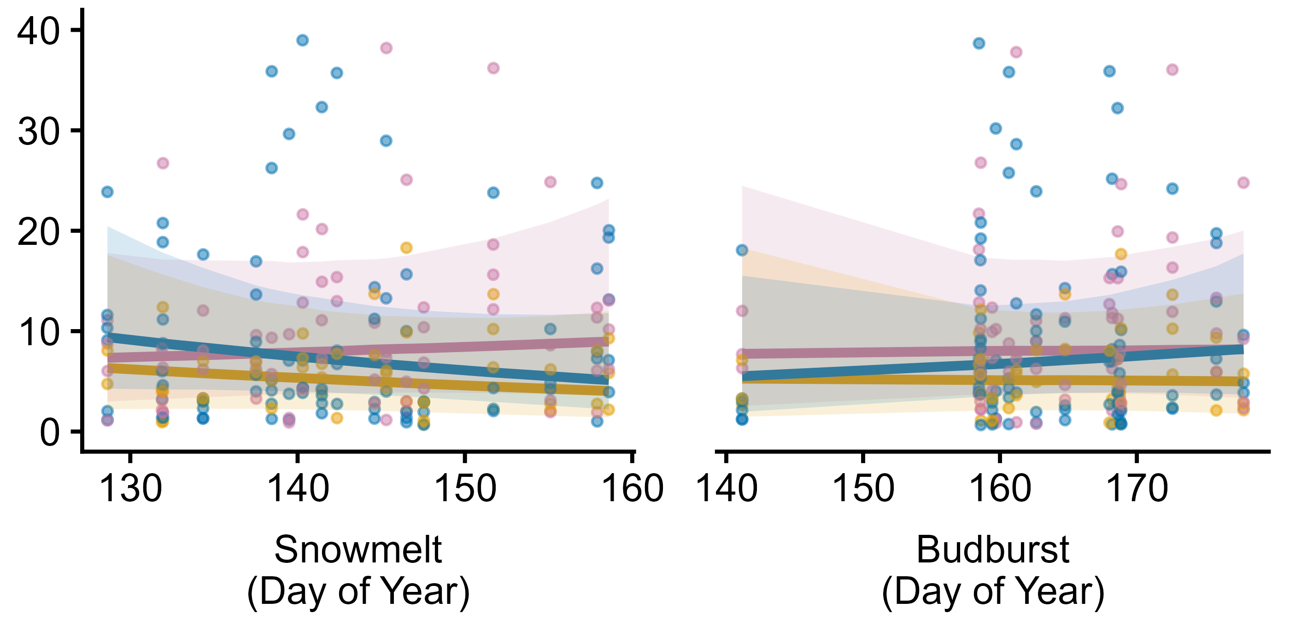
Figure X4: SEM
SEM plot
Predictions for each graph

Slide 9
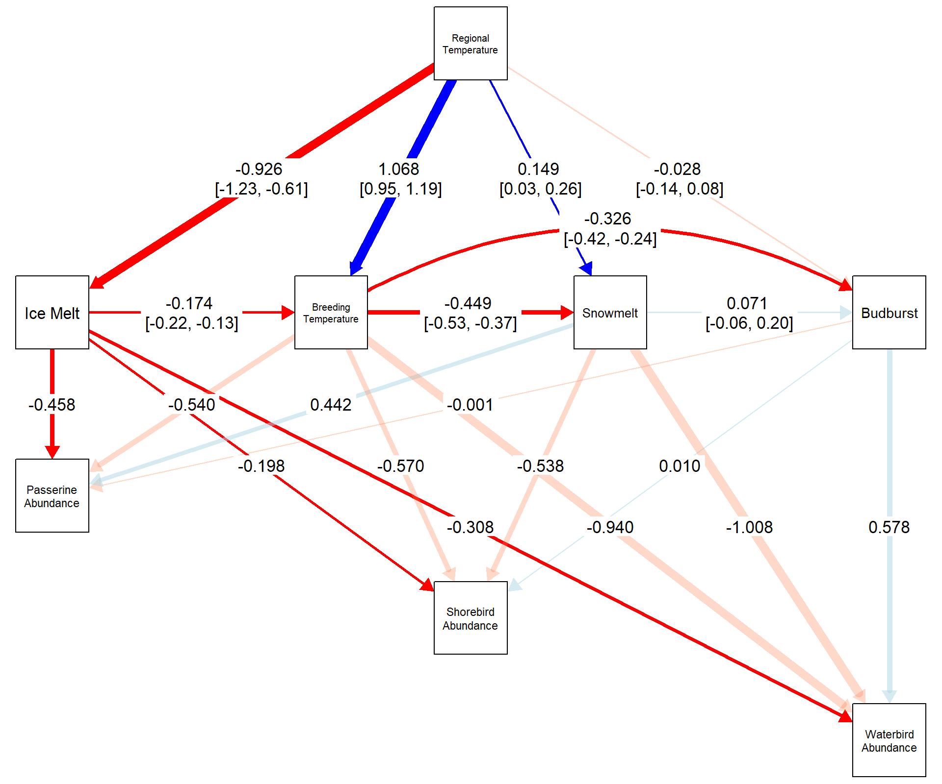
Figure X4: SEM
SEM plot
Predictions for each graph
"regional_temp" = "#999999", # Regional Temperature "breeding_temp" = "#ECDC06", # Breeding Temperature "icemelt" = "#56B4E9", # Icemelt "snowmelt" = "#D55E00", # Snowmelt "budburst" = "#009E73", # Budburst

