Slide 1
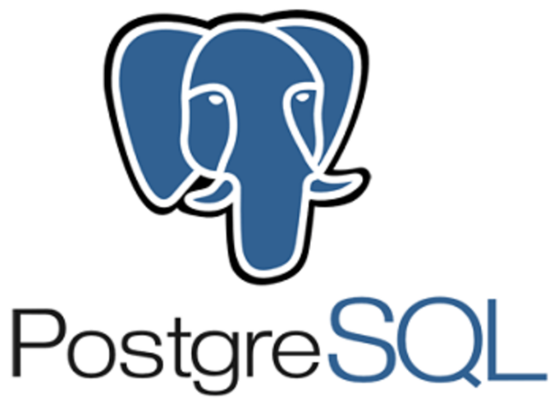
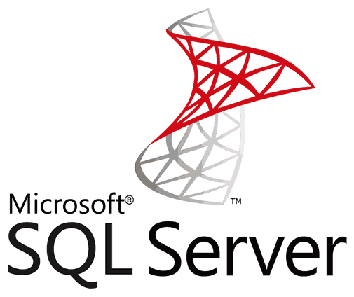
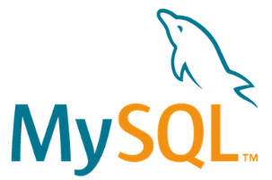
RDBMS

Slide 2
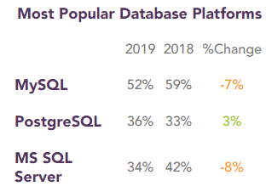
Relational Database Management Systems
RDBMs are software systems that enable users to define, create, maintain and control access to relational databases.
Relational, because the databases’ tables are inter-jointed / inter-connected with a specific hierarchy (one-to-one, one-to-many and many-to-many).
So instead of having one gigantic table with multiple columns and rows we can divide this main table into inter-linked sub-tables. Making it easier to access data, to understand the database and to handle complex data configuration.

Slide 3
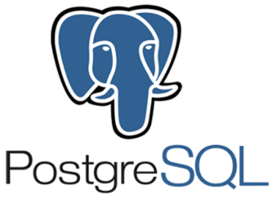
Open-source
Open-source
Licensed
Owned by Oracle
Owned by PostgreSQL Global Development Group
Owned by Microsoft
Scalable buffer pool to pull cache
Scalable buffer pool to pull cache
Isolate processes as separate OS processes
Limited functionality regarding temporary tables to deal with complex processes
More functionality regarding temporary tables (divide tables into local and global). Better with complex processes.
More functionality regarding temporary tables (divide tables into local and global). Better with complex processes.
Organizes indexes into clusters and tables (not very flexible search)
Rich automated functionality for index management
Flexible search
Belongs to the Oracle ecosystem (very large community)
Belongs to the Oracle ecosystem (very large community)
Smaller community but Microsoft support team
Targeted to all sizes of companies
Targeted to all sizes of companies
Targeted to large companies
Flexible, cost efficient and innovative
Flexible, cost efficient and innovative
Professional management tools for big businesses

Slide 4
MySQL is the most popular RDBMS. It was initially released the 23 May 1995 and written in C/C++. It is currently owned by Oracle Corporation.
It is used by many popular companies: Google, LinkedIn, Amazon, Netflix, Facebook, Twitter, Youtube…
MySQL is open-source and benefits from a very big community.
As a RDBMS it uses a strict schema model (data inputs must strictly respect a certain schema without flexibility as in NoSQL) and relational nature of its data.
As a SQL (structured query language) it uses queries to obtain data via JOINS to join / connect tables together.
Compared to NoSQL, SQL allows to automatically update data redundant in different parts of the databases.

Slide 5
Postgre SQL is the second most popular RDBMS. It was initially released the 8 July 1996 and written in C. It is developped and owned by Owned by PostgreSQL Global Development Group.
It is used by many popular companies: Cisco, Apple, Skype…
MySQL is open-source and benefits from a very big community.
As a RDBMS it uses a strict schema model (data inputs must strictly respect a certain schema without flexibility as in NoSQL) and relational nature of its data.
As a SQL (structured query language) it uses queries to obtain data via JOINS to join / connect tables together.
Compared to NoSQL, SQL allows to automatically update data redundant in different parts of the databases.

Slide 6
SQL Server is also a RDBMS. It was initially released the 2 April 1989 and written in C,C++ and C#. It was developped and owned by Microsoft.
It is used by many popular companies: EdgeWood College, Palo Alto University, Palo Alto University…
MySQL is a commercial solution (everything is licensed so must be purchased).
As a RDBMS it uses a strict schema model (data inputs must strictly respect a certain schema without flexibility as in NoSQL) and relational nature of its data.
As a SQL (structured query language) it uses queries to obtain data via JOINS to join / connect tables together.
Compared to NoSQL, SQL allows to automatically update data redundant in different parts of the databases.

