Slide 1
Introduction to Agile Model Driven Development (AMDD)
Scott W. Ambler
Senior Consultant, Ambysoft Inc.
www.ambysoft.com/scottAmbler.html
Copyright 2001-2005 Scott W. Ambler

Slide 2
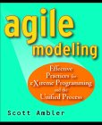
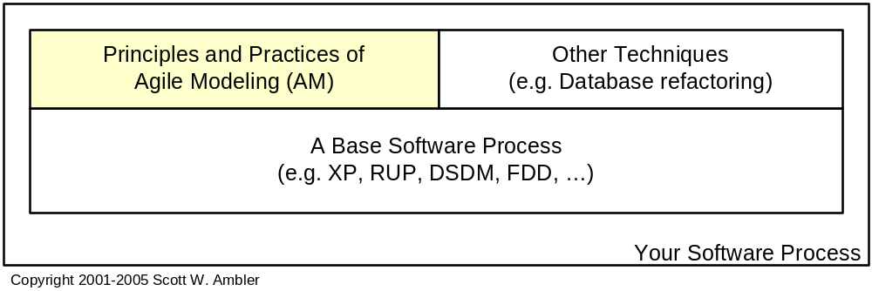
Agile Modeling (AM)
AM is a practices-based process for modeling and documentation
AM is a collection of practices based on several values and proven software engineering principles
AM is a light-weight approach for enhancing modeling and documentation efforts for other software processes such as XP and RUP
Copyright 2001-2005 Scott W. Ambler
Notes:
AM is a partial method which is meant to be tailored into other processes such as RUP, FDD, and XP
The AM site has a wealth of material

Slide 3
The Core of AM
You Need to Adopt at Least the Core
Core Principles
  Assume Simplicity
  Embrace / well come Change
  Enabling the Next Effort is Your Secondary Goal
  Incremental Change
  Model With a Purpose
  Multiple Models
  Maximize Stakeholder Investment
  Quality Work
  Rapid Feedback
  Software Is Your Primary Goal
  Travel Light
Core Practices
  Active Stakeholder Participation
  Apply the Right Artifact(s)
  Collective Ownership
  Create Several Models in Parallel
  Create Simple Content
  Depict Models Simply
  Display Models Publicly
  Iterate to Another Artifact
  Model in Small Increments
  Model With Others
  Prove it With Code
  Single Source Information
  Use the Simplest Tools
Copyright 2001-2005 Scott W. Ambler
Notes:
www.agilemodeling.com/practices.htm
www.agilemodeling.com/principles.htm
The supplementary principles and practices are good ideas which you should also consider adopting

Slide 4
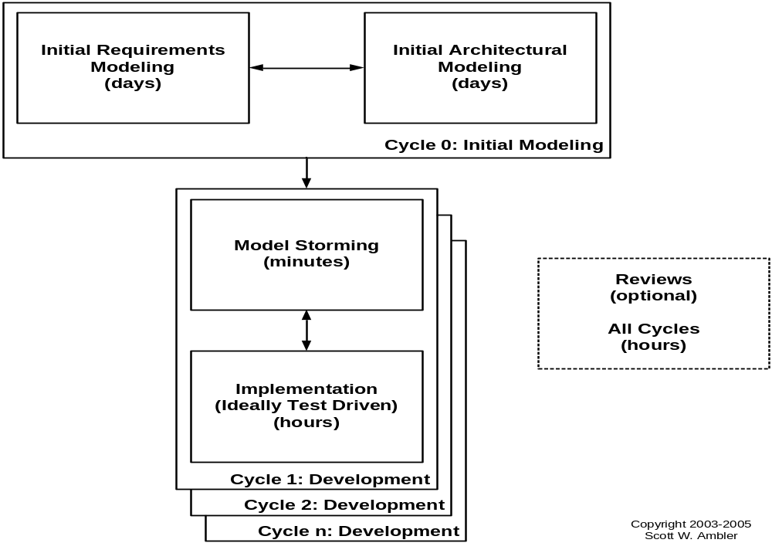
Agile Model Driven Development (AMDD)
Project Level (www.agilemodeling.com/essays/amdd.htm)
Copyright 2001-2005 Scott W. Ambler
Notes:
You should do some initial modeling up front to identify a plausible architecture and the scope of your effort
Do the detail just in time (JIT) via model storming
http://www.agilemodeling.com/essays/modelReviews.htm

Slide 5
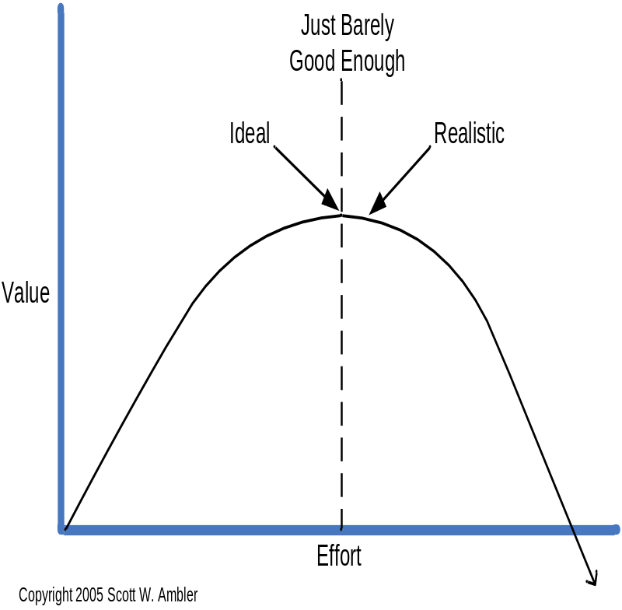
What Are Agile Models?
Agile models:
  Fulfill their purpose
  Are understandable
  Are sufficiently accurate
  Are sufficiently consistent
  Are sufficiently detailed
  Provide positive value
  Are as simple as possible
Agile models are just barely enough!
Copyright 2001-2005 Scott W. Ambler
Notes:
http://www.agilemodeling.com/essays/barelyGoodEnough.html
Agile models are the most effective possible because you invest just enough effort to get the job done.
If the model isn’t good enough yet then you can invest more effort into it and still get value.
If the model is good enough, for your current needs, or more than good enough, then any more work done on it would be a waste.
Good enough is in the eye of the beholder, so this can be tough. Active Stakeholder Participation and Model With Others to know what the audience for the model actually needs, don’t guess.

Slide 6
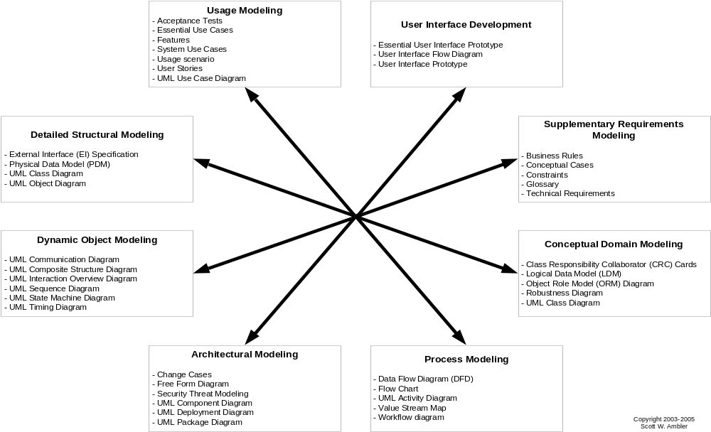
Agile Models www.agilemodeling.com/artifacts/
Copyright 2001-2005 Scott W. Ambler
Notes:
Software development is complex
Each type of model is good at one type of view, but you need many views
No starting point, no ending point
http://www.agilemodeling.com/essays/phasesExamined.htm
You need to know a range of techniques to be effective, but you don’t need to know all of them
In each category there are often several similar techniques, use the one that works for you

Slide 7
Tests as Primary Artifacts
Reduce Documentation by Single Sourcing Information
Acceptance tests are considered to be primary requirements artifacts
  You can reduce your requirements documentation dramatically by not recording the same information twice
Unit tests are considered to be detailed design artifacts
  You can reduce your design documentation dramatically and increase the chance that your detailed design artifacts are kept up to date by coders
www.agilemodeling.com/essays/singleSourceInformation.htm
Copyright 2001-2005 Scott W. Ambler
Notes:
You want to store information in the best place possible, and that’s often in tests, not documents

Slide 8
Agile Documentation
Travel light – You need far less documentation than you think
Agile documents:
  Maximize stakeholder investment
  Are concise / minified
  Fulfill a purpose
  Describe information that is less likely to change
  Describe “good things to know”
  Have a specific customer and facilitate the work efforts of that customer
  Are sufficiently accurate, consistent, and detailed
  Are sufficiently indexed
Valid reasons to document:
  Your project stakeholders require it
  To define a contract model
  To support communication with an external group
  To think something through
Copyright 2001-2005 Scott W. Ambler

Slide 9
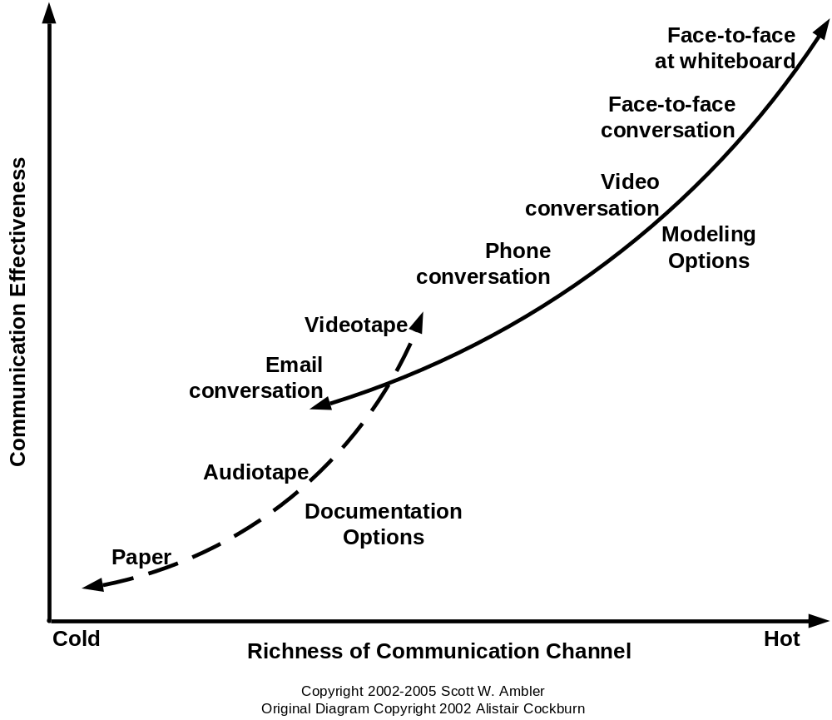
Communication Modes
Always Strive to Use the Most Effective Approach
Copyright 2001-2005 Scott W. Ambler
Notes:
Software development is a communication game
Documentation is the worst way to communicate
Whatever your situation, use the most effective means at your disposal to communicate
http://www.agilemodeling.com/essays/communication.htm

Slide 10
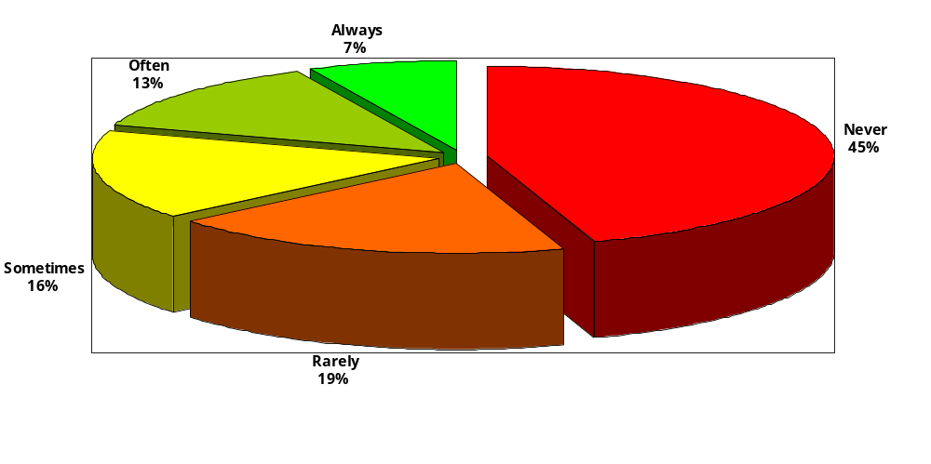
The Cost of Traditional BRUF
“Successful” Projects Still Have Significant Waste
Source: Jim Johnson of the Standish Group, Keynote Speech XP 2002
Copyright 2001-2005 Scott W. Ambler
Notes:
Looked at hundreds of “successful projects” which took a traditional/serial approach with a big requirements up front (BRUF) strategy
All projects delivered software into production – many projects in the Chaos study didn’t deliver
49% of functionality delivered wasn’t used by stakeholders, 19% rarely used
The main point to make is even when you “succeed” you still have close to 2/3 wastage

Slide 11
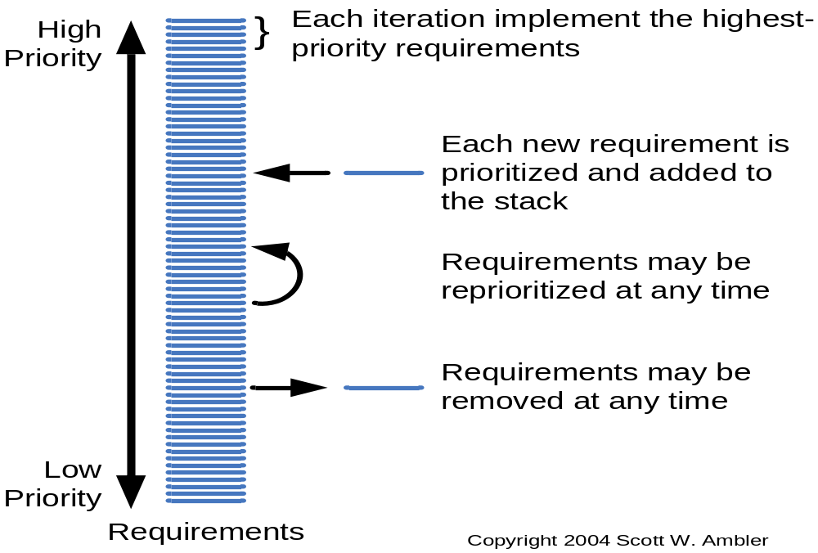
Agile Software Requirements Management
Changing Requirements Are a Competitive Advantage if You Can Act on Them: www.agilemodeling.com/essays/changeManagement.htm

Slide 12
Active Stakeholder Participation
The Stakeholders are the Experts, Shouldn’t They Model?
Project stakeholders should:
  Provide information in a timely manner
  Make decisions in a timely manner
  Actively participate in business-oriented modeling

Slide 13
Model With Others
The modeling equivalent of pair programming
You are fundamentally at risk whenever someone works on something by themselves
Several heads are better than one
Copyright 2001-2005 Scott W. Ambler
Notes:
Software development is a lot like swimming, very dangerous to do it alone
http://www.agilemodeling.com/practices.htm#ModelWithOthers

Slide 14
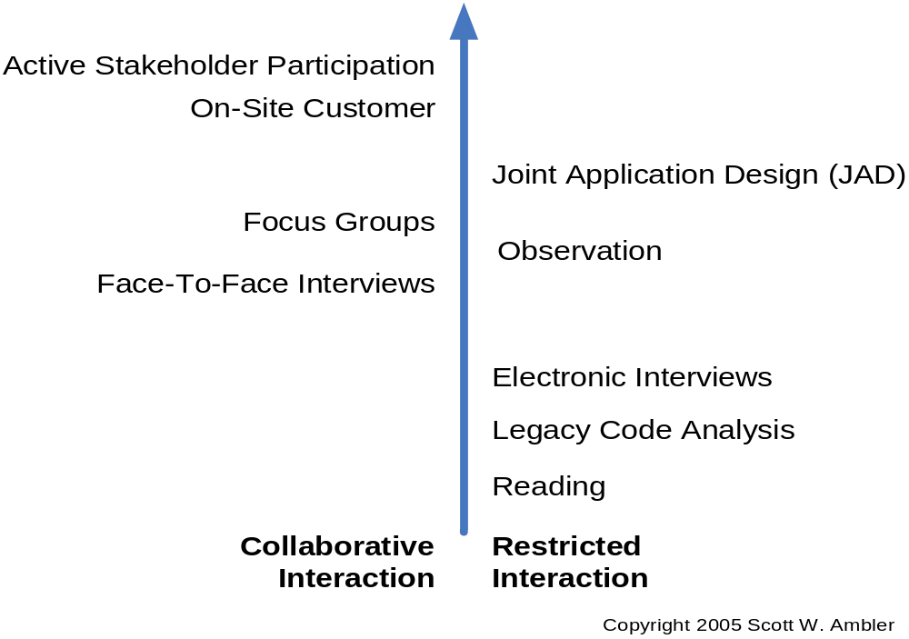
Effectiveness of Requirements Gathering Techniques
Notes:
www.agilemodeling.com/essays/agileRequirements.htm
Prefer collaborative techniques over restricted interaction techniques
Prefer techniques high up on the chart over lower ones (the arrow indicates effectiveness)

Slide 15
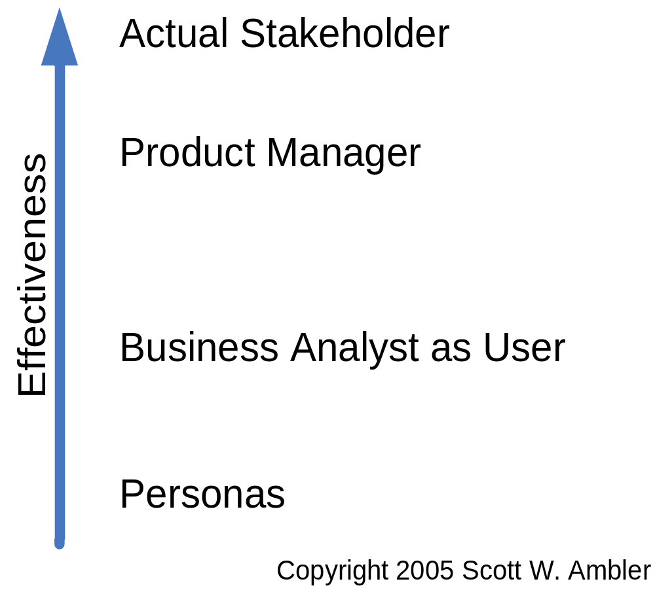
Relative Effectiveness of User Representatives
Notes:
There are different ways to represent stakeholders, the best way it to get the actual stakeholders actively involved on your project

Slide 16
References and Recommended Reading
Ambler, S.W. (2002). Agile Modeling: Effective Practices for XP and the UP. New York: John Wiley & Sons.
Ambler, S.W. (2003). Agile Database Techniques. New York: John Wiley & Sons.
Ambler, S.W. (2004). The Object Primer 3rd Edition: AMDD with UML 2. New York: Cambridge University Press.
Ambler, S.W. (2005). The Elements of UML 2.0 Style. New York: Cambridge University Press.
Beck, K. (2000). Extreme Programming Explained – Embrace Change. Reading, MA: Addison Wesley Longman, Inc.
Beck, K. & Fowler, M. (2001). Planning Extreme Programming. Reading, MA: Addison Wesley Longman, Inc.
Constantine, L.L. & Lockwood, L.A.D. (1999). Software For Use: A Practical Guide to the Models and Methods of Usage-Centered Design. New York: ACM Press.
Fowler, M. (1997). Analysis Patterns: Reusable Object Models. Menlo Park, California: Addison Wesley Longman, Inc.
Larman, C. (2004). Agile and Iterative Development: A Manager’s Guide. Reading, MA: Addison Wesley Longman, Inc.
Palmer, S.R. & Felsing, J.M. (2002). A Practical Guide to Feature Driven Development. Upper Saddle River, NJ: Prentice Hall PTR.
Copyright 2001-2005 Scott W. Ambler

