Slide 1
Section 2
Pointers, Arrays, and Structures
Notes:
OWEN: Insert chapter number

Slide 2
This section introduces the pointer, array, and reference data types and illustrates their use for defining variables.
Arrays are suitable for representing composite data which consist of many similar, individual items. For example:
For example: a list of names, a table of world cities and their current temperatures, or the monthly transactions for a bank account
Pointers are one of the strongest but also one of the most dangerous features in C/C++.
For example: uninitialized pointers (or pointers containing invalid values) can cause your system to crash.
A pointer is simply the address of an object in memory.
Generally, objects can be accessed in two ways: directly by their symbolic name, or indirectly through a pointer.
A reference provides an alternative symbolic name (alias) for an object.

Slide 3
Pointers
What is a pointer?
A pointer is a variable whose value is the address of another variable.
The general form of a pointer variable declaration, n C++, is:
datatype* var_name;
Here, datatype is the pointer's base type.
The pointer's base type must be a valid C++ type.
The var_name is the name of the pointer variable.
The asterisk (*) you used to declare a pointer is the same asterisk that you use for multiplication.
The asterisk (*) is being used to designate a variable as a pointer.
Example,
int* ptr; // ptr can point to an address which holds int data

Slide 4
Pointers
Using a Pointer Variable
The fundamental operation on a pointer is dereferencing
i.e., referring to the object pointed to by the pointer.
This operation is also called indirection.
The dereferencing operator is (prefix) unary ∗
The operator itself can be read as "value pointed to by". For example,
baz = *foo;
This could be read as: “baz is assigned to the value pointed to by foo”
There are few important operations, which we will do with the pointers very frequently:
Define a pointer variable
Assigning the address of a variable to a pointer using unary operator (&) which returns the address of that variable.
Accessing the value stored in the address using unary operator (*) which returns the value of the variable located at the address specified by its operand.

Slide 5
Pointers
Using a Pointer Variable
NOTE: Because ptr holds the address of x,
we say that ptr “points to” x
int x;
x = 12;
int* ptr;
ptr = &x;
2000
12
x
3000
2000
ptr

Slide 6
Pointers
The Dereference operator (*)
NOTE: The value pointed to by ptr is denoted by *ptr
int x;
x = 12;
int* ptr;
ptr = &x;
cout << *ptr;
2000
12
x
3000
2000
ptr

Slide 7
Pointers
Using the Dereference Operator
// changes the value at the
address ptr points to 5
int x;
x = 12;
int* ptr;
ptr = &x;
*ptr = 5;
2000
12
x
3000
2000
ptr
5

Slide 8
Pointers
Self –Test on Pointers
// the rhs has value 4000
// now p and q both point to ch
char ch;
ch = ‘A’;
char* q;
q = &ch;
*q = ‘Z’;
char* p;
p = q;
4000
A
ch
5000
4000
q
Z
6000
4000
p

Slide 9
Pointers
Program Example: The following program shows the use of operations with a pointer
#include <iostream>
using namespace std;
int main () {
int var = 20; // actual variable declaration.
int *ip; // pointer variable
ip = &var; // store address of var in pointer variable
cout << "Value of var variable: ";
cout << var << endl;
// print the address stored in ip pointer variable
cout << "Address stored in ip variable: ";
cout << ip << endl;
// access the value at the address available in pointer
cout << "Value of *ip variable: ";
cout << *ip << endl;
return 0;
}

Slide 10
Pointers
Using a Pointer to Access the Elements of a String
char msg[]=“Hello”;
char* ptr;
ptr = msg;
*ptr = ‘M’ ;
ptr++;
*ptr = ‘a’;
msg
3000
‘H’ ‘e’ ‘l’ ‘l’ ‘o’ ‘\0’
‘M’
‘a’
3001
ptr

Slide 11
Arrays
The concept of arrays is related to that of pointers.
In fact, arrays work very much like pointers to their first elements, and, actually, an array can always be implicitly converted to the pointer of the proper type.
T[size] is the type for ‘‘array of size elements of type T.’’
The elements are indexed from 0 to size-1.
For example:
float v[3]; // an array of three floats: v[0], v[1], v[2]
char* a[32]; // an array of 32 pointers to char: a[0] .. a[31]
You can access an array using the subscript operator, [ ], or through a pointer
For example:
void f() { int aa[10]; aa[6] = 9; // assign to aa’s 7th element int x = aa[99]; // undefined behavior }
The number of elements of the array (i.e., the array bound) must be a constant expression.

Slide 12
Arrays
The number of elements of the array (i.e., the array bound) must be a constant expression.
So, if you need variable bounds, use a vector
For example:
void f(int n) { int v1[n]; // error : array size not a constant expression vector<int> v2(n); // OK: vector with n int elements }

Slide 13
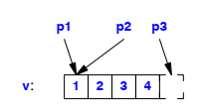
Arrays
Pointers into Arrays
There is no array assignment, and the name of an array implicitly converts to a pointer to its first element at the slightest provocation.
In C++, pointers and arrays are closely related.
The name of an array can be used as a pointer to its initial element.
For example:
int v[] = { 1, 2, 3, 4 }; int* p1 = v; // pointer to initial element (implicit conversion) int* p2 = &v[0]; // pointer to initial element int* p3 = v+4; // pointer to one-beyond-last element
Graphically can be shown as follows:

Slide 14
Arrays
Multidimensional Arrays
Multidimensional arrays are represented as arrays of arrays.
For example, a 3-by-5 array is declared as follows:
int ma[3][5]; // 3 arrays with 5 ints each
We can initialize ma as follows:
void init_ma() { for (int i = 0; i!=3; i++) for (int j = 0; j!=5; j++) ma[i][j] = 10∗i+j; }
So, how does this initialization appear graphically?

Slide 15
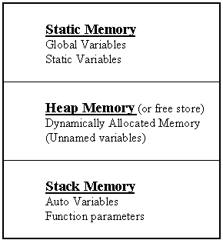
Arrays
Allocation of Arrays
Arrays can be allocated statically, on the static memory
Also they can be allocated dynamically on the free store (heap).
Actually, in C++ there are three types of memory those used by the C++ programs. These types are:
Static memory: where global variables are stored.
In static memory allocation, the size and location where variables will be stored is fixed during compile time.
Dynamic memory: It is the allocation that allows you to define memory requirement during the execution of the program
It is "managed" memory accessed using pointers.
It uses special type of memory called heap memory (do not confuse this with the heap data structure)
Stack memory: All variables declared inside functions will take up memory from the stack.

Slide 16
Arrays
Allocation of Arrays
Static Variables: Allocated at compiler time
Dynamic Variables: explicitly allocated and deallocated during program execution by C++ instructions written by programmer using new and delete operators.
Stack Variables: automatically created at function entry, resides in activation frame of the function, and is destroyed when returning from function

Slide 17
Arrays
Allocation of Arrays
In C, functions such as malloc() are used to dynamically allocate memory from the Heap.
In C++, this is accomplished using the new and delete operators
You can allocate memory at run time within the heap for the variable of a given type using a special operator in C++ which returns the address of the allocated space.
This operator is called new operator.
If you are not in need of dynamically allocated memory anymore, you can use delete operator, which de-allocates memory that was previously allocated by new operator.

Slide 18
Arrays
Allocation of Arrays
Syntax of new Operator:
If memory is available, in an area called the heap (or free store) new allocates the requested object or array, and returns a pointer to (address of) the memory allocated.
Otherwise, program terminates with error message.
The dynamically allocated object exists until the delete operator destroys the object.
new DataType
new DataType [IntExpression]

Slide 19
Arrays
Allocation of Arrays
Semantic of new Operator
NOTE: Dynamic data has no variable name
2000
ptr
char* ptr;
ptr = new char;
*ptr = ‘B’;
cout << *ptr;
5000
5000
‘B’

Slide 20
Arrays
Allocation of Arrays
Syntax of delete Operator:
The object or array currently pointed to by Pointer is deallocated, and the value of Pointer is undefined. (i.e., set the pointer to the released memory to NULL)
The memory is returned to the free store.
Square brackets are used with delete to deallocate a dynamically allocated array.
delete Pointer
delete [ ] Pointer

Slide 21
Arrays
Allocation of Arrays
Semantic of delete Operator
NOTE: delete deallocates the memory pointed to by ptr
char* ptr;
ptr = new char;
*ptr = ‘B’;
cout << *ptr;
delete ptr;
2000
ptr
5000
5000
‘B’

Slide 22
Arrays
Allocation of Arrays
Semantic of delete Operator
ptr itself is not deallocated
So, What is the value of ptr?
char* ptr;
ptr = new char;
*ptr = ‘B’;
cout << *ptr;
delete ptr;
2000
ptr
5000

Slide 23
Arrays
Allocation of Arrays
Semantic of delete Operator
the value of ptr becomes undefined
So, it is better to assign Null to ptr
char* ptr;
ptr = new char;
*ptr = ‘B’;
cout << *ptr;
delete ptr;
ptr = NULL;
2000
ptr
Null

Slide 24
Arrays
Allocation of Arrays
Example: the following program shows how memory is allocated dynamically during runtime.
#include <iostream>
using namespace std;
int main()
{
int n;
cin >> n;
//allocate memory
int *arr = new int[n];
cout << sizeof(arr) << endl;
for(int i = 0; i < n; i++)
{
cin >> arr[i];
}
//Free up space
delete []arr;
return 0;
}

Slide 25
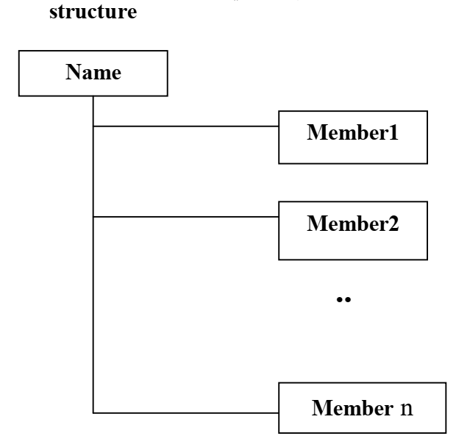
Structures
التركيب (Structures) هو تجميع لمتغيرات أو بيانرات غير متجانسرة (ممكن ان تكون من انواع مختلفة) يشار لها تحت أسم واحد، لتوفر طريقة سهلة للمحافظة على المعلومات التي لها علاقة مع بعضها البعض.
تسمى المتغيررات التي تكون التراكيب بالأعضاء (Members) أو العناصرر (Items) أو الحقول (Fields)
وبشكل عام، هنالك علاقة منطقية بين كافة حقول التركيب.
الرسم التالي يوضح بنية التركيب

Slide 26
Structures
الإعلان عن التركيب:
التركيب (Structures)

