Slide 1
Introduction to Coding Theory
lec1

Slide 2
1.Coding Theory & Cryptography the Essentials by H²L²PRW
Coding Theory
1. Intro to Coding Theory
2. Linear Codes
3. Perfect and Related Codes
4. Cyclic Linear Codes
5. BCH Codes
6. Reed-Solomon Codes
7. Burst Error-Correcting Codes
8. Convolutional Codes

Slide 3
LITERATURE
R. Hill: A first course in coding theory, Claredon Press, 1985
V. Pless: Introduction to the theory of error-correcting codes, John Willey, 1998
J. Gruska: Foundations of computing, Thomson International Computer Press, 1997
A. Salomaa: Public-key cryptography, Springer, 1990
D. R. Stinson: Cryptography: theory and practice, 1995
B. Schneier: Applied cryptography, John Willey and Sons, 1996
J. Gruska: Quantum computing, McGraw-Hill, 1999 (For additions and updatings: http://www.mcgraw-hill.co.uk/gruska)
S. Singh, The code book, Anchor Books, 1999
D. Kahn: The codebreakers. Two story of secret writing. Macmillan, 1996 (An entertaining and informative history of cryptography.)

Slide 4
INTRODUCTION
Transmission of classical information in time and space is nowadays very easy (through noiseless channel).
It took centuries, and many ingenious developments and discoveries(writing, book printing, photography, movies, radio transmissions,TV,sounds recording) and the idea of the digitalization of all forms of information to discover fully this property of information.
Coding theory develops methods to protect information against a noise.
Information is becoming an increasingly available commodity for both individuals and society.
Cryptography develops methods how to protect information against an enemy (or an unauthorized user).
A very important property of information is that it is often very easy to make unlimited number of copies of information.
Steganography develops methods to hide important information in innocently looking information (and that can be used to protect intellectual properties).

Slide 5
HISTORY OF CRYPTOGRAPHY
The history of cryptography is the story of centuries-old battles between codemakers and codebreakers, an intellectual arms race that has had a dramatic impact on the course of history.
The ongoing battle between codemakers and codebreakers has inspired a whole series of remarkable scientific breakthroughts.
History is full of codes. They have decided the outcomes of battles and led to the deaths of kings and queens.

Slide 6
Basics of coding theory
Coding theory - theory of error correcting codes - is one of the most interesting and applied part of mathematics and informatics.
All real systems that work with digitally represented data, as CD players, TV, fax machines, internet, satellites, mobiles, require to use error correcting codes because all real channels are, to some extent, noisy.

Slide 7
Basics of coding theory
Coding theory problems are therefore among the very basic and most frequent problems of storage and transmission of information.
Coding theory results allow to create reliable systems out of unreliable systems to store and/or to transmit information.
Coding theory methods are often elegant applications of very basic concepts and methods of (abstract) algebra.

Slide 8

Coding - basic concepts
Without coding theory and error-correcting codes there would be no deep-space travel and pictures, no satelite TV, no compact disc, no … no … no ….
Error-correcting codes are used to correct messages when they are transmitted through noisy channels.
Error correcting framework
Example
A code C over an alphabet Σ is a subset of Σ* - (C Ě Σ*).
A q -nary code is a code over an alphabet of q -symbols.
A binary code is a code over the alphabet {0,1}.
Examples of codes C₁ = {00, 01, 10, 11} C₂ = {000, 010, 101, 100}
C₃ = {00000, 01101, 10111, 11011}

Slide 9
Coding - basic concepts
Basic Definitions
Definition 1.1 Let A = {a1, . . . , aq} be an alphabet; we call the ai values symbols. A block code C of length n over A is a subset of An.
A vector c ∈ C is called a codeword. The number of elements in C, denoted |C|,is called the size of the code.
A code of length n and size M is called an (n,M)-code.
A code over A = {0, 1} is called a binary code and a code over A = {0, 1, 2} is called a ternary code.

Slide 10
Coding - basic concepts
examples
(i) C1 = {00, 01, 10, 11} is a (2,4)-code;
(ii) C2 = {000, 011, 101, 110} is a (3,4)-code;
(iii) C3 = {0011, 0101, 1010, 1100, 1001, 0110} is a (4,6)-code.

Slide 11
Coding - basic concepts
Basic assumptions
Definitions
Digit：0 or 1(binary digit)
Word：a sequence of digits
Example：0110101
Binary code：a set of words
Example：1. {00,01,10,11} , 2. {0,01,001}
Block code ：a code having all its words of the same length
Example： {00,01,10,11}, 2 is its length
Codewords ：words belonging to a given code
|C| ： Size of a code C(#codewords in C)

Slide 12
Coding - basic concepts
One of the tasks in coding theory is to detect, or even correct, errors.
Usually, coding is defined as source coding and channel coding.
Source coding involves changing the message source to a suitable code to be transmitted through the channel.
The idea of channel coding is to encode the message again after the source coding by introducing some form of redundancy so that errors can be detected or even corrected.

Slide 13
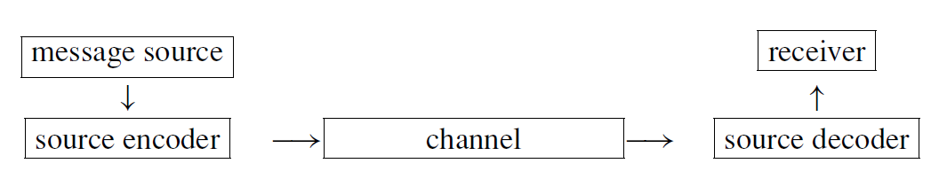
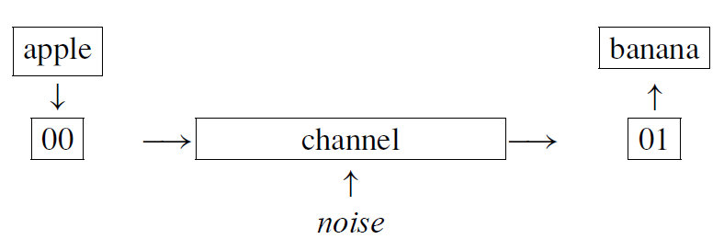
Source coding

Slide 14
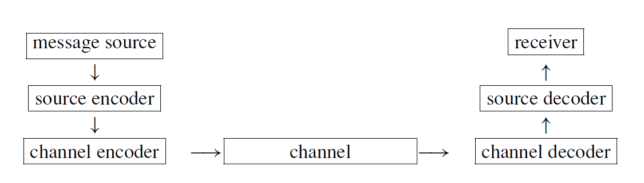
channel coding
perform the channel encoding by introducing a redundancy of 1 bit as follows:

Slide 15
CHANNEL
is the physical medium through which information is transmitted.
(Telephone lines and the atmosphere are examples of channels.)
NOISE
may be caused by sunpots, lighting, meteor showers, random radio disturbance, poor typing, poor hearing, ….
TRANSMISSION GOALS
1. Fast encoding of information.
2. Easy transmission of encoded messages.
3. Fast decoding of received messages.
4. Reliable correction of errors introduced in the channel.
5. Maximum transfer of information per unit time.
METHOD OF FIGHTING ERRORS: REDUNDANCY!!!
0 is encoded as 00000 and 1 is encoded as 11111.

Slide 16
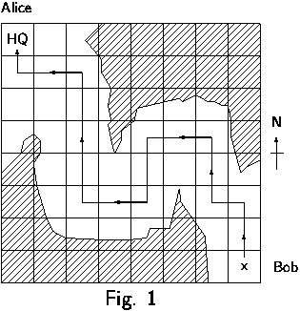
EXAMPLE: Codings of a path avoiding an enemy territory
Story Alice and Bob share an identical map gridded as shown in Fig.1. Only Alice knows the route through which Bob can reach her avoiding the enemy territory. Alice wants to send Bob the following information about the safe route he should take.
NNWNNWWSSWWNNNNWWN
Three ways to encode the safe route from Bob to Alice are:
1. C₁ = {00, 01, 10, 11}
Any error in the code word
000001000001011111010100000000010100
would be a disaster.
2. C₂ = {000, 011, 101, 110}
A single error in encoding each of symbols N, W, S, E could be detected.
3. C₃ = {00000, 01101, 10110, 11011}
A single error in decoding each of symbols N, W, S, E could be corrected.

Slide 17
Coding - basic concepts
Correcting and detecting error patterns
Any received word should be corrected to a codeword that requires as few changes as possible.
Cannot detect any errors !!!
source
Channel
correct
parity-check digit
source
Channel
correct

Slide 18
Introduction to Coding Theory
Information rate
Definition: information rate of code C
Is number that is designed to measure the proportion of each codeword that is carrying the message
C1={00,01,10,11} c2={000000,010101,10……}
Examples

Slide 19
Notation and Examples
Notation: An (n,M,d) - code C is a code such that
n - is the length of codewords.
M - is the number of codewords.
d - is the minimum distance in C.
Example:
C₁ = {00, 01, 10, 11} is a (2,4,1)-code.
C₂ = {000, 011, 101, 110} is a (3,4,2)-code.
C₃ = {00000, 01101, 10110, 11011} is a (5,4,3)-code.
Comment: A good (n,M,d) code has small n and large M and d.

Slide 20
Basic terminology
Block code - a code with all words of the same length.
Codewords - words of some code.
Basic assumptions about channels
1. Code length preservation Each output codeword of a channel has the same length as the input codeword.
2. Independence of errors The probability of any one symbol being affected in transmissions is the same.
Basic strategy for decoding
For decoding we use the so-called maximal likehood principle, or nearest neighbor decoding strategy, which says that the receiver should decode a word w' as that codeword w that is the closest one to w'.

Slide 21
Hamming Distance
The Hamming distance between two words over the same alphabet is the number of places where the symbols differ.
Example : d(100111, 001110) = 3
Look at 100111
001110
For a code , C, the minimum distance d(C) is defined by d(C) = min{d(c₁,c₂),| c₁, c₂∈C, c₁≠c₂}

Slide 22
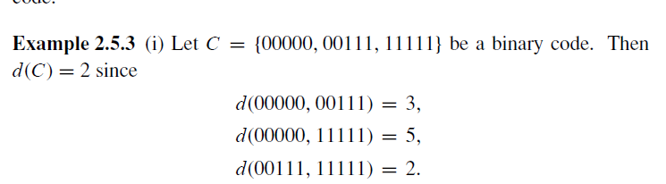
Hamming Distance Properties
Let x and y be any words over the alphabet for C; x and y may or not be codewords.
d(x, y) = 0 iff x = y
d(x, y)= d(y, x) for all x, y
d(x, y) ≤ d(x, z) + d(z, y) for all x, y, and z

Slide 23
Detection and Correction
A code C can detect up to s errors in any codeword if d (C) ≥ s + 1
A code C can correct up to t errors if d(C) ≥ 2t + 1

Slide 24
Introduction to Coding Theory
finding the most likely codeword transmitted
V & w disagree in d position , so n-d digits correctly transmitted, d is incorrectly transmitted. If v is sent w is received with prob=p
Example：
p ：reliability d ：#digits incorrectly transmitted n ：code length
BSC channel
Code length = 5

Slide 25
Introduction to Coding Theory
Calculate
V=01101101 , w=10001110
V=00101, w=11010
V=1110101 , w=1110101
given p =.97

Slide 26
Introduction to Coding Theory
Assume is sent when is received if
Theorem 1.6.3
Suppose we have a BSC with ½ < p < 1. Let and be codewords and a word, each of length . Suppose that and disagree in positions and and disagree in positions. Then

Slide 27
Introduction to Coding Theory
Example
channel
 | d (number of disagreements with )
01101 | 3
01001 | 4
10100 | 2 ← smallest d
10101 | 3

Slide 28
The ISBN-code
Each recent book has International Standard Book Number which is a 10-digit codeword produced by the publisher with the following structure:
l p m w = x₁ … x₁₀
language publisher number weighted check sum
0 07 709503 0
such that
The publisher has to put X into the 10-th position if x₁₀ = 10.
The ISBN code is designed to detect: (a) any single error (b) any double error created by a transposition
Single error detection
Let X = x₁ … x₁₀ be a correct code and let
Y = x₁ … x_{J-1} y_{J} x_{J+1} … x₁₀ with y_{J} = x_{J} + a, a ą 0
In such a case:

Slide 29
The ISBN-code
Transposition detection
Let x_{J} and x_{k} be exchanged.

