Slide 1
Linear Block Codes
lec2

Slide 2
Linear Block Codes
The parity bits of linear block codes are linear combination of the message. Therefore, we can represent the encoder by a linear system described by matrices.

Slide 3
Basic Definitions
Linearity:
where m is a k-bit information sequence
c is an n-bit codeword.
is a bit-by-bit mod-2 addition without carry
Linear code: The sum of any two codewords is a codeword.
Observation: The all-zero sequence is a codeword in every linear block code.

Slide 4
Basic Definitions (cont’d)
Def: The weight of a codeword c_{i} , denoted by w(c_{i}), is the
number of of nonzero elements in the codeword.
Def: The minimum weight of a code, w_{min}, is the smallest
weight of the nonzero codewords in the code.
Theorem: In any linear code, d_{min} = w_{min}
Systematic codes
Any linear block code can be put in systematic form
n-k
check bits
k
information bits

Slide 5
Linear Encoder.
By linear transformation
c =m ⋅G =m₀g₀ + m₁g₀ +……+ m_{k-1}g_{k-1}
The code C is called a k-dimensional subspace.
G is called a generator matrix of the code.
Here G is a k ×n matrix of rank k of elements from GF(2), g_{i} is the i-th row vector of G.
The rows of G are linearly independent since G is assumed to have rank k.

Slide 6

Example:
(7, 4) Hamming code over GF(2)
The encoding equation for this code is given by
c₀ = m₀ c₁ = m₁ c₂ = m₂ c₃ = m₃ c₄ = m₀ + m₁ + m₂ c₅ = m₁ + m₂ + m₃ c₆ = m₀ + m₁ + m₃

Slide 7
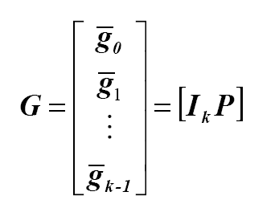
Linear Systematic Block Code:
An (n, k) linear systematic code is completely specified by a k × n generator matrix of the following form.
where Ik is the k × k identity matrix.

Slide 8
Linear Block Codes
the number of codeworde is 2^{k} since there are 2^{k} distinct messages.
The set of vectors {g_{i}} are linearly independent since we must have a set of unique codewords.
linearly independent vectors mean that no vector g_{i} can be expressed as a linear combination of the other vectors.
These vectors are called baises vectors of the vector space C.
The dimension of this vector space is the number of the basis vector which are k.
G_{i} є C→ the rows of G are all legal codewords.

Slide 9
Hamming Weight
the minimum hamming distance of a linear block code is equal to the minimum hamming weight of the nonzero code vectors.
Since each g_{i} єC ,we must have W_{h}(g_{i})≥ d_{min} this a necessary condition but not sufficient.
Therefore, if the hamming weight of one of the rows of G is less than d_{min}, →d_{min} is not correct or G not correct.

Slide 10
Generator Matrix
All 2^{k} codewords can be generated from a set of k linearly independent codewords.
The simplest choice of this set is the k codewords corresponding to the information sequences that have a single nonzero element.
Illustration: The generating set for the (7,4) code:
1000 ===> 1101000
0100 ===> 0110100
0010 ===> 1110010
0001 ===> 1010001

Slide 11
Generator Matrix (cont’d)
Every codeword is a linear combination of these 4 codewords.
That is: c = m G, where

Slide 12
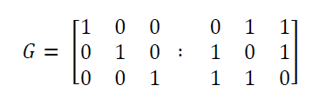
Generator Matrix
Problem
The generator matrix for a (6,3) block code is given below. Find all code vectors of this code.

Slide 13
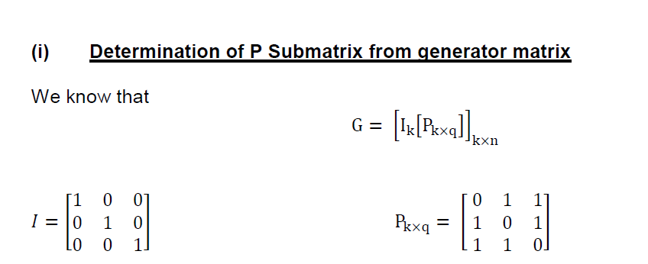
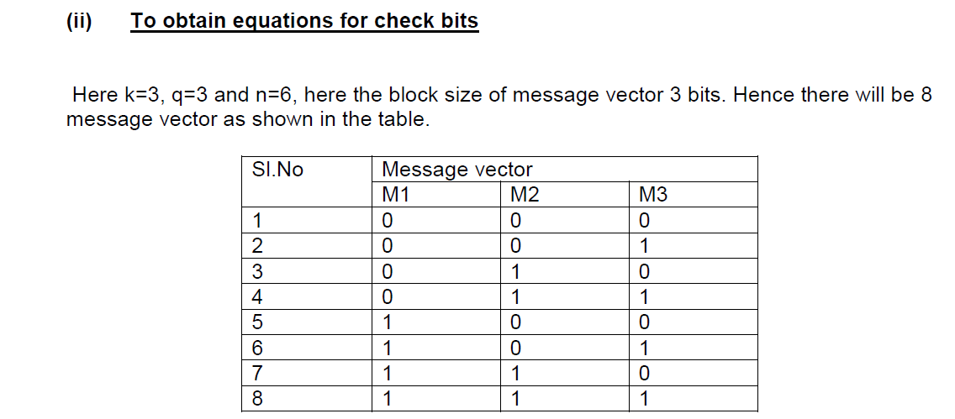

Slide 14
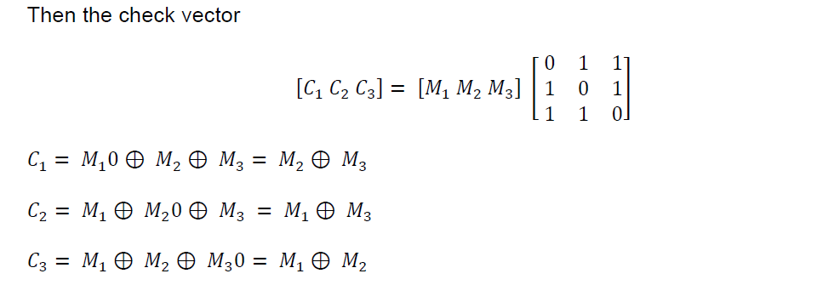
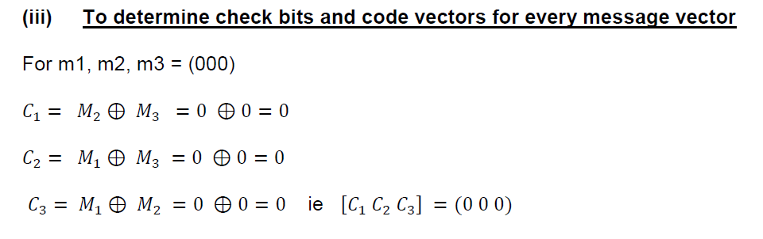

Slide 15
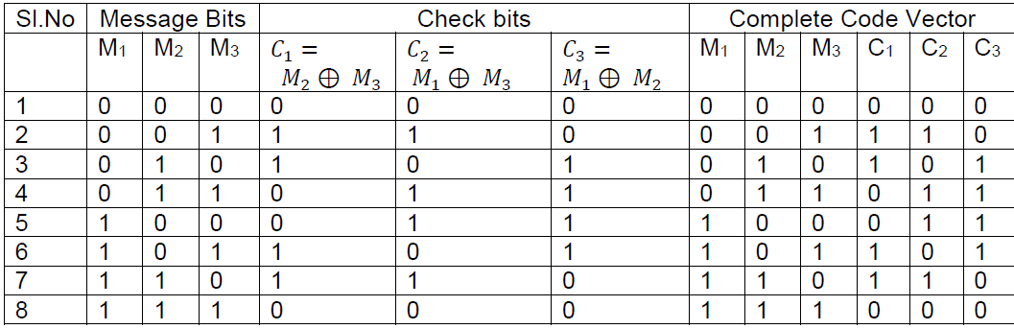

Slide 16
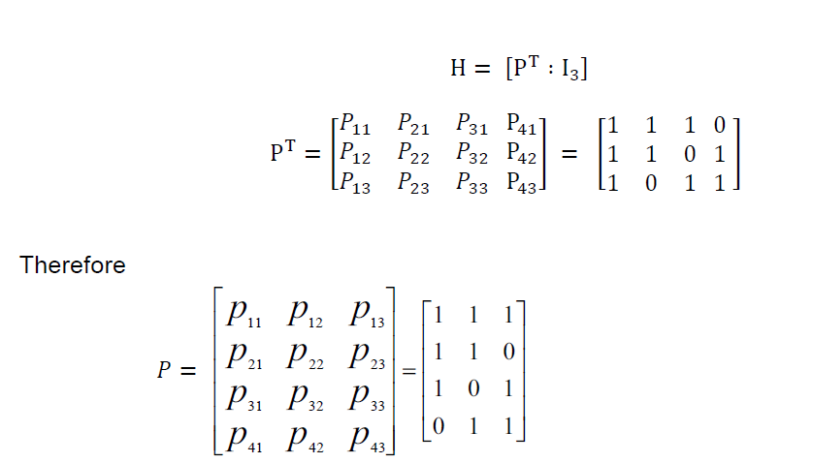

Slide 17
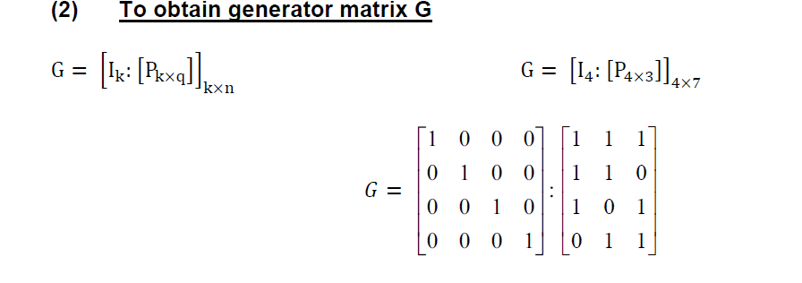

Slide 18
Parity-Check Matrix
For G = [ P | I_{k} ], define the matrix H = [I_{n-k} | P^{T}]
(The size of H is (n-k)xn).
It follows that GH^{T} = 0.
Since c = mG, then cH^{T} = mGH^{T} = 0.

Slide 19
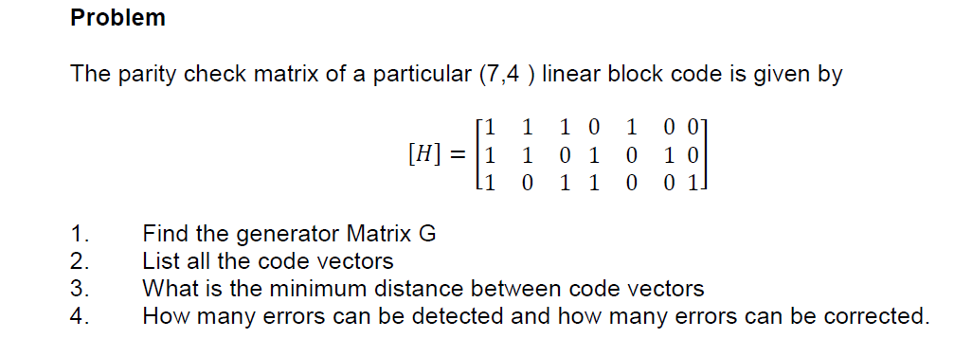
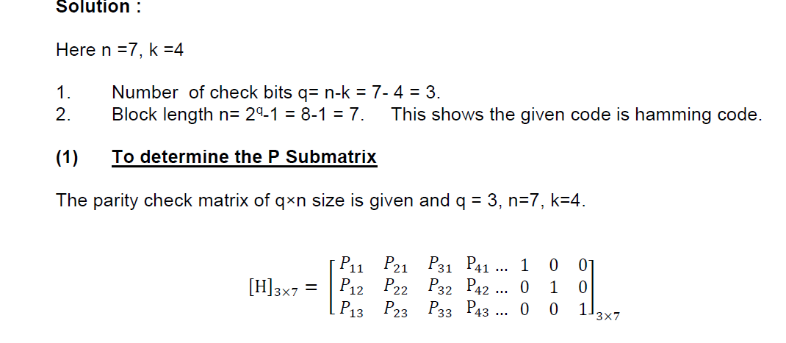

Slide 20
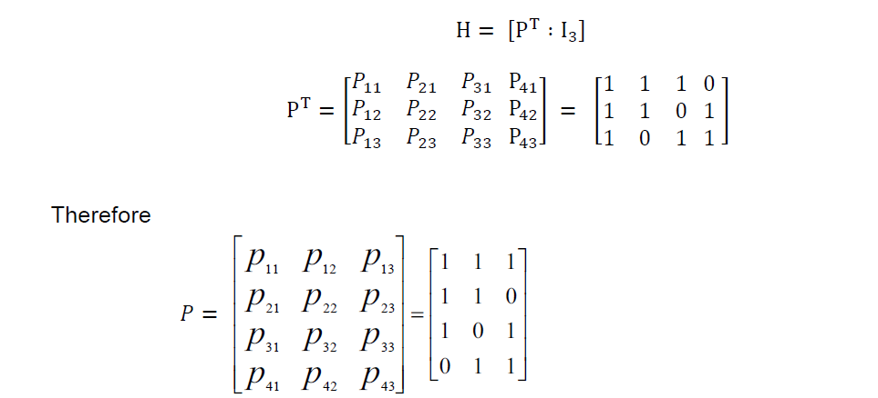

Slide 21
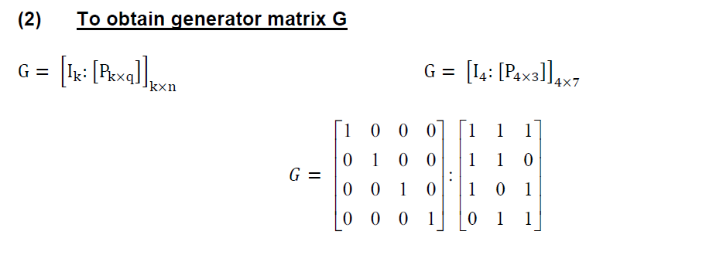

Slide 22
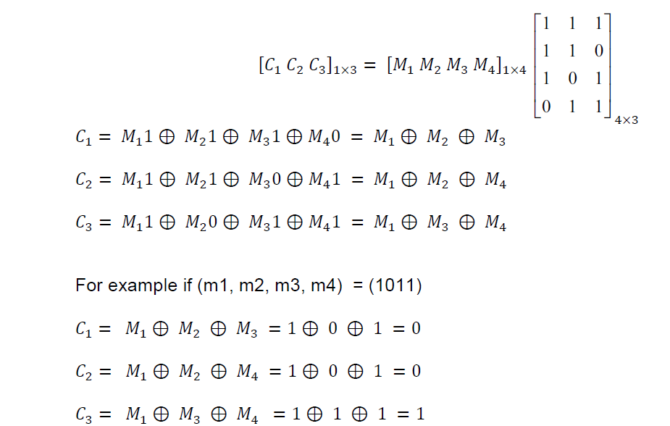

Slide 23
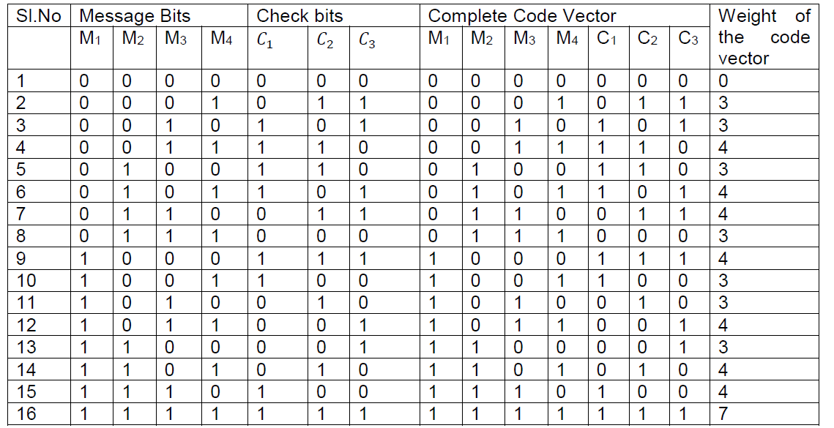

Slide 24
Encoding Using H Matrix
information

Slide 25
Hamming Codes
Hamming codes constitute a class of single-error correcting codes defined as:
n = 2^{r}-1, k = n-r, r > 2
The minimum distance of the code d_{min} = 3
Hamming codes are perfect codes.
Construction rule:
The H matrix of a Hamming code of order r has as its columns all non-zero r-bit patterns.
Size of H: r x(2^{r}-1)=(n-k)xn

Slide 26
Decoding
Let c be transmitted and r be received, where
r = c + e
e = error pattern = e₁e₂..... e_{n}, where
The weight of e determines the number of errors.
If the error pattern can be determined, decoding can be achieved by:
c = r + e
c
+
r
e

Slide 27
Decoding (cont’d)
Consider the (7,4) code.
(1) Let 1101000 be transmitted and 1100000 be received.
Then: e = 0001000 ( an error in the fourth location)
(2) Let r = 1110100. What was transmitted?
c e
#2 0110100 1000000
#1 1101000 0011100
#3 1011100 0101000
The first scenario is the most probable.

Slide 28
Standard Array
correctable error patterns

Slide 29
Standard Array (cont’d)
1. List the 2^{k} codewords in a row, starting with the all-zero codeword c₀.
2. Select an error pattern e₁ and place it below c₀. This error pattern will be a correctable error pattern, therefore it should be selected such that:
(i) it has the smallest weight possible (most probable error)
(ii) it has not appeared before in the array.
3. Repeat step 2 until all the possible error patterns have been accounted for. There will always be 2^{n} / 2^{k} = 2 ^{n-k} rows in the array. Each row is called a coset. The leading error pattern is the coset leader.

Slide 30
Standard Array Decoding
For an (n,k) linear code, standard array decoding is able to correct exactly 2^{n-k} error patterns, including the all-zero error pattern.
Illustration 1: The (7,4) Hamming code
# of correctable error patterns = 2³ = 8
# of single-error patterns = 7
Therefore, all single-error patterns, and only single-error patterns can be corrected. (Recall the Hamming Bound, and the fact that Hamming codes are perfect.

Slide 31
Standard Array Decoding (cont’d)
Illustration 2: The (6,3) code defined by the H matrix:

Slide 32
Standard Array Decoding (cont’d)
Can correct all single errors and one double error pattern

Slide 33
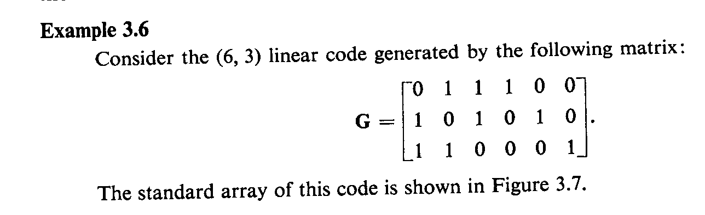

Slide 34
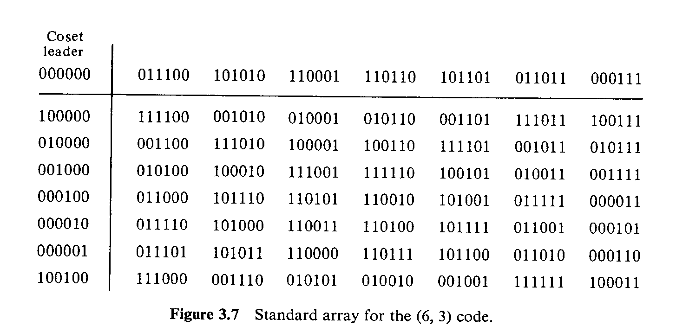

Slide 35
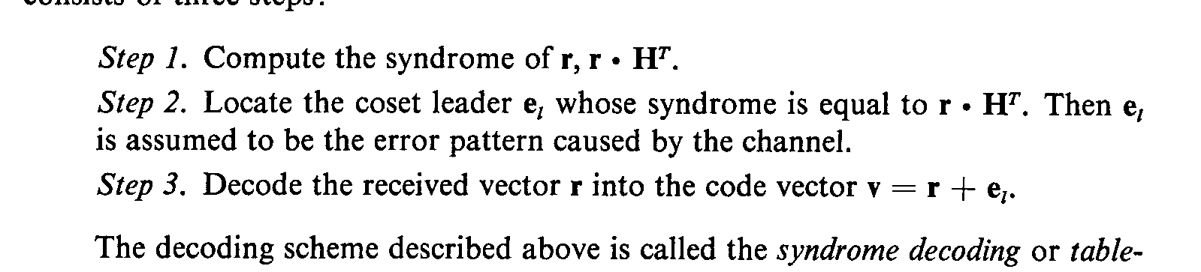

Slide 36
The Syndrome
Huge storage memory (and searching time) is required by standard array decoding.
Define the syndrome
s = vH^{T} = (c + e) H^{T} = eH^{T}
The syndrome depends only on the error pattern and not on the transmitted codeword.
Therefore, each coset in the array is associated with a unique syndrome.

Slide 37
The Syndrom (cont’d)

Slide 38
Syndrome Decoding
Decoding Procedure:
1. For the received vector v, compute the syndrome s = vH^{T}.
2. Using the table, identify the error pattern e.
3. Add e to v to recover the transmitted codeword c.
Example:
v = 1110101 ==> s = 001 ==> e = 0010000
Then, c = 1100101
Syndrome decoding reduces storage memory from nx2^{n} to 2^{n-k}(2n-k). Also, It reduces the searching time considerably.

Slide 39
Decoding of Hamming Codes
Consider a single-error pattern e^{(i)}, where i is a number determining the position of the error.
s = e^{(i)} H^{T} = H_{i}^{T} = the transpose of the i^{th} column of H.
Example:

Slide 40
Decoding of Hamming Codes (cont’d)
That is, the (transpose of the) i^{th} column of H is the syndrome corresponding to a single error in the i^{th} position.
Decoding rule:
1. Compute the syndrome s = vH^{T}
2. Locate the error ( i.e. find i for which s^{T} = H_{i})
3. Invert the i^{th} bit of v.

Slide 41
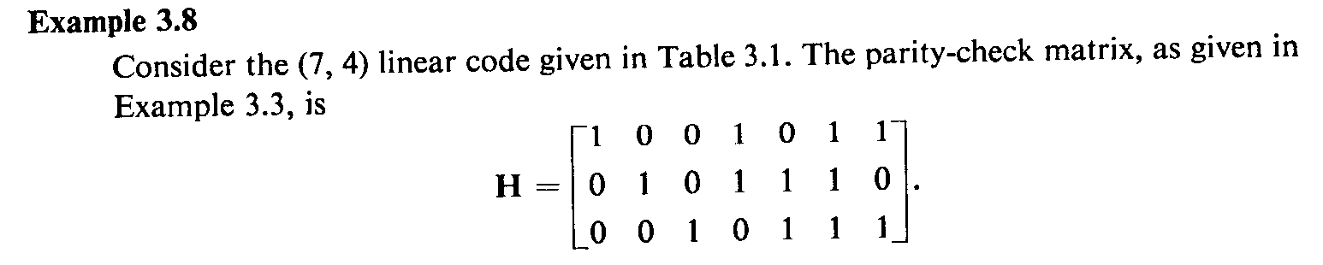
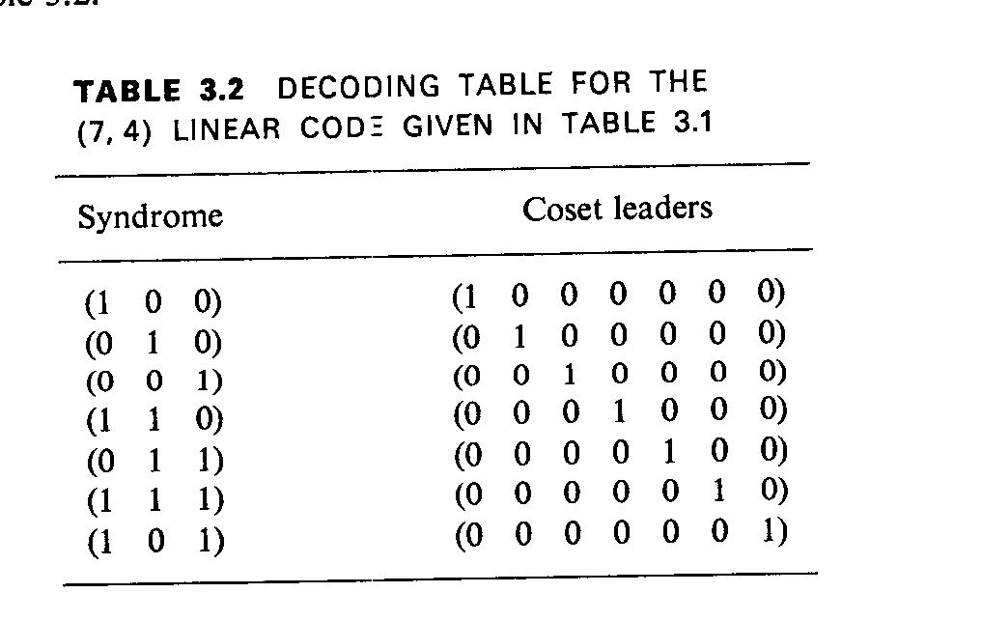

Slide 42
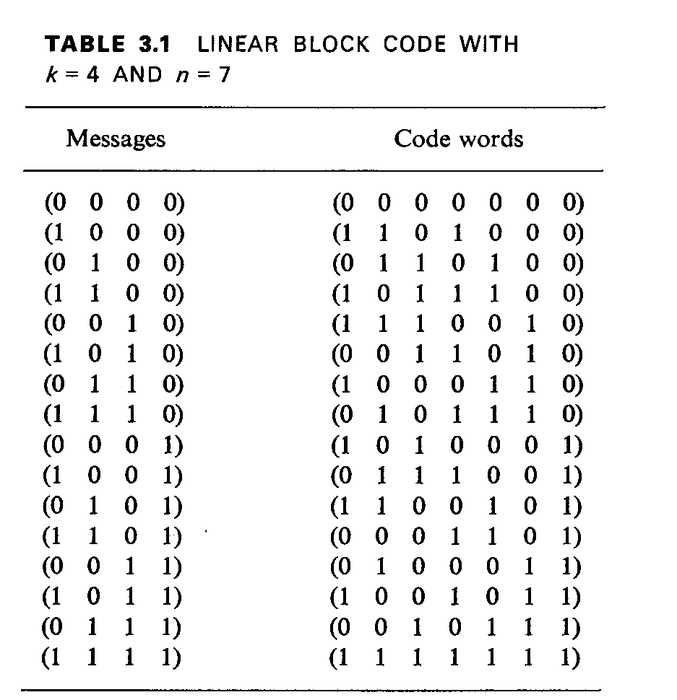

Slide 43
