Slide 1
بسم الله الرحمن الرحيم
جــــــامـعـة كـــــرري
كلية علوم الحاسوب وتقانة المعلومات
Database lab
By Ashraf Mohamed Abbas
Tel 0911257595 Email ashraf10.moh@gmail.com

Slide 2
Database Lab
Outlines :
Chapter 1 - Lec 1 How to install oracle 11g .
Chapter 2
> Lec 1 structured query language SQL
> lec 2 SQL con…
Chapter 3 Data Manipulation Language DML
Chapter 4 Data Definition Language DDL
Chapter 5 Transaction Control
Chapter 6 Data Control Language DCL
By Ashraf Mohamed Abbas Email ashraf10.moh@gmail.com

Slide 3
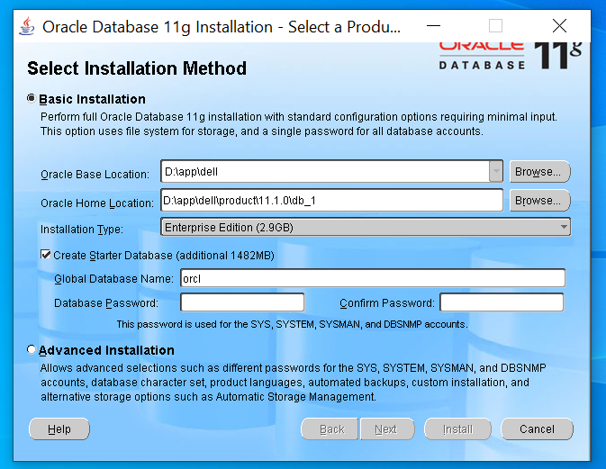
installing ORACLE 11G – stepes:
By Ashraf Mohamed Abbas Email ashraf10.moh@gmail.com

Slide 4
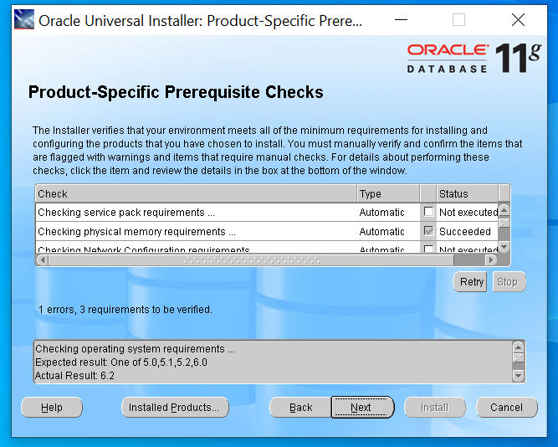

Slide 5
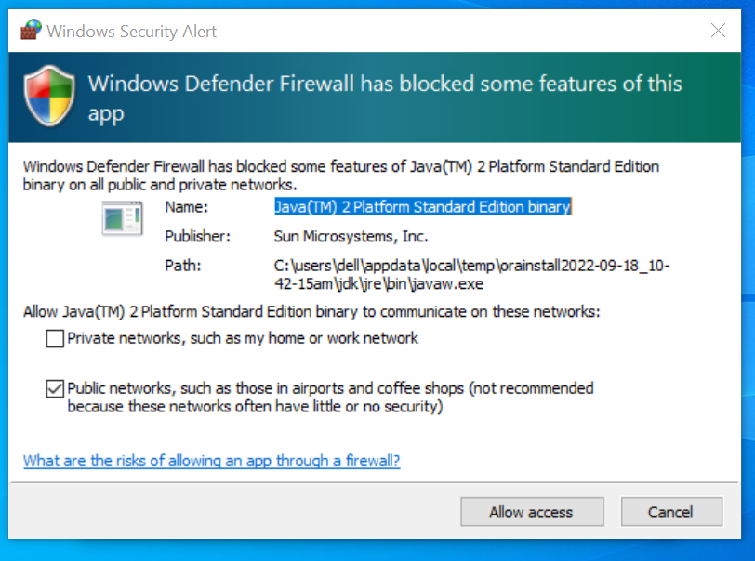

Slide 6
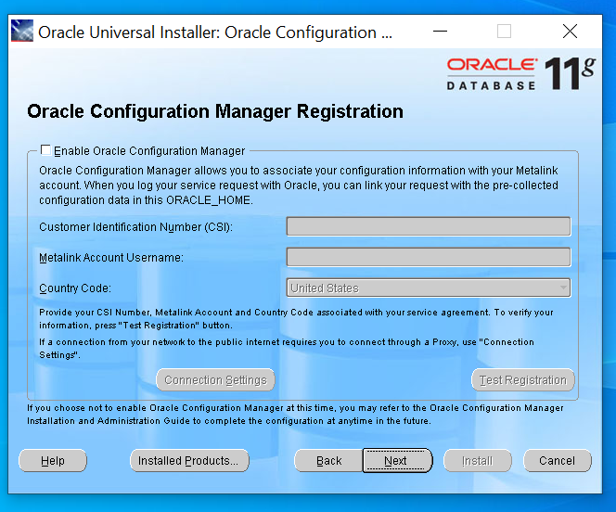

Slide 7
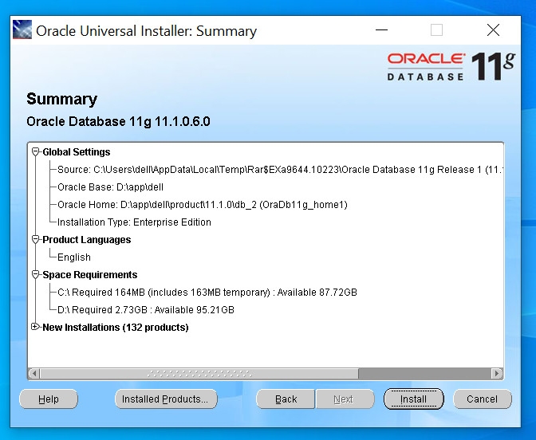

Slide 8
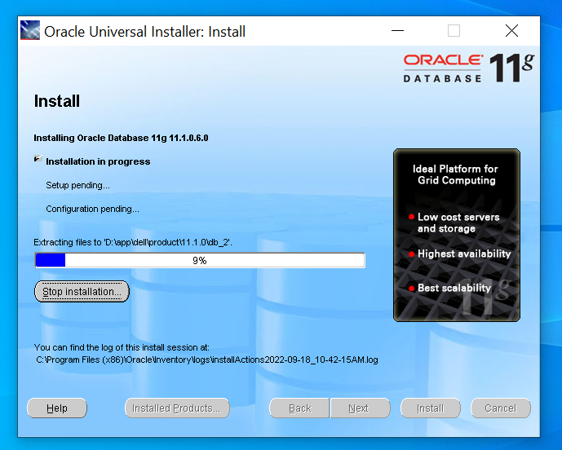

Slide 9
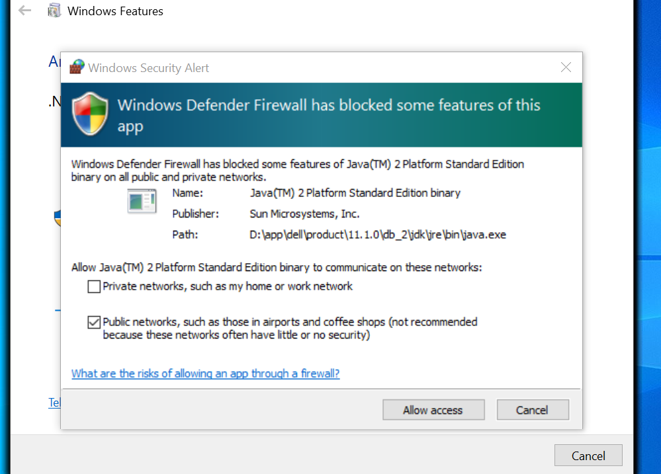

Slide 10
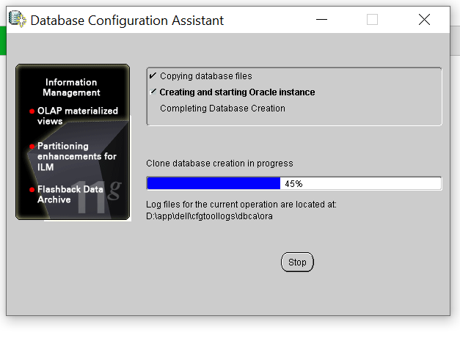

Slide 11
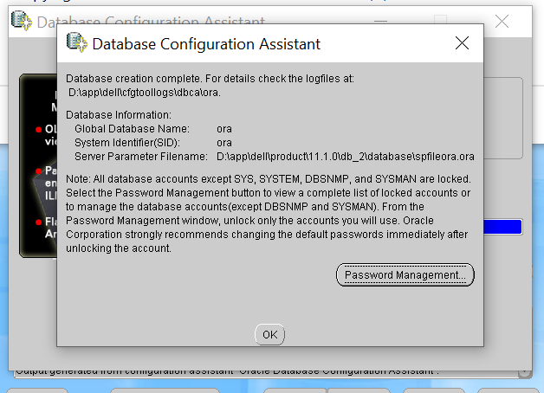

Slide 12
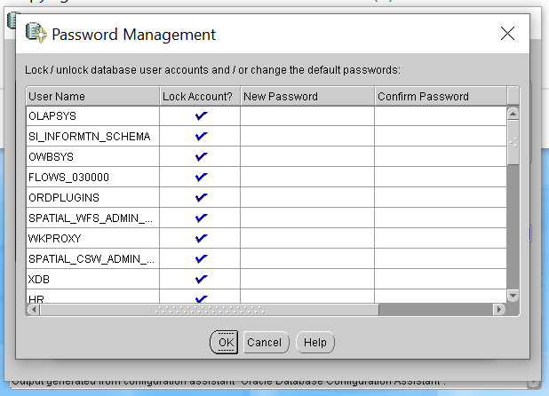

Slide 13
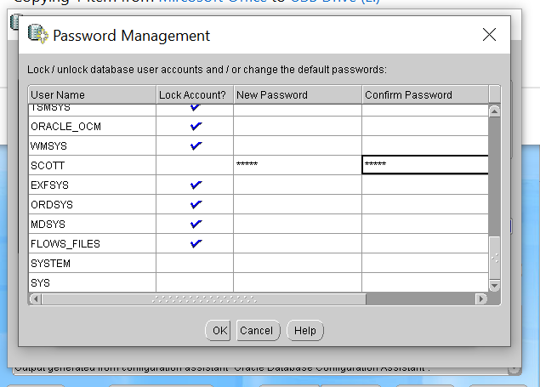

Slide 14
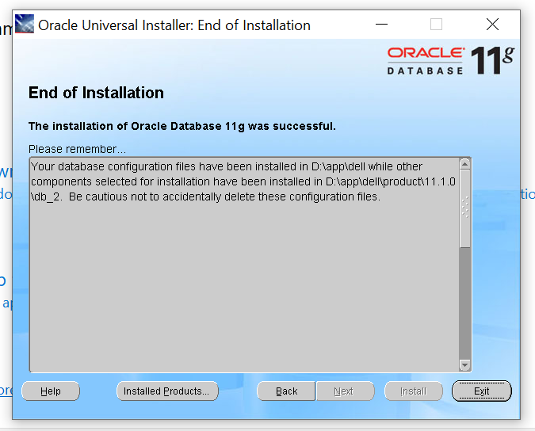

Slide 15
