Slide 1
A gile methods
luc1

Slide 2
Course content
Course name : agile methods
Course prerequisite :
SW development and OO _ SW
Course Hours : 3 Hrs
12 weeks duration

Slide 3
Course content
Agile manifesto : agile principles
An overview of agile methods: XP , Scrum , crystal and FDD
Background and motivations
XP and Scrum agile practices
Similarities and differences of methods
Ref : agile methods development & essentials Persse 2006

Slide 4
Agile Methods and Practices
Main concepts

Slide 5
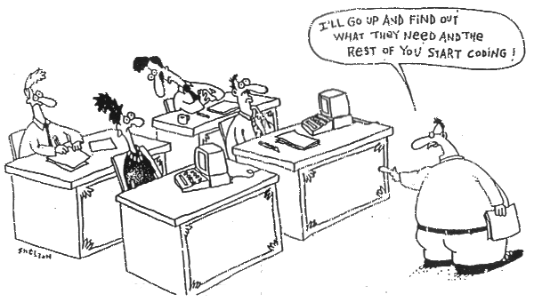
Being Agile

Slide 6

From Thoughtworks

Slide 7
Agile Methods
Why do we want to talk about this?
What are Agile Methods and Practices?

Slide 8
In my mind all of this has to do with success.

Slide 9
What is success

Slide 10

For Organizations

Slide 11

For Customers

Slide 12
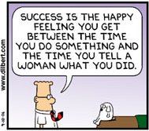
For some

Slide 13
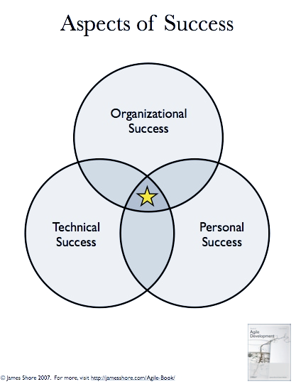
The way I look at it

Slide 14
So success is intersection point of various other successes as defined by the parties involved.
What has this got to with Agile Methods? What are Agile Methods?

Slide 15
Is this what we mean by agile method:
public Method agile Methods{
get Method ( Agile. agile);
}

Slide 16
Agile Manifesto
The Agile Manifesto is a foundational document for agile software development, created in 2001 by a group of software developers and thought leaders. It outlines core values and principles that emphasize flexibility, collaboration, and customer satisfaction over rigid processes and documentation.

Slide 17
The 4 Core Values of the Agile Manifesto:
Individuals and interactions over processes and tools.
Working software over comprehensive documentation.
Customer collaboration over contract negotiation.
Responding to change over following a plan.

Slide 18
The 12 Principles of Agile:
Customer satisfaction through early and continuous delivery
of valuable software.
Welcome changing requirements, even late in development.
Deliver working software frequently, with a preference for shorter timescales.
Business people and developers must work together daily throughout
the project.
Build projects around motivated individuals. Give them the environment and support they need, and trust them to get the job done.
Face-to-face conversation is the most effective method of
conveying information.
Working software is the primary measure of progress.
Agile processes promote sustainable development. The sponsors, developers, and users should be able to maintain a constant pace indefinitely.
Continuous attention to technical excellence and good design enhances agility.

Slide 19
Simplicity—the art of maximizing the amount of work not done—is essential.
The best architectures, requirements, and designs emerge from self-organizing teams.
At regular intervals, the team reflects on how to become more effective, then tunes and adjusts its behavior accordingly.
This manifesto serves as the backbone of various Agile frameworks like :
Scrum, Kanban and Extreme Programming (XP).

