Slide 1

An
Introduction to
Agile SCRUM Methodology

Slide 2
Agenda
  Introduction
  What is Agile Methodology?
  What is Scrum?
  History of Scrum
  Functionality of Scrum
  Components of Scrum
    Scrum Roles
    The Process
    Scrum Artifacts and tools
  Scaling Scrum
  Q & A Session

Slide 3
Presumptions
The audience is well aware of traditional software development methodologies like Waterfall Model, Iterative models, etc.

Slide 4
Introduction
Classical methods of software development have many disadvantages:
  huge effort during the planning phase
  poor requirements conversion in a rapid changing environment
  treatment of staff as a factor of production
New methods:
Agile Software Development Methodology

Slide 5
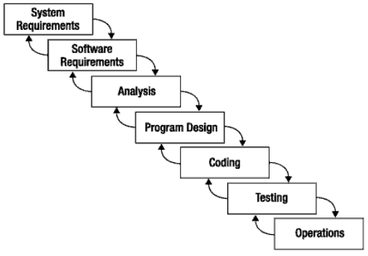
What is Scrum?
Scrum:
  Is an agile, lightweight process
  Can manage and control software and product development
  Uses iterative, incremental practices
  Has a simple implementation
  Increases productivity
  Reduces time to benefits
  Embraces adaptive, empirical systems development
  Is not restricted to software development projects
  Embraces the opposite of the waterfall approach…
It’s about common sense

Slide 6


Agile Manifesto
Individuals and interactions
Process and tools
over
Working software
Comprehensive documentation
over
Customer collaboration
Contract negotiation
over
Responding to change
Following a plan
over
Source: www.agilemanifesto.org

Slide 7
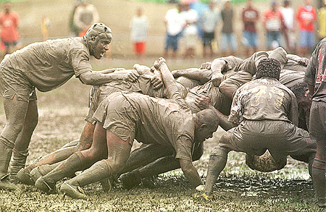
Scrum

Slide 8
Scrum in 100 words
Scrum is an agile process that allows us to focus on delivering the highest business value in the shortest time.
It allows us to rapidly and repeatedly inspect actual working software (every two weeks to one month).
The business sets the priorities. Our teams self-manage to determine the best way to deliver the highest priority features.
Every two weeks to a month anyone can see real working software and decide to release it as is or continue to enhance for another iteration.

Slide 9
History of Scrum
1995:
  Design of a new method: Scrum by Jeff Sutherland & Ken Schwaber
  Enhancement of Scrum by Mike Beedle & combination of Scrum with Extreme Programming
1996:
  introduction of Scrum at OOPSLA conference
2001:
  publication “Agile Software Development with Scrum” by
  Ken Schwaber & Mike Beedle
Successful appliance of Scrum in over 50 companies
Founders are members in the Agile Alliance

Slide 10



Scrum Origins
Jeff Sutherland
  Initial scrums at Easel Corp in 1993
  IDX and 500+ people doing Scrum
Ken Schwaber
  ADM
  Scrum presented at OOPSLA 96 with Sutherland
  Author of three books on Scrum
Mike Beedle
  Scrum patterns in PLOPD4
Ken Schwaber and Mike Cohn
  Co-founded Scrum Alliance in 2002, initially within Agile Alliance

Slide 11
Characteristics
Self-organizing teams
Product progresses in a series of month-long “sprints”
Requirements are captured as items in a list of “product backlog”
No specific engineering practices prescribed
Uses generative rules to create an agile environment for delivering projects
One of the “agile processes”

Slide 12

How Scrum Works?

Slide 13
Scrum at a Glance
24 hours
Daily Scrum
Meeting
Backlog tasks
expanded
by team
30 days
Sprint Backlog
Potentially Shippable
Product Increment
Product Backlog
As prioritized by Product Owner
Source: Adapted from Agile Software Development with Scrum by Ken Schwaber and Mike Beedle.

Slide 14
Scrum Framework
Roles
Product owner
Scrum Master
Team
Ceremonies
Sprint planning
Sprint review
Sprint retrospective
Daily scrum meeting
Artifacts
Product backlog
Sprint backlog
Burndown charts

Slide 15







Scrum Roles
  Product Owner
    Possibly a Product Manager or Project Sponsor
    Decides features, release date, prioritization, $$$
  Scrum Master
    Typically a Project Manager or Team Leader
    Responsible for enacting Scrum values and practices
    Remove impediments / politics, keeps everyone productive
  Project Team
    5-10 members; Teams are self-organizing
    Cross-functional: QA, Programmers, UI Designers, etc.
    Membership should change only between sprints

Slide 16


"Pigs" and "Chickens"
Pig: Team member committed to success of project
Chicken: Not a pig; interested but not committed
A pig and a chicken are walking down a road. The chicken looks at the pig and says, "Hey, why don't we open a restaurant?" The pig looks back at the chicken and says, "Good idea, what do you want to call it?" The chicken thinks about it and says, "Why don't we call it 'Ham and Eggs'?" "I don't think so," says the pig, "I'd be committed but you'd only be involved."

Slide 17
Sprints
Scrum projects make progress in a series of “sprints”
  Analogous to XP iterations
Target duration is one month
  +/- a week or two
    But, a constant duration leads to a better rhythm
Product is designed, coded, and tested during the sprint

Slide 18
Sequential vs. Overlapping Dev.
Requirements
Design
Code
Test

Slide 19

Sequential vs. Overlap
Requirements
Design
Code
Test
Rather than doing all of one thing at a time...
...Scrum teams do a little of everything all the time

Slide 20
No changes during the sprint
Change
Inputs
Sprint
Tested Code
Plan sprint durations around how long you can commit to keeping change out of the sprint

Slide 21
Scrum Framework
Roles : Product Owner, ScrumMaster, Team
Ceremonies or activities : Sprint Planning, Sprint Review, Sprint Retrospective, & Daily Scrum Meeting
Artifacts : Product Backlog, Sprint Backlog, and Burndown Chart

Slide 22
Product Owner
Define the features of the product
Decide on release date and content
Be responsible for the profitability of the product (ROI)
Prioritize features according to market value
Adjust features and priority every iteration, as needed
Accept or reject work results.

Slide 23
The Scrum Master
Represents management to the project
Responsible for enacting and roles of Scrum values and practices
Removes impediments / problems
Ensure that the team is fully functional and productive
Enable close cooperation across all roles and functions
Shield the team from external interferences

Slide 24
Scrum Team
Typically 5-10 people
Cross-functional
  QA, Programmers, UI Designers, etc.
Members should be full-time
  May be exceptions (e.g., System Admin, etc.)
Teams are self-organizing
  What to do if a team self-organizes someone off the team??
  Ideally, no titles but rarely a possibility
Membership can change only between sprints

Slide 25
Ceremonies
Sprint Planning Meeting
Sprint
Daily Scrum Meeting
Sprint Review Meeting

Slide 26
Spring Planning Meeting
Product Owner
Scrum Team
Customers
Management
Product Backlog
Sprint Planning
Meeting
Team Capabilities
Sprint Goal
Business Conditions
Technology
Sprint Backlog
Current Product

Slide 27


Sprint Planning Mtg.
Team capacity
Sprint planning meeting
Sprint prioritization
Sprint
goal
Product backlog
Analyze/evaluate product backlog
Select sprint goal
Business conditions
Sprint planning
Decide how to achieve sprint goal (design)
Create sprint backlog (tasks) from product backlog items (user stories / features)
Estimate sprint backlog in hours
Current product
Sprint
backlog
Technology

Slide 28
Parts of Sprint Planning Meeting
1st Part:
  Creating Product Backlog
  Determining the Sprint Goal.
  Participants: Product Owner, Scrum Master, Scrum Team
2nd Part:
  Participants: Scrum Master, Scrum Team
  Creating Sprint Backlog

Slide 29
Pre-Project/Kickoff Meeting
A special form of Sprint Planning Meeting
Meeting before the begin of the Project

Slide 30
Sprint
A month-long iteration, during which is incremented a product functionality
NO outside influence can interfere with the Scrum team during the Sprint
Each Sprint begins with the Daily Scrum Meeting

Slide 31
Daily Scrum
Parameters
  Daily
  15-minutes
  Stand-up
  Not for problem solving
Three questions:
  What did you do yesterday
  What will you do today?
  What obstacles are in your way?
Chickens and pigs are invited
  Help avoid other unnecessary meetings
Only pigs can talk

Slide 32
Daily Scrum
Is NOT a problem solving session
Is NOT a way to collect information about WHO is behind the schedule
Is a meeting in which team members make commitments to each other and to the Scrum Master
Is a good way for a Scrum Master to track the progress of the Team

Slide 33
Scrum …
Why daily?
  “How does a project get to be a year late?”
    “One day at a time.”
Can Scrum meetings be replaced by emailed status reports?
  No
    Entire team sees the whole picture every day
    Create peer pressure to do what you say you’ll do

Slide 34

Sprint Review Meeting
Team presents what it accomplished during the sprint
Typically takes the form of a demo of new features or underlying architecture
Informal
  2-hour prep time rule
Participants
  Customers
  Management
  Product Owner
  Other engineers

Slide 35
Sprint Retrospective Meeting
Scrum Team only
Feedback meeting
Three questions
  Start
  Stop
  Continue
Don’t skip for the first 5-6 sprints!!!

Slide 36
Product Backlog
A list of all desired work on the project
  Usually a combination of
    story-based work (“let user search and replace”)
    task-based work (“improve exception handling”)
List is prioritized by the Product Owner
  Typically a Product Manager, Marketing, Internal Customer, etc.

Slide 37
Product Backlog
Requirements for a system, expressed as a prioritized list of Backlog Items
Is managed and owned by a Product Owner
Spreadsheet (typically)
Usually is created during the Sprint Planning Meeting
Can be changed and re-prioritized before each PM

Slide 38
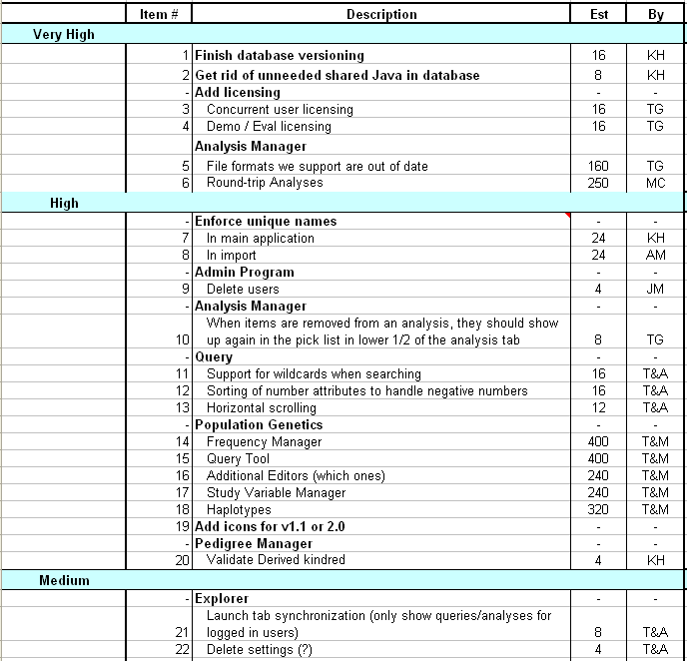
Sample Product Backlog

Slide 39
From Sprint Goal to Sprint Backlog
Scrum team takes the Sprint Goal and decides what tasks are necessary
Team self-organizes around how they’ll meet the Sprint Goal
  Manager doesn’t assign tasks to individuals
Managers don’t make decisions for the team
Sprint Backlog is created

Slide 40
Sprint Backlog during the Sprint
Changes
  Team adds new tasks whenever they need to in order to meet the Sprint Goal
  Team can remove unnecessary tasks
  But: Sprint Backlog can only be updated by the team
Estimates are updated whenever there’s new information

Slide 41
Sprint Backlog
A subset of Product Backlog Items, which define the work for a Sprint
Is created ONLY by Team members
Each Item has it’s own status
Should be updated every day

Slide 42
Sprint Backlog
No more than 300 tasks in the list
If a task requires more than 16 hours, it should be broken down
Team can add or subtract items from the list. Product Owner is not allowed to do it

Slide 43
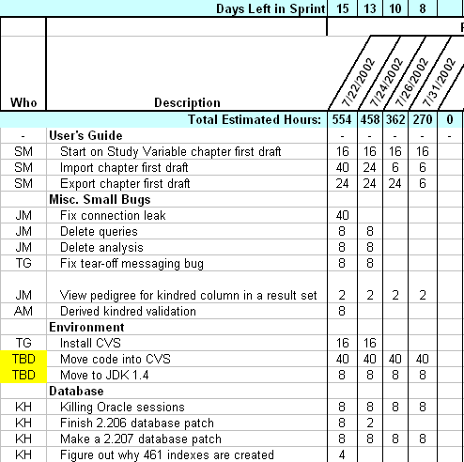
Sample Sprint Backlog

Slide 44
Sprint Burn down Chart
Depicts \ illustrates the total Sprint Backlog hours remaining per day
Shows the estimated amount of time to release
Ideally should burn down to zero to the end of the Sprint
Actually is not a straight line
Can bump UP

Slide 45
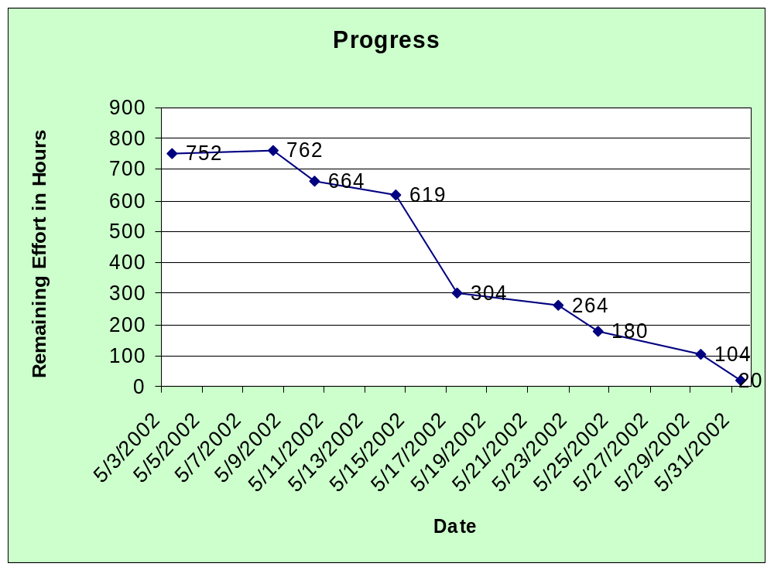
Sprint Burndown Chart

Slide 46
Release Burndown Chart
Will the release be done on right time?
X-axis: sprints
Y-axis: amount of hours remaining
The estimated work remaining can also burn up

Slide 47
Product Burndown Chart
Is a “big picture” view of project’s progress (all the releases)

Slide 48
Scalability of Scrum
A typical Scrum team is 6-10 people
Jeff Sutherland - up to over 800 people
"Scrum of Scrums" or what called "Meta-Scrum“
Frequency of meetings is based on the degree of coupling between packets

Slide 49
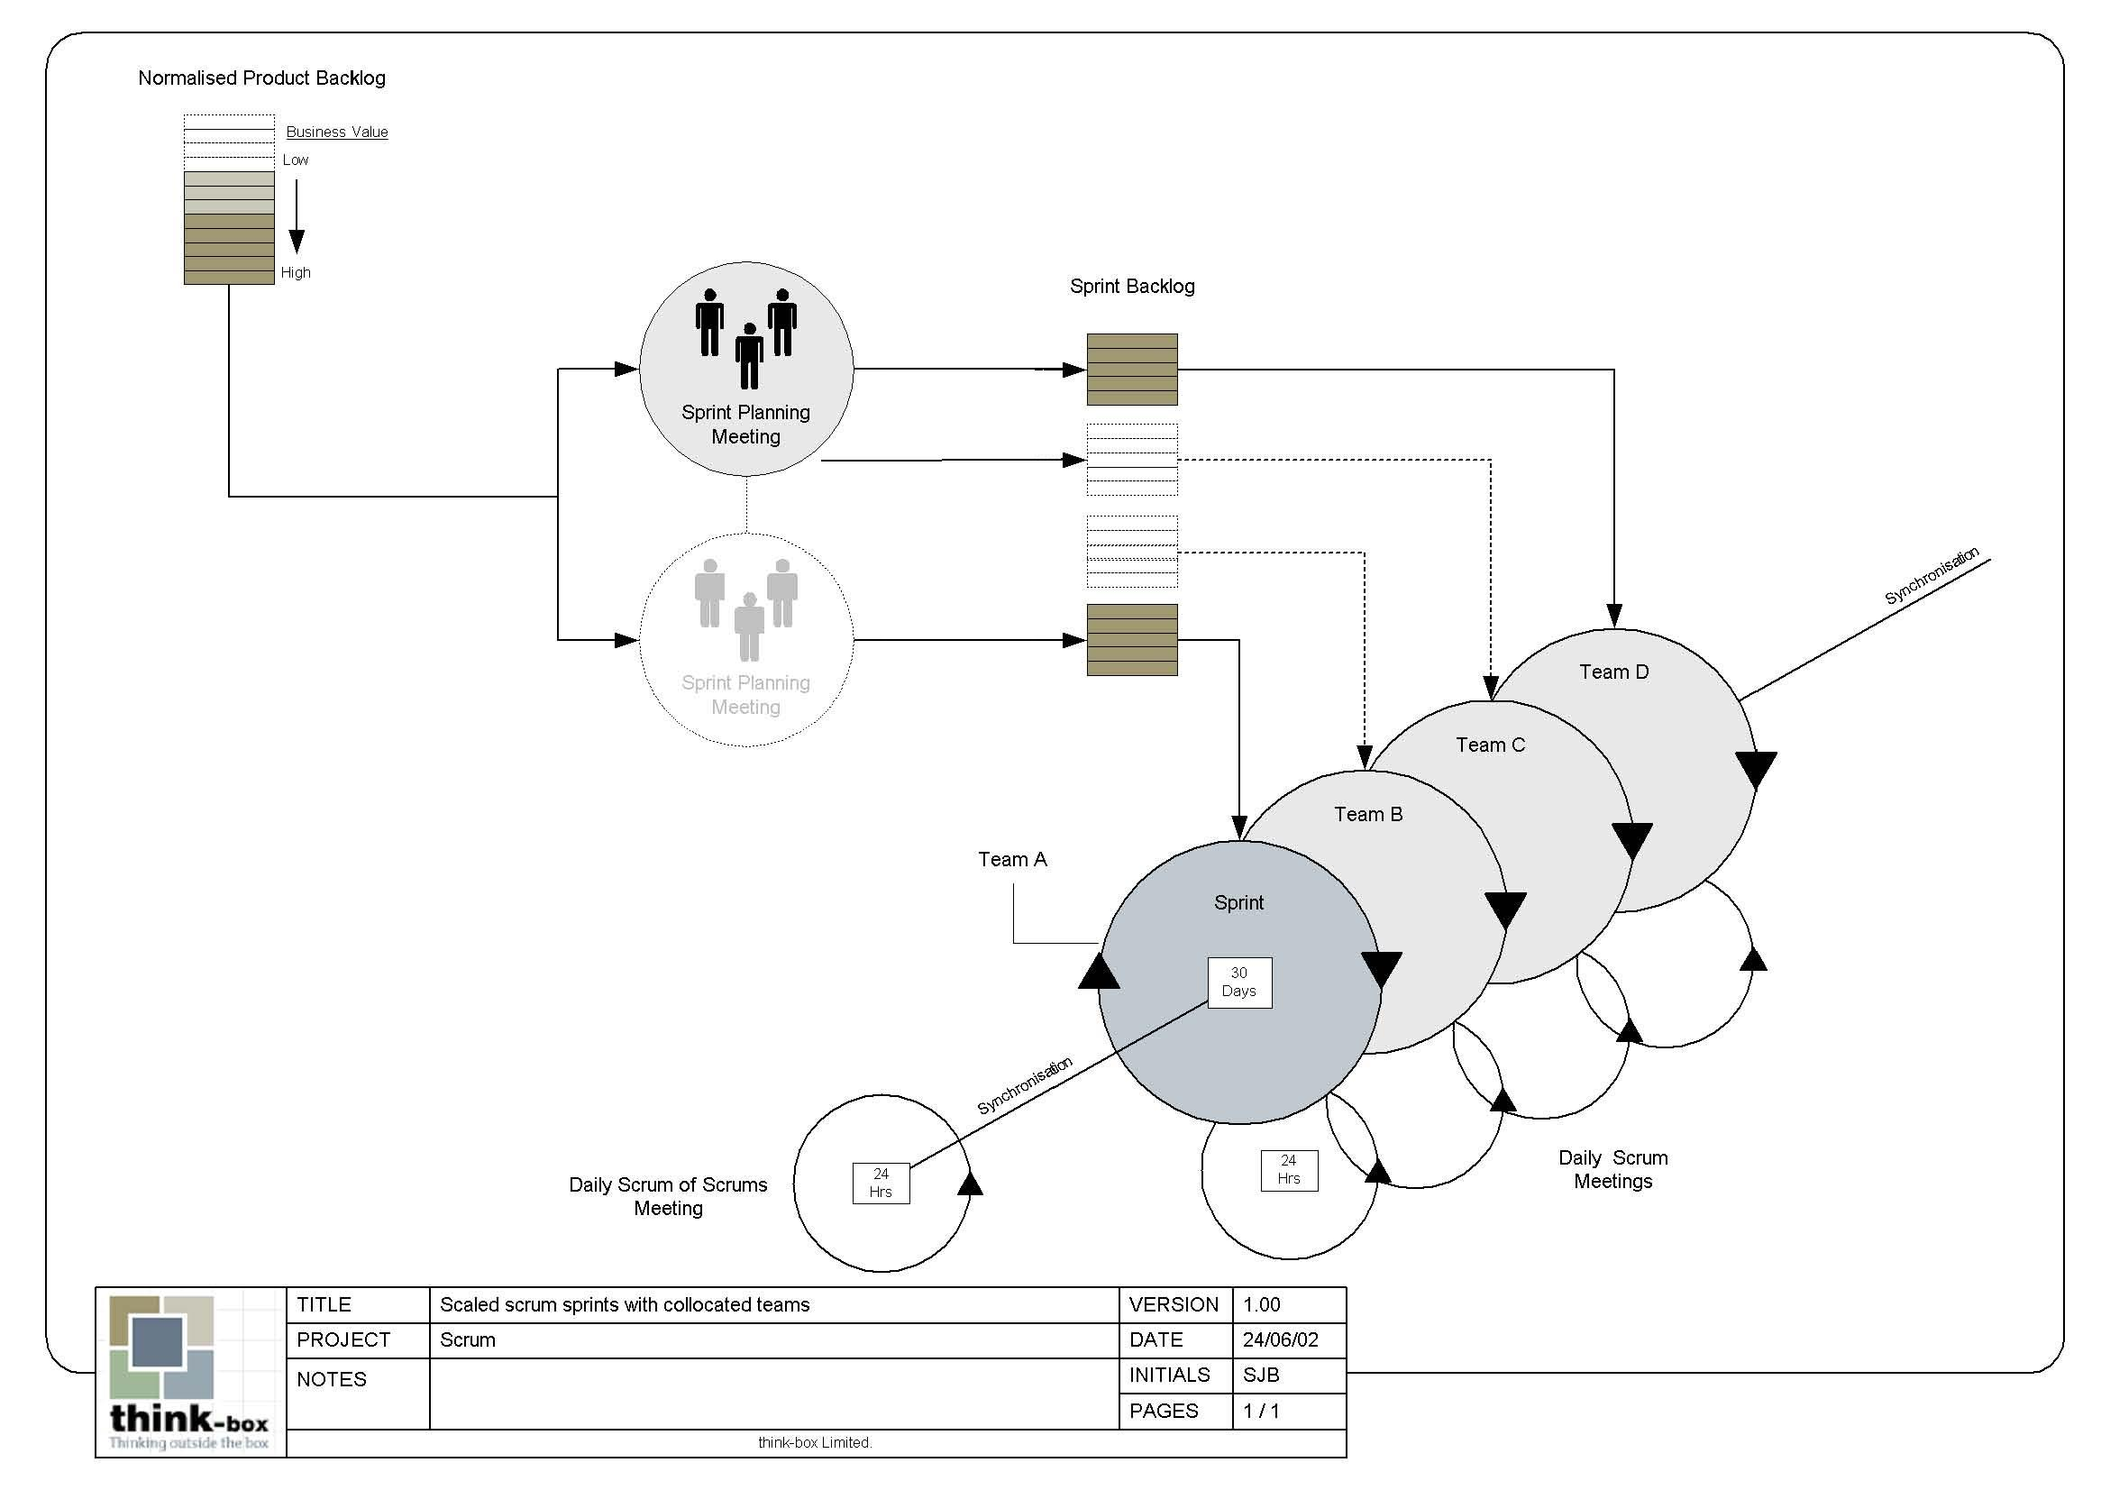
Scalability of Scrum

Slide 50
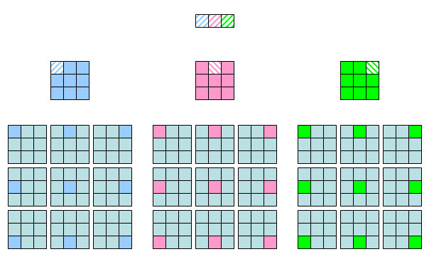
Scalability of Scrum

Slide 51
Pros/Cons
Advantages
  Completely developed and tested features in short iterations
  Simplicity of the process
  Clearly defined rules
  Increasing productivity
  Self-organizing
  each team member carries a lot of responsibility
  Improved communication
  Combination with Extreme Programming
Drawbacks
  “Undisciplined hacking” (no written documentation)
  Violation of responsibility
  Current mainly carried by the inventors

Slide 52
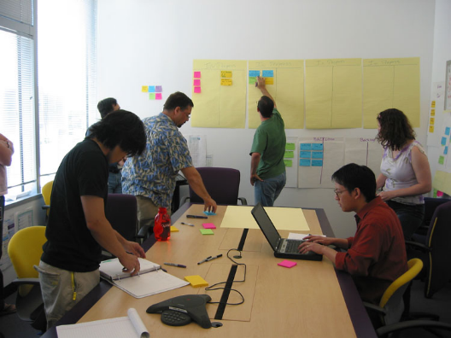
Daily Scrum Meeting
Parameters
  Daily, ~15 minutes, Stand-up
  Anyone late pays a $1 fee
Not for problem solving
  Whole world is invited
  Only team members, Scrum Master, product owner, can talk
  Helps avoid other unnecessary meetings
Three questions answered by each team member:
  What did you do yesterday?
  What will you do today?
  What obstacles are in your way?

Slide 53
Scrum's Artifacts
Scrum has remarkably few artifacts
  Product Backlog
  Sprint Backlog
  Burndown Charts
Can be managed using just an Excel spreadsheet
  More advanced / complicated tools exist:
    Expensive
    Web-based – no good for Scrum Master/project manager who travels
    Still under development

Slide 54

Product Backlog
The requirements
A list of all desired work on project
Ideally expressed as a list of user stories along with "story points", such that each item has value to users or customers of the product
Prioritized by the product owner
Reprioritized at start of each sprint
This is the
product backlog

Slide 55
User Stories
Instead of Use Cases, Agile project owners do "user stories"
  Who (user role) – Is this a customer, employee, admin, etc.?
  What (goal) – What functionality must be achieved/developed?
  Why (reason) – Why does user want to accomplish this goal?
As a [user role], I want to [goal], so I can [reason].
Example:
  "As a user, I want to log in, so I can access subscriber content."
story points: Rating of effort needed to implement this story
  common scales: 1-10, shirt sizes (XS, S, M, L, XL), etc.

Slide 56
Sample Product Backlog
Backlog item | Estimate
Allow a guest to make a reservation | 3 (story points)
As a guest, I want to cancel a reservation. | 5
As a guest, I want to change the dates of a reservation. | 3
As a hotel employee, I can run RevPAR reports (revenue-per-available-room) | 8
Improve exception handling | 8
... | 30
... | 50

Slide 57
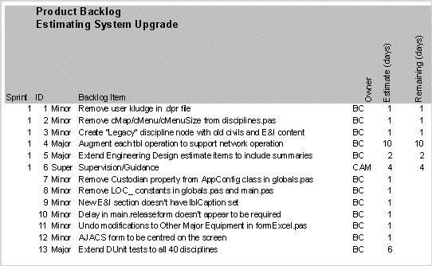
Sample Product Backlog 2

Slide 58
Sprint Backlog
Individuals sign up for work of their own choosing
  Work is never assigned
Estimated work remaining is updated daily
Any team member can add, delete change sprint backlog
Work for the sprint emerges
If work is unclear, define a sprint backlog item with a larger amount of time and break it down later
Update work remaining as more becomes known

Slide 59
Sample Sprint backlog
Tasks
Mon
Tue
Wed
Thu
Fri
Code the user interface
8
4
8
Code the middle tier
16
12
10
4
Test the middle tier
8
16
16
11
8
Write online help
12
Write the Foo class
8
8
8
8
8
Add error logging
8
4

Slide 60
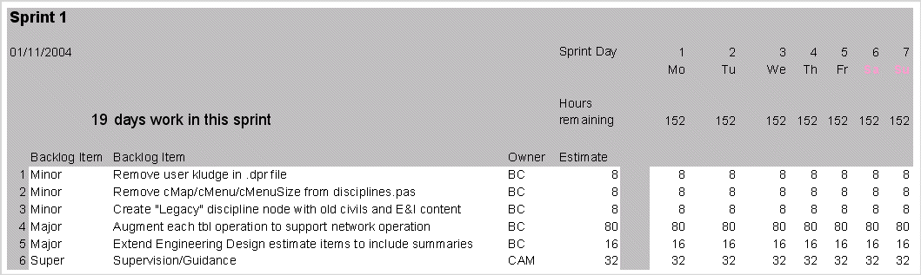
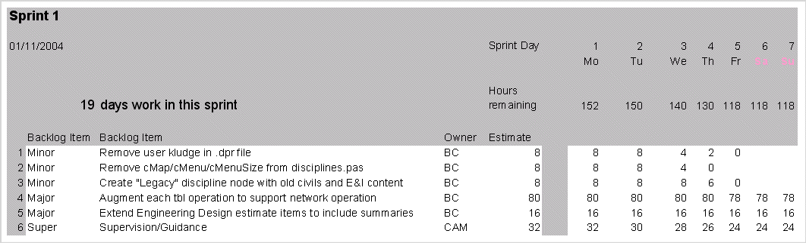
Sample Sprint Backlog

Slide 61
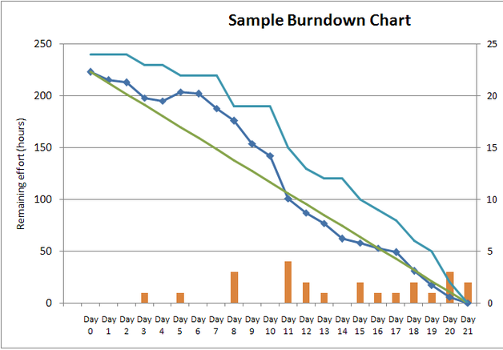
Sprint Burndown Chart
A display of what work has been completed
and what is left to complete
  one for each developer or work item
  updated every day
  (make best guess about hours/points completed each day)
variation: Release burndown chart
  shows overall progress
  updated at end of each sprint

Slide 62
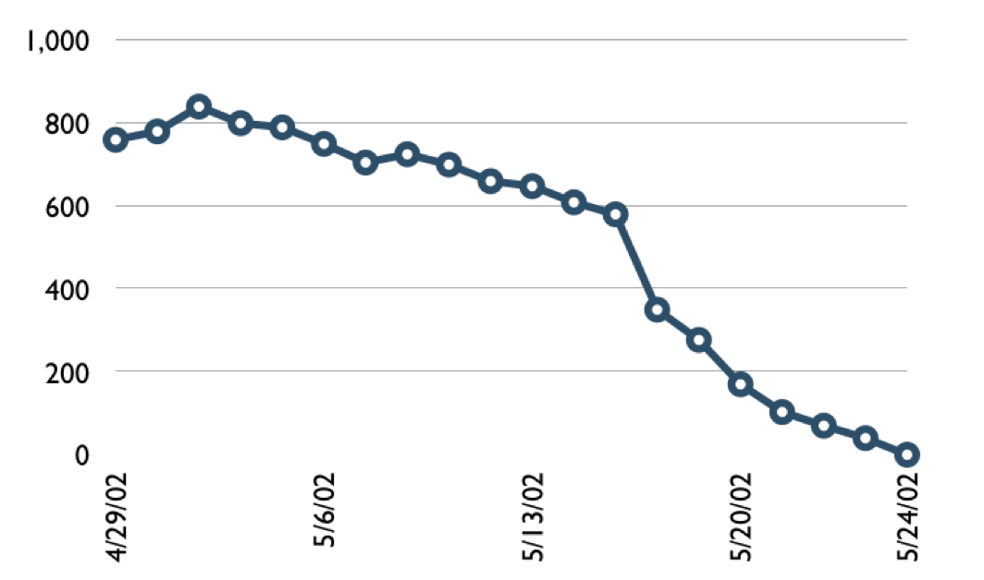

Sample Burndown Chart
Hours

Slide 63
Tasks
Mon
Tue
Wed
Thu
Fri
Code the user interface
8
4
8
Code the middle tier
16
12
10
7
Test the middle tier
8
16
16
11
8
Write online help
12
50
40
30
Hours
20
10
0
Mon
Tue
Wed
Thu
Fri

Slide 64
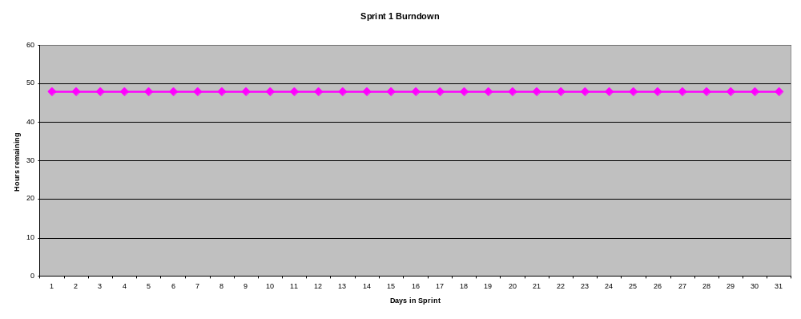
Burndown Example 1
No work being performed

Slide 65
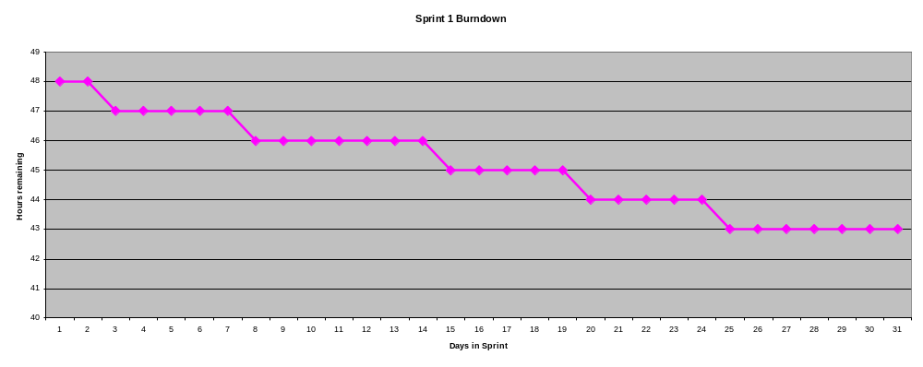
Burndown Example 2
Work being performed, but not fast enough

Slide 66
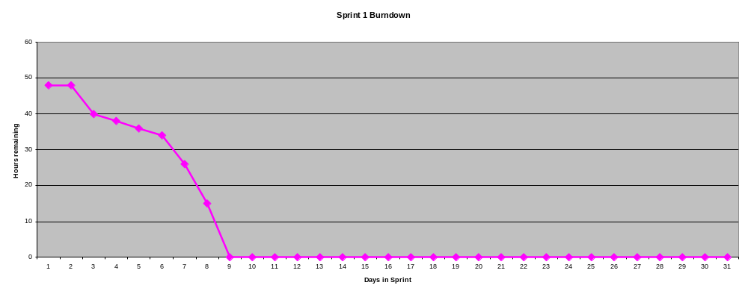
Burndown Example 3
Work being performed, but too fast!

Slide 67
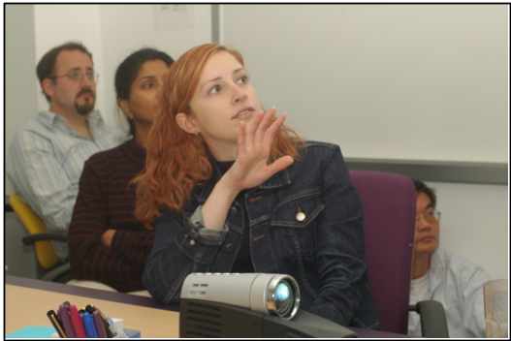
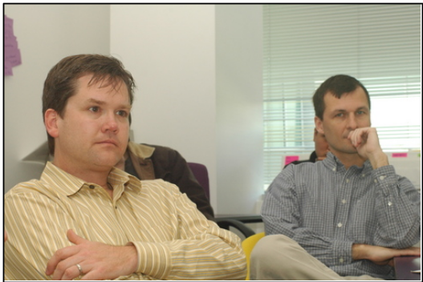
The Sprint Review
Team presents what it accomplished during the sprint
Typically takes the form of a demo of new features or underlying architecture
Informal
  2-hour prep time rule
  No slides
Whole team participates
Invite the world

Slide 68
Scalability
Typical individual team is 7 ± 2 people
  Scalability comes from teams of teams
Factors in scaling
  Type of application
  Team size
  Team dispersion
  Project duration
Scrum has been used on multiple 500+ person projects

Slide 69






Scaling: Scrum of Scrums

Slide 70
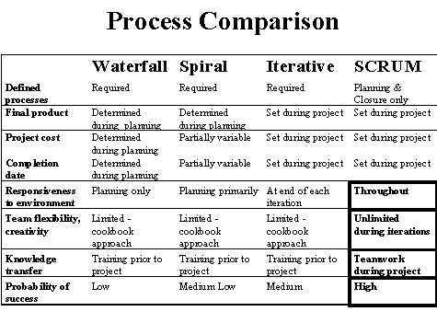
Scrum vs. Other Models

Slide 71

Credits, References
  Mike Cohn, Mountain Goat Software
  www.mountaingoatsoftware.com
  Scrum and The Enterprise by Ken Schwaber
  Succeeding with Agile by Mike Cohn
  Agile Software Development Ecosystems by Jim Highsmith
  Agile Software Development with Scrum by K. Schwaber and M. Beedle
  User Stories Applied for Agile Software Development by Mike Cohn
  www.agilescrum.com/
  www.objectmentor.com
  jeffsutherland.com/
  www.controlchaos.com/scrumwp.htm
  agilealliance.com/articles/articles/InventingScrum.pdf

Slide 72
Thank You !!!

