Slide 1
RUP
Process and Method:
An Introduction to the
Rational Unified Process

Slide 2
Waterfall Method
Requirements Analysis
  Analysis Specification
    Design Specification
      Coding from Design Specification
        Unit Testing
        System Testing
        UAT Testing
        Ship It (????)
Measuring the form of formal documents (specifications).

Slide 3
Waterfall Process Assumptions
Requirements are known up front before design
Requirements rarely change
Users know what they want, and rarely need visualization
Design can be conducted in a purely abstract space, or trial rarely leads to error
The technology will all fit nicely into place when the time comes (the apocalypse)
The system is not so complex. (Drawings are for wimps)

Slide 4
Structured Analysis Problems
Reuse is complicated because Data is strewn throughout many different functions
  Reuse is usually defined as code reuse and is implemented through cutting and pasting of the same code in multiple places. What happens when the logic changes?
    coding changes need to be made in several different places
    changing the function often changes the API which breaks other functions dependent upon that API
    data type changes need to be made each time they are used throughout the application

Slide 5
The Rational Unified Process
RUP is a method of managing OO Software Development
It can be viewed as a Software Development Framework which is extensible and features:
  Iterative Development
  Requirements Management
  Component-Based Architectural Vision
  Visual Modeling of Systems
  Quality Management
  Change Control Management

Slide 6
RUP Features
Online Repository of Process Information and Description in HTML format
Templates for all major artifacts, including:
  RequisitePro templates (requirements tracking)
  Word Templates for Use Cases
  Project Templates for Project Management
Process Manuals describing key processes

Slide 7
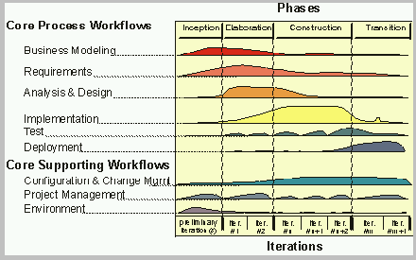
The Phases

Slide 8
An Iterative Development Process...
Recognizes the reality of changing requirements
  Caspers Jones’s research on 8000 projects
    40% of final requirements arrived after the analysis phase, after development had already begun
Promotes early risk mitigation, by breaking down the system into mini-projects and focusing on the riskier elements first
Allows you to “plan a little, design a little, and code a little”
Encourages all participants, including testers, integrators, and technical writers to be involved earlier on
Allows the process itself to modulate with each iteration, allowing you to correct errors sooner and put into practice lessons learned in the prior iteration
Focuses on component architectures, not final big bang deployments

Slide 9
An Incremental Development Process...
Allows for software to evolve, not be produced in one huge effort
Allows software to improve, by giving enough time to the evolutionary process itself
Forces attention on stability, for only a stable foundation can support multiple additions
Allows the system (a small subset of it) to actually run much sooner than with other processes
Allows interim progress to continue through the stubbing of functionality
Allows for the management of risk, by exposing problems earlier on in the development process

Slide 10
Goals and Features of Each Iteration
The primary goal of each iteration is to slowly chip away at the risk facing the project, namely:
  performance risks
  integration risks (different vendors, tools, etc.)
  conceptual risks (ferret out analysis and design flaws)
Perform a “miniwaterfall” project that ends with a delivery of something tangible in code, available for scrutiny by the interested parties, which produces validation or correctives
Each iteration is risk-driven
The result of a single iteration is an increment--an incremental improvement of the system, yielding an evolutionary approach

Slide 11
Risk Management
Identification of the risks
Iterative/Incremental Development
The prototype or pilot project
  Booch’s “Tiger Team”
Early testing and deployment as opposed to late testing in traditional methods

Slide 12
The Development Phases
Inception Phase
Elaboration Phase
Construction Phase
Transition Phase

Slide 13
Inception Phase
Overriding goal is obtaining buy-in from all interested parties
Initial requirements capture
Cost Benefit Analysis
Initial Risk Analysis
Project scope definition
Defining a candidate architecture
Development of a disposable prototype
Initial Use Case Model (10% - 20% complete)
First pass at a Domain Model

Slide 14
Elaboration Phase
Requirements Analysis and Capture
  Use Case Analysis
    Use Case (80% written and reviewed by end of phase)
    Use Case Model (80% done)
    Scenarios
      Sequence and Collaboration Diagrams
      Class, Activity, Component, State Diagrams
  Glossary (so users and developers can speak common vocabulary)
  Domain Model
    to understand the problem: the system’s requirements as they exist within the context of the problem domain
  Risk Assessment Plan revised
  Architecture Document

Slide 15
Construction Phase
Focus is on implementation of the design:
  cumulative increase in functionality
  greater depth of implementation
  greater stability begins to appear
  implement all details, not only those of central architectural value
  analysis continues, but design and coding predominate

Slide 16
Transition Phase
The transition phase consists of the transfer of the system to the user community
It includes manufacturing, shipping, installation, training, technical support and maintenance
Development team begins to shrink
Control is moved to maintenance team
Alpha, Beta, and final releases
Software updates
Integration with existing systems (legacy, existing versions, etc.)

Slide 17
Elaboration Phase in Detail
Use Case Analysis
  Find and understand 80% of architecturally significant use cases and actors
  Prototype User Interfaces
  Prioritize Use Cases within the Use Case Model
  Detail the architecturally significant Use Cases (write and review them)
Prepare Domain Model of architecturally significant classes, and identify their responsibilities and central interfaces (View of Participating Classes)

Slide 18
Use Case Analysis
What is a Use Case?
  A sequence of actions a system performs that yields a valuable result for a particular actor.
What is an Actor?
  A user or outside system that interacts with the system being designed in order to obtain some value from that interaction
Use Cases describe scenarios that describe the interaction between users of the system and the system itself.
Use Cases describe WHAT the system will do, but never HOW it will be done.

Slide 19
What’s in a Use Case?
Define the start state and any preconditions that accompany it
Define when the Use Case starts
Define the order of activity in the Main Flow of Events
Define any Alternative Flows of Events
Define any Exceptional Flows of Events
Define any Post Conditions and the end state
Mention any design issues as an appendix
Accompanying diagrams: State, Activity, Sequence Diagrams
View of Participating Objects (relevant Analysis Model Classes)
Logical View: A View of the Actors involved with this Use Case, and any Use Cases used or extended by this Use Case

Slide 20
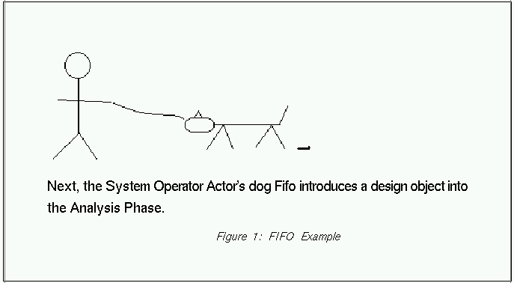
Use Cases Describe Function not Form
Use Cases describe WHAT the system will do, but never HOW it will be done.
Use Cases are Analysis Products, not Design Products.

Slide 21
Use Cases Describe Function not Form
Use Cases describe WHAT the system should do, but never HOW it will be done
Use cases are Analysis products, not design products

Slide 22
Benefits of Use Cases
Use cases are the primary vehicle for requirements capture in RUP
Use cases are described using the language of the customer (language of the domain which is defined in the glossary)
Use cases provide a contractual delivery process (RUP is Use Case Driven)
Use cases provide an easily-understood communication mechanism
When requirements are traced, they make it difficult for requirements to fall through the cracks
Use cases provide a concise summary of what the system should do at an abstract (low modification cost) level.

Slide 23
Difficulties with Use Cases
As functional decompositions, it is often difficult to make the transition from functional description to object description to class design
Reuse at the class level can be hindered by each developer “taking a Use Case and running with it”. Since UCs do not talk about classes, developers often wind up in a vacuum during object analysis, and can often wind up doing things their own way, making reuse difficult
Use Cases make stating non-functional requirements difficult (where do you say that X must execute at Y/sec?)
Testing functionality is straightforward, but unit testing the particular implementations and non-functional requirements is not obvious

Slide 24
Use Case Model Survey
The Use Case Model Survey is to illustrate, in graphical form, the universe of Use Cases that the system is contracted to deliver.
Each Use Case in the system appears in the Survey with a short description of its main function.
  Participants:
    Domain Expert
    Architect
    Analyst/Designer (Use Case author)
    Testing Engineer

Slide 25
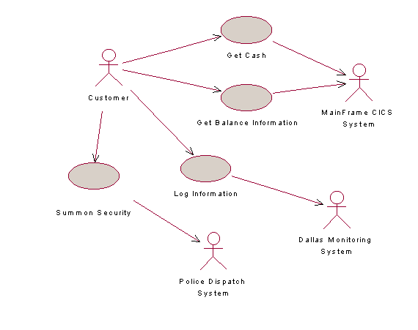
Sample Use Case Model Survey

Slide 26
Analysis Model
In Analysis, we analyze and refine the requirements described in the Use Cases in order to achieve a more precise view of the requirements, without being overwhelmed with the details
Again, the Analysis Model is still focusing on WHAT we’re going to do, not HOW we’re going to do it (Design Model). But what we’re going to do is drawn from the point of view of the developer, not from the point of view of the customer
Whereas Use Cases are described in the language of the customer, the Analysis Model is described in the language of the developer:
  Boundary Classes
  Entity Classes
  Control Classes

Slide 27
Why spend time on the Analysis Model, why not just “face the cliff”?
By performing analysis, designers can inexpensively come to a better understanding of the requirements of the system
By providing such an abstract overview, newcomers can understand the overall architecture of the system efficiently, from a ‘bird’s eye view’, without having to get bogged down with implementation details.
The Analysis Model is a simple abstraction of what the system is going to do from the point of view of the developers. By “speaking the developer’s language”, comprehension is improved and by abstracting, simplicity is achieved
Nevertheless, the cost of maintaining the AM through construction is weighed against the value of having it all along.

Slide 28
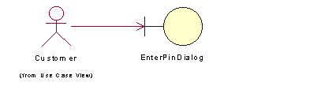
Boundary Classes
Boundary classes are used in the Analysis Model to model interactions between the system and its actors (users or external systems)
Boundary classes are often implemented in some GUI format (dialogs, widgets, beans, etc.)
Boundary classes can often be abstractions of external APIs (in the case of an external system actor)
Every boundary class must be associated with at least one actor:

Slide 29
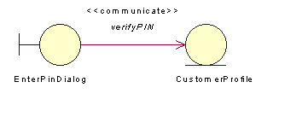
Entity Classes
Entity classes are used within the Analysis Model to model persistent information
Often, entity classes are created from objects within the business object model or domain model

Slide 30
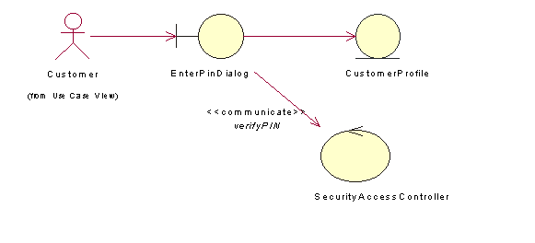
Control Classes
The Great Et Cetera
Control classes model abstractions that coordinate, sequence, transact, and otherwise control other objects
In Smalltalk MVC mechanism, these are controllers
Control classes are often encapsulated interactions between other objects, as they handle and coordinate actions and control flows.

