Slide 1
Introduction to Internet Technology
Lecture 2

Slide 2
AN OVERVIEW OF INTERNET TECHNOLOGIES
Although we use the term Internet to refer to a single entity or structure, the Internet is actually the infrastructure that provides access to or exchanges of information using several telecommunication services, or technologies, across numerous networks.
In contrast to the Internet, an intranet is a private network that resides within an organization and is not accessible to the public.
It uses networking hardware and software for communicating and storing or sharing files within the intranet.
Usually a networked computer can access both an intranet and the Internet.

Slide 3
AN OVERVIEW OF INTERNET TECHNOLOGIES
Internet technologies provide access to information that would have been impossible to access just a few years ago.
Using the World Wide Web, students have access to virtual libraries, electronic databases, and powerful search engines.
The Internet also permits interaction and communication among peers and with experts outside the local classroom, both synchronously and asynchronously.
Internet technologies support interaction and collaboration that allow students to share ideas, ask questions, and discuss classroom projects.

Slide 4
Old Internet Technologies
Old Internet technologies were used on the Internet prior to the beginning of the World Wide Web and now are not widely used.
Gopher
Gopher brought hierarchically organized text files from servers all over the world to a user’s computer.
Gopher was developed at the University of Minnesota (where sports teams are called the Golden Gophers) and was prominently used from about 1992 through 1996, when it was effectively replaced by the World Wide Web.

Slide 5
Telnet
Telnet is a protocol that permits basic communication between two host computers.
It was developed in the early days of the Internet as an accommodation to overcome simple differences among computers, such as what kind of character set to use.
Telnet allowed a person to log on to a host computer through the Internet as a regular user with whatever privileges were granted to the specific application and data on that computer.

Slide 6
Recycled Internet Technologies
Recycled Internet technologies were used on the Internet prior to the beginning of the World Wide Web but were modified to work as a Web service or are still widely used.

Slide 7
Electronic Mail
E-mail was one of the original Internet technologies, yet it remains probably the most popular technology used on the Internet.
E-mail allows messages comprised of text and other media to be sent between computers.
It was invented during the 1960s, when computer scientists devised ways of exchanging short messages within a large time-sharing computer system.
By 1970 electronic message traffic was moving smoothly on the Department of Defense network, and by the early 1980s network mail was called e-mail and the @ sign became an indispensable component of e-mail addresses.

Slide 8
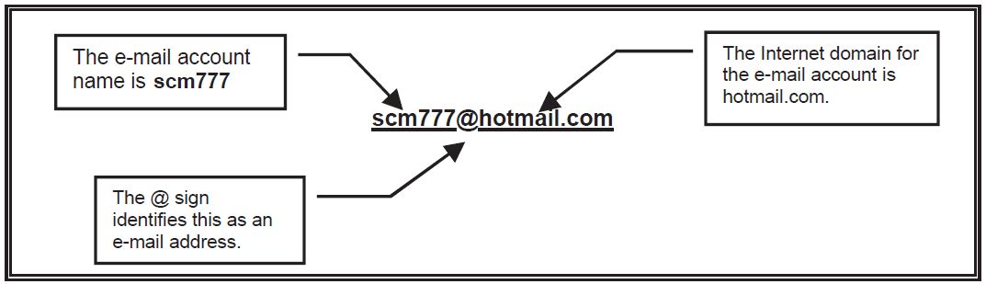
Electronic Mail…
An e-mail account is identified by an e-mail address, which has two parts, separated by an @ symbol.
To the left of the @ symbol is the account or user name; the part on the right identifies the domain of the mail server where your account resides.
The account or user name can be chosen or assigned, but it must be unique within the domain in which it is used.
The Structure of an E-Mail Address

Slide 9
File Transfer Protocol
File transfer protocol (FTP) is a standard Internet protocol that permits the exchange of files between computers on the Internet.
Like Telnet, FTP was developed in the early days of the Internet (it was released as a standard protocol in 1972) to make it possible to share files between computers.
FTP is now commonly used to transfer Web page files from the Web page author’s computer to a Web server. FTP is also commonly used to download programs and other files from a Web server to a user or client computer.

Slide 10
Transmission Control Protocol Internet Protocol
TCP/IP (transmission control protocol/Internet protocol) is the basic communication language, or protocol, of the Internet.
It can also be used in a local area network. The collection of networks eventually called the Internet was named for the first word of Internet protocol.
The Internet can best be described as one large worldwide network connecting many smaller networks.

Slide 11
Transmission Control Protocol Internet Protocol
TCP/IP is a two-layer program.
TCP manages the assembling of a message or file into smaller packets that are transmitted over the Internet and are then reassembled into the original message.
The other layer, IP, handles the address part of each packet so that it gets to the right destination.
A Gateway computer checks the address to see where to forward the message.

Slide 12
New Internet Technologies
New Internet technologies support the use of the World Wide Web.
Chat
Chat is real-time communication between two or more people using computers, usually through the Internet.
Any online, real-time conversation is chat or a form of chat.
Most networks, online services, and conferencing programs offer a chat feature.

Slide 13
Chat...
A chat room is a virtual space where a chat session takes place.
Technically, a chat room is a communications channel, but the term room supports the chat metaphor.
Because chat is intended for two-way communication, it supports a high level of interactivity among users.

Slide 14
Hypertext Transfer Protocol
Hypertext transfer protocol (HTTP) is the underlying protocol used by the World Wide Web.
HTTP defines how messages are formatted and transmitted and what actions Web servers and Web browsers should take in response to various commands.
For example, when you enter a URL in your browser, you send an HTTP command to the Web server directing it to fetch and transmit the requested Web page.

Slide 15
Hypertext Transfer Protocol...
FTP is a two-way system in which files can be transferred back and forth between server and client computers.
HTTP is a one-way system in which files are transferred from the Web server into the Web browser of the client computer.
When HTTP appears in a URL, it means that the user is connecting to a Web server and files are transferred but not downloaded and stored.

Slide 16
Hypertext Markup Language
Hypertext markup language (HTML) is the language in which Web pages are written.
HTML uses a simple system for denoting instructions, called tags, to convey the content and structure of a hypertext document, or Web page.
Hypertext, Web pages now commonly include other media, and it may be more accurate to use the term hypermedia instead of hypertext.

Slide 17
Hypertext Markup Language...
HTML files, or Web pages, use HTTP to transfer Web pages from a Web server through the World Wide Web to a client computer, where they are parsed and displayed using a Web browser program.

Slide 18
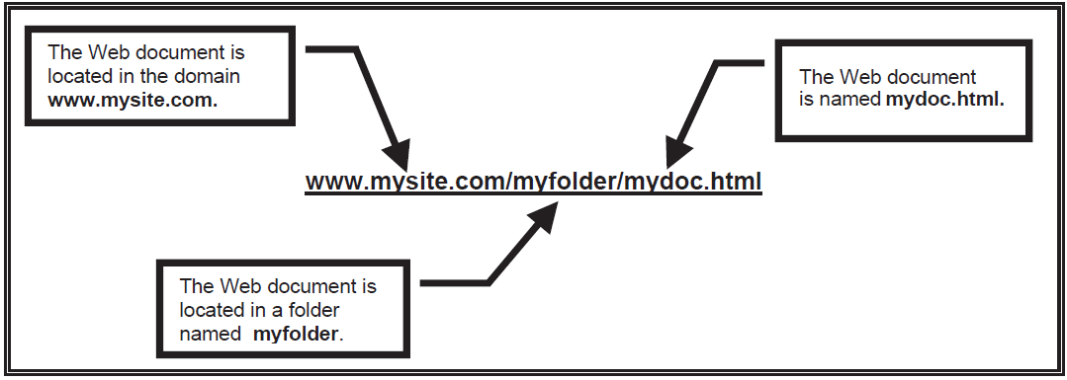
Uniform Resource Locator
A uniform resource locator (URL) is the address or location on the World Wide Web of a document or file that resides on a Web server connected to the Internet.
The URL is the most fundamental innovation of the Web, it is the specification used by any program, computer, or server connected to the Internet to locate a resource on the Web.
The Structure of a URL

Slide 19
Web Log
A Web log, or blog, is an online journal in the form of a Web page that is comprised of links and postings in reverse chronological order.
The activity of updating a blog is called blogging, and the person who maintains a blog is a blogger.
The totality of Web logs on the World Wide Web is often called the blogosphere.
Web logs are not actually an Internet technology but use Web publishing technologies and tools to disseminate information on the Web.
Two features common to Web logs are blogrolls and commenting, or feedback.

Slide 20
World Wide Web
The World Wide Web (WWW, or just Web) is the second most popular Internet application, second only to e-mail.
The Web is an application built on top of the Internet and used to access information resources through the Internet, using specific protocols to identify and locate that information.
The World Wide Web is a body of software, protocols, and conventions that provide for the viewing and publication of text and multimedia documents stored on computers known as Web servers.

Slide 21
SYNCHRONOUS AND ASYNCHRONOUS MODES
The Internet supports both synchronous and asynchronous communication channels.
Asynchronous communication is communication that occurs without regard to time or location; it is not necessary for all communicating parties to be present when communication occurs.
With asynchronous communication a message is sent but is not necessarily received (accessed and read) immediately.
Synchronous communication is communication that occurs in real time and is highly interactive; all communicating parties are simultaneously present.
With synchronous communication a message is sent and immediately received.

Slide 22
NETIQUETTE
Because of the unstructured nature of asynchronous and synchronous communication, it is important to establish clear rules and expectations for Internet communication sessions.
You should establish ground rules ahead of time that focus discussions on learning goals and make it easier to evaluate student participation.
Rules and expectations for information exchanges should be made clear in general guidelines for online communication.
Netiquette means network etiquette and refers to the dos and don’ts of online communication.

Slide 23
Questions ?

