Slide 1
To
MY
Presentation

Slide 2
RESEARCH PROPOSAL TITLE
RESEARCH PROPOSAL ON IDENTIFYING MAJOR FACTORS THAT AFFECT THE YIELD OF MAIZE PRODUCTION IN CASE OF WEREBABO WOREDA
.
BY:YIDIDIYA TESFAYE…… ID No: WOUR/2883/11
ADVISOR: TILAYE MATEBE (MSc)
APRIL, 2021
DESSIE,ETHIOPLA
28/8/2013

Slide 3
Research overview
Introduction
Statement of problem
Objectives
Significance of study
Methodologies
Data Analysis
Work Plan and Budget Breakdown

Slide 4
Introduction Background of Study
Maize is produced globally across temperate and tropical zones and spanning all continents.
Maize is one of the three leading global cereals that feed the world (shiferawet al.2011). Maize, together with rice and wheat, dominate human diets (lgnaciuk, 2014) and provide at least 30% of the food calories of more than 4.5 billion people in 94 developing countries.
It is produced by private peasant on wide holding and by cooperative and state form.

Slide 5
Cont’d…
Maize is often consumed because of providing nutrients for humans and animals
It also serves as a basic raw material for the production of starch, oil, protein, alcoholic beverages, food sweeteners, and fuel. There are many factors that hinder (obstacle) the yield of maize.
This study helps us to known the effect of these factors on the maize production.

Slide 6
Statement of the problem
Agricultural productivity in Ethiopia is very low compared to other Sub-Saharan African countries.
Even though the majority of people are depend on agriculture, private peasant land holders are many problems that one face. From this problem the major one is minimum production of maize.
The main goal of this study is to examine factors that influence yield from maize production and investigate the causes of relate with the minimum production of maize.

Slide 7
Objectives of the Study
General objective of the study
The general objective of this study to examine the factors that affect the yield of maize production.
Specific objective of the study
To identify the factor that affects the yield of maize production.
To identify the relationship between production of maize and the factor affecting the maize production
To know how to the increasing or decreasing the productivity of maize

Slide 8
Significance of the study
Maize plays important role in the country as staple human and livestock food and as arrow material for many industrial production..
This research study will be design to benefit the production by explore the effect of area of land, fertilizer, temperature, humidity and rainfall and make proper condition for this who are living in Werebabo woreda.
To identify the factor that affects to maize production in the Werebabo woreda and to increases the awareness of factor that affects maize production for the farmer lives in the study area.

Slide 9
Methodology
Description of Study Area
The Study will be conducted in Amhara Region Werebaboworeda.
This town is found at North part of Ethiopia 420 kilometer for Addis Ababa.
Study population
The study population is the total production found in case of Werebaboworeda.
The target population of this study is yearly maize production in the Werebaboworeda.

Slide 10
Study design and Sampling Techniques
The data being considered here is secondary source of data and obtained from Werebaboworeda Agriculture and cooperation development organization and Amhara region meteorological service center.
The data will be extracted from recorded documents in 1995 up to 2009, based on relevant information (variables) which is the cause of maize.

Slide 11
Variables considered in the study
The response variable/dependent variable
Total average yield of maize production in quintal per hectare.
Independent / explanatory variables
average annual temperature(x₁)
average annual rain fall(x₂)
total average fertilizer(x₃)
humidity(x₄)
Farm land size (x₅)

Slide 12
Sample size determination
The sample size is an important feature of any empirical study in which the goal is to make inferences about a population from a sample and the need to have sufficient statistical power.
An appropriate sample size is means of gaining high precision, accuracy and confidence with minus cost.
Methods of data collection
Secondary data collection methods will be applied to get the desired information

Slide 13
Methods of data Analysis
There are two types of method of data analysis
Descriptive statistics and
Inferential statistic
Descriptive statistics is Descriptive statistics deals with any methods or procedures used to organize and summarize masses of numerical data in to a meaning full form by using various statistical techniques such as graphs, averages, range, standard deviation and variances.

Slide 14
Inferential statistics
Inferential statistics deals with making inference or conclusion about population based on data will be obtained from a limit number of observation from population.
Inferential statistics Consists of estimation and hypothesis testing and there were two ways of estimation a certain parameters namely point estimation and interval estimation..
I will be use p-value approach to the smallest significance level at which the null hypothesis was rejected.
It will be use for conclusion and prediction of analyses, Multiple Regression and Correlation.

Slide 15
Regression Analysis
Regression analysis is a statistical technique that can be use to develop the mathematical equation showing how variables are related and it helps to find the form of relationship.
Multiple Linear Regressions
It is used when the researcher want to predict the value of a dependent variable based on the value of two or more independent variables (predictor or explanatory variables
Multiple linear regressions are an extension of simple linear regression.

Slide 16
Significance test for multiple linear regressions
Analysis of variance(ANOVA)
The ANOVA table is use to test the overall significance of the model.
It tests the null hypotheses which states that all coefficients of the model are equal to zero against the alternative hypothesis which states that at least one coefficient is different from zero.
Statistical Inference for Multiple Linear Regressions
It is used to understand whether all independent variables taken together to explain the variability observed in the dependent variable parameter estimation
The parameters of regression are estimated by ordinary least squares (OLS) method.

Slide 17
Overall model adequacy checking
Linearity
It is assumed that the relationships between dependent and independent variable are linear.
Normality
Probability plot (sometimes called a rank it plot) based on what a normally distributed data set of a given sample size should look like
Homoscedasticty (Constant Variance)
The constancy of the variance of the dependent variable (error variance) can be examined from plots of the residuals against any of the independent variables, or against the predicted value

Slide 18
Cont’d…
Test of presence of multicollinearity
Multicollinearity refers to the existence of high (perfect) linear relationship among regress ores can test the presence of multicollinearity by variance inflation factor,
Test of the presence of autocorrelation
Auto correlated refers to existence of correlation between the successive values of the error term

Slide 19
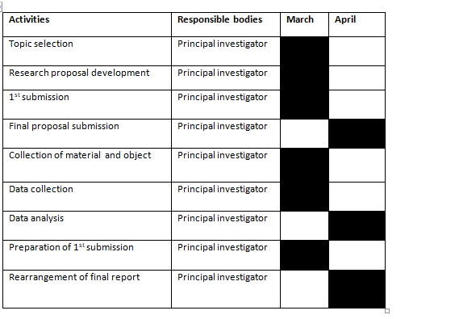
Work Plan and Budget Breakdown

Slide 20
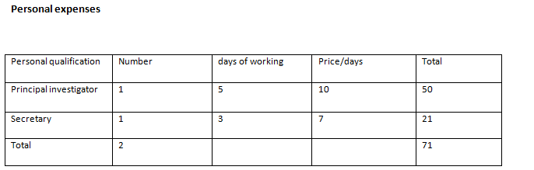

Slide 21
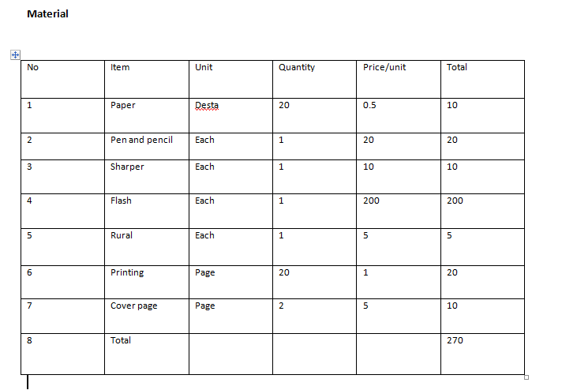

Slide 22

THANK YOU

