Slide 1
Progress report CW8
Bachelor Thesis, Elias Hanelt, 2025

Slide 2
How to organize
Using typst for my bachelor thesis and weekly progress reports
Created a github repo for the bachelor thesis

Slide 3
Trying to build a prototype with the Arduino Portenta H7
Before starting the bachelor thesis, Giacomo and I picked the Portenta H7, Portenta Max Carrier, Portenta Breakout Board for developing a prototype
Next steps: Ordering a Mid Carrier board to access the pins
Developed a small prototype to test things out

Slide 4
Creating a simple test script

Slide 5
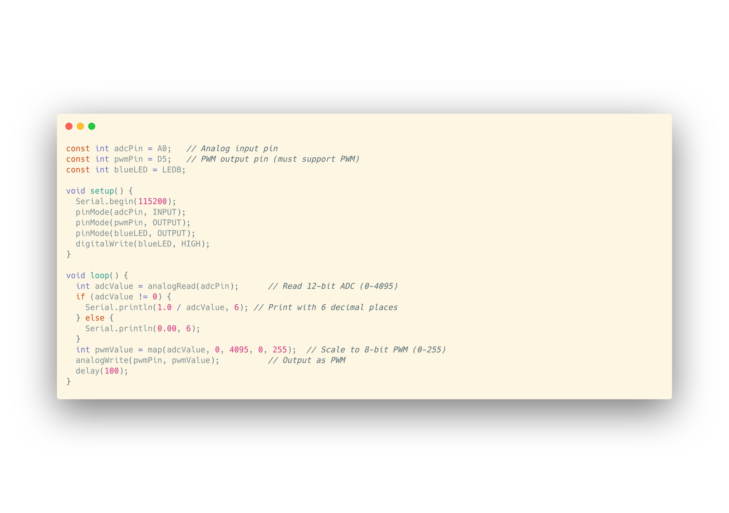

Slide 6
Errors while testing
Due to loose connections, testing was quite hard
-> ordering the mid size carrier

Slide 7
Designing a PCB
Requirements:
2 ADCs, 2 D/A converters for 2 BMC input/output pairs
JTAG programmer to program the STM32H7x
Ethernet Jack
USB-C power supply / data transfer
On/Off switch, physical knobs for gain/delay and threshold control
Debug LEDs/Testpads
Choosing parts that are available at JLCPCB for PCBA

Slide 8
Choosing the right IC
STM32H7x series
offers great adc performance (high resolution and sample rate)
integrated 10/100 Mbps Ethernet MAC
Dual core to handle communication and signal filtering at the same time
Since we only need to 2 pairs of ADCs and D/A converters STM32H723vgt6 is enough

Slide 9
Creating the schematics

Slide 10
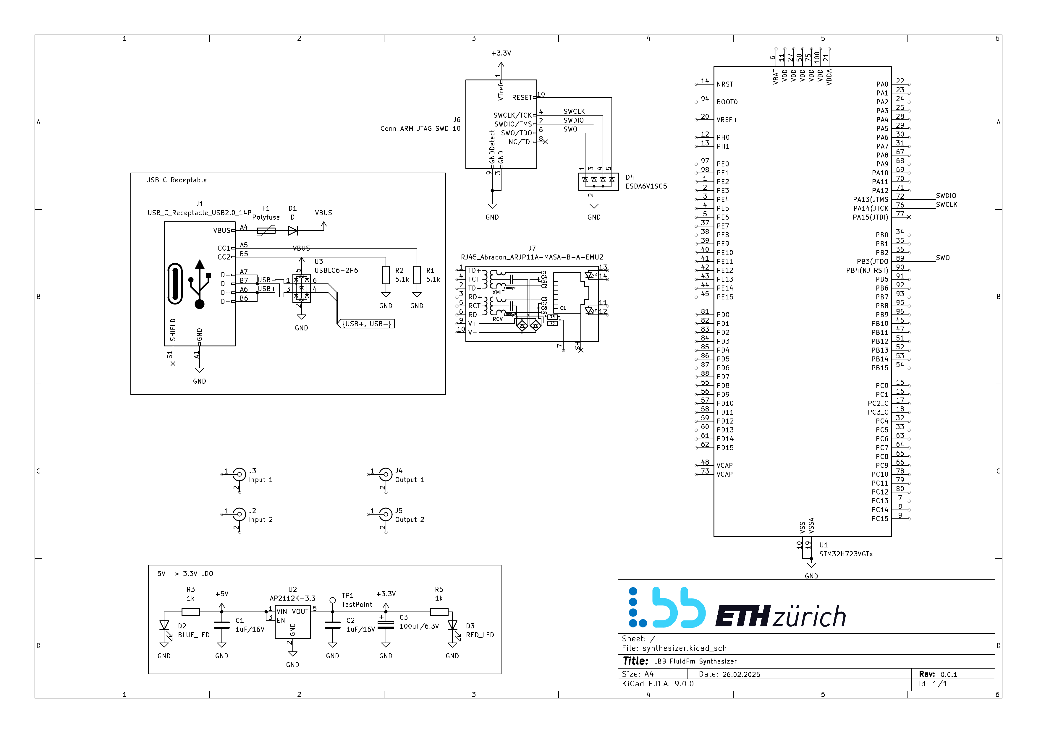

Slide 11
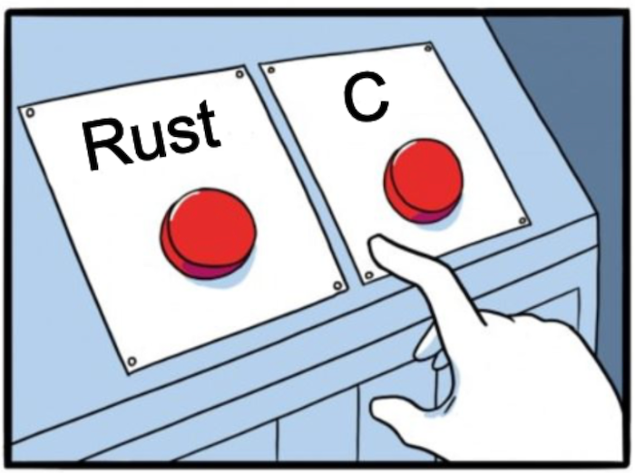
Choosing Rust over everything
Choosing rust as programming language because of its:
Memory Safety & Reliability
Zero-Cost Abstractions
Async Concurrency with Embassy-rs
Scalable & Maintainable Codebase

Slide 12
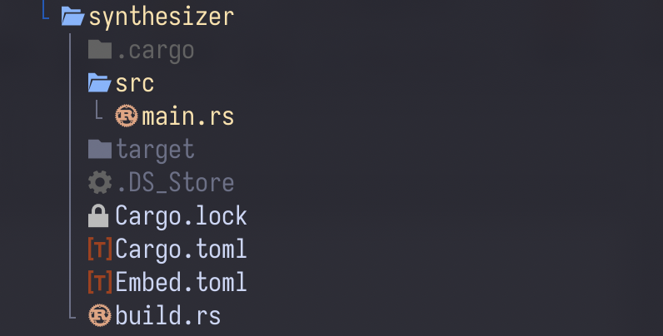
Codebase setup
A bit tricky since rust embedded is quite new

Slide 13
