Slide 1
Progress report CW9
Bachelor Thesis, Elias Hanelt, 2025

Slide 2
What did I do?
95% finished with own PCB (just missing the impedance matching) and LSE/HSE oscillators need to be checked
First tests using just the Portenta H7, ran into issues

Slide 3
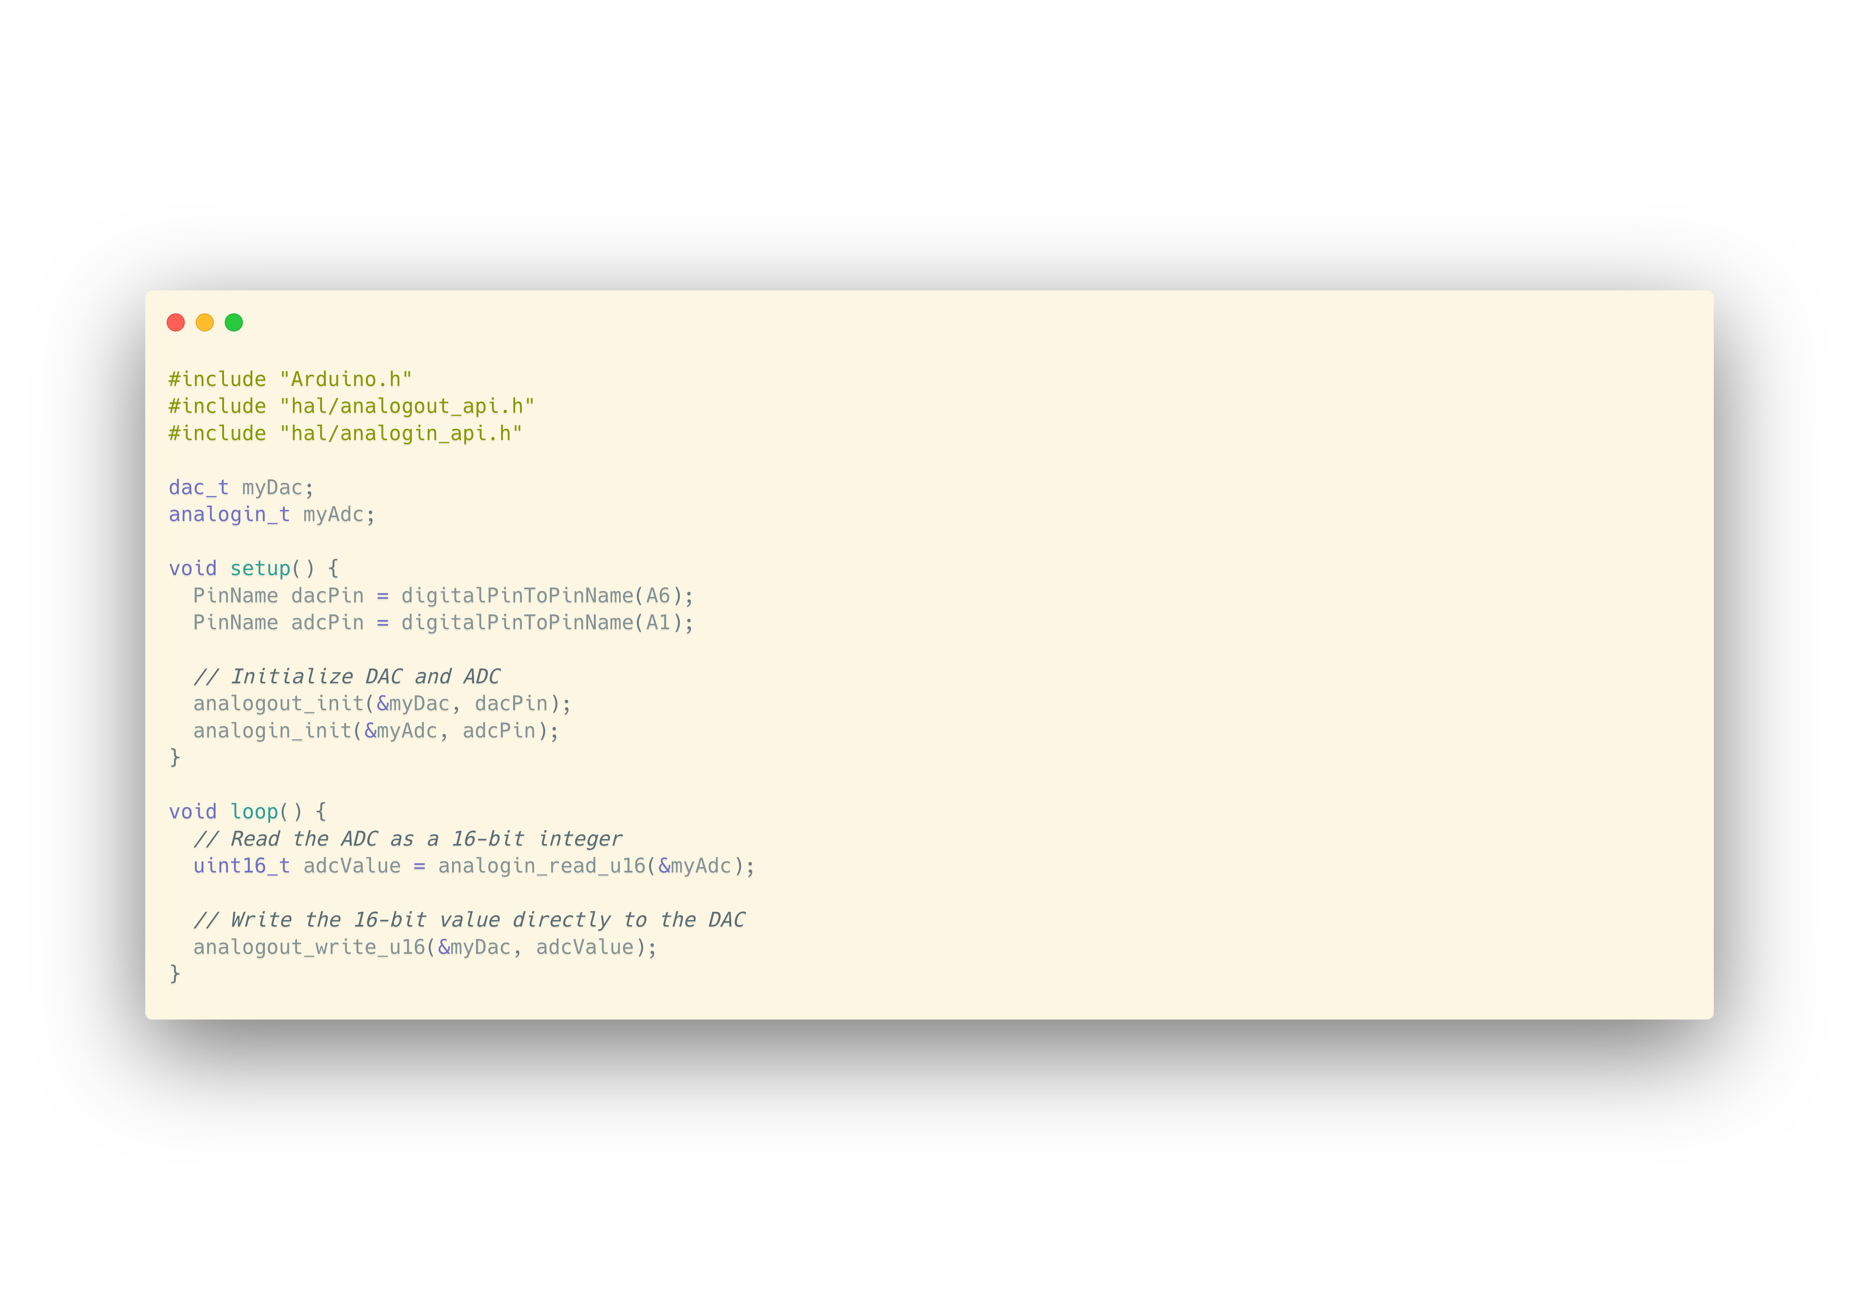

Slide 4
Results

Slide 5
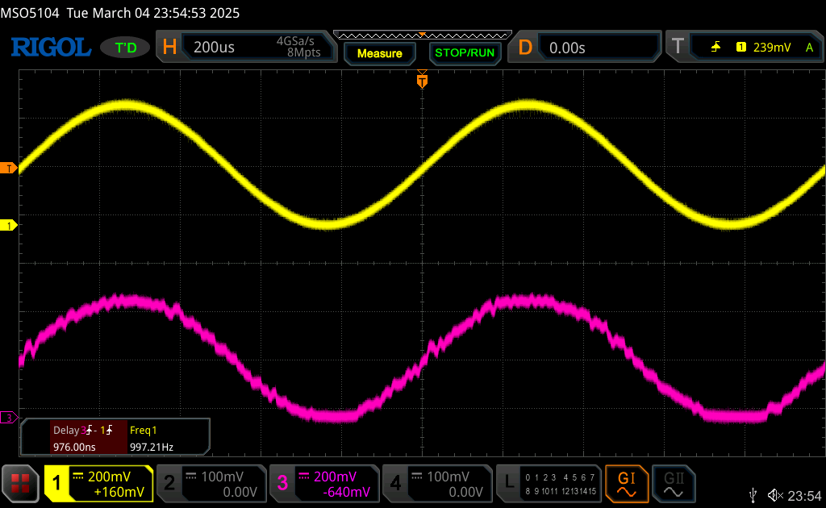
1Khz
Input
Output

Slide 6
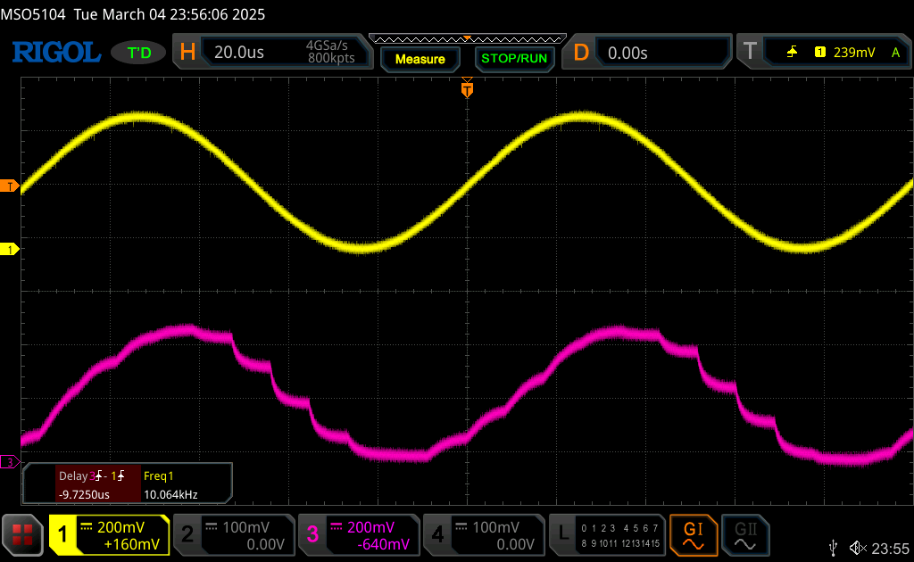
10 Khz
Input
Output

Slide 7
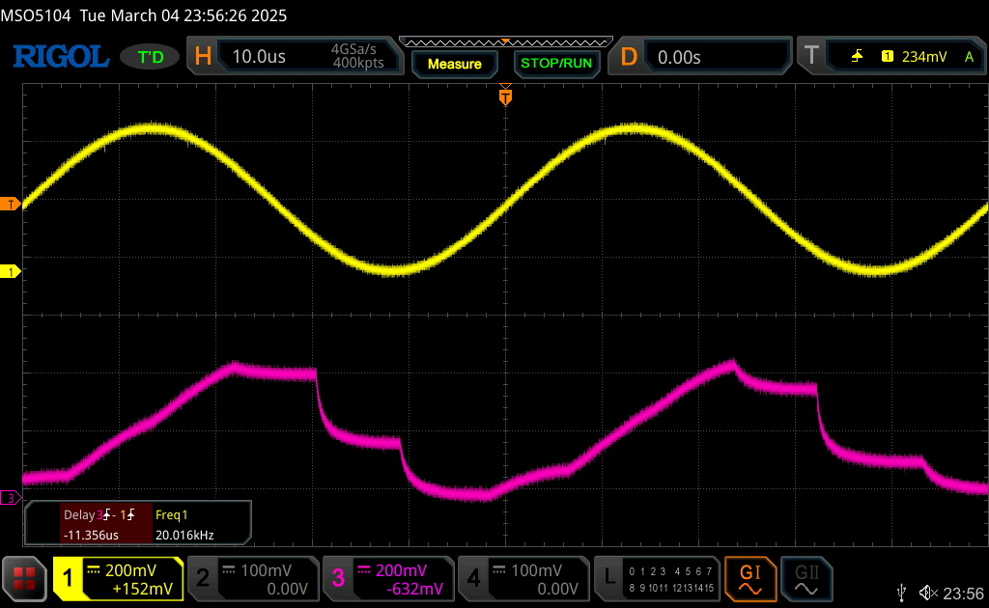
20Khz
Input
Output

Slide 8
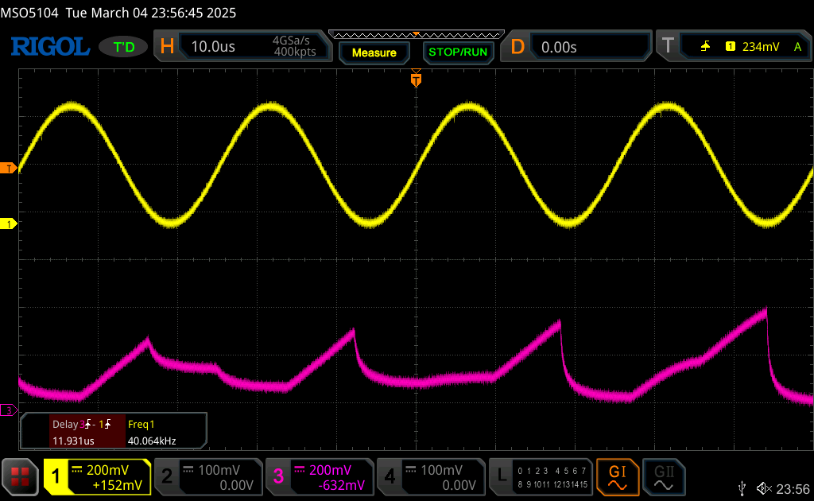
40Khz
Input
Output

Slide 9
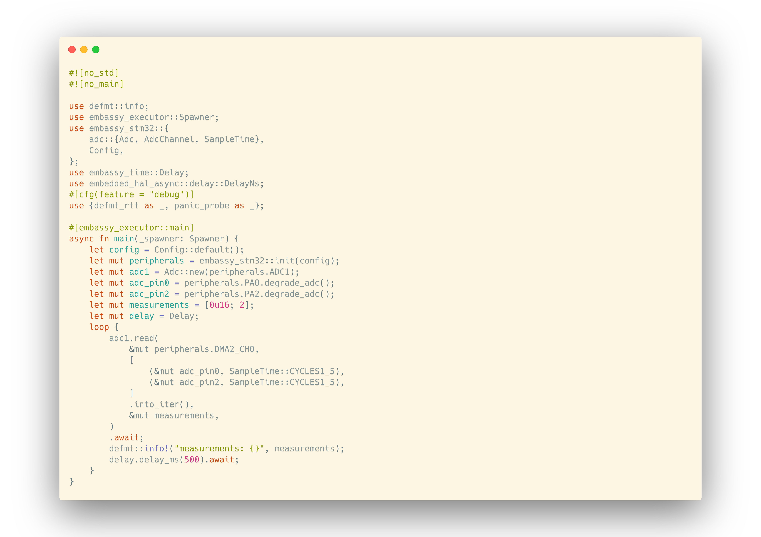

Slide 10
