Slide 1
Node & React
Elias Carlston, DevelopIntelligence
elias@eliascarlston.com
https://github.com/eliasjames/training-node-react

Slide 2
Day 4 Schedule
Flux pattern
Redux library
Test with Jest

Slide 3
Flux
What is Flux?
Flux is a pattern
Can be implemented from scratch fairly easily
There is also a library from Facebook called Flux
Avoids reinventing the wheel
Provides useful tools and benefits
Open source, so it's tested and supported

Slide 4
Flux
Why Flux?
One-way data flow works great
But in practice, UI events are not the only trigger
XHR events
setTimeout/setInterval
HTML5 APIs

Slide 5
Flux
Browser API
(XHR)
Listening to everything
at top level bloats it
Listening at lower levels
compromises clarity
App
Modular Components
UI event triggers
async API
Children
("Lego Blocks")
Potential for bugs
increases greatly when
UI and API events take different paths

Slide 6
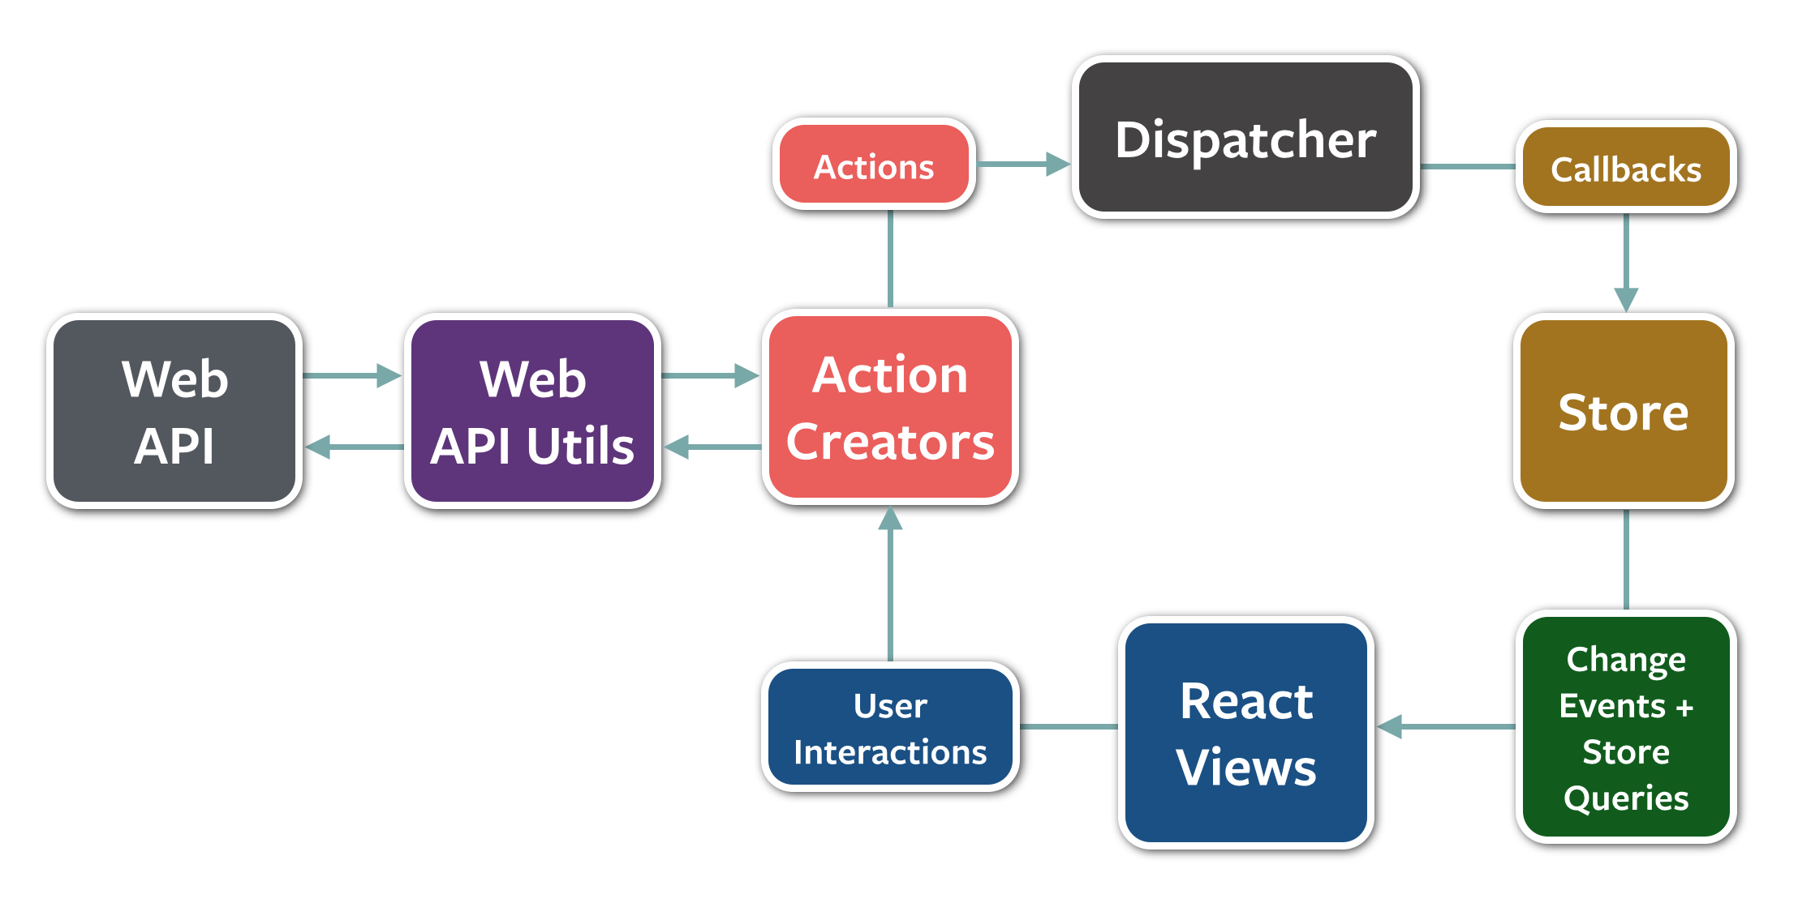
Flux

Slide 7
Flux
Flux pattern:
Stores (one or more) contain state
Initiators choose an Action from a predefined list
Send Action to dispatcher
Dispatcher notifies listeners, usually including a Store
Store updates views

Slide 8
Flux
Best practice bonanza
Actions contain all possible triggers
Stores contain all trigger handlers
Dispatcher decouples Stores from app code

