Slide 1
Intro to Web Dev
Elias Carlston, DevelopIntelligence
elias@eliascarlston.com
https://github.com/eliasjames/training-web-dev/

Slide 2
Day 1 Schedule
Introductions / Icebreakers
Course Overview
Intro to Web Dev
HTML Lab
Lunch
Intro to CSS + Lab

Slide 3
Introductions
About me
About you
Your name & brief experience
Something you look forward to learning
Something non-work related

Slide 4
Course Overview
Day 1
Web Development Basics
Developer Tools
Intro to HTML
HTML5 and Semantic markup
Intro to CSS

Slide 5
Course Overview
Day 2
CSS: Box Model, Display & Positioning
CSS: Selectors, Specificity, Cascade
Intro to Javascript
Control flow, data structures, functions
JS Lab

Slide 6
Course Overview
Day 3
Functions: scope, context, hoisting
Basic Objects and Prototypes
JS Lab 2
jQuery
JS Lab 3

Slide 7
Intro to Web Dev
Expectations for Basics session
Some information may feel like review for you
May not be review for your neighbor
Fundamental concepts deserve review

Slide 8
Intro to Web Dev
Common Historical Themes
Versionless - ad hoc feature support
Stateless - data not stored between actions
Backwards compatible & fault tolerant
Iterative - modern web not planned
Community builds solutions between iterations

Slide 9
Intro to Web Dev
Goals for Web Development
Clear: easily identify which code does what
Usable: productive and helpful for users
Robust: work as often as possible; fail gracefully
Limber: easily reuse and adapt

Slide 10
Intro to Web Dev
Best Practices
Small pieces
Good organization & formatting
Separation of Concerns / Single Responsibility

Slide 11
Web Dev Basics
What is the Web?
At its most basic, Request and Response
Client makes a request to Server
Client handles the Server's response

Slide 12

Web Dev Basics
What is the Web?
Server
Request
Client
(User Agent)
…wait…
Client:
"Page not found"
Response
Client changes
"state"

Slide 13
Web Dev Basics
User Agents
Browsers
Mobile Apps
Voice Browser ("Screen Reader")
Web crawler ("Robot")

Slide 14
Web Dev Basics
Server / Host
A Server accepts connections from clients
A host is a network device providing resources
Server : Hotel Front Desk :: Host : Guest in room
May be the same machine - client doesn't know

Slide 15
Web Dev Basics
TCP/IP
Transmission Control / Internet Protocol
IP like phone hardware: addresses, routing, signal transmission
TCP like a phone call: place call, wait for answer, ask question, ensure answer received, hang up

Slide 16
Web Dev Basics
Domain Name Service (DNS)
Like a phone book
Turns a human-friendly name into IP address
'google.com' -> 172.16.254.1
A server at that IP "listens" on Port 80 (HTTP)

Slide 17
Web Dev Basics
Uniform Resource Locator (URL)
Everything needed to locate a resource
http://google.com/news/today#sports
Scheme. Usually called "protocol". Sets default port
Host. DNS replaces with IP address
Everything after host. Often called "path". Should uniquely identify a resource (URI)
Full syntax:
scheme:[//[user:password@]host[:port]][/]path[?query][#fragment]

Slide 18
Web Dev Basics
HTTP
Hyper Text Transfer Protocol
Defines communication methods
HTTP message consists of header and body
Split into chunks & sent via TCP/IP

Slide 19
Web Dev Basics
Layers in a typical transaction
URL host -> DNS -> IP address
TCP/IP connect to host -> HTTP GET request
Server
(Host)
…Host
processes
path…
Browser
(URL)
Client & server consider transaction finished
"Hello World"
TCP/IP connect to client
Send HTTP Response
Containing HTML payload
Browser parses HTTP
& renders HTML

Slide 20
Web Dev Basics
HTTP
Hyper Text Transfer Protocol
Defines communication methods
Two types, Request and Response
Response often includes HTML
Stateless - each Response ends transaction

Slide 21
Network Tools
nslookup
'nslookup [target domain]'
Displays results of DNS lookup
IP address of DNS server
IP address of target
Try using IP address of target in browser

Slide 22
Network Tools
traceroute (Windows: tracert)
'traceroute [target domain]'
Traces route takes to destination
Useful to verify server location

Slide 23
Network Tools
curl
Name pronounced "curl" but means "See URL"
Fetch HTTP based on command line input
Write raw results to command line output
Useful for verifying server response without browser

Slide 24
Network Tools
curl
(Windows: https://curl.haxx.se/download.html)
'curl -v google.com'
Verbose mode (-v) is more interesting:
'curl -v www.google.com'

Slide 25
Web Dev Basics
HTTP Request
Specify a resource (noun) and a method (verb)
Common methods
GET: retrieve data ("safe" - does nothing else)
POST: add request body to a resource
PUT, DELETE, OPTIONS

Slide 26
Web Dev Basics
Common HTTP Request Headers
Accept (content-types)
Cookie
Origin
User-Agent

Slide 27
Web Dev Basics
Common HTTP Response Headers
Status
Cache-Control
Content-Type ('text/html', 'application/json')
Set-Cookie
Access-Control-Allow-Origin (aka CORS)

Slide 28
Web Dev Basics
HTTP Status Codes
1xx Informational
2xx Success
3xx Redirection
4xx Client Error
5xx Server Error

Slide 29
Lab: More HTTP
Visit http://requestb.in/
Follow instructions
Create a new bin
Submit POST / PUT / DELETE requests
Examine results

Slide 30
HTML
Hyper Text Markup Language
Invented by Tim Berners-Lee at CERN
Inspired by SGML, an earlier markup from IBM
Intended for physicists to share white papers
Took its guidance from outline format
List, section, header, paragraph

Slide 31
HTML
Hyper Text Markup Language
"Markup" human-readable content with semantics
Syntax : Semantics :: Grammar : Meaning
Elements add semantic meaning
Attributes modify elements

Slide 32
HTML
HTML Syntax
<element-name attribute-name="value">
Element innerHTML <another-element>
</element-name>
Case insensitive, lower case preferred
Double quotes required
Closing tag depends on element

Slide 33
HTML
HTML Document structure
Document begins with <html> element
Contains <head> and <body>
<head> contains metadata about the document
<body> contains document content

Slide 34
HTML
<!-- from https://www.sitepoint.com/a-basic-html5-template/ -->
<!doctype html>
<html lang="en">
<head>
<meta charset="utf-8">
<title>The HTML5 Herald</title>
<meta name="description" content="The HTML5 Herald">
<meta name="author" content="SitePoint">
<link rel="stylesheet" href="css/styles.css?v=1.0">
<!--[if lt IE 9]>
<script src="https://cdnjs...html5shiv.js"></script>
<![endif]-->
</head>
<body>
<h1>Most Important</h1>
<script src="js/scripts.js"></script>
</body>
</html>

Slide 35
HTML
Common tags
a: 'anchor', for links (with 'href=#' attribute)
img: image, with 'src' attribute
h1-6: header, like main topic in an outline

Slide 36
HTML
Common tags
div: 'division', a generic container
ul/ol/li: (un-)orderered lists, list item
table/tr/td: tabular data, rows and cells (td)

Slide 37
Lab: Plan HTML UI
Plan a basic HTML file for TicTacToe UI
Determine requirements
(See /examples for suggestions)
Identify proper HTML elements

Slide 38
HTML
Style guide - why have one?
Many styles are a matter of taste
Codebase should look like it had one author
Following the guide more important than taste
Proper indentation is not just taste
Formatting is critical to visual clarity

Slide 39
HTML
Common style rules
All lowercase
Indent nested tags
Use two spaces for indenting
Break long elements (>80 chars) into multi lines
Use whitespace to separate functional sections

Slide 40
Lab: HTML UI
Implement HTML for TicTacToe UI
Create a separate folder for this project
Copy 00-html5-starter-template.html there
Add HTML based on Plan Lab
View in browser

Slide 41
HTML
Fault Tolerance
Browsers will "fix" a lot of problem HTML
Unrecognized elements
Unmatched close tags
Invalid attributes
This can be good and bad

Slide 42
HTML
Validation
Automatic validation identifies HTML errors
Bad HTML can cause insidious problems
SEO / ADA penalties
JavaScript errors

Slide 43
HTML
Validation
https://validator.w3.org/
Various browser & IDE plugins available

Slide 44
HTML
Common validation errors
Some tags and elements are required
<!doctype html>, <meta charset>
Some tags can't nest within others
<input> and header tags (<h*>)
<img> tags require 'alt' attribute

Slide 45
Lab: Validation
Validate basic HTML file from last lab
Examine results & fix errors
Find some other validation rules
Intentionally invalidate
Examine what happens in browser

Slide 46
HTML
Document Object Model (DOM)
Browser parses HTML
Creates a representation in memory
HTML is the recipe, DOM is the food
HTML attributes become DOM properties

Slide 47
HTML
Chrome Developer Tools
View > Developer > Developer Tools
Or, right-click and choose "Inspect Element"
If not already, choose "Elements" from menu

Slide 48
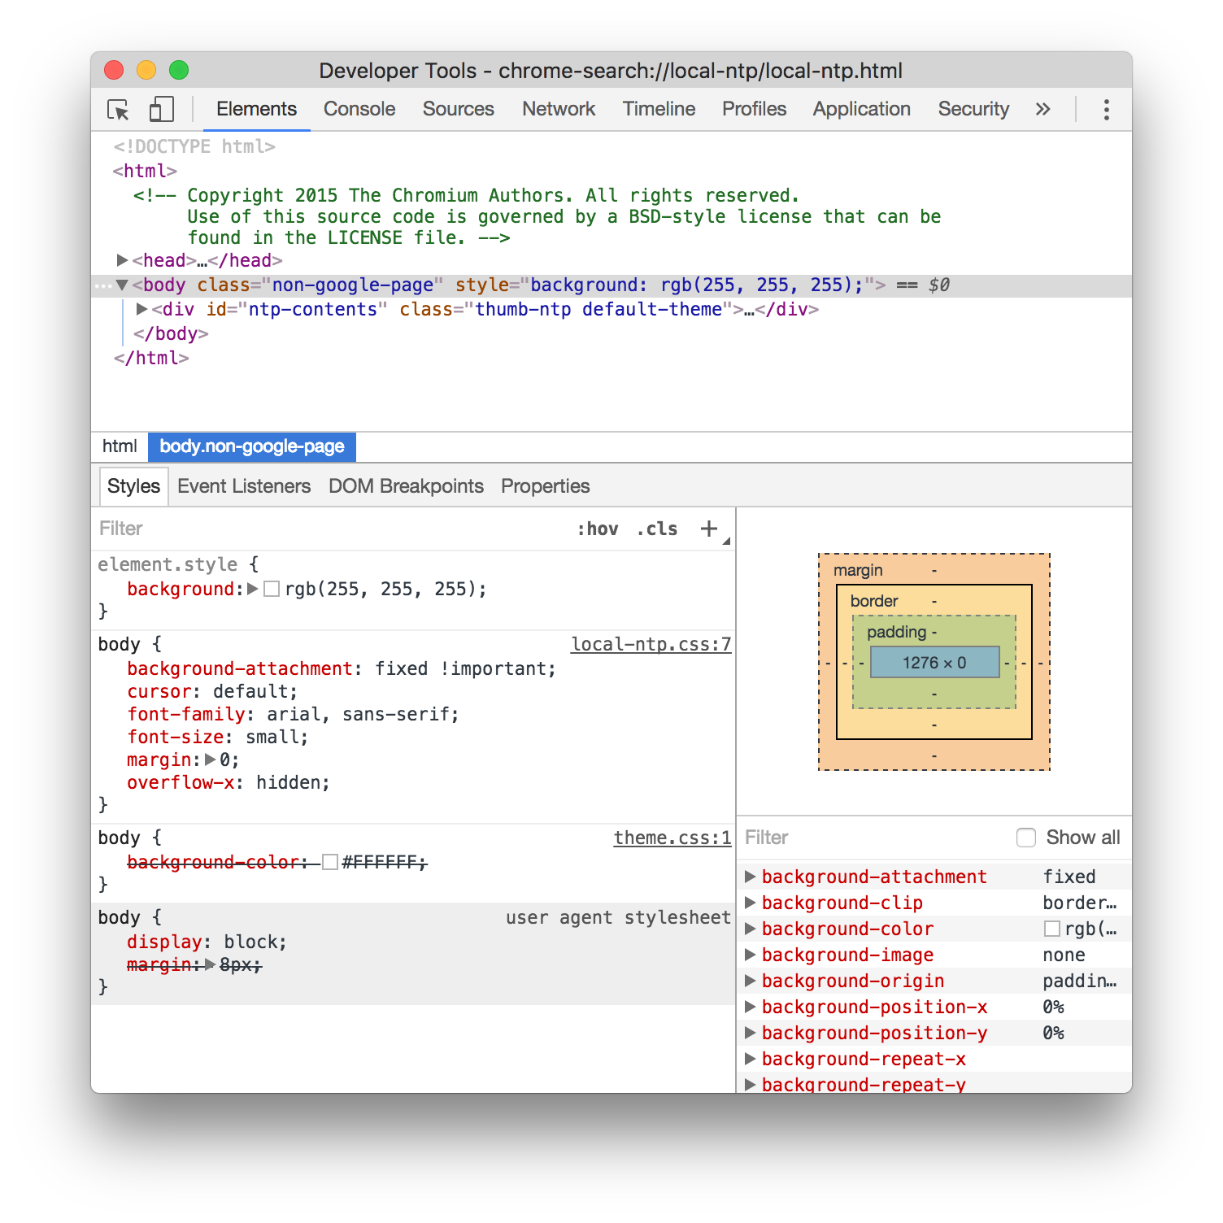
HTML
Chrome Developer Tools

Slide 49
Lab: Dev Tools
Examine HTML page with Dev Tools
Context-click on items in Elements panel
Modify elements' HTML
Modify elements' properties
Delete elements
Reload page

Slide 50
Advanced HTML
HTML Spec
Version 4 finalized in 2000
A lot changed since then
Spec didn't change until 2014
What happened?

Slide 51
Advanced HTML
HTML Spec
Browsers started supporting new features
<video>, SVG, geolocation, oh my!
HTMLWG couldn't / didn't keep up
Fault tolerance ~= future proofing

Slide 52
Advanced HTML
HTML5
Spec used to declare what should be implemented
Didn't work out great (JavaScript, CSS wars)
HTML5 flipped the order
Described the consensus usage of what already existed

Slide 53
Advanced HTML
HTML5
HTML5 is a group of features
Browsers support as many as they can
Developer is responsible for either
Progressive enhancement
Graceful degradation

Slide 54
Advanced HTML
HTML5 additions
New functional elements: <video>, <canvas> etc.
JavaScript: APIs like local storage
JavaScript ES6 often lumped in with HTML5
Semantic elements

Slide 55
Semantic Elements
Remember voice browsers?
They need an equivalent experience
<div> and <span> got overused for formatting
Use semantic elements instead

Slide 56
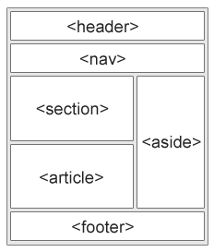
Semantic Elements
Instead of multiple <div>…

Slide 57
Semantic Elements
<details> - Additional info the user can view or hide
<summary> - heading for <details>
<figure> - Content, like images, code, etc.
<figcaption> - caption an <img> within <figure>
<main> - Specifies the main content of a document
<mark> - Defines marked/highlighted text
<time> - Defines a date/time

Slide 58
Semantic Elements
New Input Types
date/time/-local, number, range, search, tel, url
Older browsers treat new tags as type="text"
New Input Attributes
autocomplete, form, list, multiple, pattern

Slide 59
Lab: HTML5 UI
Add header, footer, main, nav, sections
Use template for several additional pages
"Player Info" section
"About TicTacToe"
Login / Signup
Repeat planning process for HTML elements

Slide 60
Intro to CSS
What is CSS?
Cascading Style Sheets
Controls visual display (presentation)
Consists of DOM property settings
And tools to organize them

Slide 61
Intro to CSS
What is CSS?
A helpful oversimplification:
Every HTML element is a rectangular box
Browser has rules to render those boxes
CSS alters that default rendering

Slide 62
Intro to CSS
What is CSS?
Two part syntax
Selectors
Rules
Selectors define groups of elements
Rules set properties

Slide 63
Intro to CSS
Selectors
Expressions which describe groups of elements
Identifiers: Tags, classes, ids
Operators: space, comma, greater than, plus
Rule is then applied to the matched elements

Slide 64
Intro to CSS
Rules
Set CSS properties on selected elements
All aspects of display: positions, colors, images
CSS3 supports animations, 3D rotation, etc

Slide 65
Intro to CSS
Selector
body {
border: 1px solid red;
color: lightblue;
}
div.some-class {
background-image: #ffffff url("img_tree.png") no-repeat right top;
font-size: 3em;
margin: 3px 2px 3px 2px;
padding: 3px 2px; padding-left: 4px;
}
Rule
Properties

Slide 66
Lab: Basic CSS
In index.html, add a link to a style.css file
Play with styles in Dev Tools
When satisfied, write a style to file
Refresh browser

Slide 67
CSS Flow
Content flows left-to-right until some border is hit
Then down, increasing box height, until
content runs out
or a border is hit

Slide 68
CSS Flow
Several properties interact to create those borders
Width
Display
Float
Clear

Slide 69
CSS Width
If width is not specified, content makes the box as wide as necessary to fit
If width is specified, content makes the box as tall as as necessary
If there's more content than width & height can display, 'overflow' property controls extra

Slide 70
CSS Width
Measurements - px
pixels
Atomic units of display
Actual size based on device

Slide 71
CSS Width
Measurements - em
ems
Based on the width of the 'm' character
From print industry
Relative based on font size

Slide 72
CSS Width
Measurements -%
percent
Based on the width of the container
Specifying a width of 100% has some special behavior

Slide 73
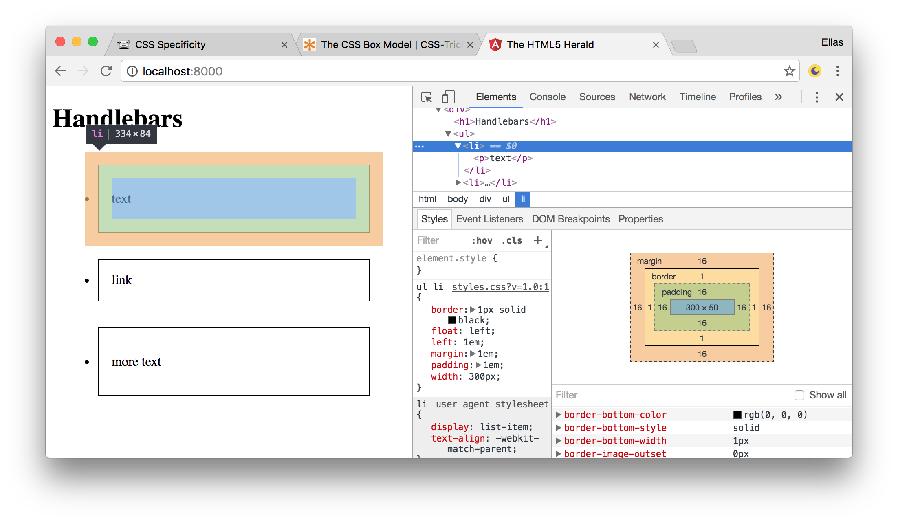
CSS Box Model
Inside out: width/height, padding, border, margin

Slide 74
CSS Box Model
Padding
Space between box contents and border
When no width set, padding will "squeeze" contents
When width is set to 100%, padding will "push" other elements to make room

Slide 75
CSS Box Model
Border
Visible area around box
Can set color, pattern, etc
Does not affect box contents
Does affect box width & height

Slide 76
CSS Box Model
Margin
Invisible area outside border
Does not affect box contents
May affect layout with other boxes
Can think of margin as "pushing" others
Depending on their positioning (some can't be)

Slide 77
Lab: Box model
Style TicTacToe UI using box model
Style other pages
Observe differences between elements

Slide 78
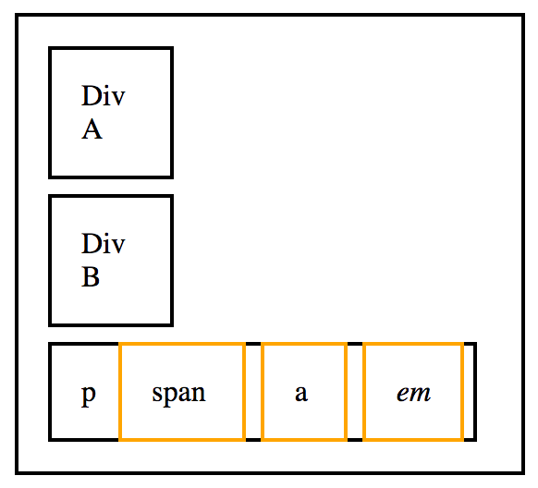
CSS Layout
Display
"Block" - forces a new line
div, p, ul, table
"Inline" - flows within a block element
span, a, img

Slide 79
CSS Layout
Float
Float removes block elements from flow
Attaches them to left / right side
Text / inline elements wrap around floats
Float only kicks in when width allows

Slide 80
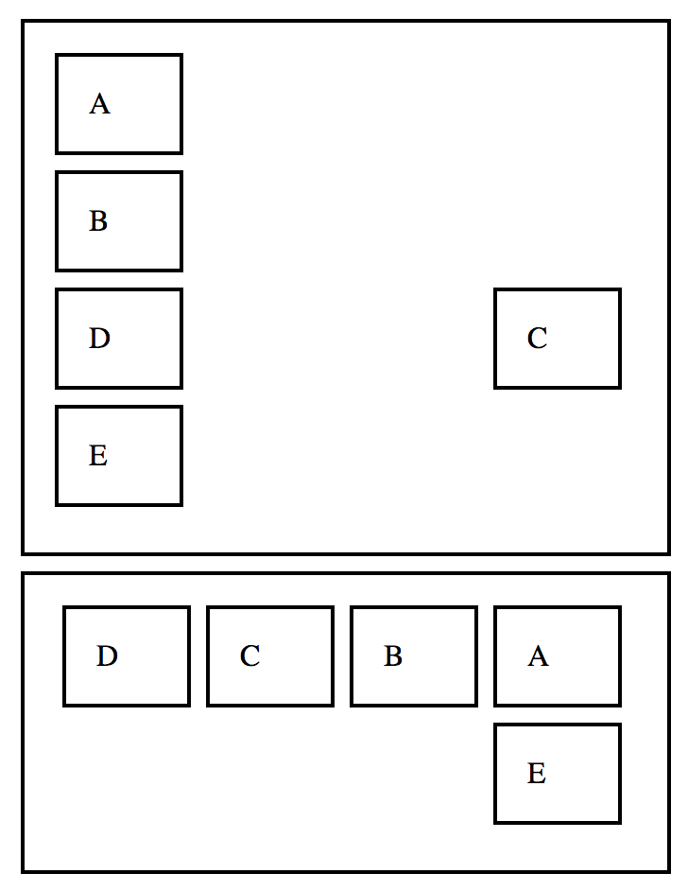
CSS Layout
.right, .right * {
float: right;
}
<section>
<div>A</div>
<div>B</div>
<div class="right">C</div>
<div>D</div>
<div>E</div>
</section>
<section class="right">
<div>A</div>
<div>B</div>
<div>C</div>
<div>D</div>
<div>E</div>
</section>

Slide 81
CSS Layout
Clear
Sets sides on which floats can't go
Values: left / right / both
Causes elements to start a new line

Slide 82
Lab: Layout
Make nav bar menu items horizontal
Wrap text around picture in "Player Info"
Use percentage widths and floats to make basic fluid layout
Observe what happens when resizing window

Slide 83
Positioning
Like float, another way of altering element flow
Can use top / bottom in addition to left / right
Aware of containers

Slide 84
Positioning
Static: no positioning, default
Relative: offset based on flow position
Fixed: offset based on viewport
Absolute: based on parent, removed from flow
Sticky: relative until scrolled past, then fixed

Slide 85
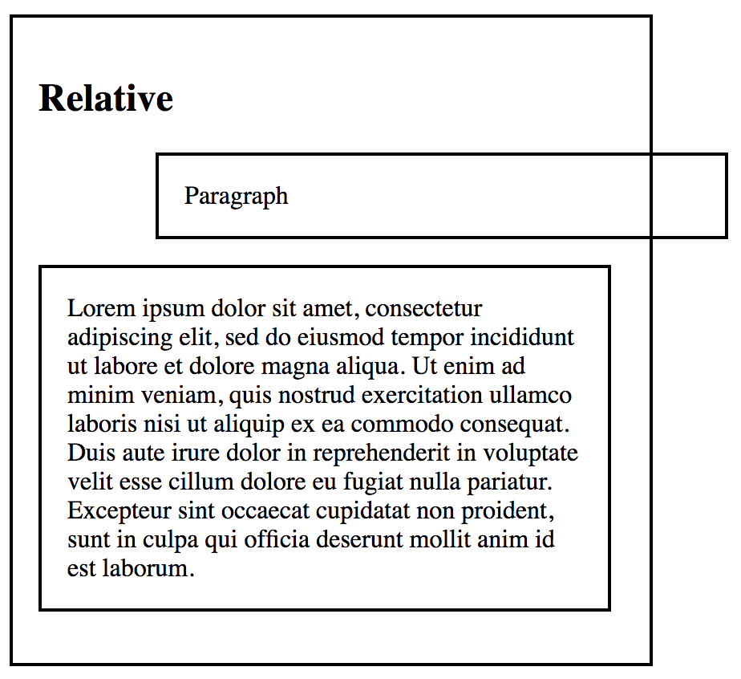
Positioning
Relative position
Calculated based on regular flow position
Offset added
Moving the element "relative" to normal location

Slide 86
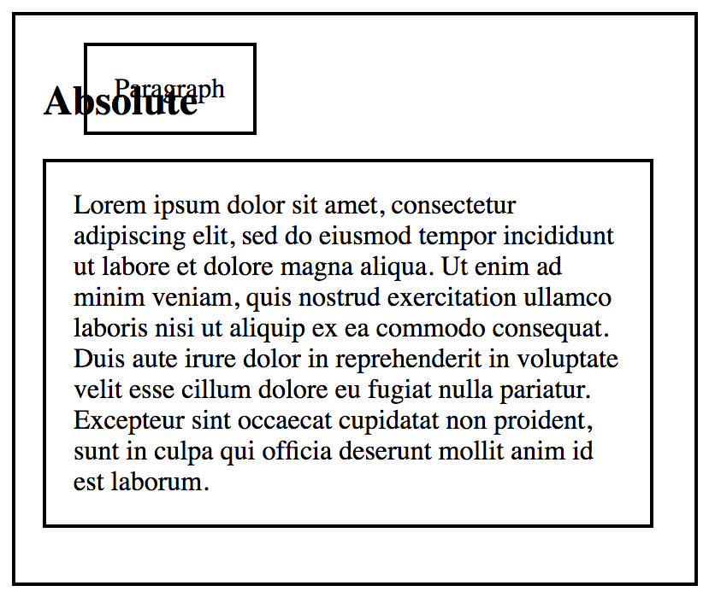
Positioning
Absolute position
Removed from regular flow (takes up no space)
Offset based on nearest positioned (non-static) parent
If no non-positioned parent, initial container (body)

Slide 87
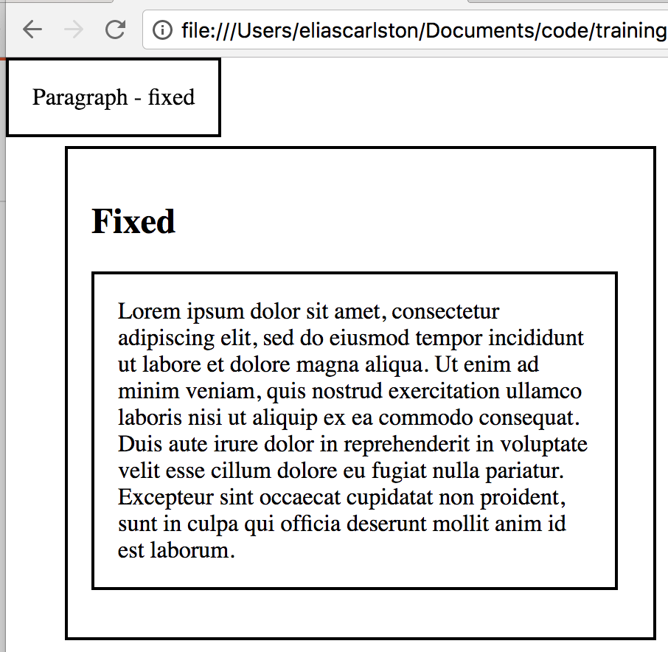
Positioning
Fixed position
Removed from regular flow (takes up no space)
Offset based on viewport (currently visible screen)
Keeps position when page scrolls

Slide 88
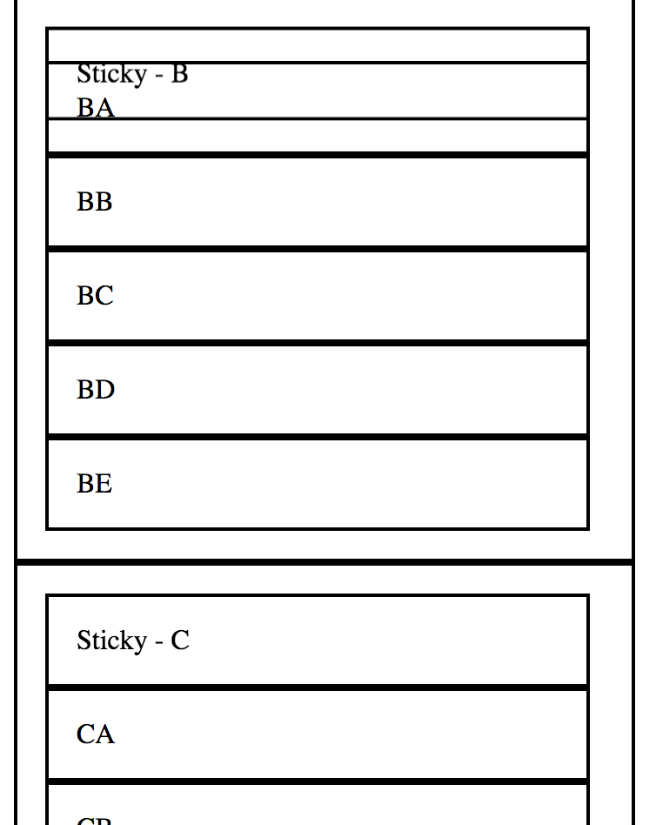
Positioning
Sticky position
Behaves relative until scroll passes offset
Then behaves as fixed but within container
Must have offset to work
Supported in "evergreen" browsers

Slide 89
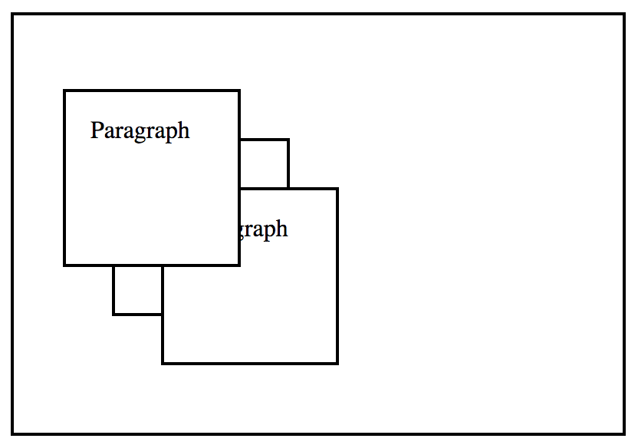
Positioning
Z-Index
Indicates element "on top"
Within "stacking context"
New context started
Positioned element with a z-index
opacity, transform, filter, perspective

Slide 90
Lab: Positioning
Full width header and content area
Side bar next to content area
Full width footer
Modal dialog (aka "popup" or overlay)
Scrollable side bar with sticky headers

