Slide 1
Intermediate JavaScript
Elias Carlston, DevelopIntelligence
elias@eliascarlston.com
https://github.com/eliasjames/training-web-dev/

Slide 2
Course Overview
Day 3
Responsive Design & Grids
CSS3 Overview
Foundation 5 CSS & Sass
Foundation 5 JS

Slide 3
Responsive
General Principles
Responsive means responding to client
Too many clients to customize for each
Clients may not be visual or even human
All clients can't have the same experience
…but, all clients can have a good experience

Slide 4
Responsive
General Principles
Recommended approaches
Content first
Mobile first
Offline first

Slide 5
Responsive
General Principles
Minimalism
Support a few cases really well
Use as little CSS as possible
Less to maintain, less to debug
Remove unused styles

Slide 6
Responsive
Responsive means responding to client

Slide 7
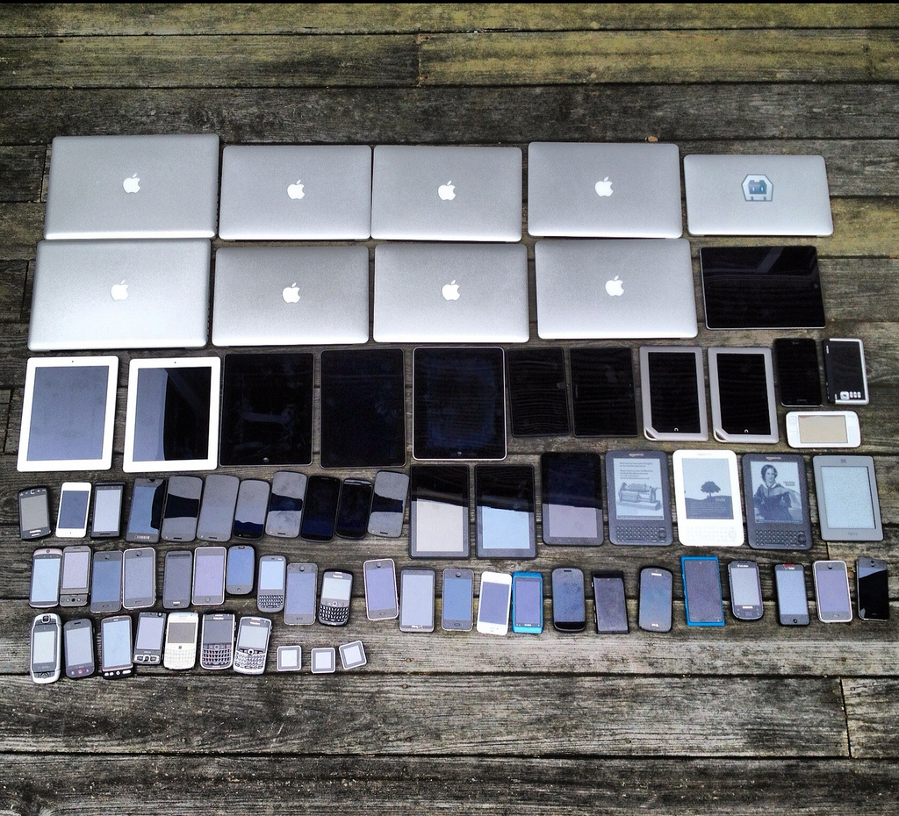
Responsive
But how to respond to a client you don't know?

Slide 8
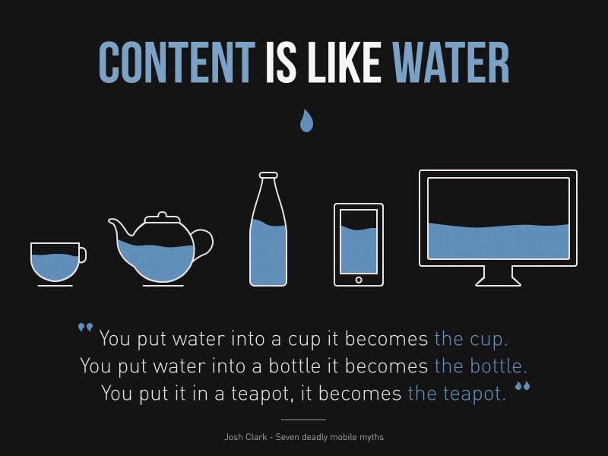
Responsive
But how to respond to a client you don't know?
source: mightyminnow.com

Slide 9

Responsive Design
Affordance
The possibility of an action on an object or environment.
Mapping
Correspondence between possibility and action
Feedback
Signal that indicates effectiveness of action

Slide 10
Accessibility
Review accessibility checklist
https://www.hhs.gov/web/section-508/making-files-accessible/checklist/html/index.html

Slide 11

Chrome emulator
Open Dev Tools
Open Device Toolbar
Examine common sizes
…and some uncommon ones:
Device list > edit… > Emulated Devices

Slide 12
Lab: View on Device
Start web server in directory
Mac: python -m SimpleHTTPServer
Win: Use node server from previous example
Find IP
Mac: System Preferences > Network
Win: cmd.exe > 'ipconfig'
On device, open "http://[IP address]]/"

Slide 13
Lab: Fluid
examples/day3/am-responsive/01-fluid/01-fluid.html
Layout should look good at all sizes
Use ems for relative measurements
Center content within containers
Use % width and margin: auto for blocks
Add padding to inline content

Slide 14
Media Queries
Target rules based on device capability
Most commonly min- and max- width
Transitions ranges are called "breakpoints"
Think "ranges" or "uses" instead of "devices"
2 may be enough. More than 5 prob too many

Slide 15
Media Queries
Multiple Breakpoints
Think of groups / categories of devices
Mobile: bite sized info, 1 min
Tablet: laying on the couch, 10 mins
Desktop: long running sessions, 100 mins

Slide 16
Media Queries
Mobile: <413px width
Nexus 412px; iPhone 6 375px
Phablet: >412px <768px width
iPad portrait 768px;
Desktop-capable: >768px width
Treat iPad landscape and up as Desktop-ish

Slide 17
Media Queries
@media screen and ( min-width: 320px ) and ( max-width: 500px ) {
nav h2 {
margin-left: -10em;
}
}
@media screen and ( max-width: 320px ) {
main, nav {
min-width: 320px;
}
.pl-items-wrapper ul li {
border: none;

Slide 18
Media Queries
<link rel="stylesheet" media="screen and (max-width: 400px)" href="small-sized-styles.css" />
<link rel="stylesheet" media="screen and (min-width: 701px) and (max-width: 900px)" href="medium-sized-styles.css" />
<link rel="stylesheet" media="screen and (min-width: 900px)" href="large-sized-styles.css" />

Slide 19
Lab: Breakpoints
examples/day3/am-responsive/02-media-queries/02-media-query.html
Add rules to any page's CSS
<412px, 413px - 768px, >768px
Change font color at each break to verify
Then reduce font-size by 0.1em at each

Slide 20
Lab: Small Sizes
examples/day3/am-responsive/02-media-queries/03-single-column.html
Alter layout at smallest size
Single column
Float sidebar left & increase width to fill
Increase main section to fill space sidebar left

Slide 21
Viewport
Mobile browser has to be able to "zoom" pages

Slide 22
Viewport
<!-- necessary -->
<meta name="viewport" content="width=device-width, initial-scale=1">
<!-- belt-and-suspenders -->
<style>
@-ms-viewport { width: device-width; }
@-o-viewport { width: device-width; }
@viewport { width: device-width; }
</style>

Slide 23
Grids
Next step / improvement on floats & widths
In markup, use classes to designate rows
Create several classes for various #s of columns
Divide horizontal row area using percentages
Nest rows to create more complex layouts

Slide 24
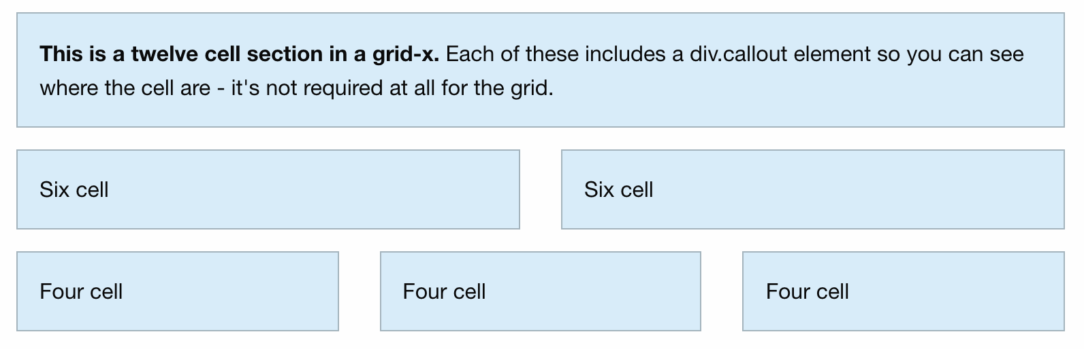
Grids
Nested grids can easily
solve complex layouts

Slide 25
Lab: Grids
examples/day3/am-responsive/03-grids/index.html
Create grid classes
2, 3, and 4 columns
Overlap columns: 1/2, 1/3 and 2/3, 1/4 2/4 3/4
Nest rows within columns

Slide 26
Lab: Thinking Grids
Review 3-4 popular websites
Break down their design
How can it be done in nested rows and columns?

Slide 27
CSS3
Like HTML5, a collection of APIs
Check for browser support before using
Transitions
Flexbox

Slide 28
Transitions
Tell CSS to smoothly alter certain properties
Instead of abruptly changing
Can help ease breakpoint transitions
Ex: font-size
Not all properties can be transitioned
Ex: display: none/block/inline

Slide 29
Transitions
Multiple transition- settings
-property: the CSS property to transition
-duration: elapsed time to complete transition
-timing-function: bezier, defaults to linear
-delay: wait before transition starts

Slide 30
Transitions
Shorthand syntax
transition: <property> <duration> <timing-function> <delay> [, repeat… ]
Shorthand is recommended for multiple properties
Otherwise very important to verify # of arguments

Slide 31
Transitions
Single transition
.delay {
font-size: 14px;
transition-property: font-size;
transition-duration: 4s;
transition-delay: 2s;
}
.delay:hover {
font-size: 36px;
}

Slide 32
Transitions
Multiple transition
Duration repeated to match # of properties (treated like '3s, 5s, 3s, 5s')
div {
transition-property: opacity, left, top, height;
transition-duration: 3s, 5s;
}

Slide 33
Lab: Transitions
examples/day3/am-responsive/04-transitions/03-single-column.html
Ease some changes between breakpoints
Create CSS transitions to ease the changes
Compare individual rules to transition: all

Slide 34
Flexbox
Next-gen improvement on float
Declare flex container
Declare flex direction
Add items to container

Slide 35
Flexbox
.flex-container {
display: flex;
}
.flex-direction .flex-container {
flex-direction: row;
}

Slide 36
Flexbox
Other properties
flex-grow / flex-shrink
flex-wrap
justify-content / align-items
align-content
order

Slide 37
Lab: Flexbox
Start with examples/05-flexbox
Center one flex-item vertically
Explore align-items
Nest #2 within #1
Create a flex-row with enough items to wrap
Use #4 to explore align-content

Slide 38
Web Fonts
CSS feature allows loading font from web
Declare / describe / name via @font-face
Then apply as a regular font-family property

Slide 39
Web Fonts
@font-face {
font-family: 'MyWebFont';
src: url('webfont.eot'); /* IE9 Compat Modes */
src: url('webfont.eot?#iefix') format('embedded-opentype'), /* IE6-IE8 */
url('webfont.woff2') format('woff2'), /* Super Modern Browsers */
url('webfont.woff') format('woff'), /* Pretty Modern Browsers */
url('webfont.ttf') format('truetype'), /* Safari, Android, iOS */
url('webfont.svg#svgFontName') format('svg'); /* Legacy iOS */
}
body {
font-family: 'MyWebFont', Fallback, sans-serif;
}

Slide 40
Icons
Icons are libraries of images
Useful for UI like settings gear, mail envelope
Foundation offers icons via web font
add @font-face
http://zurb.com/playground/foundation-icons
Add class "general foundicon-[icon name]"

Slide 41
SVG
Scalable Vector Graphics
Creates graphic through calculation / drawing
As opposed to static "raster" or bitmap approach
Con: larger file size for small images
Pro: scales to any size
Pro: can be changed programmatically

Slide 42
SVG
<svg width="100" height="100">
<circle cx="50" cy="50" r="40" stroke="green" stroke-width="4" fill="yellow" />
</svg>

Slide 43
Foundation
From ZURB, a design company
A Swiss Army Knife / framework
Flexible grid, MQ breakpoints, resets
UI Widgets
SASS mixins
JS plugin API

Slide 44
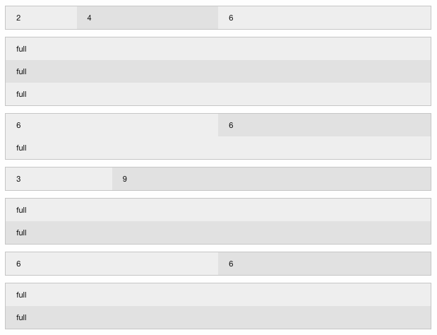
Foundation
The Grid
Start with rows
Add column spans
Ex: first row = 2 / 4 / 6
Each row adds up to 12 cols for current viewport

Slide 45
Foundation
Simpler UI Widgets
<ul class="accordion" data-accordion>
<li class="accordion-item is-active" data-accordion-item>
<a href="#" class="accordion-title">Accordion 1</a>
<div class="accordion-content" data-tab-content>
I would start in the open state, due to using the `is-active` state class.
</div>
</li>
<!-- ... -->
</ul>

Slide 46
Foundation
Several ways to get Foundation
Straight download from foundation.zurb.com
npm i && build from SASS

Slide 47
Lab: Foundation d/l
examples/day3/pm-foundation/00-foundation
Open index.html
Examine default styles

Slide 48
Lab: Foundation build
examples/day3/pm-foundation/01-foundation
npm install
Run grunt
Add link to main.css to html

