Slide 1
Intermediate JavaScript
Elias Carlston, DevelopIntelligence
elias@eliascarlston.com
https://github.com/eliasjames/training-web-dev/

Slide 2
Course Overview
Day 3
Foundation 5 CSS & Sass
Foundation 5 JS
Responsive Design & Grids
Icon & Web fonts

Slide 3
Foundation
From ZURB, a design company
A Swiss Army Knife / framework
Flexible grid, MQ breakpoints, resets
UI Widgets
SASS mixins
JS plugin API

Slide 4
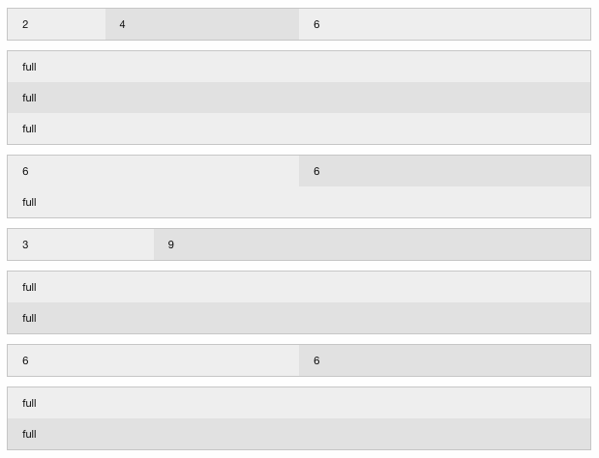
Foundation
The Grid
Start with rows
Add column spans
Ex: first row = 2 / 4 / 6
Each row adds up to 12 cols for current viewport

Slide 5
Foundation
Simpler UI Widgets
<ul class="accordion" data-accordion>
<li class="accordion-item is-active" data-accordion-item>
<a href="#" class="accordion-title">Accordion 1</a>
<div class="accordion-content" data-tab-content>
I would start in the open state, due to using the `is-active` state class.
</div>
</li>
<!-- ... -->
</ul>

Slide 6
SVG
Scalable Vector Graphics
Creates graphic through calculation / drawing
As opposed to static "raster" or bitmap approach
Con: larger file size for small images
Pro: scales to any size
Pro: can be changed programmatically

Slide 7
SVG
<svg width="100" height="100">
<circle cx="50" cy="50" r="40" stroke="green" stroke-width="4" fill="yellow" />
</svg>

Slide 8
Web Fonts
@font-face {
font-family: 'MyWebFont';
src: url('webfont.eot'); /* IE9 Compat Modes */
src: url('webfont.eot?#iefix') format('embedded-opentype'), /* IE6-IE8 */
url('webfont.woff2') format('woff2'), /* Super Modern Browsers */
url('webfont.woff') format('woff'), /* Pretty Modern Browsers */
url('webfont.ttf') format('truetype'), /* Safari, Android, iOS */
url('webfont.svg#svgFontName') format('svg'); /* Legacy iOS */
}
body {
font-family: 'MyWebFont', Fallback, sans-serif;
}

Slide 9
Icons
Icons are libraries of images
Useful for UI like settings gear, mail envelope
Foundation offers icons via web font
add @font-face
http://zurb.com/playground/foundation-icons
Add class "general foundicon-[icon name]"

