Slide 1
Can synthesized data fool U(-net)?
Medical Imaging Project
Niklas Khoss
Elias Marcon

Slide 2

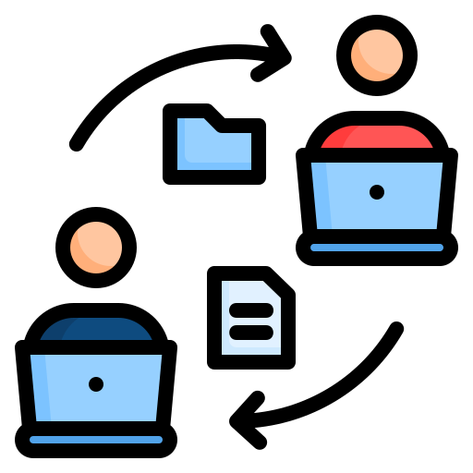


Problem Area
Very difficult to obtain labelled data in the medical field, because labelling is expensive and time intense
Sharing data is not a common practice
Legal/privacy issues with patient data
Solution: Creating synthetic data (from existing datasets)

Slide 3
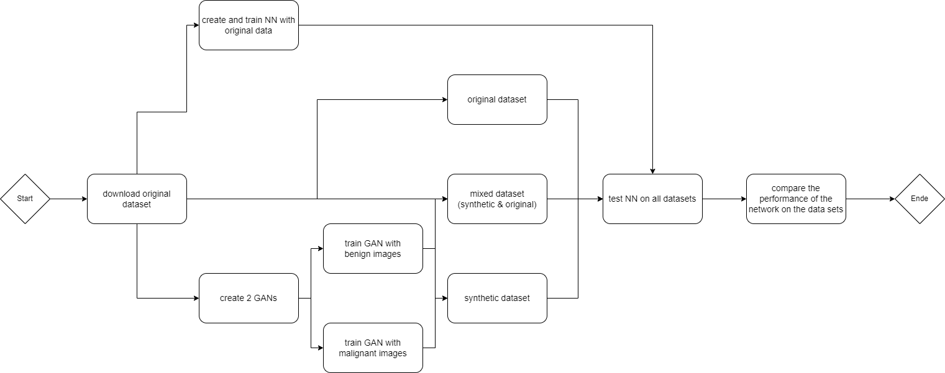
Workflow
optional: reversed flow (first train on synthetic and then test on original data)
Notes:
and the opposite workflow for training on synthesized data

Slide 4


Research question
How does the performance (Recall, Accuracy, F1-Score, Precision) of an established model change when evaluated with synthesised data?
Can a GAN model synthesize histopathological images well enough to be indistinguishable for a pre-trained classifier?
literature research
implement & evaluate ML model (DenseNet)
implement & evaluate GAN model
Jupyter notebook / python script (Pytorch or TF)

Slide 5
Methods
Used densenet pretrained on imagenet weights (Bild vl.)
Gan Architecture
Standard Gan Architektur Bild einfügen
Jupyter Notebooks for Evaluation
Cluster for model training (~1 TB, >> 1000 Stunden)

Slide 6
Results Densenet Training
Densenet ausprobiert auf 40x, 100x, 200x,400x * (64,128,256) Size → 40X 128x128
→ Table/Matrix mit Spalten (Resolution), Rows (pixels)
→ mit allen Daten trainiert/ Accurarcy Werte sind Test Accuracy

Slide 7
Results GAN
GAN Images
GAN 128x128 beste leistung (64x64 zu schlechte Bilder, 256x256 Out of memory)
Pro Type ein Originalbild und ein Gan generiertes bild einfügen
4 Subtypes gut

Slide 8
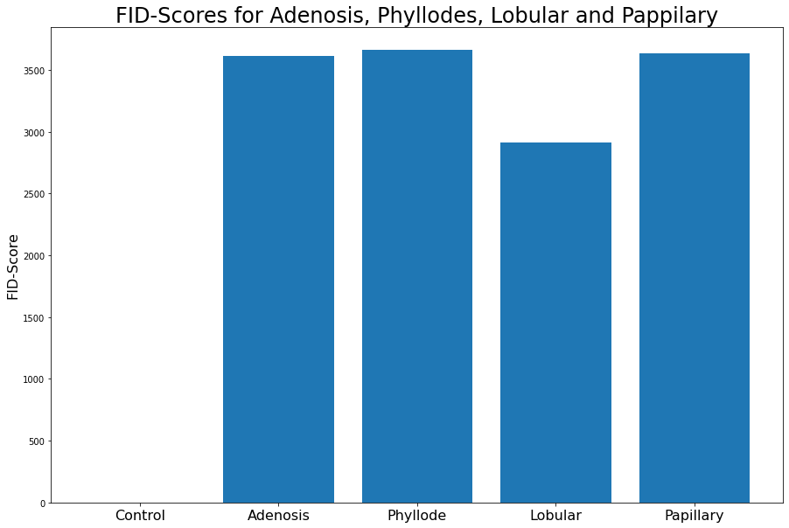
Results GAN
4 Subtypen gut → nochmal ein Gan trainiert nur für dieses Subtypen 100k epochs → D_Loss und A_Loss für 1 gutes und 1 schlechtes (gehen alle aus) Bilder herzeigen → kompletten 100k plotten (tatsächliche Epochwahl, 100k Epochs folder CSVs) → FID Score ausgerechnet Grafik einfügen (erklären)

Slide 9
Results Densenet Testing
Evaluierung Densenet 3x3 Columns Original, Mixed, Gan (Accuracy)
Classification Report herzeigen mit Beschriftung (3 herzeigen/ Train_original_Test_original gegen Train_original_Test_gan, Train_gan_Test_original → KEY FINDING Train_gan_Test_original FUNKTIONIERT GUT WAR AUCH RESEARCH QUESTION/STORY)
Zeigen alle Classification Report von Trained_gan

Slide 10
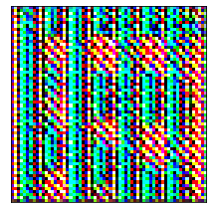
Discussion & Problems
3 GAN Architekturen ausprobiert
GANs funktionieren gar nicht oder nicht auf allen Subtypen
Cluster Problems (Kicked-Outed, Jobs not started, kurzfristig) !!!!!!!
GANs Divergence (Übertraining bei GAN Loss → definieren was loss ist A-loss, D-loss wie zustandekommen)
GANs Variety → ein 6x6 Bild einfügen (Architektur 2)
Architektur 3 64x64 (Augenkrebs bilder) und Archtiektur 1 256x256 out of memory (überhaupt keine Variation gehabt)

Slide 11

Do you have any further Questions?

Slide 12
Sources
Pictures are from https://www.flaticon.com/
Dataset can be found here https://web.inf.ufpr.br/vri/databases/breast-cancer-histopathological-database-breakhis/

Slide 13
Überraschungsfünde
Trained_mix:
test_gan >> test_mixed >> test_original Classification Report
Notes:
understand whether our synthetic data is classified as well as the original data

Slide 14

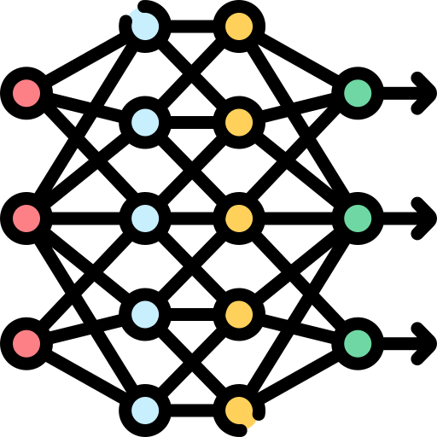

Project Objectives
Develop a GAN model that synthesises a histopathological data set (BreakHis)
generated synthetic data is then given into the NN
possible test data sets:
2 GAN models would be trained (benign/malignant)
original
mixed
synthetic
Train an already existing NN (Unet, DenseNet, ResNet, etc.) for quantitative evaluation of the synthetic data
Output: comparison of the NN performances (in terms of accuracy, precision, recall, F1 score)
Notes:
understand whether our synthetic data is classified as well as the original data

Slide 15

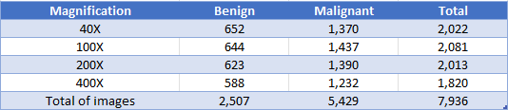
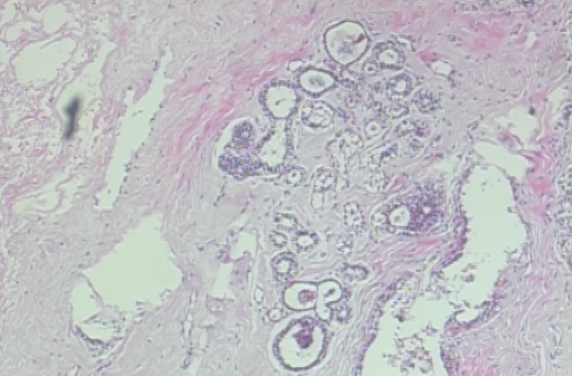
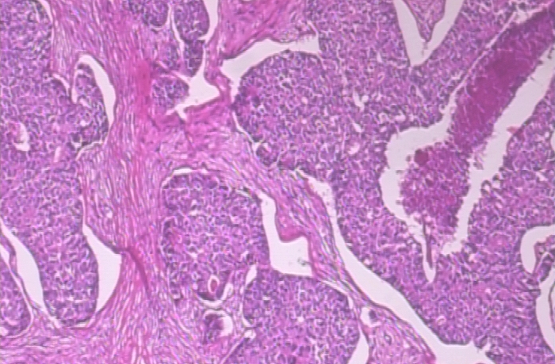
Data
Breast Cancer Histopathological Database (BreakHis)
benign (left), malignant (right) (700x460x3)
Notes:
Worst case resize

Slide 16

Expected results
optional, if time allows:
train on synthetic data and test on original dataset
consistent performance of NN (Acc, Prec, Recall, F1)
take samples along GAN training (100, 500, etc. epochs) and evaluate
deteriorating performance of NN, if GAN performs badly

Slide 17




Open issues
if GAN performance is not good enough: reduce benign/malignant to the largest cancer type
select suitable NN (ResNet, DenseNet etc.) and GAN architecture
do we have enough time and resources?
implementing feedback

