Slide 1
Can synthesized data fool U(-net)?
Medical Imaging Project
Niklas Khoss
Elias Marcon

Slide 2

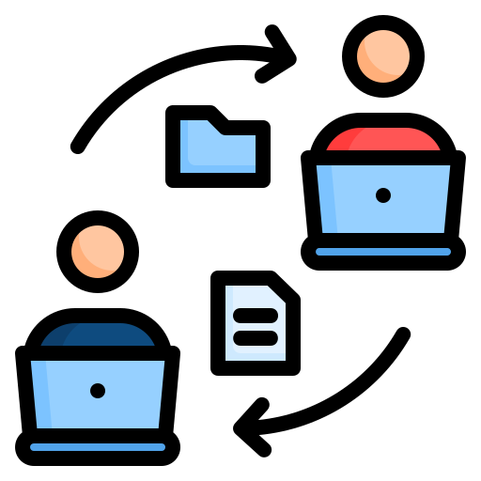


Problem Area
Very difficult to obtain labelled data in the medical field, because labelling is expensive and time intense
Sharing data is not a common practice
Legal/privacy issues with patient data
Solution: Creating synthetic data (from existing datasets)

Slide 3

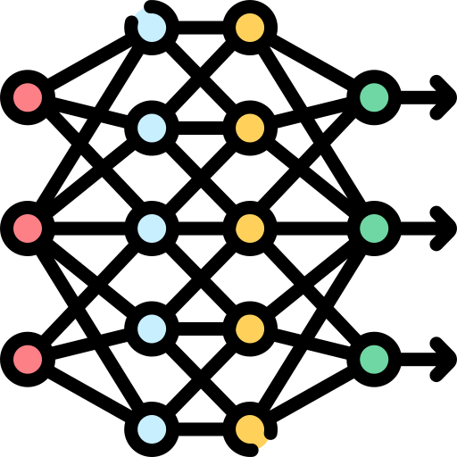

Project Objectives
Develop a GAN model that synthesises a histopathological data set (BreakHis)
generated synthetic data is then given into the NN
possible test data sets:
2 GAN models would be trained (benign/malignant)
original
mixed
synthetic
Train an already existing NN (Unet, DenseNet, ResNet, etc.) for quantitative evaluation of the synthetic data
Output: comparison of the NN performances (in terms of accuracy, precision, recall, F1 score)
Notes:
understand whether our synthetic data is classified as well as the original data

Slide 4
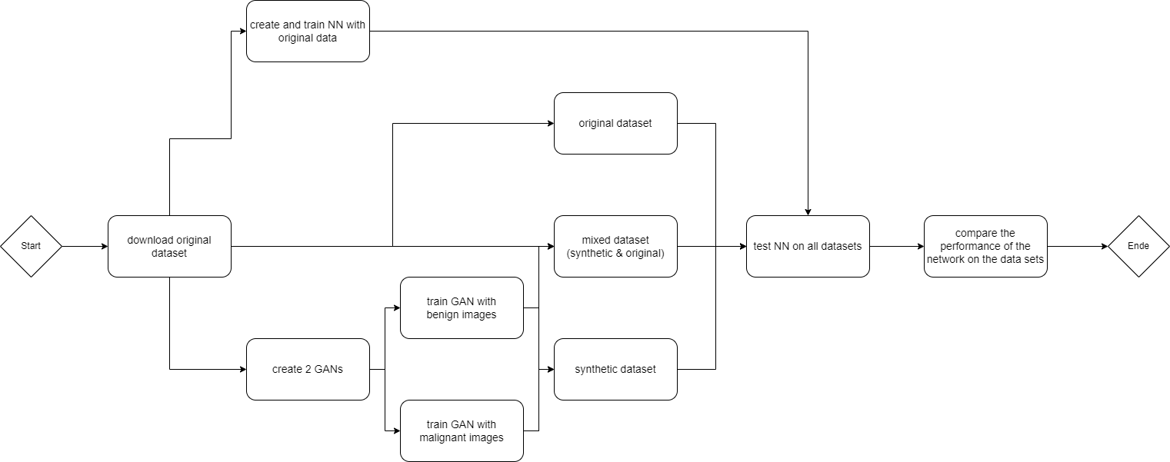
Workflow
optional: reversed flow (first train on synthetic and then test on original data)
Notes:
and the opposite workflow for training on synthesized data

Slide 5

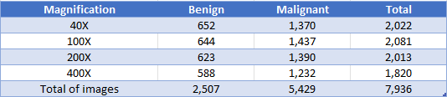
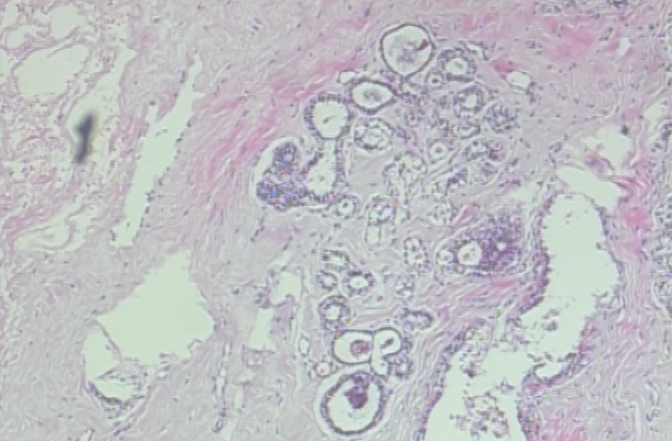
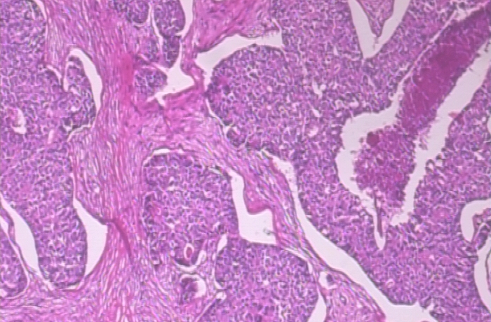
Data
Breast Cancer Histopathological Database (BreakHis)
benign (left), malignant (right) (700x460x3)
Notes:
Worst case resize

Slide 6


Research question & Methods
How does the performance (Recall, Accuracy, F1-Score, Precision) of an established model change when evaluated with synthesised data?
Can a GAN model synthesize histopathological images well enough to be indistinguishable for a pre-trained classifier?
literature research
implement & evaluate ML model (U-Net, ResNet, DenseNet)
implement & evaluate GAN model
Jupyter notebook / python script (Pytorch or TF)

Slide 7

Expected results
optional, if time allows:
train on synthetic data and test on original dataset
consistent performance of NN (Acc, Prec, Recall, F1)
take samples along GAN training (100, 500, etc. epochs) and evaluate
deteriorating performance of NN, if GAN performs badly

Slide 8




Open issues
if GAN performance is not good enough: reduce benign/malignant to the largest cancer type
select suitable NN (ResNet, DenseNet etc.) and GAN architecture
do we have enough time and resources?
implementing feedback

Slide 9

Do you have any further Questions?

Slide 10
Sources
Pictures are from https://www.flaticon.com/
Dataset can be found here https://web.inf.ufpr.br/vri/databases/breast-cancer-histopathological-database-breakhis/

