Slide 1

SVD
ELIAS RENAWI :
AMEER SGAYER:

Slide 2
Singular value decomposition
The “SVD” is a factorization of a real or complex matrix that generalizes the eigendecomposition of a square normal matrix to any M *N matrix via an extension of the polar decomposition.

Slide 3
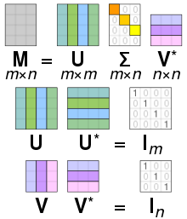

The SVD
The matrix “M” can be factorization to the following 3 matrixs
U$mxm$ , $Σ mxn , V^{T}mxn$

Slide 4
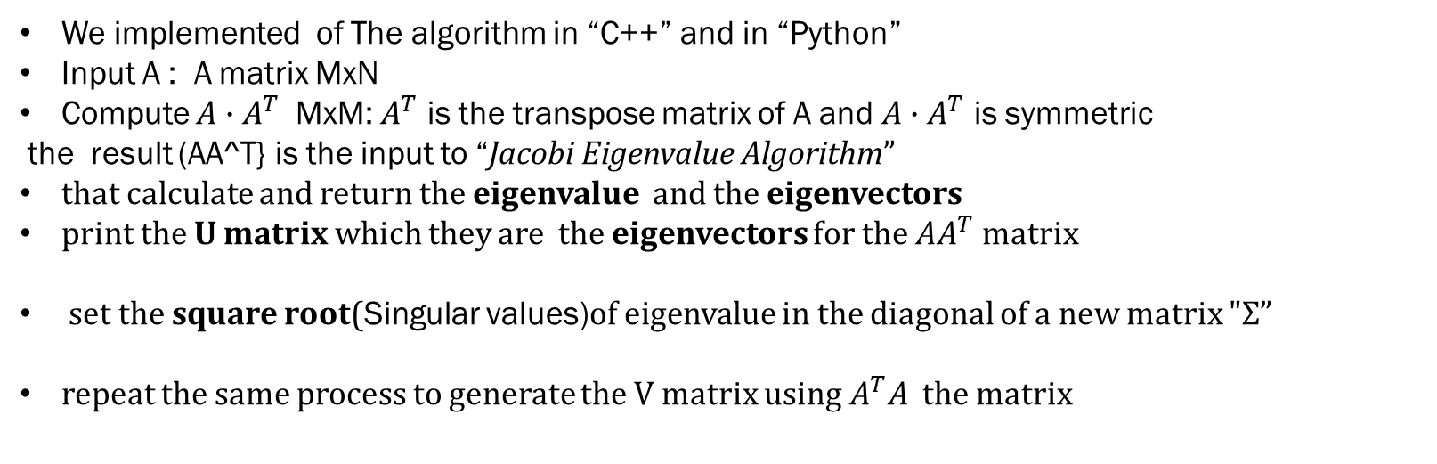
THE ALGORITHM
We implemented of The algorithm in “C++” and in “Python”
Input A : A matrix MxN
Compute $A∙A^{T}$ MxM: $A^{T}$ is the transpose matrix of A and $A∙A^{T}$ is symmetric
the result (AA^T} is the input to “Jacobi Eigenvalue Algorithm”
that calculate and return the eigenvalue and the eigenvectors
print the U matrix which they are the eigenvectors for the $AA^{T}$ matrix
set the square root(Singular values)of eigenvalue in the diagonal of a new matrix $"Σ$”
repeat the same process to generate the V matrix using${ A}^{T}A$ the matrix

Slide 5
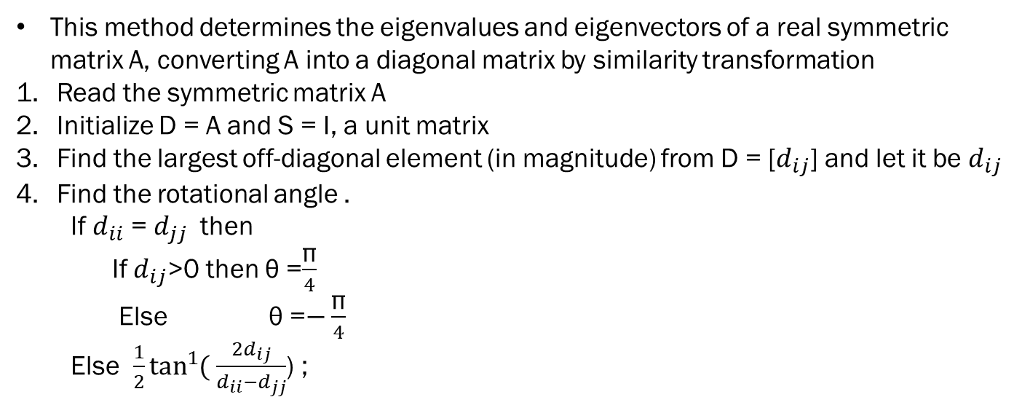
Jacobi Eigenvalue Algorithm
This method determines the eigenvalues and eigenvectors of a real symmetric matrix A, converting A into a diagonal matrix by similarity transformation
Read the symmetric matrix A
Initialize D = A and S = I, a unit matrix
Find the largest off-diagonal element (in magnitude) from D = [$d_{ij}$] and let it be $d_{ij}$
Find the rotational angle .
If $d_{ii}$ = $d_{jj}$ then
If $d_{ij}$>0 then θ =$\frac{\text{π}}{4}$
Else θ =$−\frac{\text{π}}{4}$
Else $\frac{1}{2}\tan^{1}{(}$ $\frac{{2d}_{ij}}{d_{ii}−d_{jj}}$) ;

Slide 6
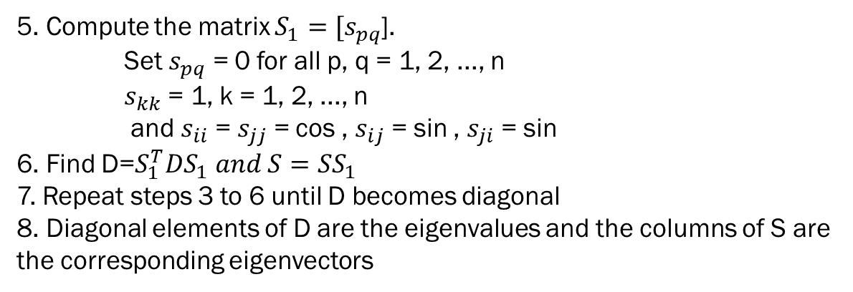
Jacobi Eigenvalue Algorithm
5. Compute the matrix $S_{1}=[s_{pq}$].
Set $s_{pq}$ = 0 for all p, q = 1, 2, ..., n
$s_{kk}$ = 1, k = 1, 2, ..., n
and $s_{ii}$ = $s_{jj}$ = cos , $s_{ij}$ = sin , $s_{ji}$ = sin
6. Find D=$S_{1}^{T}DS_{1} and S=SS_{1}$
7. Repeat steps 3 to 6 until D becomes diagonal
8. Diagonal elements of D are the eigenvalues and the columns of S are the corresponding eigenvectors

Slide 7

Python vs C++

Slide 8
Python vs C++
Python
-Easy to implement and learn
-Easy access to libraries like numpy,math .. Etc
which really help us with computing the Matrixes .
For example :
Matrix multiplication =“np.dot(matA, matB)” ..
But on the other hand :
-Errors only discovered on run time
-The slow running time especially on the large Data
(took approximately 4 hour of the run time )
C++
-Faster compared to python (or any other programming language)
-Typed :need to specify the type of the variable when declare it
But on the other hand :
- It is harder to learn
-harder to access to the libraries
so we needed to implement some of the code in stood

Slide 9
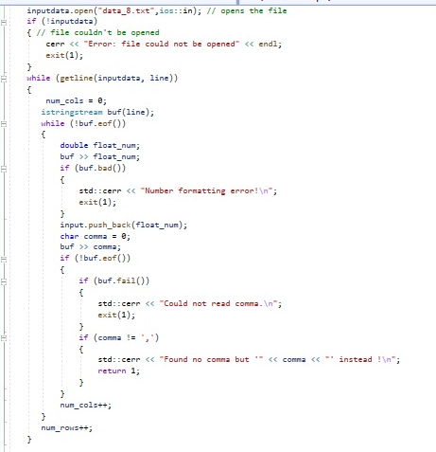

Example :Load an input from a txt file Python vs C++
Python
C++

Slide 10
Optimization of the code
In stood of using a regular python operation to compute the matrixes
We used the NumPy Library that is based on Intel-MKL Library which gave us a high level of
Optimization on matrix related operations .

Slide 11





Outputs example :
Matrix A=
Matrix U =
Matrix V=
Matrix Σ=
A=UΣ$V^{T}=$

Slide 12
speed comparison
in np.linalg.svd(a) :
1,072.51 (sec) approximately 0.5 h
Nearly 50 times faster than our implementation
Duo to the fact that NumPy provides tools for integrating C, C++, and Fortran code in Python. Which make it faster
in our implemtation :took approximately 15h
=15*60*60=54000 s

Slide 13
References
-https://en.wikipedia.org/wiki/Eigenvalue_algorithm
-https://www.sciencedirect.com/science/article/abs/pii/0045782582901050

