Slide 1
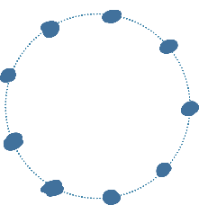





Simulation illustration figure
9
1
polymer
$C_{3}^{0}\left(1−p_{SE}\right)$³
8
2
Signaling
efficiency
3
$$C_{3}^{1}\left(1−p_{SE}\right)\text{2}\left(pSE\right)1$$
signaling
7
4
efficiency
$$C_{3}^{2}\left(1−p_{SE}\right)1\left(pSE\right)2$$
z
6
5
$C_{3}^{3}\left(pSE\right)$³
z
Blinking
Gaussian blur
bin
2D

Slide 2
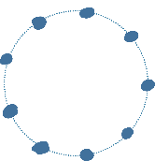








a
1
polymer
$C_{3}^{0}\left(1−p_{SE}\right)$³
9
signaling
8
2
$$C_{3}^{1}\left(1−p_{SE}\right)\text{2}\left(pSE\right)1$$
Signaling
efficiency
Blinking
Gaussian blur
2D
3
efficiency
7
4
$$C_{3}^{2}\left(1−p_{SE}\right)1\left(pSE\right)2$$
binning
z
6
5
$C_{3}^{3}\left(pSE\right)$³
z
z
b
c
Different primary antibody incubation time
Signaling
efficiency
0.125
0.125
0.125
0.25
0.5
1

Slide 3
Comparison of different signaling efficiency
Signaling efficiency
0.125
0.125
0.125
0.25
0.5
1

