Slide 1
Chapter 3:
Sequential Logic
Elements of Computing Systems, Nisan & Schocken, MIT Press, 2005 www.idc.ac.il/tecs
Usage and Copyright Notice:
Copyright 2005 © Noam Nisan and Shimon Schocken
This presentation contains lecture materials that accompany the textbook “The Elements of Computing Systems” by Noam Nisan & Shimon Schocken, MIT Press, 2005.
The book web site, www.idc.ac.il/tecs , features 13 such presentations, one for each book chapter. Each presentation is designed to support about 3 hours of classroom or self-study instruction.
You are welcome to use or edit this presentation for instructional and non-commercial purposes.
If you use our materials, we will appreciate it if you will include in them a reference to the book’s web site.
And, if you have any comments, you can reach us at tecs.ta@gmail.com

Slide 2
Sequential VS combinational logic
Combinational devices: operate on data only;
provide calculation services (e.g. Nand … ALU)
Sequential devices: contain state and (optionally) operate on data;
provide storage / synchronization services (e.g. flip-flop … RAM)
Sequential devices are clock-based;
the clock cycles determine when the states are “committed”
The low-level behavior of clocked / sequential gates is tricky
The good news: the complex clock-dependency details can be encapsulated at a very elementary level in the computer’s logic design.

Slide 3
Lecture plan
Clock
A hierarchy of memory chips:
  Flip-flop gates
  Binary cells
  Registers
  RAM
Counters
Perspective.

Slide 4
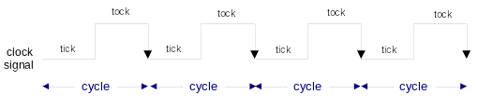
The Clock
HW
simulator
demo
In our jargon, a clock cycle = tick-phase (low), followed by a
tock-phase (high)
In real hardware, the clock is implemented by an oscillator
In our hardware simulator, clock cycles can be simulated either
  Manually, by the user, or
  “Automatically,” by a test script.

Slide 5
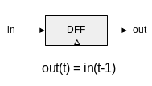
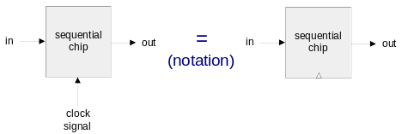
Flip-flop
HW
simulator
demo
A fundamental state-keeping device
For now, let us not worry about the DFF implementation
Memory devices are made from numerous flip-flops
All regulated by the same master clock signal
Notational convention:

Slide 6
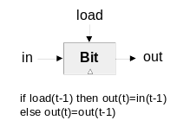
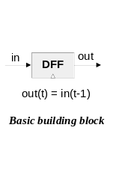
1-bit register (Bit)
Objective: build a storage unit that can:
Change its state to a given input
Maintain its state over time (until changed)
in
DFF
out
load
in
out
MUX
DFF
out(t) = out(t-1) ?
out(t) = in(t-1) ?
Won’t work
if load(t-1) then out(t)=in(t-1)
else out(t)=out(t-1)
OK

Slide 7
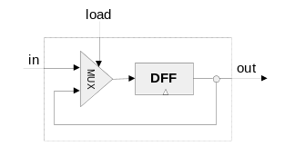
1-bit register (cont.)
HW
simulator
demo
Interface
Implementation
Load bit
Read logic
Write logic

Slide 8
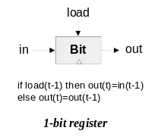
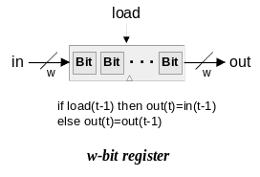
Multi-bit registers
HW
simulator
demo
Register’s width: a trivial parameter
Read logic
Write logic

Slide 9
Aside: Hardware Simulation
HW
simulator
demo
HW simulator tutorial:
Built-in chips
Clocked chips
GUI-empowered chips.

Slide 10
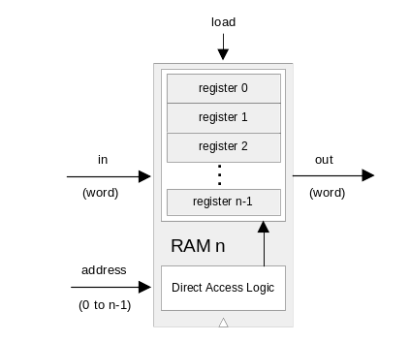
Random Access Memory (RAM)
HW
simulator
demo
Read logic
Write logic.

Slide 11
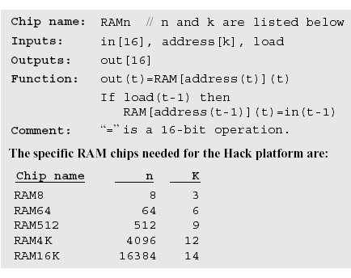
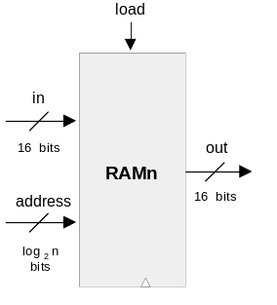
RAM interface

Slide 12
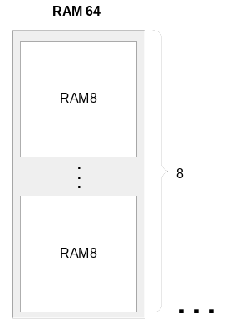
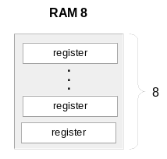

RAM anatomy

Slide 13
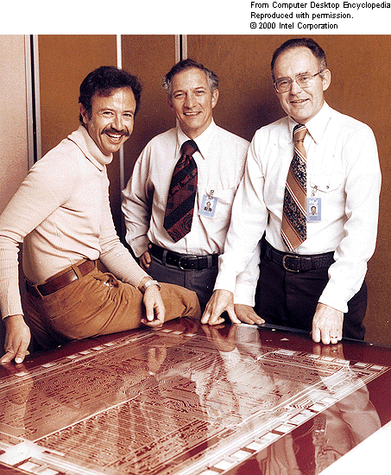
Historical aside: One of Intel’s first RAM chips (c. 1972)

Slide 14
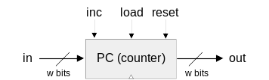
Counter
Needed: a storage device that can:
(a) set its state to some base value
(b) increment the state in every clock cycle
(c) maintain its state (stop incrementing) over clock cycles
(d) reset its state
If reset(t-1) then out(t)=0
else if load(t-1) then out(t)=in(t-1)
else if inc(t-1) then out(t)=out(t-1)+1
else out(t)=out(t-1)
Typical function: program counter
Implementation: register chip + some combinational logic.

Slide 15
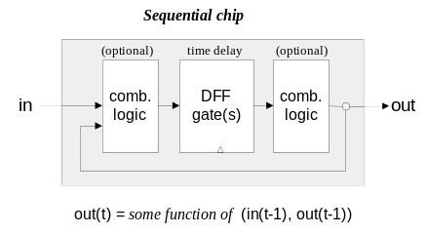
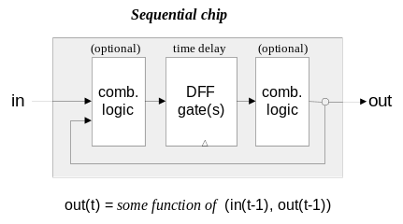
Sequential VS combinational logic (revisited)

Slide 16
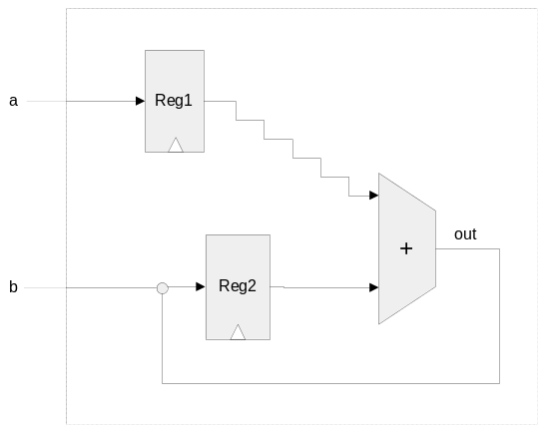
Time matters
During a tick-tock, the internal states of all the clocked chips are allowed to change, but their outputs are “latched”
At the beginning of the next tick, the outputs of all the clocked chips in the architecture commit to the new values.
Implications:
Challenge: propagation delays
Solution: clock synchronization
Cycle length and processing speed.

Slide 17
Perspective
All the memory units described in this lecture are standard
Typical memory hierarchy (listed in increasing access time and decreasing cost):
  SRAM (“static”), typically used for the cache
  DRAM (“dynamic”), typically used for main memory
  Disk
  (Elaborate caching / paging algorithms)
A Flip-flop can be built from Nand gates
But ... real memory units are highly optimized, using a great variety of storage technologies.

