Slide 1
Chapter 4:
Machine Language
Elements of Computing Systems, Nisan & Schocken, MIT Press, 2005 www.idc.ac.il/tecs
Usage and Copyright Notice:
Copyright 2005 © Noam Nisan and Shimon Schocken
This presentation contains lecture materials that accompany the textbook “The Elements of Computing Systems” by Noam Nisan & Shimon Schocken, MIT Press, 2005.
The book web site, www.idc.ac.il/tecs , features 13 such presentations, one for each book chapter. Each presentation is designed to support about 3 hours of classroom or self-study instruction.
You are welcome to use or edit this presentation for instructional and non-commercial purposes.
If you use our materials, we will appreciate it if you will include in them a reference to the book’s web site.
And, if you have any comments, you can reach us at tecs.ta@gmail.com

Slide 2
Where we are at:
Human
Abstract design
Software
Thought
abstract interface
hierarchy
Chapters 9, 12
H.L. Language
Compiler
&
abstract interface
Operating Sys.
Chapters 10 - 11
Virtual
VM Translator
Machine
abstract interface
Chapters 7 - 8
Assembly
Language
Assembler
Chapter 6
abstract interface
Computer
Machine
Architecture
Language
abstract interface
Chapters 4 - 5
Gate Logic
Hardware
abstract interface
Platform
Chapters 1 - 3
Electrical
Hardware
Chips &
Engineering
Logic Gates
Physics
hierarchy

Slide 3
Machine language is “the soul of the machine”
Duality:
Machine language ( = instruction set) can be viewed as an abstract description of the hardware platform
The hardware can be viewed as a means for realizing an abstract machine language
Another duality:
Binary version
Symbolic version
Loose definition:
Machine language = an agreed upon formalism for manipulating
a memory using a processor and a set of registers
Same spirit but different syntax across different hardware platforms.

Slide 4
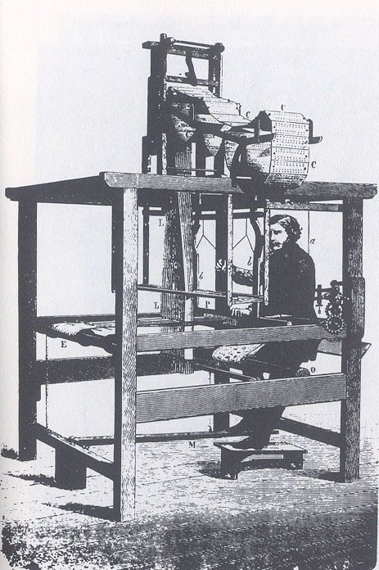
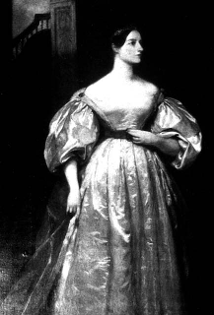
Binary and symbolic notation
1010 0011 0001 1001
ADD R3, R1, R9
Evolution:
Physical coding
Symbolic documentation
Symbolic coding
Requires a translator.
Jacquard loom
(1801)
Ada Lovelace
(1815-1852)

Slide 5
Lecture plan
Machine languages at a glance
The Hack machine language:
  Symbolic version
  Binary version
Perspective.

Slide 6
Arithmetic / logical operations (in typical machine language syntax)
ADD R2,R1,R3 // R2 ← R1+R3 where R1,R2,R3 are registers
AND R1,R1,R2 // R1 ← And(R1,R2) (bit-wise)
ADD R2,R1,foo // R2 ← R1+foo where foo stands for the value of the
// memory location pointed at by the user-defined
// label foo.

Slide 7
Memory access (in typical machine language syntax)
Direct addressing:
LOAD R1,67 // R1 ← Memory[67]
// Or, assuming that bar refers to memory address 67:
LOAD R1,bar // R1 ← Memory[67]
Immediate addressing:
LOADI R1,67 // R1 ← 67
STORE R1,bar // bar ← R1
Indirect addressing:
// x=foo[j] ,also known as: x=*(foo+j):
ADD R1,foo,j // R1 ← foo+j
LOAD* R2,R1 // R2 ← memory[R1]
STORE R2,x // x ← R2

Slide 8
Flow of control (in typical machine language syntax)
Branching
JMP foo // unconditional jump
Conditional branching
JGT R1,foo // If R1>0, goto foo
// in general:
cond register, label
Where: cond is JEQ, JNE, JGT, JGE , ...
register is R1, R2, ...
label is a user-defined label
And that’s all you need in order to implement any high-level control structure (while, switch, etc.) in any programming language.

Slide 9
A hardware abstraction (Hack)
Registers: D, A
Data memory: M ≡ RAM[A] (M stands for RAM[A])
ALU: {D|A|M} = ALU(D, A, M) (set D, A, or M to the ALU output
on the inputs D,A,M)
Instruction memory: current instruction = ROM[A]
Control: instruction memory is loaded with a sequence of instructions, one per memory location. The first instruction is stored in ROM[0]
Instruction set: A-instruction, C-instruction.

Slide 10
A-instruction
@value // A ← value
Where value is either a number or a symbol referring to some number.
Used for:
Entering a constant ( A = value )
Selecting a RAM location ( M ≡ RAM[A])
Selecting a ROM location ( instruction = ROM[A] ).

Slide 11
C-instruction
dest = comp ; jump // comp is mandatory
// dest and jump are optional
Where:
comp is one of:
0,1,-1,D,A,!D,!A,-D,-A,D+1,A+1,D-1,A-1,D+A,D-A,A-D,D&A,D|A,
M, !M, -M, M+1, M-1,D+M,D-M,M-D,D&M,D|M
dest is one of:
Null, M, D, MD, A, AM, AD, AMD
jump is one of:
Null, JGT, JEQ, JGE, JLT, JNE, JLE, JMP

Slide 12
Coding examples (practice)
Write the Hack instructions that implement
each of the following tasks:
Set A to 17
Set D to A-1
Set both A and D to A+1
Compute –1
Set D to 19
Set RAM[53] to 171
Set both A and D to A+D
Set RAM[5034] to D-1
Add 1 to RAM[7], and also store the result in D.
@value // set A to value
dest = comp ; jump

Slide 13
Higher-level coding examples
Symbol table:
y 20
j 17
sum 22
q 21
x 16
end 507
next 112
sum = 12
j = j + 1
q = sum + 12 – j
x[j] = 15
Etc.
@value // set A to value
dest = comp ; jump

Slide 14
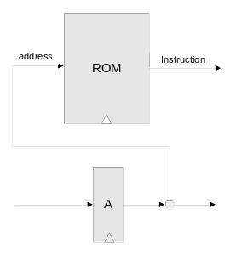
Control (first approximation)
ROM = instruction memory
Program = sequence of 16-bit
numbers, starting at
ROM[0]
Current instruction = ROM[address]
To select instruction n from the ROM, we set A to n, using the command @n

Slide 15
Coding branching operations (examples / practice)
Symbol table:
y 20
j 17
sum 22
q 21
X 16
end 507
next 112
Write the Hack instructions that implement
each of the following tasks:
Low level:
IF D=0 GOTO 112
IF D–12<5 GOTO 507
IF D–1>RAM[12] GOTO 112
Higher level:
IF sum>0 GOTO end
IF x[i]–12<=y GOTO next.
C-instruction
dest = comp ; jump
where jump is one of:
Null, JGT, JEQ, JGE,
JLT, JNE, JLE, JMP

Slide 16
Flow of control operations (IF logic)
High level:
Low level (goto logic)
Hack:
IF condition {
code segment 1}
ELSE {
code segment 2}
etc.
D ← not(condition)
IF D=0 GOTO if_true
ELSE
code segment 2
GOTO end
if_true:
code segment 1
end:
etc.
D ← not(condition)
@IF_TRUE
D;JEQ
code segment 2
@END
0;JMP
(IF_TRUE)
code segment 1
(END)
etc.
To prevent conflicting use of the A register, in well-written Hack programs a C-instruction that includes a jump directive should not contain a reference to M, and vice versa.

Slide 17
Flow of control operations (WHILE logic)
High level:
Hack:
WHILE condition {
code segment 1
}
code segment 2
(LOOP)
D ← not(condition)
@END
D;jeq
code segment 1
@LOOP
0;jmp
(END)
code segment 2

Slide 18
Complete program example
C:
Hack:
// Adds 1+...+100.
int i = 1;
int sum = 0;
while (i <= 100){
sum += i;
i++;
}
// Adds 1+...+100.
@i // i refers to some mem. location
M=1 // i=1
@sum // sum refers to some mem. location
M=0 // sum=0
(LOOP)
@i
D=M // D=i
@100
D=D-A // D=i-100
@END
D;JGT // If (i-100)>0 goto END
@i
D=M // D=i
@sum
M=D+M // sum=sum+i
@i
M=M+1 // i=i+1
@LOOP
0;JMP // Goto LOOP
(END)
@END
0;JMP // Infinite loop
Demo
CPU emulator

Slide 19
Lecture plan
Symbolic machine language
Binary machine language

Slide 20
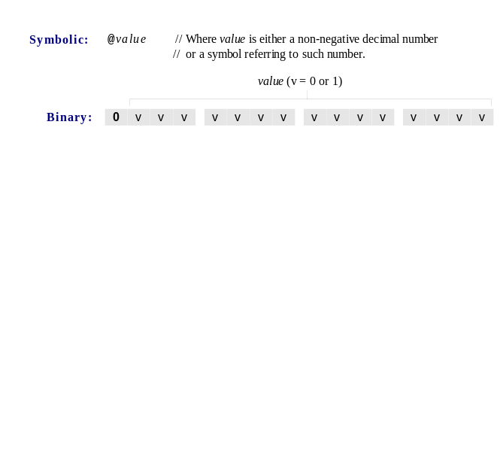
A-instruction

Slide 21
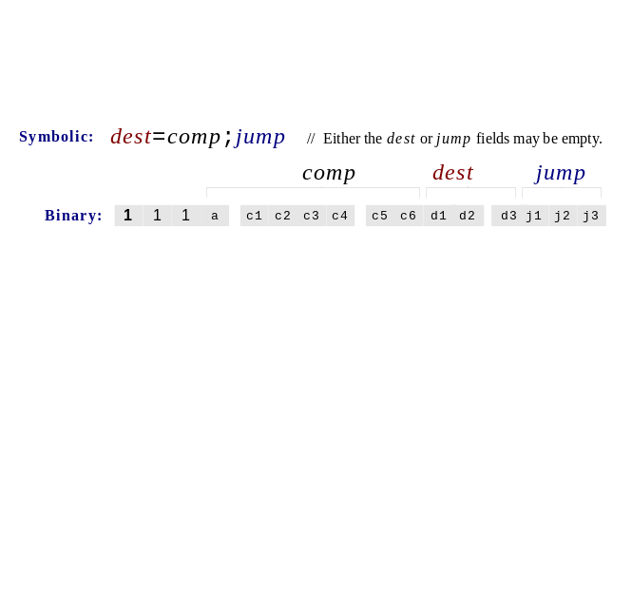
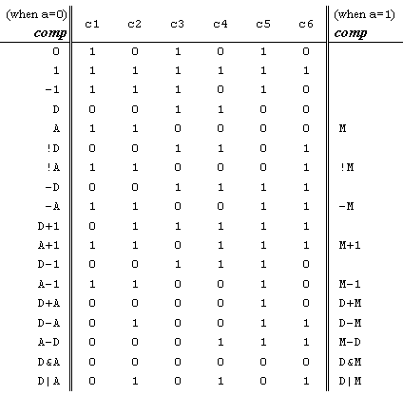
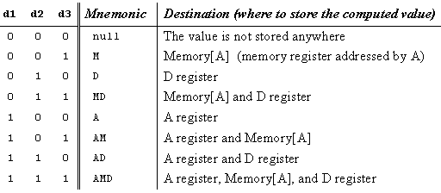
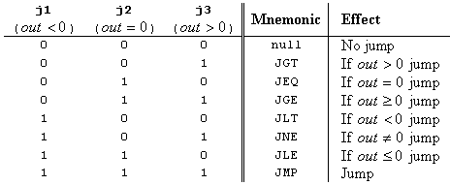
C-instruction

Slide 22
Symbols (user-defined)
// Rect program
@R0
D=M
@INFINITE_LOOP
D;JLE
@counter
M=D
@SCREEN
D=A
@addr
M=D
(LOOP)
@addr
A=M
M=-1
@addr
D=M
@32
D=D+A
@addr
M=D
@counter
MD=M-1
@LOOP
D;JGT
(INFINITE_LOOP)
@INFINITE_LOOP
0;JMP
Label symbols: User-defined symbols, used to label destinations of goto commands. Declared by the pseudo command (Xxx). This directive defines the symbol Xxx to refer to the instruction memory location holding the next command in the program
Variable symbols: Any user-defined symbol Xxx appearing in an assembly program that is not defined elsewhere using the “(Xxx)“ directive is treated as a variable, and is assigned a unique memory address by the assembler, starting at RAM address 16.

Slide 23
Symbols (pre-defined)
// Rect program
@R0
D=M
@INFINITE_LOOP
D;JLE
@counter
M=D
@SCREEN
D=A
@addr
M=D
(LOOP)
@addr
A=M
M=-1
@addr
D=M
@32
D=D+A
@addr
M=D
@counter
MD=M-1
@LOOP
D;JGT
(INFINITE_LOOP)
@INFINITE_LOOP
0;JMP
Virtual registers: R0,…,R15 are predefined to be 0,…,15
I/O pointers: The symbols SCREEN and KBD are predefined to be 16384 and 24576, respectively (base addresses of the screen and keyboard memory maps)
Predefined pointers: the symbols
SP, LCL, ARG, THIS, and THAT
are predefined to be 0 to 4, respectively.

Slide 24
Perspective
Hack is a simple language
User friendly syntax: D=D+A instead of ADD D,D,A
Hack is a “½-address machine”
A Macro-language can be easily developed
Assembler.

Slide 25
End-note: a macro machine language (can be implemented rather easily)
Assignment:
x = constant (e.g. x=17)
x = y
x = 0 , x = 1, x = -1
Arithmetic / logical:
x = y op z
where y, z are variables or constants and
op is some ALU operation like +, -, and, or, etc.
Control:
GOTO s
IF cond THEN GOTO s
where cond is an expression (x op y) {=|<|>|…} {0|1}
e.g. IF x+17>0 goto loop
White space or comments:
White space: ignore
// comment to the end of the line: ignore.

