Slide 1
Working With a Twitter Stream
Eli Brunette

Slide 2
Little bit of background
Who am I?
Why did I start working with Twitter?
Where are you headed with this project?
Why are you doing this presentation?

Slide 3
Basic Overview
What do we hope to achieve?
Learn some basic methods for processing a stream
Learn about a Tweet Object, and one way to process it
Learn how to upload the processed file to SSMS
All code used is also located here:
https://github.com/elibrunette/PyDataTwitterPresentation

Slide 4
Steps to get there
1. Sign up for a Twitter Account
2. Create a Developer Account
3. Get a feel for what we are dealing with
4. Know what you are filtering your stream on
Location
Language
Keywords
5. Know what you actually need and how to find it
6. Upload to a database

Slide 5
Steps 1-2: Your Twitter Account
Creating an account and making that account a Developer account
Need name and Phone Number/Email Address
Sends verification text, or email
Apply for a developer account
You can just create a filler cite that you can update later
You will need Keys and tokens tab under App

Slide 6
Step 3: Twitter Stream Essentials
What is a Stream?
What do I get with a Developer account?
How much data can I get?
What Libraries are available to access a stream?
How is the data given to me?
Can I filter the data?

Slide 7
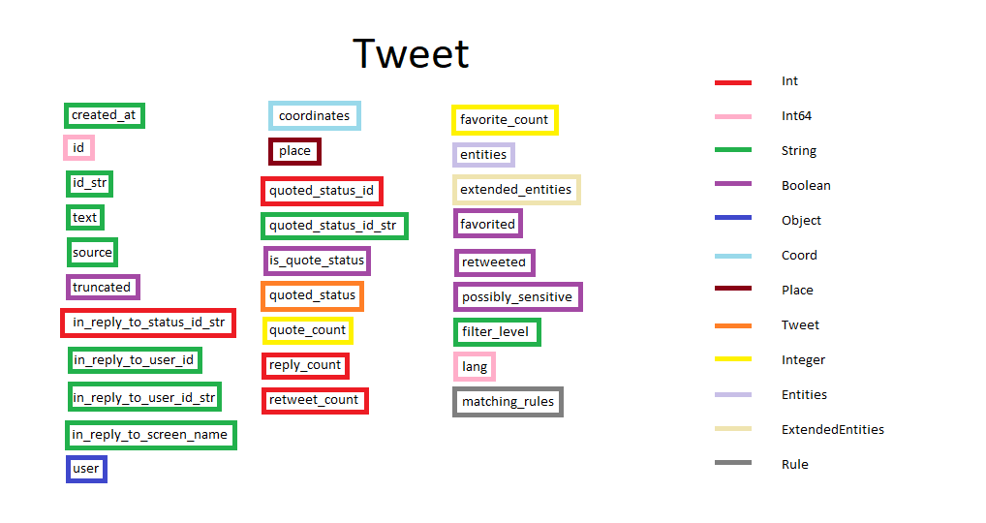
Tweets

Slide 8
Step 4: Filtering your stream
Code Examples for three different cases:
Location
Language
Keywords

Slide 9
Step 5: Processing you JSON file
Library used and higher level walkthrough
Code example for getting:
Tweet ID
Created Date
Tweet Text
User ID
*Language*
Hashtags

Slide 10
Uploading to Database
Assuming you have SSMS setup and a local database running
Create Database
Right-click DB -> Tasks -> Import Data
Select Flat Source File -> Fill out the information
Make sure to change the Columns
Delimiter is {:}{:} if using my program
Edit column names under Advanced and don’t forget Hashtags!
Have it suggest types! (Still might have to change them manually)
Have destination be where you want it to be for us a “Microsoft OLE DB Provider for SQL Server”

Slide 11

Questions?

Slide 12
References from steps
Sign up for Twitter:
https://twitter.com/i/flow/signup
Sign up for Developer Account:
https://developer.twitter.com/en/docs
Tweepy Examples
https://github.com/tweepy/examples
Reference Libraries:
https://developer.twitter.com/en/docs/developer-utilities/twitter-libraries.html

Slide 13
More Reference Material
https://www.dataquest.io/blog/streaming-data-python/
http://adilmoujahid.com/posts/2014/07/twitter-analytics/

