Slide 1
Working with data using Open Refine and Other Tools
Tim Ribaric
tribaric@brocku.ca
@elibtronic

Slide 2
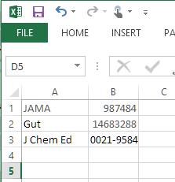
I really hate this!
Can anyone tell me what is wrong with this picture?
Excel doesn’t know what an ISSN is for gosh sake…

Slide 3
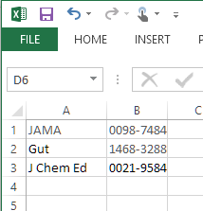
Finally!
How much of your life have you spent doing this?
Wait, don’t answer. I’ve spent an enormously embarrassing amount of my professional life fussing about like this.

Slide 4
There has to be a better way?!
Notes:
http://imgur.com/gallery/eZqcr
4

Slide 5
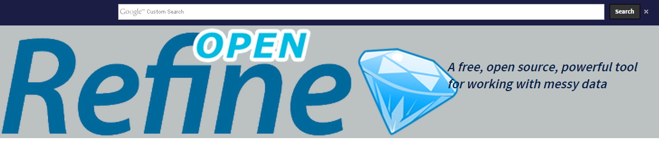
Enter OpenRefine

Slide 6
First a word on logistics
It is pretty tricky to run a session that looks at processing data without using an Internet connection
Low and behold that is what we will do today
So we are officially going to break the rules a bit
Notes:
6

Slide 7

…Logistics
We are going to use two modified Library Boxes to pretend we are online
Can anyone tell me what this is?
Notes:
7

Slide 8

Plan B?

Slide 9
…Logistics
With luck, you’ll be able to connect to them using the Wifi on your laptops
With even more luck they’ll work for the whole session

Slide 10
…Logistics
Using OpenRefine is probably the most fiddly thing in the world… so I’ll ask you to have patience with me as we move through our time together
I’m going to ask that you help one another as we do our tutorials

Slide 11
…Logistics
In fact take a moment to say hello to who you are sitting next to
Please stop me when you need help

Slide 12
…Logistics
Another thing too, I'm not sure how long it will take to go through the material I have
There are plenty of things to experiment with using the software so if we do finish early we can experiment and see what we can do
It won't hurt my feelings if you get up and leave whenever you've had enough

Slide 13

Open Refine
Platform to translate messy data into usable data
Originally a product called Google Refine
In 2012 stopped being actively developed by Google
Now maintained by a group of enthusiasts

Slide 14
Open Refine
Another bonus, it isn’t 'installed' on your computer
You just need Java running
You can export the info you work on in lots of different ways

Slide 15
Lesson 0
Installing and Running

Slide 16
Lesson 1
Tim’s bad treadmill performance
Or: Just the Basics

Slide 17
Lesson 2
Looking at some Census Farm data

Slide 18
Lesson 3
GREL

Slide 19
Lesson 4
EZproxy Log Files

Slide 20
Lesson 5
Tweets

Slide 21
Lesson 6
Visualize

Slide 22
Lesson 7
Bonus Round: OLA Attendees

Slide 23
Final Thoughts
We've really only scratched the surface
There is a slew of features I didn't get into today:
Pulling in data from the web (ie, give it a Lat/Long you can get a City name)
Reconciling Data
RDF
Plotting results

Slide 24
Final Thoughts
If you'd like to see this kind of session at the next SuperConference let the organizers know via the feedback form
I'd be happy to do this as a pre-con session for a whole day if people would show up
Web access in sesson is tricky, however if enough people express an interest that would help get it for sessons that really could use it

Slide 25


Final Thoughts
http://altbibl.io/dst4l/

Slide 26
Processing data still/will/always feel(s) like this
Tim Ribaric
tribaric@brocku.ca
@elibtronic

Slide 27
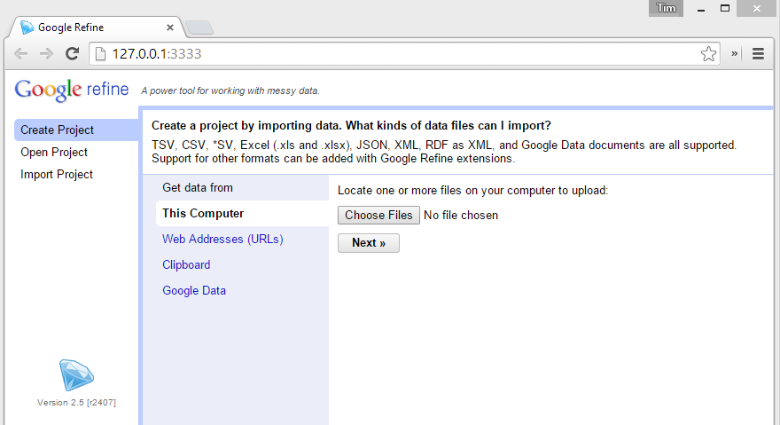

Slide 28
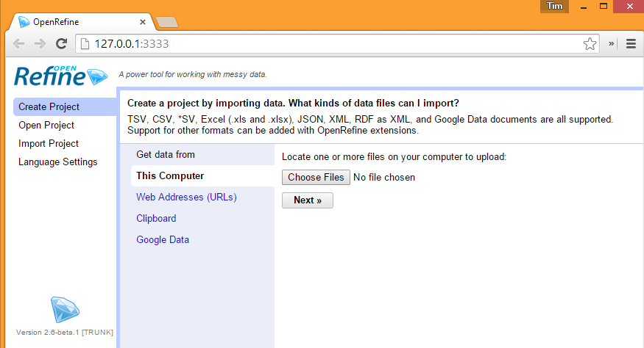

Slide 29
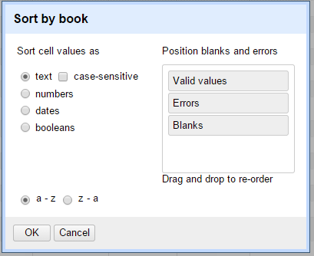
Sort
Notes:
http://msdn.microsoft.com/en-us/library/ms762271%28v=vs.85%29.aspx
29

Slide 30
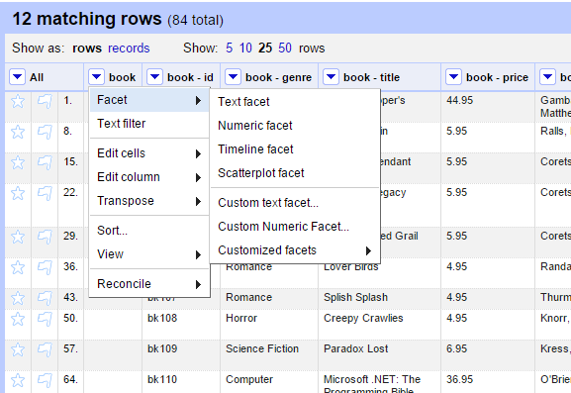
Facets

Slide 31
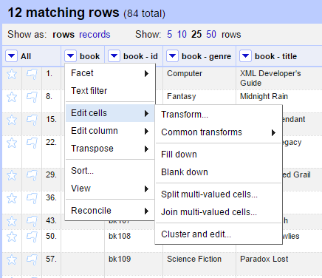
Edit Cells

Slide 32
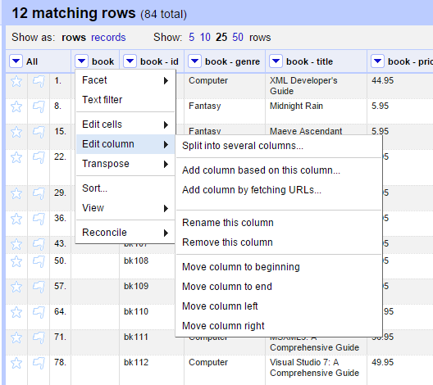
Edit Column

Slide 33
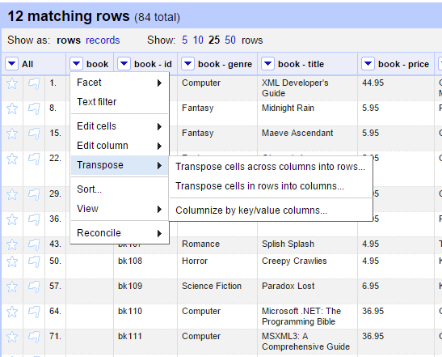
Transpose

Slide 34
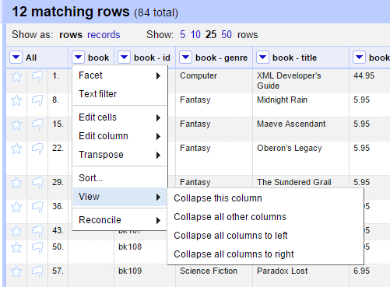
View

Slide 35
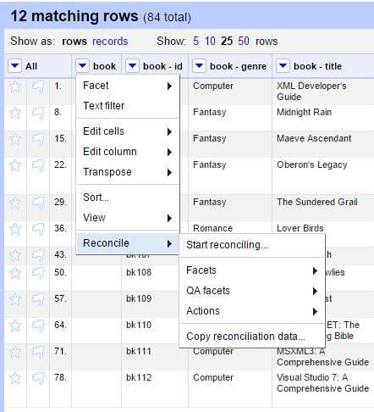
Reconcile

Slide 36
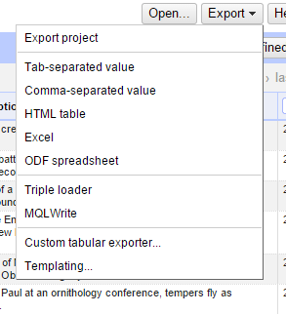
Export

