Slide 1
數位電路實驗
Lab7
FPGA-VGA display and Rotary、Keyboard applications

Slide 2
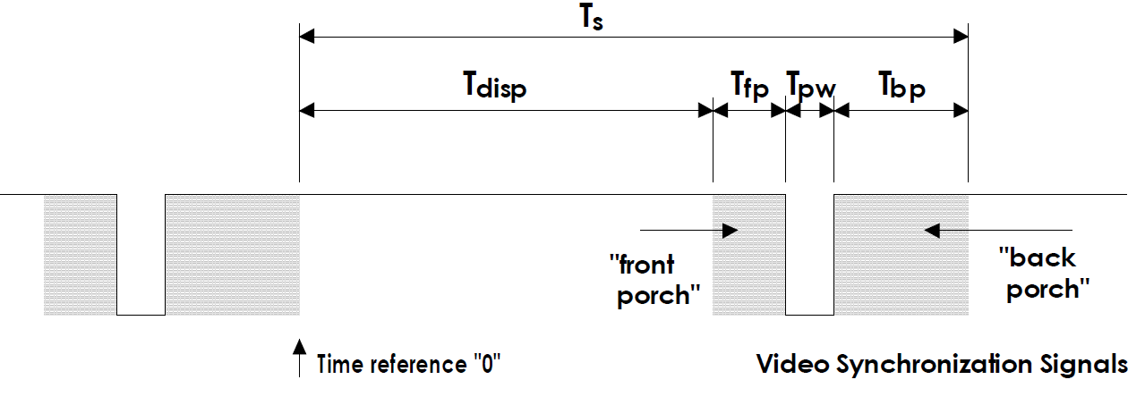
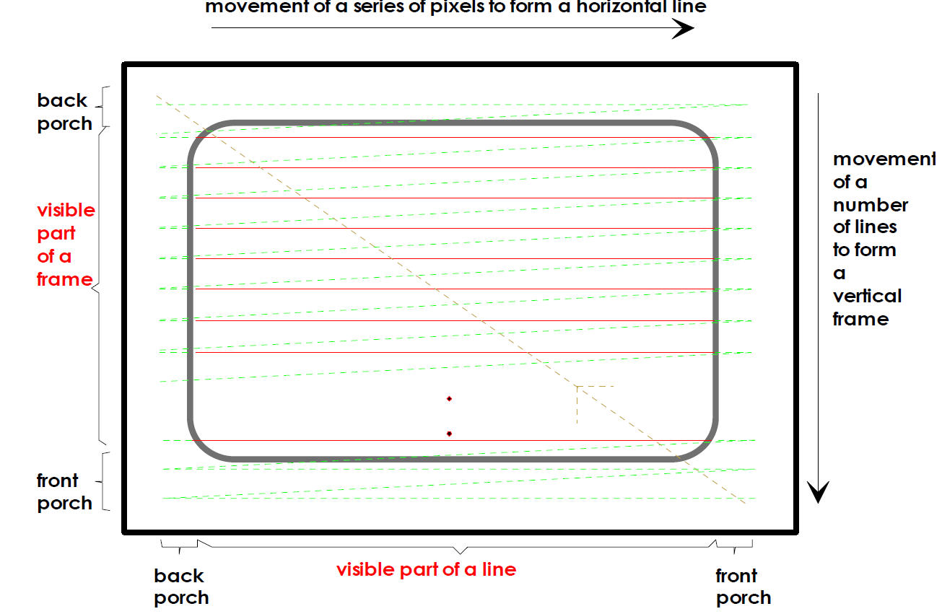
VGA 原理

Slide 3
VGA 原理
Horizontal Sync Pulse Width：LCD需另一個信號HSYNC，用來標
示Horizontal掃描線的開始，此信號需維持一段時間讓LCD
Controller能夠正確收到
Horizontal Back Porch：收到HSYNC後，LCD Controller需一段處
理時間，才能開始收取horizontal line的pixel資料
Horizontal Front Porch：處理完一條horizontal line後，需休息一
段時間才能再處理下一條

Slide 4
VGA 原理
Vertical Sync Pulse Width：水平掃描線做完形成一個畫面(frame)
，而每個畫面的開頭需VSYNC來告知LCD Controller所維持的時間
Vertical Back Porch：收到VSYNC後，LCD Controller需一段處
理時間
Vertical Front Porch：處理完所有水平掃描線後，需休息一段時間
才能再處理下一個

Slide 5
VGA timing Horizontal
Symbol | Name | Pixels
Tdisp | Display Time | 640
Tfp | Front Porch | 16
Tpw | Pulse width | 96
Tbp | Back Porch | 48
Ts | Whole line | 800

Slide 6
VGA timing Vertical
Symbol | Name | Lines
Tdisp | Display Time | 480
Tfp | Front Porch | 10
Tpw | Pulse width | 2
Tbp | Back Porch | 33
Ts | Whole line | 525

Slide 7

VGA contoller line
oVS
VGA
controller
vcounter
oHS
0-479
hcounter
R
RGB
controller
G
0-639
B

Slide 8
VGA controller
已經幫你們實作好 controller
CLK為25MHz
vcounter, hcounter代表現在電子槍掃到的位置
當visible =1,代表可顯示的區域
請根據vcounter , hcounter的位置給R G B 值
module VGA_control(
input CLK,
input reset,
output reg [10:0] vcounter, //vcounter 0~479
output reg [11:0] hcounter,// hcounter 0~639
output reg visible,
output reg oHS,
output reg oVS);

Slide 9
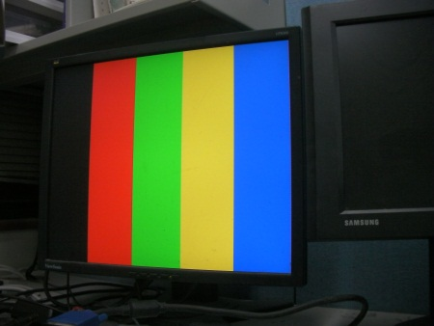
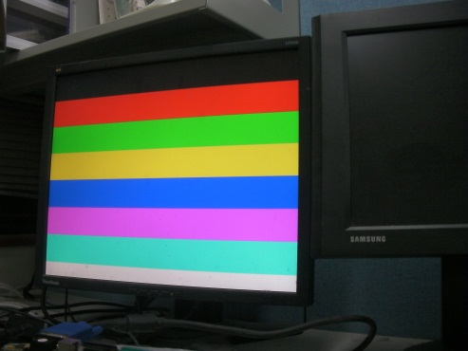
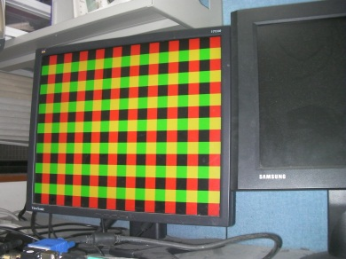
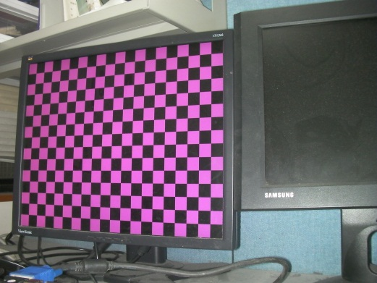
VGA DEMO
case ({iSW[1],iSW[0]})
2'b00:begin
oVGA_R=hcounter[7]; oVGA_G=hcounter[8];
oVGA_B=hcounter[9];end
2'b01:begin
oVGA_R=vcounter[6];
oVGA_G=vcounter[7];
oVGA_B=vcounter[8];end
2'b10:begin
oVGA_R=hcounter[5];
oVGA_G=vcounter[5];
oVGA_B=1'b0;end
2'b11:begin
oVGA_R=hcounter[5] ~^ vcounter[5];
oVGA_G=1'b0;
oVGA_B=hcounter[5] ~^ vcounter[5];
end case

Slide 10
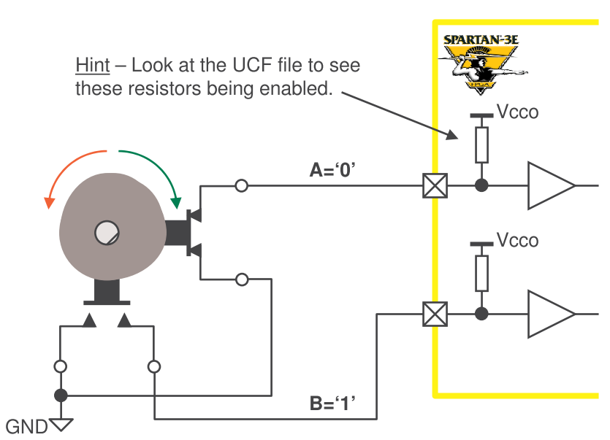
Rotary Controller

Slide 11
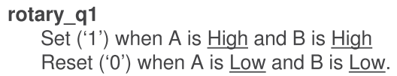
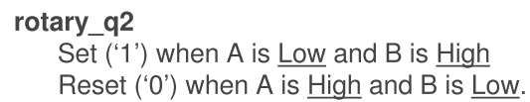
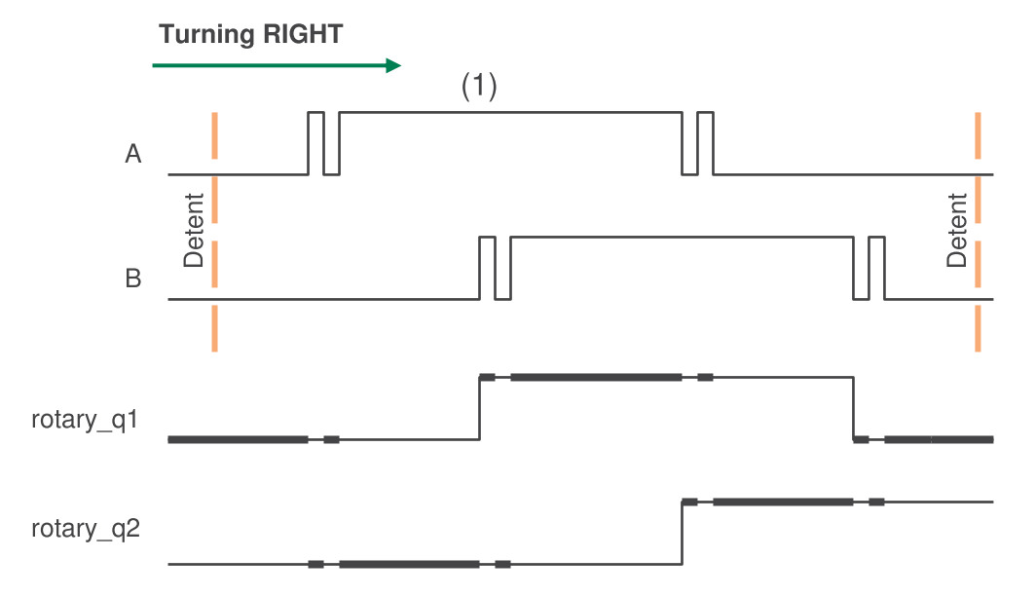
Rotary Controller

Slide 12
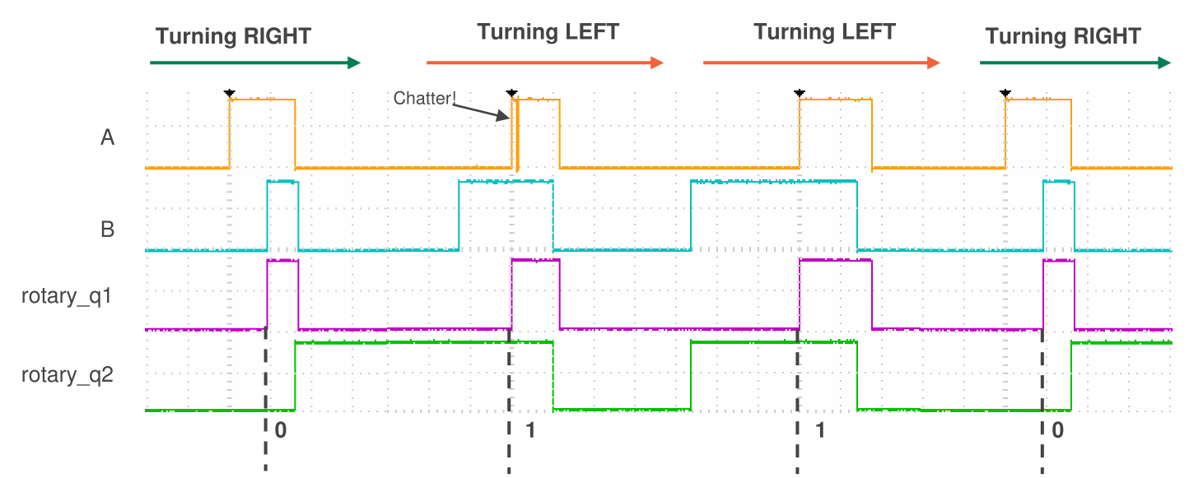
Rotary Controller

Slide 13
Rotary controller
已經幫你們實作好 controller
CLK為50MHz
當rotary_event＝1,偵測到訊號
當rotary_right =0,代表右轉，反之左轉
module Rotation_direction(
input CLK,
input ROT_A,
input ROT_B,
output reg rotary_event,
output reg rotary_right);
想知道更多可以參考http://www.xilinx.com/products/boards/s3estarter/files/s3esk_rotary_encoder_interface.pdf

Slide 14
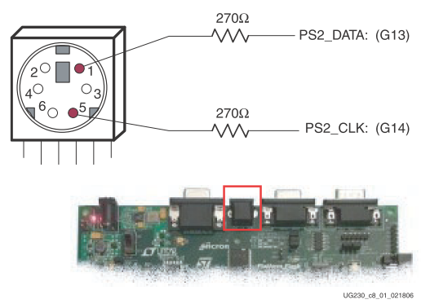
PS/2 Keyboard
CLK為10~16.7MHz
Keyboard會在clock為high時將資料寫入Data Line, 接著FPGA板在clock為low時將資料讀出
按下Keyboard按鍵時會送出11-bit， 第1個bit為‘0’, 接著送出按下按鍵的8 bits of scan code(LSB first), 而後再送出1bit的odd parity bit 以及1個stop bit為‘1’
當放開按鍵時，Keyboard會再送出結束碼為 “F0”
例如：按下9(8’h46)，放開按鍵後Keyboard會依序送出0000011111100110001001

Slide 15
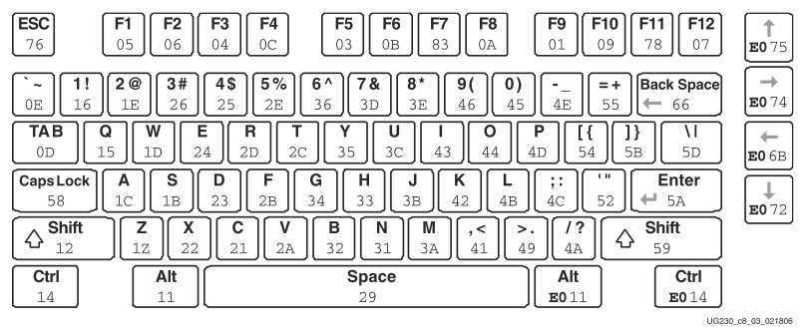
PS/2 Keyboard
參考資訊 http://www.vetra.com/scancodes.html

Slide 16
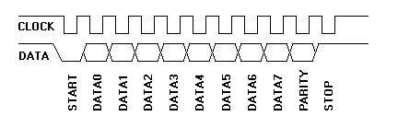






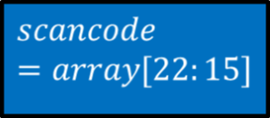


PS/2 Keyboard

Slide 17
PS/2 Keyboard
Clock 1
2.recive PS2_DATA
0
22
21
20
19
18
17
16
15
14
13
12
11
10
9
8
7
6
5
4
3
2
1
1.shift right 1 bit
Clock 2
2.recive PS2_DATA
0
0
22
21
20
19
18
17
16
15
14
13
12
11
10
9
8
7
6
5
4
3
2
1
1.shift right 1 bit

Slide 18
PS/2 Keyboard
Clock 3
2.recive PS2_DATA
0
0
0
22
21
20
19
18
17
16
15
14
13
12
11
10
9
8
7
6
5
4
3
2
1
1.shift right 1 bit
Clock 4
2.recive PS2_DATA
0
0
0
0
22
21
20
19
18
17
16
15
14
13
12
11
10
9
8
7
6
5
4
3
2
1
1.shift right 1 bit

Slide 19
PS/2 Keyboard
Clock 11
2.recive PS2_DATA
1
1
1
1
1
1
0
0
0
0
0
22
21
20
19
18
17
16
15
14
13
12
11
10
9
8
7
6
5
4
3
2
1
1.shift right 1 bit
Clock 12
2.recive PS2_DATA
0
1
1
1
1
1
1
0
0
0
0
0
22
21
20
19
18
17
16
15
14
13
12
11
10
9
8
7
6
5
4
3
2
1
1.shift right 1 bit

Slide 20
PS/2 Keyboard
Clock 19
2.recive PS2_DATA
1
0
0
0
1
1
0
0
1
1
1
1
1
1
0
0
0
0
0
22
21
20
19
18
17
16
15
14
13
12
11
10
9
8
7
6
5
4
3
2
1
1.shift right 1 bit
Clock 20
2.recive PS2_DATA
0
1
0
0
0
1
1
0
0
1
1
1
1
1
1
0
0
0
0
0
22
21
20
19
18
17
16
15
14
13
12
11
10
9
8
7
6
5
4
3
2
1
1.shift right 1 bit

Slide 21
PS/2 Keyboard
Clock 21
2.recive PS2_DATA
0
0
1
0
0
0
1
1
0
0
1
1
1
1
1
1
0
0
0
0
0
22
21
20
19
18
17
16
15
14
13
12
11
10
9
8
7
6
5
4
3
2
1
1.shift right 1 bit
Clock 22
2.recive PS2_DATA
1
0
0
1
0
0
0
1
1
0
0
1
1
1
1
1
1
0
0
0
0
0
22
21
20
19
18
17
16
15
14
13
12
11
10
9
8
7
6
5
4
3
2
1
1.shift right 1 bit

Slide 22
LAB7-1 畫圓
module ballgame(
input iCLK_50,
input iSW3,
input ROT_A,
input ROT_B,
output wire oVGA_R,
output wire oVGA_G,
output wire oVGA_B,
output oHS,
output oVS,
output wire [7:0] oLED
);
reg CLK_25;
wire [10:0] ball_x,ball_y;
wire [1:0] color; //配合之後的功能，先設1（紅色）
wire [2:0] radius; //配合之後放大、縮小的功能，可先設0
wire reset;
wire [10:0]vcounter;
wire [11:0]hcounter;
assign reset = iSW3;

Slide 23
LAB7-1 畫圓(radius=0,半徑50)
// generate a 25Mhz clock
always @(posedge iCLK_50)
if(iCLK_50)
CLK_25=~CLK_25;
end
VGA_control vga_c(.CLK(CLK_25),.reset(reset),.vcounter(vcounter),.hcounter(hcounter),
.visible(visible),.oHS(oHS),.oVS(oVS));
draw_ball d_ball(.vcounter(vcounter), .hcounter(hcounter), .visible(visible), .color(color), .radius(radius), .ball_x(ball_x), .ball_y(ball_y), .VGA_R(oVGA_R), .VGA_G(oVGA_G), .VGA_B(oVGA_B));
endmodule

Slide 24
LAB7-2 加入Rotary 功能
module ballgame(
input iCLK_50,
input iSW3,
input ROT_A,
input ROT_B,
output wire oVGA_R,
output wire oVGA_G,
output wire oVGA_B,
output oHS,
output oVS,
output wire [7:0] oLED
);
reg CLK_25;
wire [10:0] ball_x,ball_y;
wire [1:0] color; //配合之後的功能，可先設1或2或3
wire [2:0] radius; //0~7，向左轉變大，每增加1，半徑多5個pixel，若遇到螢幕邊緣，則不能再放大
wire reset;
wire [10:0]vcounter;
wire [11:0]hcounter;
wire rotary_event,rotary_right;
assign reset = iSW3;

Slide 25
LAB7-2 加入Rotary 功能
// generate a 25Mhz clock
always @(posedge iCLK_50)
if(iCLK_50)
CLK_25=~CLK_25;
VGA_control vga_c(.CLK(CLK_25),.reset(reset),.vcounter(vcounter),
.hcounter(hcounter),.visible(visible),.oHS(oHS),.oVS(oVS));
Rotation_direction r_dir(.CLK(iCLK_50),.ROT_A(ROT_A),.ROT_B(ROT_B),
.rotary_event(rotary_event),.rotary_right(rotary_right));
* radius_control radius_c(.CLK(iCLK_50),.reset(reset),.rotary_event(rotary_event),.rotary_right(rotary_right),.ball_x(ball_x),.ball_y(ball_y),.radius(radius),.oLED(oLED));
* draw_ball d_ball(.vcounter(vcounter), .hcounter(hcounter), .visible(visible), .color(color), .radius(radius), .ball_x(ball_x), .ball_y(ball_y), .VGA_R(oVGA_R), .VGA_G(oVGA_G), .VGA_B(oVGA_B));
endmodule

Slide 26
LAB7-3 加入Keyboard 功能
module ballgame(
input iCLK_50,
input iSW3,
input ROT_A,
input ROT_B,
input PS2_CLk,
input PS2_DATA,
output wire oVGA_R,
output wire oVGA_G,
output wire oVGA_B,
output oHS,
output oVS,
output wire [7:0] oLED
);
reg CLK_25;
wire [10:0] ball_x,ball_y;
wire [1:0] color; //按1之後再按enter→紅色 ； 2→綠色 ； 3→藍色
wire [2:0] radius;
wire reset;
wire [10:0]vcounter;
wire [11:0]hcounter;
wire rotary_event,rotary_right;
assign reset = iSW3;

Slide 27
LAB7-3 加入Keyboard 功能
// generate a 25Mhz clock
always @(posedge iCLK_50)
if(iCLK_50)
CLK_25=~CLK_25;
VGA_control vga_c(.CLK(CLK_25),.reset(reset),.vcounter(vcounter),
.hcounter(hcounter),.visible(visible),.oHS(oHS),.oVS(oVS));
Rotation_direction r_dir(.CLK(iCLK_50),.ROT_A(ROT_A),.ROT_B(ROT_B),
.rotary_event(rotary_event),.rotary_right(rotary_right));
radius_control radius_c(.CLK(iCLK_50),.reset(reset),.rotary_event(rotary_event),.rotary_right(rotary_right),.ball_x(ball_x),.ball_y(ball_y),.radius(radius),.oLED(oLED));
* PS2_Control ps2(.CLK(iCLK_50), .PS2_CLK(PS2_CLK), .PS2_DATA(PS2_DATA), .reset(reset),.radius(radius),.color(color),.ball_x(ball_x),.ball_y(ball_y));
* draw_ball d_ball(.vcounter(vcounter), .hcounter(hcounter), .visible(visible), .color(color), .radius(radius), .ball_x(ball_x), .ball_y(ball_y), .VGA_R(oVGA_R), .VGA_G(oVGA_G), .VGA_B(oVGA_B));
endmodule

Slide 28
LAB7 要求
在螢幕上顯示一個圓，圓必須是實心的，半徑為50，隨著radius值每增加1，半徑增加5(radius : 0~7 ； 半徑：50~85 )，初始顏色為紅色
輸入完數字後(1~3)，按下enter鍵，變換圓的顏色（1→紅，2→綠，3→藍）
按鍵盤上、下、左、右鍵，可控制圓移動，當圓在移動的時候，遇到螢幕邊緣不能再繼續移動，也不能陷入螢幕之中（一點點沒關係）
旋轉Rotary 可調整圓的大小，並顯示於LED上，向左轉變大，每增加1，半徑多5個pixel，若遇到螢幕邊緣，則不能再放大

