Slide 1
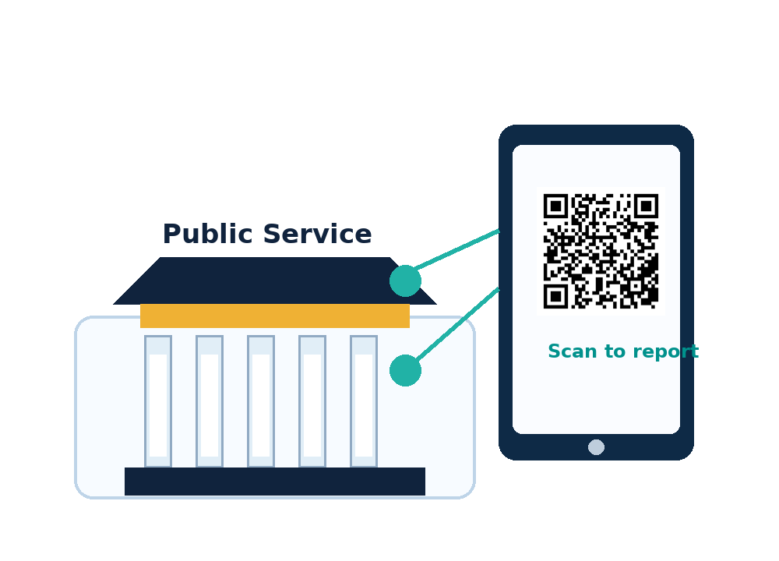
Research Presentation
Smart Anti-Corruption and Citizen Feedback Platform
Using QR Code Technology
Case Study: Remera Sector Office, Gasabo District, City of Kigali, Rwanda
Presented by: LYDIVINE KASINE
Reg No: 2305000371
University of Kigali
School of Computing and Information Technology
Bachelor of Business Information Technology
June 2026
01
Notes:
Introduce the study title, case study area, presenter name, registration number, university, school and program. Mention that the project proposes a QR-based system for reporting corruption and service delivery issues.

Slide 2

Introduction
Why this research matters
• The study focuses on improving how citizens report corruption and service delivery problems.
• Public institutions are expected to serve citizens in a transparent, timely, lawful and respectful way.
• Citizens may face delays, unofficial payment requests, poor communication, intimidation or weak follow-up.
• The proposed platform allows citizens to scan QR codes, submit complaints and track progress clearly.
Core idea: safe, simple and traceable citizen reporting.
Smart Anti-Corruption and Citizen Feedback Platform | University of Kigali
02
Notes:
Explain that the research is about making complaint reporting easier and safer. Emphasize transparency, timely response, and the role of QR codes in directing citizens to the correct reporting page.

Slide 3
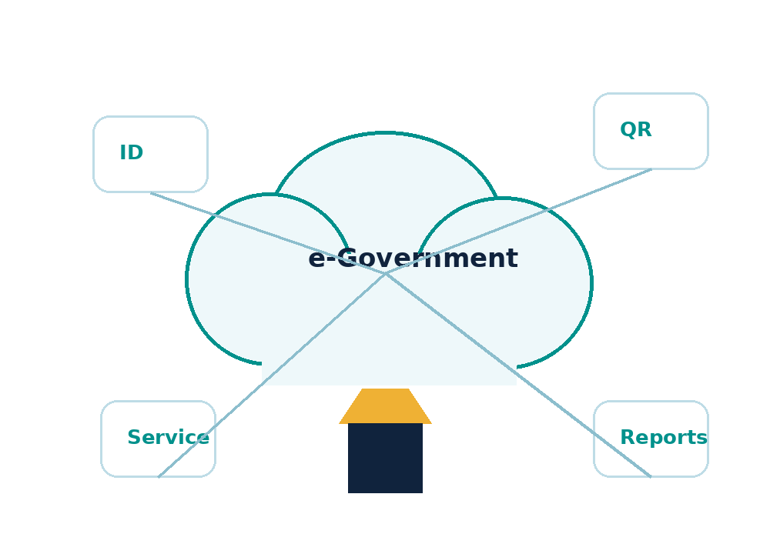
Background of the Study
Context
• Governments are increasingly using digital technologies to improve public service delivery and accountability.
• Rwanda has made progress in e-government, digital identity and public service systems.
• However, some challenges still exist at local service points where citizens meet public offices directly.
• At offices such as Remera Sector, citizens may need clearer guidance, safer reporting and stronger follow-up.
Digital governance must reach local service points.
Smart Anti-Corruption and Citizen Feedback Platform | University of Kigali
03
Notes:
Give the background: Rwanda uses digital services, but citizen-facing local offices still need better systems for reporting problems and following up complaints.

Slide 4
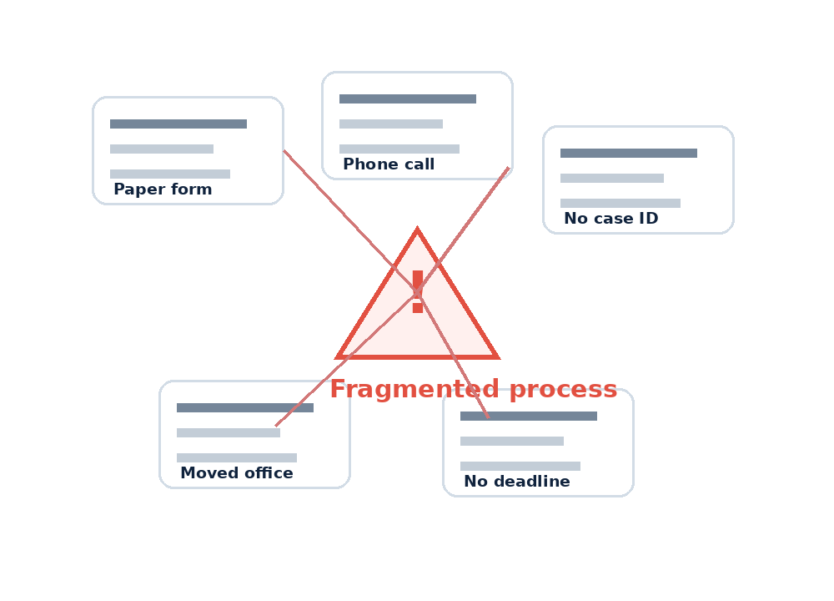
Problem Statement
Main problem
• Current complaint and feedback processes are often manual, fragmented and weakly traceable.
• Citizens may not know where to report or may move from one office to another without clear guidance.
• Some citizens may fear exposing their identity when reporting corruption.
• Verbal or paper-based complaints may have no case number, deadline or escalation path.
• This can cause poor follow-up, low trust, repeated visits and weak accountability.
Smart Anti-Corruption and Citizen Feedback Platform | University of Kigali
04
Notes:
State the problem clearly: manual complaint systems are hard to track. Citizens may not know where to report, and officers may not have a reliable case management process.

Slide 5
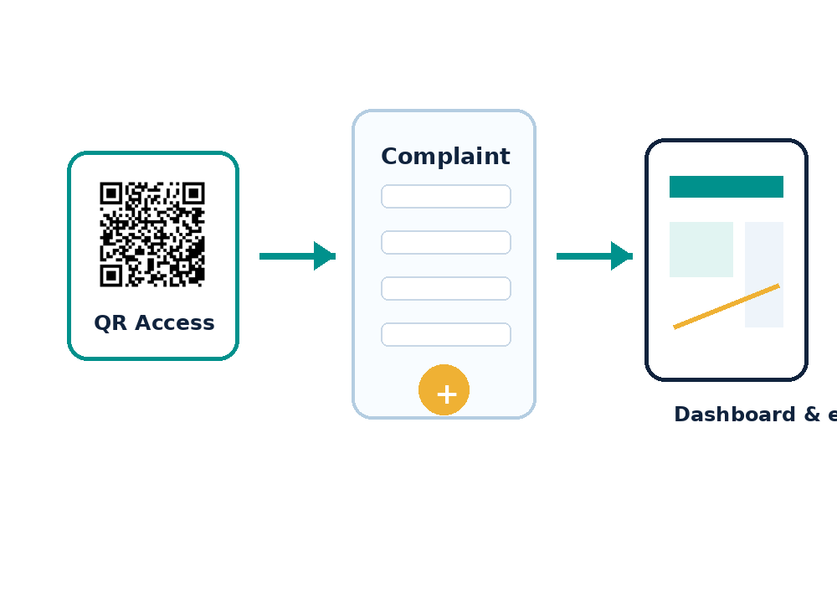
Proposed Solution
SACCFP platform
• A Smart Anti-Corruption and Citizen Feedback Platform using QR code technology.
• Each institution can have a unique QR code linked to the correct service or reporting page.
• Citizens can submit complaints, attach evidence, use voice notes, receive a case number and track progress.
• Officers and administrators monitor complaints through dashboards, respond to cases and escalate sensitive or unresolved issues.
Smart Anti-Corruption and Citizen Feedback Platform | University of Kigali
05
Notes:
Explain how QR codes simplify access. The citizen scans, reports, receives a case number, and the institution manages the case through dashboards and escalation.

Slide 6
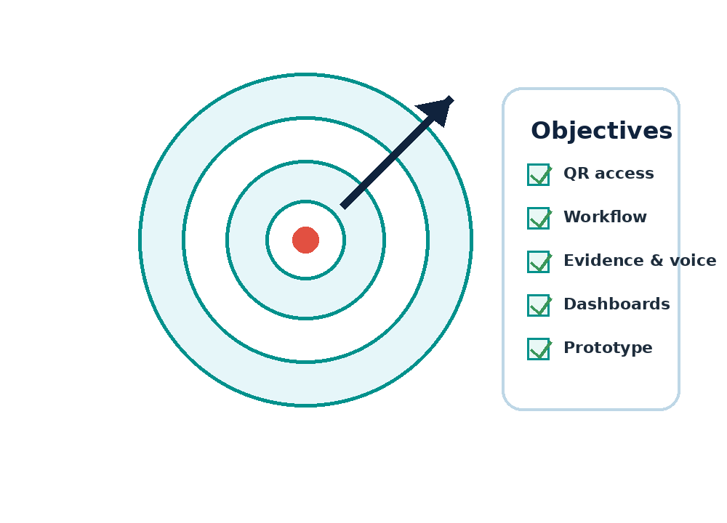
Research Objectives
General Objective
To design and prototype a smart anti-corruption and citizen feedback platform that enables citizens to report corruption and public service challenges through QR code access, structured reporting and accountable follow-up.
Specific Objectives
• Design a QR-based access model.
• Develop a structured complaint and feedback workflow.
• Support text, evidence attachment and voice-based reporting.
• Implement dashboard monitoring and escalation functions.
• Demonstrate the prototype for citizen reporting and institutional response.
Smart Anti-Corruption and Citizen Feedback Platform | University of Kigali
06
Notes:
Present the general objective first, then read the five specific objectives. Link every objective to a feature of the prototype.

Slide 7
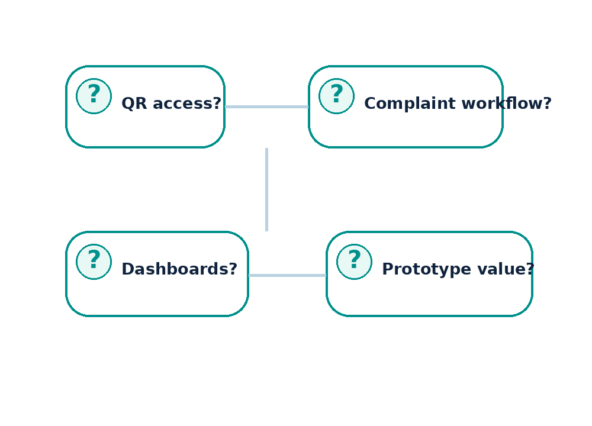
Research Questions
• How can QR code access direct citizens to the correct institutional reporting point?
• How can structured complaint workflows support text, evidence and voice-note reporting?
• How can dashboards and escalation improve accountability and follow-up?
• How can the prototype demonstrate citizen reporting, institutional response and service improvement?
Smart Anti-Corruption and Citizen Feedback Platform | University of Kigali
07
Notes:
These questions match the objectives. Mention that the research asks how the system should work and how it can improve reporting and accountability.

Slide 8
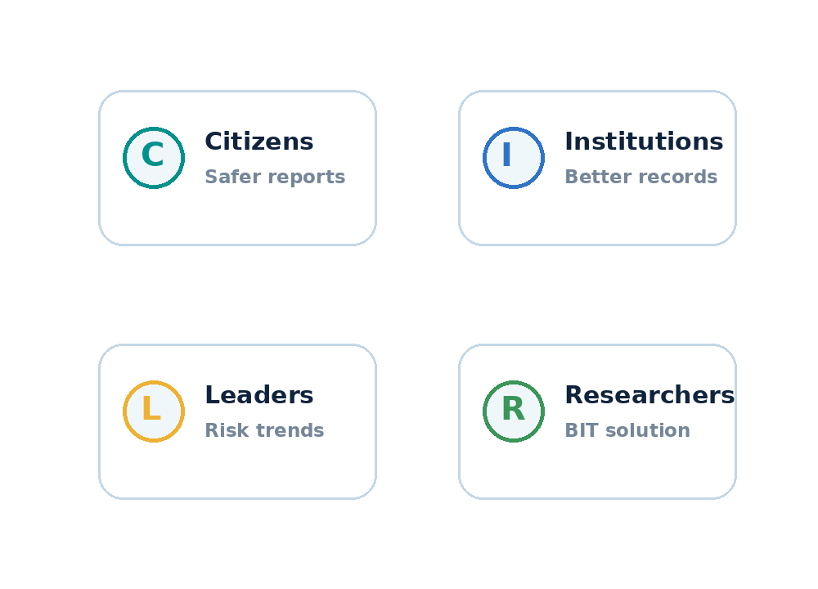
Significance of the Study
1
Citizens
Provides easier, safer and clearer reporting.
2
Public institutions
Improves complaint records, routing, response and monitoring.
3
Leaders and oversight bodies
Provides dashboard data for delays, trends and corruption-risk points.
4
Researcher and future scholars
Connects business information technology, digital governance and system design.
Smart Anti-Corruption and Citizen Feedback Platform | University of Kigali
08
Notes:
Explain the value for each group: citizens, institutions, leaders or oversight bodies, and researchers.

Slide 9
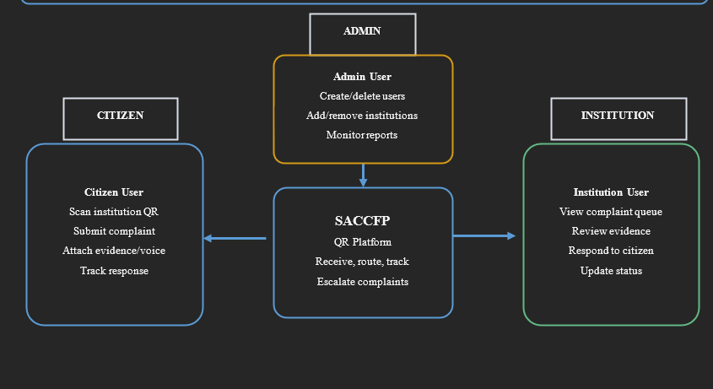
Conceptual Framework
Conceptual Framework
User roles and actions around the SACCFP QR platform
Smart Anti-Corruption and Citizen Feedback Platform | University of Kigali
09
Notes:
Use this slide to explain the framework. The platform connects citizens, institution users, administrators and outcomes through a single complaint management process.

Slide 10
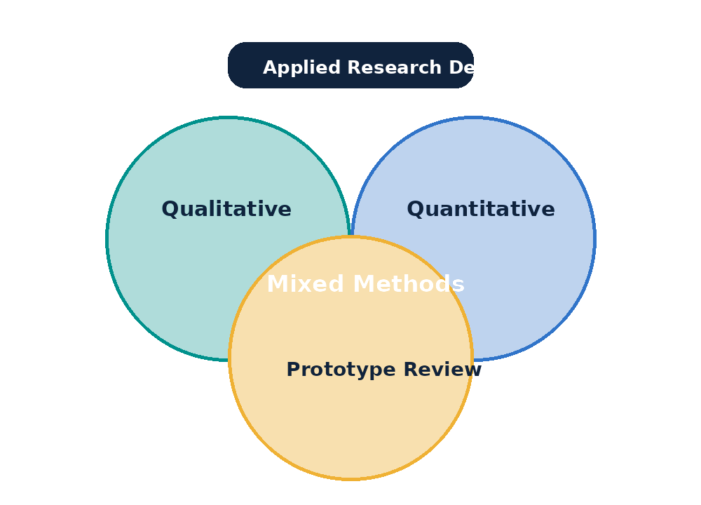
Research Methodology
Methodological Approach
• Approach: mixed methods, combining qualitative and quantitative methods.
• Case study: Remera Sector Office in Gasabo District.
• Estimated population: 1,600; sample size: approximately 350 respondents using Yamane’s formula.
• Data collection: observation, interviews, questionnaires, documentation review and prototype review checklist.
Smart Anti-Corruption and Citizen Feedback Platform | University of Kigali
12
Notes:
Explain the research design, population and sample size, data collection methods and analysis methods. Keep it simple and connect methodology to system development.

Slide 11
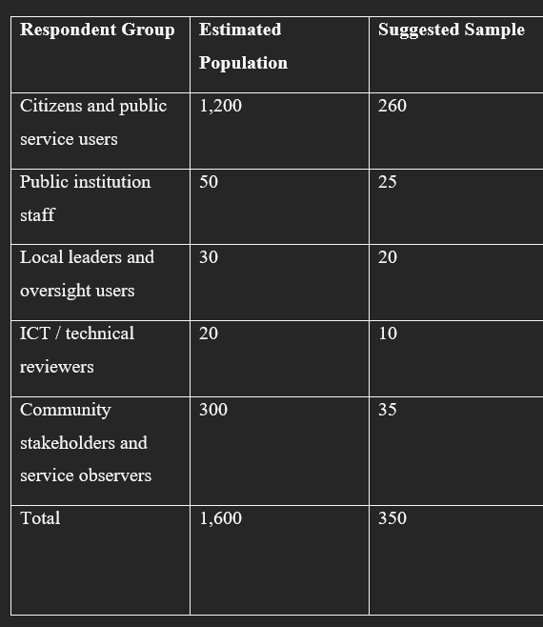
Population and Sample Selection
Smart Anti-Corruption and Citizen Feedback Platform | University of Kigali
11
Notes:
Mention the three theories and how they support system design and evaluation. Then summarize that empirical evidence supports digital complaint and feedback systems.

Slide 12
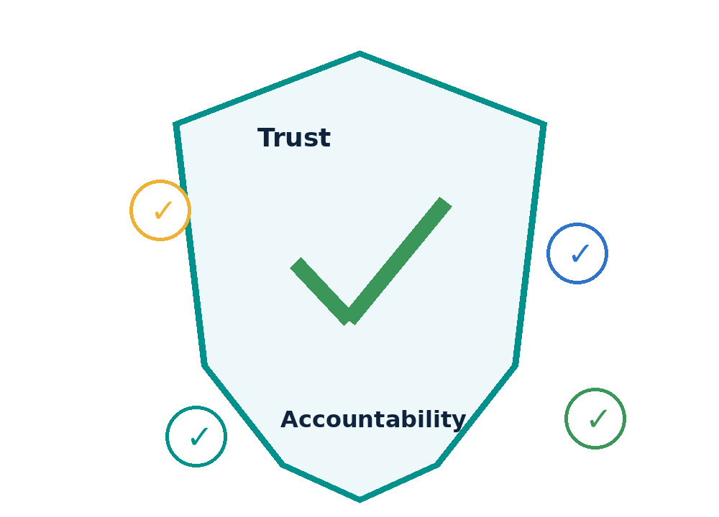
Scope, Limitations and Conclusion
Scope
The study focuses on Remera Sector Office, Gasabo District, during the 2025/2026 academic period. It covers QR access, complaint submission, feedback tracking, voice-note support, evidence attachment, dashboards and escalation.
Limitations
Limitations include proposal-stage implementation, limited field validation, privacy sensitivity and no nationwide deployment.
Conclusion
The project proposes a practical digital solution that can reduce confusion, improve complaint follow-up, protect citizens and strengthen accountability in public service delivery.
Smart Anti-Corruption and Citizen Feedback Platform | University of Kigali
13
Notes:
Finish by stating the scope, acknowledging limitations, and concluding that SACCFP can improve citizen reporting, follow-up and accountability in public service delivery.

