Slide 1
A Data Visualization Project Netflix Data Stock Profile
Elie Kourieh
September 4th, 2020

Slide 2

Project Objective
With the help of Codeacademy and Yahoo Finance’s stock database, an analysis on Neflix’s 2017 stock profile will be done in this project.
A stock profile is a series of studies, visualizations, and analyses that dive into different aspects a publicly traded company’s data.
The following visualizations are achieved with the help of python, conda installation packages and jupyter:
The distribution of Netflix's stock prices for 2017
The actual vs. estimated earnings per share for the four quarters in 2017
Netflix's earnings and revenue in the last four quarters
A comparison of the Netflix Stock price vs the Dow Jones Industrial Average price in 2017

Slide 3
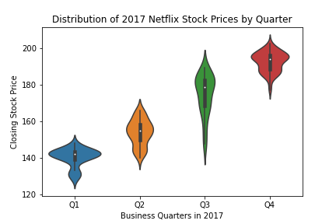
The distribution of Netflix's stock prices for 2017
This plot allows us to approximately see the distribution of the closing stock price for each quarter.
In Q1 → 142.00$
In Q2 → 157.00$
In Q3 → 182.00$
In Q4 → 195.00$
From the results, an upper trend is noticeable in Netflix’s 2017 closing stock price

Slide 4
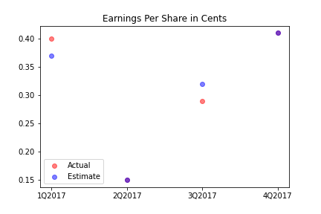
The actual vs. estimated earnings per share for the four quarters in 2017
The Earnings per Share, or EPS, generally indicates a company’s profitability.
The red dot represents the the actual EPS for a given Quarter.
The blue dot represents the the estimated EPS for a given Quarter.
The purple dot represents the event where the actual and estimated EPS are equal.

Slide 5
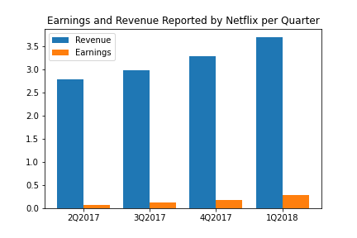
Netflix's earnings and revenue in the last four quarters
A side-by-side bar graph compares the revenue and earnings for each Quarter
A trend is noticeable here: both Netflix revenues and earnings are growing with time.
Setting up the x-axis as well as the bars was a challenge, check out the .py file for steps on how to execute!

Slide 6
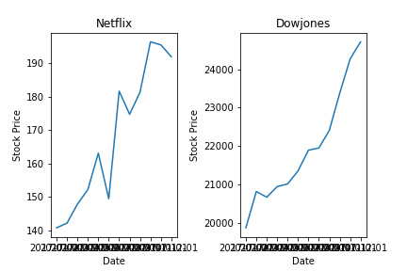
A comparison of the Netflix Stock price vs the Dow Jones Industrial Average price in 2017
Although the Dowjones stock prices are significantly greater than Netflix’s, it is safe to say both companies stock prices increased around 25% for Netflix and around 18% for Dowjones.
Just by looking at the graph, Netflix’s stock price seems to be more volatile than Dowjones.

