Slide 1
Travel agency decision
Caroline Le Verdier
Elie Bensoussan
Anaelle Fer
Clémence Arnaud
Michel Matei
Inès Dronet
Coline Vivert

Slide 2
Analytics roadmap
Do security and economic factors affect the number of tourists arrivals in countries in 2015 ?
Business question
Methodology
Findings → Insights
Patterns, results, implications
We use hierarchical clustering analysis to identify groups of similar countries based on their number of tourists and other economics variables. Describe clusters using hypothesis tests.
With Anova test :
-The average of GDP in each clusters is not the same, the percentage of growth of wealth is different between the 3 clusters.
-The average life expectancy and GDP per capita between the 3 groups is not significantly different.
With Chi-Squared test, the high risks natural disasters, the conflicts and the democracy are not significative. This variables doesn’t affect the arrivals.
Cluster 3 includes the countries with the highest number of tourist arrivals, the highest life expectancy, and the lowest GDP per capita. It has a relatively high growth percentage of national income.
Cluster 1 represents the grouping of countries with the lowest national income
Cluster 2 represents the grouping of countries with the highest national income, the lowest life expectancy and the countries with the highest GDP per capita.
The comparison between clusters allows us to affirm that it is the number 3 cluster that welcomes the most people
Context
What happened, where and when.
Data
8 quantitative and qualitative variables studied on 30 countries worldwide
Travel agency plans to launch a new guided tour in a country. They have asked us to determine whether security and economic factors affect the number of arrivals in a country.
Intuition → Hypotheses
Informed guess of causes & drivers
Rich countries with high level of wealth attract more tourists.
Countries with security problems have lower numbers of arrivals.
Stakeholders
What actions, by who and for when.
Recommendations
To launch a guided tour in a country, the travel agency doesn’t need to take into account security factors because the number of arrival doesn’t vary significatively depending on whether there is democracy, risks of natural disasters or conflicts. The most important thing is the percentage of growth of national income, that is relatively higher in countries with more numerous arrivals
Travel agencies, tourists, countries, investors, air transport companies, cruise companies.
Analysis goals
Specific and measurable
Segment a sample of countries based on the number of visitors. Identify and describe a number of segments.

Slide 3
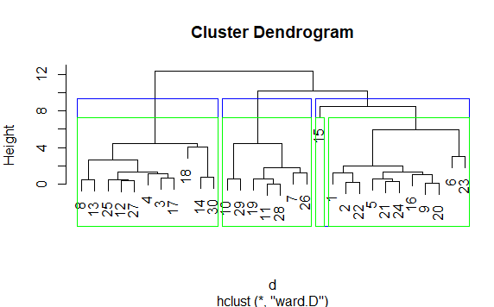


Project highlights
Key results:
We chose to select 3 clusters. Then we saw that variables such as natural risks, democracy and conflicts don’t impact the tourist attractivity of a country. Only the adjusted national income influences significantly the attractivity of a country.
Recommendations thanks to our results:
Regarding the results we prescribe that the travel agency focuses on the growth percentage of the country to decide whether or not to get settled in it.

Slide 4
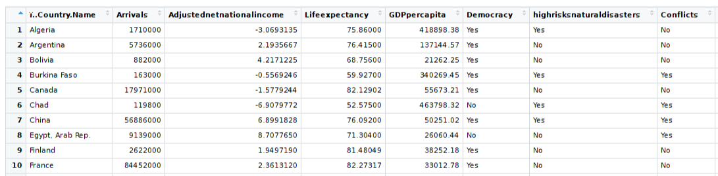
Annexe 1 : data collection and input
We collected our quantitative data on World development Indicators database and then we searched for qualitative values one-by-one. We put it in an excel file and saved it in csv format.
There was no missing values.
We standardized the data with “scale” and isolated quantitative variables with “grpdata”.

Slide 5
Annexe 2 : data processing
After loading our dataset and inspecting our datas we selected quantitative variables and we normalized them. We performed hierarchical clustering with “hclust”. We plot our datas to see our different clusters. We counted the number of individuals in each cluster, and we choose to keep 3 clusters. Then, we described the clusters using ANOVA tests and Chi-squared tests for relationships between groups and variables. We also used plot, Tukey tests and means with “tapply”.
We wanted to find the group with more arrivals and find common characteristics of countries in the same group. So we found Groups and Clusters analysis relevant.
We encountered difficulties to analyse our datas and find the good tests and
variables.

Slide 6
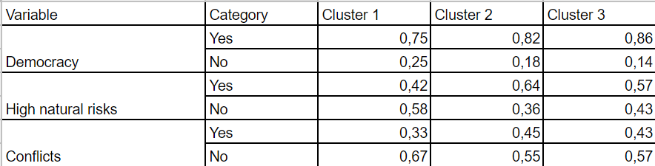
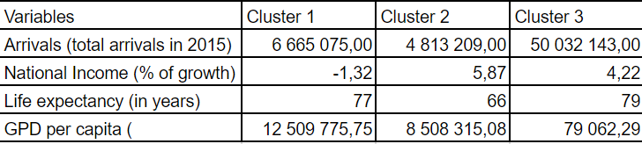
Annexe 3 : results
Anova results
Chi squared tests
Confidence interval
Means for each quantitatives variables

