Slide 1

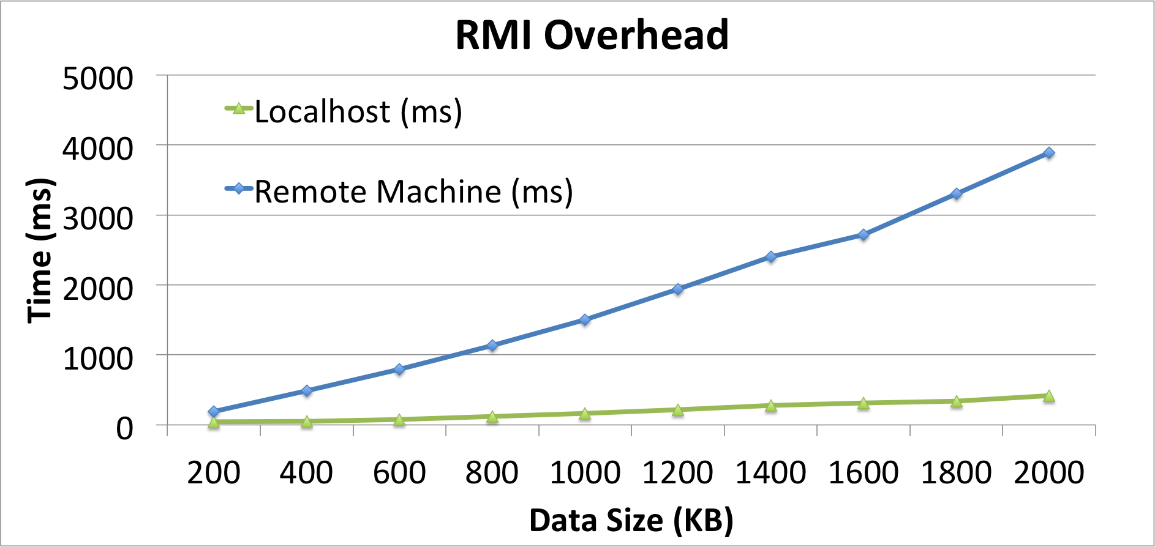
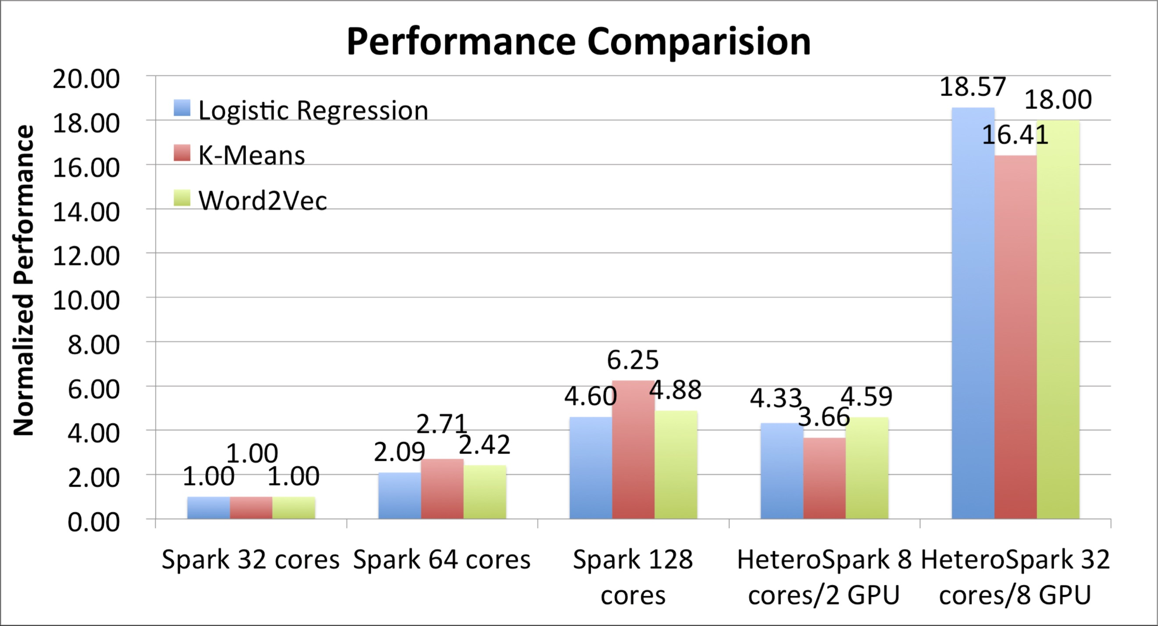
HeteroSpark: A Heterogeneous CPU/GPU Spark Platform for Machine Learning Algorithms
Peilong Li, Yan Luo, Ning Zhang and Yu Cao
University of Massachusetts Lowell
BACKGROUNDS
THE DESIGN OF HETEROSPARK
WHY RMI
Recent research advance in machine learning / deep learning algorithms and data analytics tools imposes new requirements on existing computing systems and architectures.
Distributed computing platform such as Hadoop and Spark are invented to address ‘big data’ problems.
The complex algorithms applied on the data unit in a single node still consume a large number of CPU cycles.
GPUs have been leveraged as accelerators in speeding up complex workloads thanks to the density of the cores and their power efficiency.
HeteroSpark Architecture
Solutions | Pros | Cons
RMI | Secure, faster, lightweight | Java-specific
COBRA | Language independent | No GC supported
SOAP | XML-based web service | Heavy and slow
Spring+JMS | Message queuing; simple programming interface | Spring framework learning curve, extra dependency
Enable/Disable GPU accelerators in configuration file
Three Configs:
Local GPU
Remote GPU
No GPU
RMI overhead is < 500 ms with 2MB of data if connected locally.
In most cases, we will use local GPU which is connected via PICe.
CPU-GPU Communication
Java Remote Method Invocation: methods of remote Java objects can be invoked from other Java virtual machines (on different hosts)
RMI uses object serialization to marshal and unmarshal parameters
MOTIVATIONS
PERFORMANCE
Marriage of GPUs to Spark cluster computing framework to address both big data and intensive computation challenges.
Acceleration:
Heterogeneous architecture will be utilized to speed the workloads on the best suitable processors
Plug-n-play:
GPUs can be dropped in or removed flexibly
Portability:
Reduce programming complexity and achieve transparent acceleration.
Algorithms that are benchmarked:
Logistic regression
K-Means
Word2Vec
System setup:
CPU: EC2 m3.xlarge nodes
GPU: EC2 g2.2xlarge
HeteroSpark Glue Logic
CONCLUSION
CONTRIBUTIONS
Acceleration: HeteroSpark enhances Spark by accelerating machine learning algorithms and reducing CPU resources.
Plug-n-play: zero interference with original application if choose to “mute” acceleration.
Portability: non-tedious work to port existing Spark application into HeteroSpark (if using the maintained libraries).
We present the first scalable computing architecture with heterogeneous processors (CPU + GPU) as an effective extension to Spark on computationally intensive work- loads
We design APIs to seamlessly glue exiting and newly developed GPU kernels to HeteroSpark so that the growing set of GPU libraries can be leveraged.
We conduct experiments to demonstrate the effectiveness of HeteroSpark in scalability and portability.
Two Usage Mode
Black Box Mode: Use HeteroSpark with provided acceleration libraries.
Eev Mode: Extend HeteroSpark with user developed GPU acceleration libraries.
FUTURE WORK
Serialization Overhead
Simplified Interface
Spawning the Library
Dynamic scheduling
This work is supported in part by the National Science Foundation (ACI-1440737, ACI-1450996, and IIP-1530989)

