Slide 1
HeteroSpark: A Heterogeneous CPU/GPU Spark Platform for Machine Learning Algorithms
Peilong Li, Yan Luo, Yu Cao, Ning Zhang
University of Massachusetts Lowell

Slide 2
Background
GPU outperforms CPU in a broad area of applications:
Machine learning, image processing, bioinformatics, etc.
Pros and cons of current solutions:
Current Solutions | Pros | Cons
Single GPU | Good data parallelism | Difficult to handle large scale dataset due to memory size
GPU Cluster | Good data parallelism | Complexity in data partitioning (MPI, OpenMP)
CPU Cluster | Scalability, programmability | Single node performance due to limited number of cores

Slide 3
Motivations
Acceleration: Integrate GPU accelerators into current Spark platform to achieve further data parallelism and algorithm acceleration.
Plug-n-play: “Plugin” style design – current Spark applications can choose to enable/disable GPU acceleration.
Portability: Existing Spark code can be easily ported to the heterogeneous platform.

Slide 4
HeteroSpark Architecture
Enable/disable GPU accelerators in configuration file
Three configs:
Local GPU
Remote GPU
No GPU

Slide 5
CPU-GPU Communication
Java Remote Method Invocation: methods of remote Java objects can be invoked from other Java virtual machines (on different hosts)
RMI uses object serialization to marshal and unmarshal parameters

Slide 6
HeteroSpark Glue Logic

Slide 7
GPU Accelerator Development
Accelerate your application:
Use HeteroSpark existing libraries.
Develop HeteroSpark accelerator libs.
File sharedLibrary = new File(”Func_JNI.so");
System.load(sharedLibrary.getAbsolutePath());
public native int func(float[] para1, int para2 …);
…
int retArray = obj.func(para1, para2…);
// Read all input parameters
jdouble *para1 = (*env)->GetFloatArrayElements(env, array1, 0);
func(para1, para2, …); // Call the native function which is implemented on GPU
// Return data back to Java env
(*env)->ReleaseFloatArrayElements(env, array1, para1, 0);
public native int func(float[] para1, int para2 …);
…
int retArray = obj.func(para1, para2…);

Slide 8
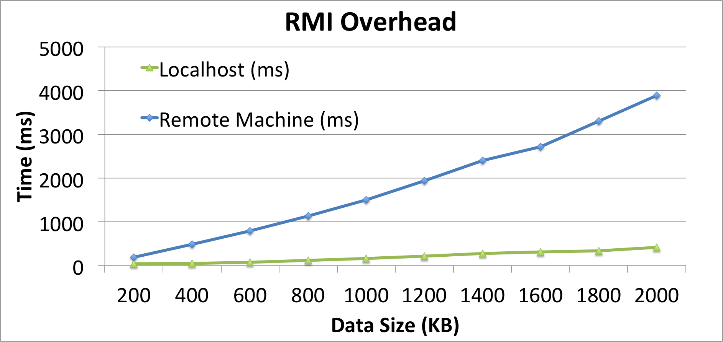
Why RMI?
Solutions | Pros | Cons
RMI | Secure, faster, lightweight | Java-specific
COBRA | Language independent | No GC supported
SOAP | XML-based web service | Heavy and slow
Spring+JMS | Message queuing; Clear programming interface | Spring framework learning curve, extra dependency
RMI overhead is < 500 ms with 2MB of data if connected locally.
In most cases, we will use local GPU which is connected via PICe.
Notes:
COBRA: Common Object Request Broker Architecture
SOAP: Simple Object Access Protocol

Slide 9
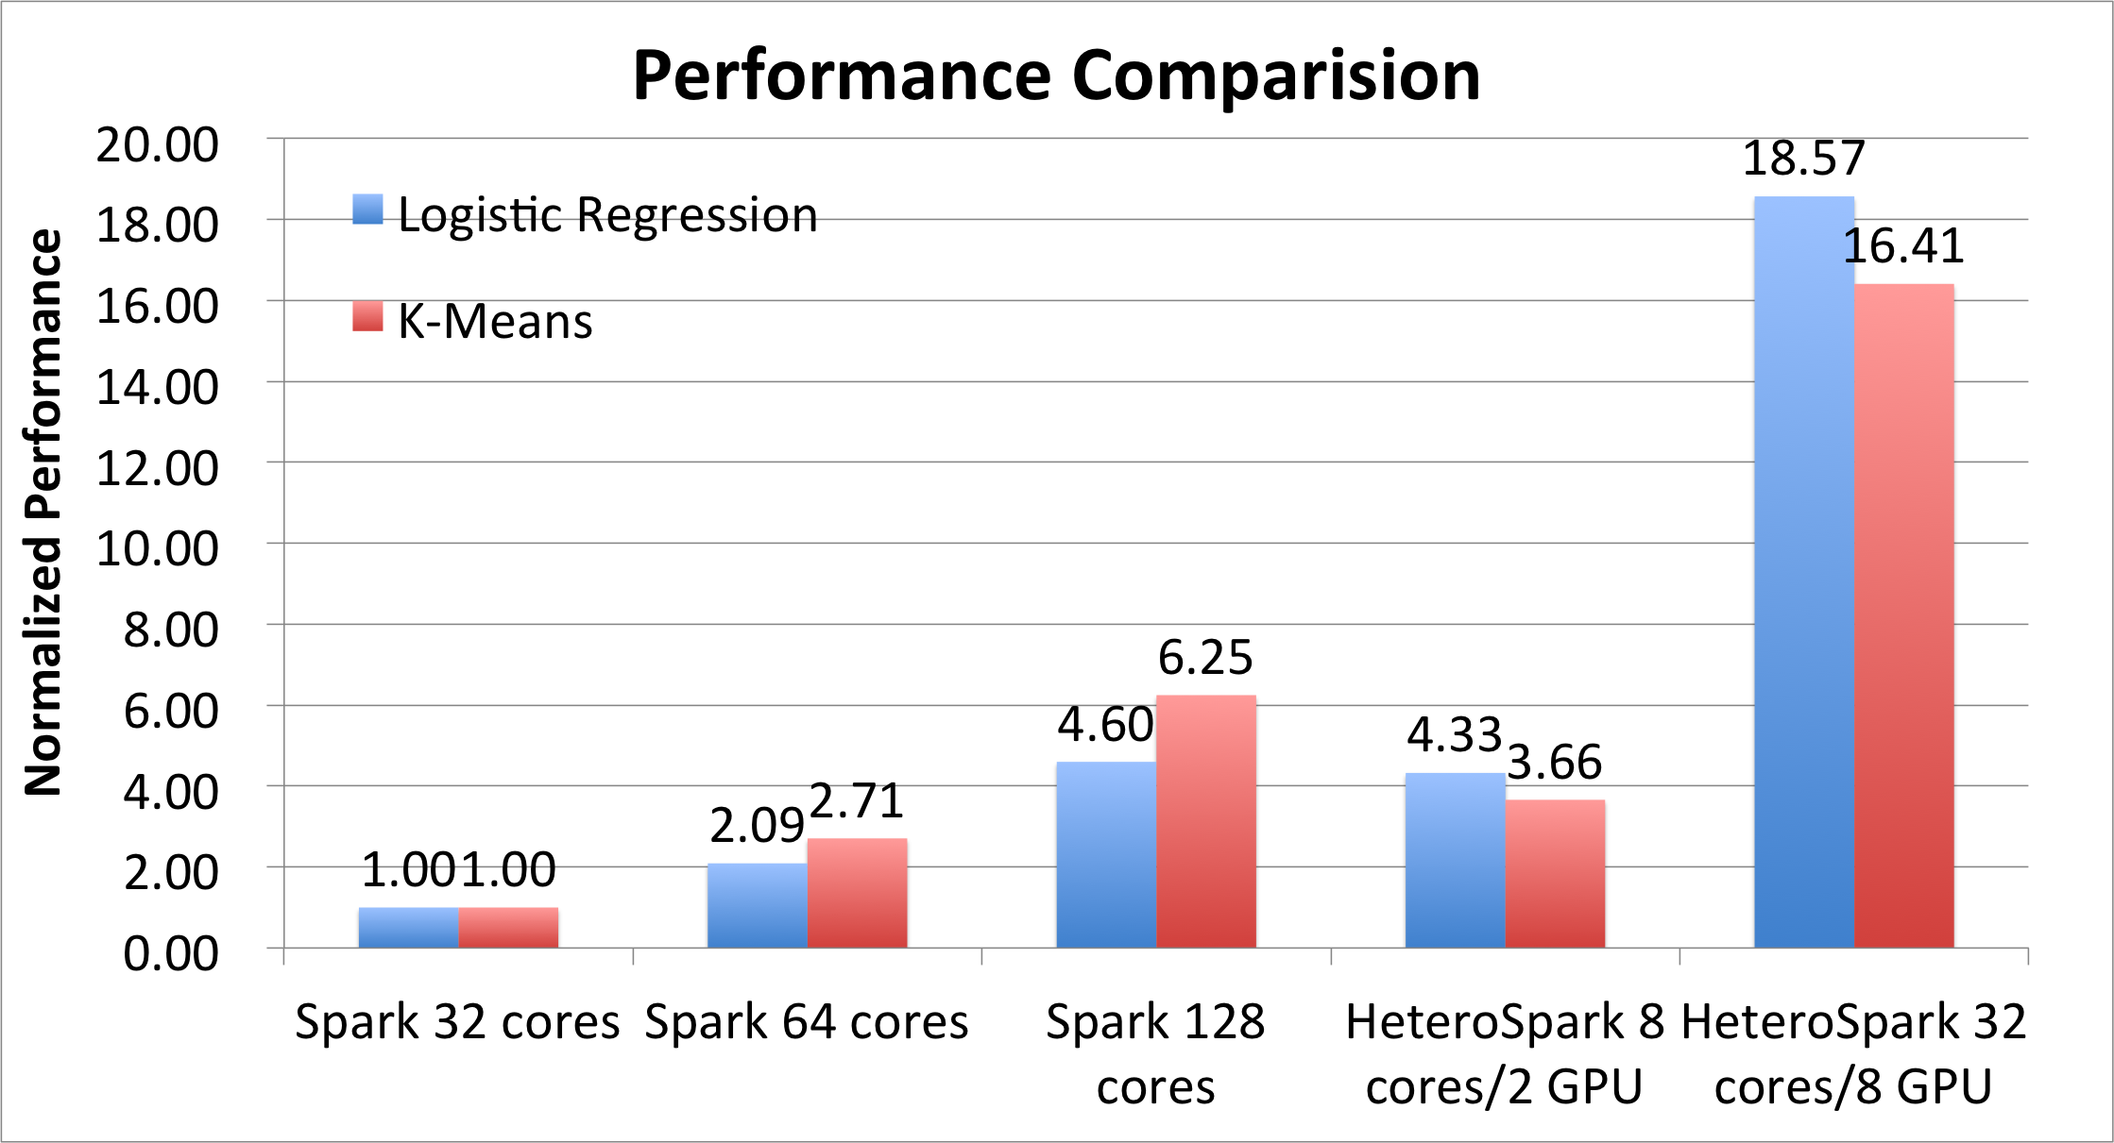
Performance Evaluation
Benchmark applications:
Logistic regression
Dataset: Criteo (click prediction task), trainining 11.15 GB , test 1.46 GB
K-Means
Dataset: MNIST-8M, (handwritten digits), 8.1 M data, 24.8 GB
System setup:
CPU: EC2 m3.xlarge nodes
GPU: EC2 g2.2xlarge

Slide 10
Conclusion
Acceleration: HeteroSpark enhances Spark by accelerating machine learning algorithms and reducing CPU resources.
Plug-n-play: zero interference with original application if choose to “mute” acceleration.
Portability: non-tedious work to port existing Spark application into HeteroSpark (if using the maintained libraries).

Slide 11
Future Work
Serialization Overhead: Utilize faster serialization technique for communication.
Simplified Interface: Use Spring framework to simplify remote method innovation interface.
Spawning the Library: Integrating more machine learning libraries into HeteroSpark, esp. deep learning algorithms.

Slide 12
Thank you!

