Slide 1
Predicting Political Party Affiliation for Google Street View Images
Elie Eshoa, Daniela Shuman, Luke Stoner

Slide 2
Research Question: Can we use convolutional neural networks to predict the party affiliation of the congressional district associated with Google Street View images?

Slide 3
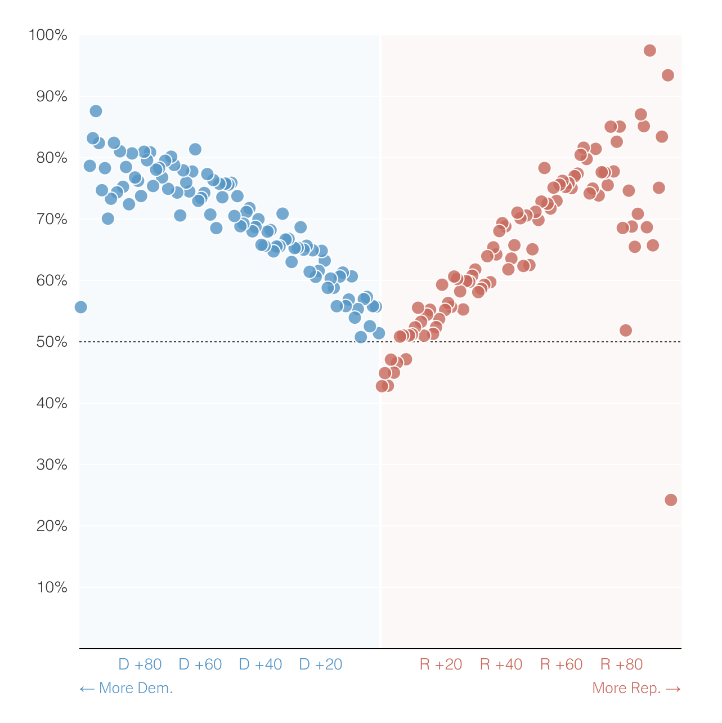
Motivation
After the 2020 election, the New York Times asked readers to guess party affiliation based on street view images
On average, readers guessed correctly 60-67% of the time
More politically homogeneous locations were easier to guess

Slide 4
Data Collection
Congressional Data
Based on 2022 midterm election results (via Bloomberg)
Match congressional district results to street view image via ZIP code
Street View Data
Collected 10,000 random street view images via web scraping of randomstreetview.com
Originally skewed Republican, lacked urban images
Caveat about unbalanced data will be addressed in the following slides

Slide 5
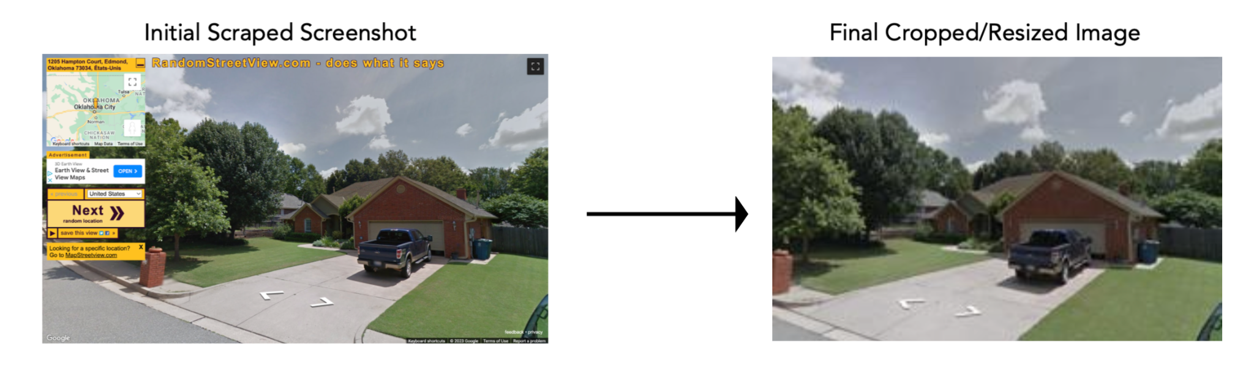
Preprocessing
Crop web scraped images to remove Street View UI
Resize images and convert to RGB
Clean dataset, removing observations missing ZIP code or congressional district result

Slide 6
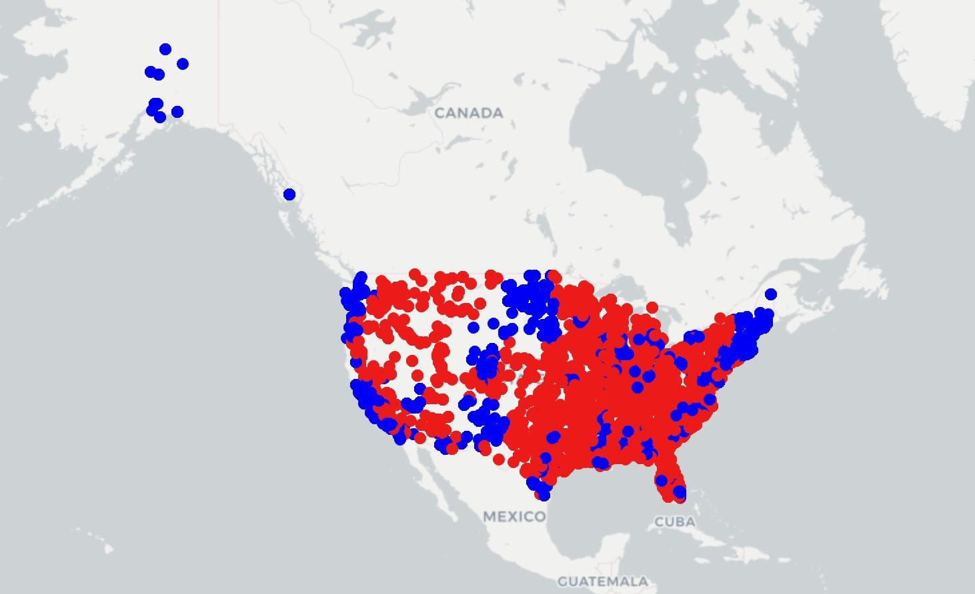
EDA
Unbalanced Data:
Republican districts cover bigger surface area
Around 70% of the randomly sampled images were Republican
Fix:
Add from the University of Florida dataset, which includes district images from Manhattan, Pittsburgh, and Orlando
Randomly Scraped Street View Locations

Slide 7
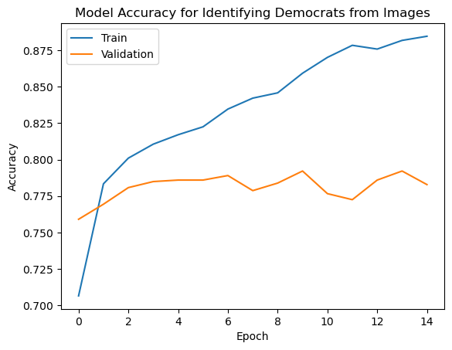
Baseline Model
Basic CNN Architecture
3 convolutional / max pooling layers
2.3 million total parameters
Based on 5000 image subsample
Achieved strong accuracy
Compared to baseline of ~50%
Train: 88% accuracy
Test: 79% accuracy
Needed to improved generalization

Slide 8
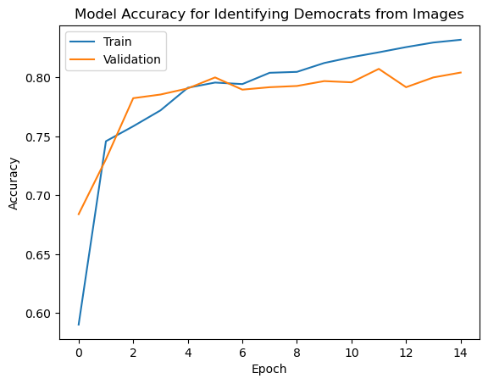
Improvement
Basic CNN Architecture
4.6 million total parameters
Added dropout layers
Larger dense layer (64 vs. 32)
Smaller batch size (16 vs. 32)
Improved test accuracy
Compared to baseline of ~50%
Train: 84% accuracy
Test: 81% accuracy

Slide 9
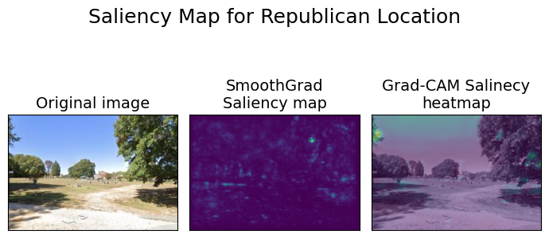
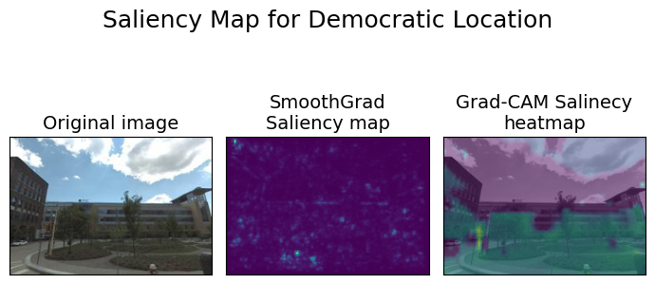
Saliency Maps
Republican
Values sky
Appears to value foliage/greenery
Democrat
Ignores sky
Highlights building lines and street features

Slide 10
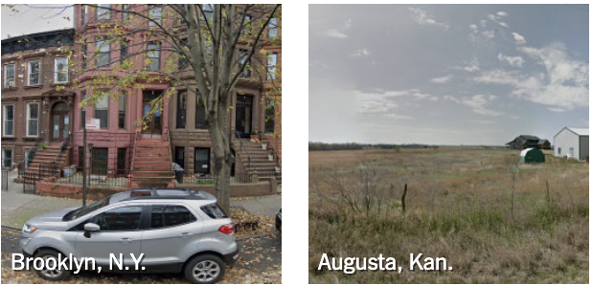
Hypothesis - Feature Extraction
Identifying Dense Urban Environments vs. Rural Areas should be a good differentiating factor between political party.
Areas with more sky would more likely be Republican
Areas with more buildings and less rural landscape would be more likely Democrat

Slide 11
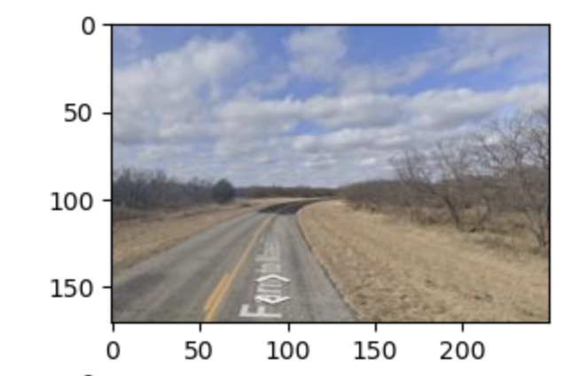
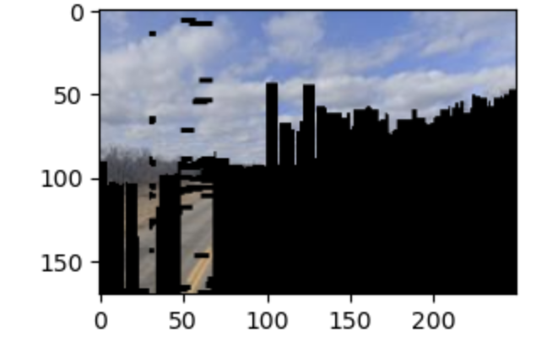
Methodology - Feature Extraction
Sky Detector uses an existing mask in CV to extract skyline as a feature
Landscape Detection using VGG19 and transfer learning
This image is from a district that is Republican and is clearly a highway with no buildings or many objects obstructing the view of the sky.
The feature we extracted here is the amount of sky: 47.55%
For this same image in the Republican district, the landscape predicted was a street.

Slide 12
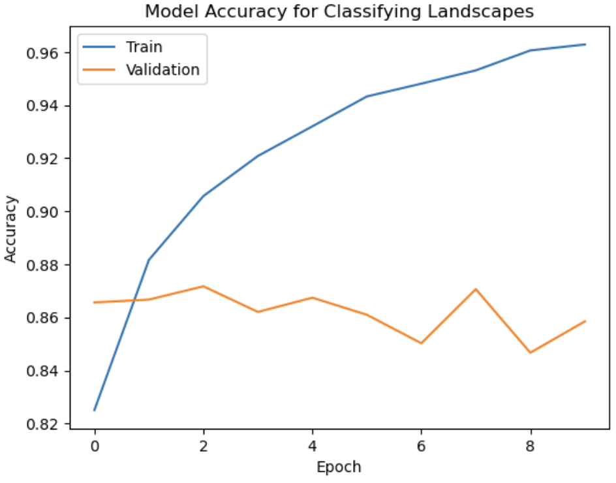
Landscape Identification
CNN Architecture using transfer learning on VGG19
5 Convolutional Blocks
Approximately 20M parameters
Trained on 14k images
Categorical Output
Reached 96% accuracy on train and 86% accuracy on test.

Slide 13
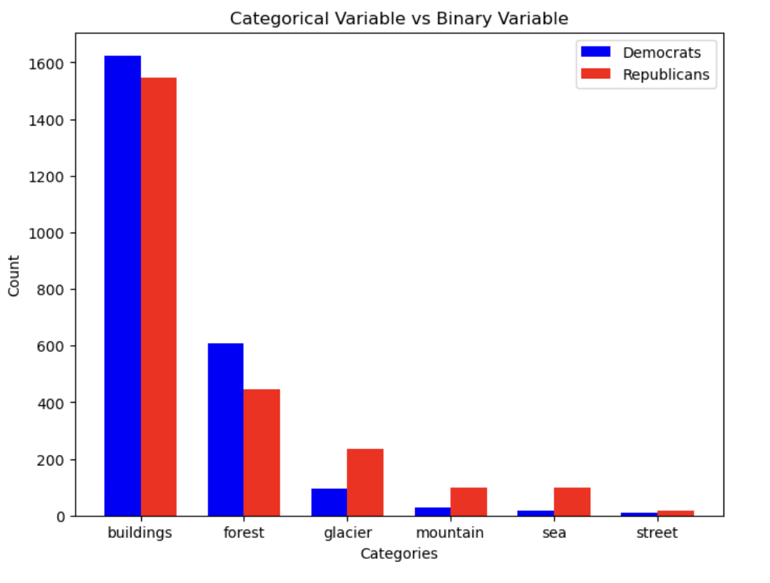
Results - Feature Extraction
Our original hypothesis was wrong: that more buildings would be more Democratic.
This lack of statistical difference lead to very poor model performance, where it did not achieve above baseline (50%) accuracy.

Slide 14
Conclusion and Future Work
We were able to use a CNN architecture to classify images across the US as in Democratic or Republican Districts.
We reached an accuracy of 84% on training &
81% on testing
Future Work: Exploring more features that can be used to identify Republican vs. Democratic districts (i.e. American flags or Trucks)

