Slide 1
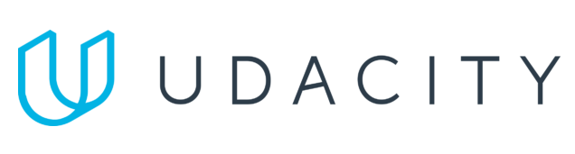
Data Lake Value Proposition
Medical Data Processing Company
Elie Kawerk
Udacity IPS Version 1.0

Slide 2
Agenda
What is a Data Lake
Components of a Data Lake
Data Lake vs Data Warehouse
Business Value of Data Lake Solution
Proposed Data Lake Architecture for Medical Data Processing Company
Udacity IPS Ver. 1 2/2020

Slide 3
What is a Data Lake
Executive summary
A data lake is a centralized repository for ingesting, storing, processing, and serving structured, unstructured, and semi-structured data without enforcing any schema constraints upon ingestion. Data lakes leverage the elastic storage and compute capabilities of cloud computing to scale on demand and democratize the storage, processing, and access to data through APIs, SQL interfaces and dashboards.

Slide 4
Components of Data Lake
A data lake consists of 4 layers:
Ingestion: responsible of ingesting real-time data and batch data
Storage: responsible of storing raw, real-time, and transformed data
Processing: responsible of processing the raw data and real-time data
Serving: responsible of serving raw, real-time and transformed data through dashboards, SQL interfaces, and APIs

Slide 5
Data Warehouse
Data Lake
A DWH is meant for processing structured data only
It has rigid constraints on schema for writing the data
Stores golden data that has been thoroughly validated
A DWH mixes storage and compute (ex: Redshift)
A data lake can store and process structured, unstructured, and semi-structured data
No constraints on schema for writing the data
Can store raw or processed data
Storage can be decoupled from compute (ex: S3, Spark)
Udacity IPS Ver. 1 2/2020

Slide 6
Business Value of Data Lake
The data lake architecture for the Medical Data Processing Company tackles the following business problems:
Centralization of data assets: all data assets of the MDPC are centralized within the lake
Scalability & Continuous uptime : the lake is built using cloud computing resources that scale storage, processing, and serving elastically – you pay only operational expenses
Reliability & Fault Tolerance: the data lake uses serverless computing resources that can handle fault-tolerance in data processing, and replicate storage that can handle disaster recovery
Automation & capability to use new frameworks: the lake is powered by an automated ETL orchestration workflow (AWS Glue) that processes data periodically

Slide 7
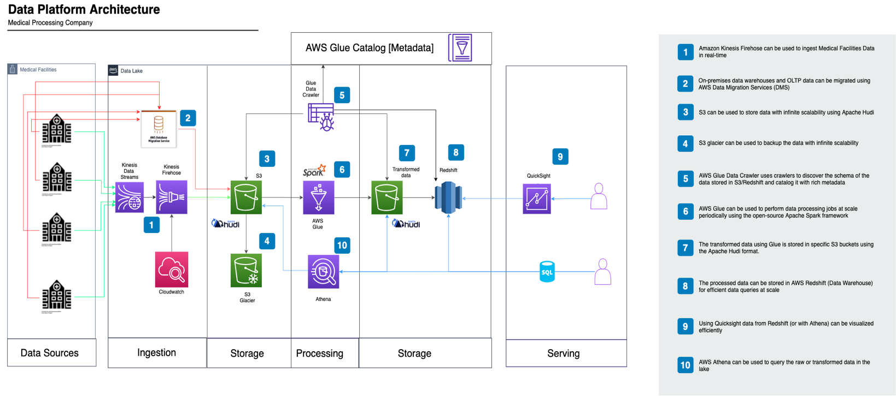
Data Lake Architecture
Data Lake Architecture for the Medical Data Processing Company

Slide 8
THANK YOU
Udacity IPS Version 1.0

