Slide 1


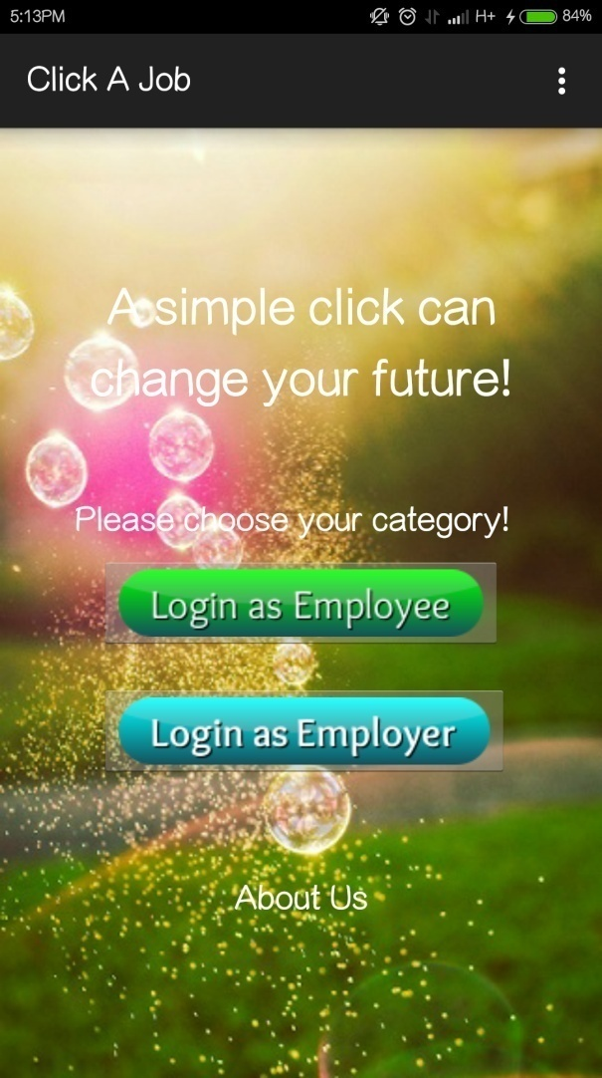
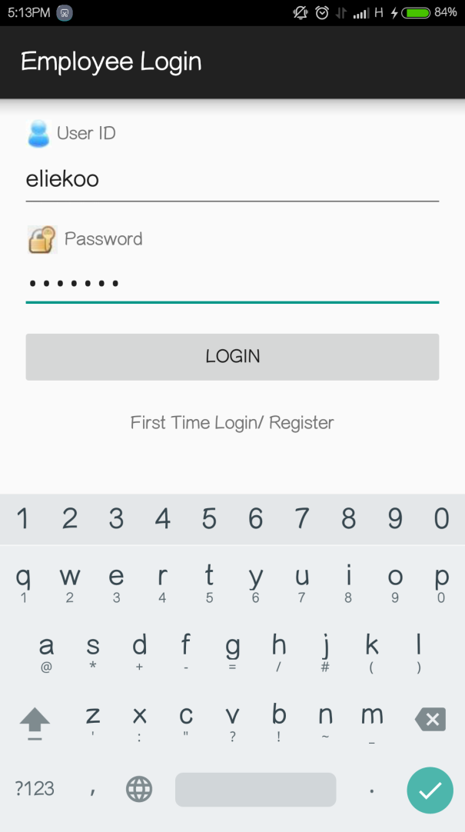
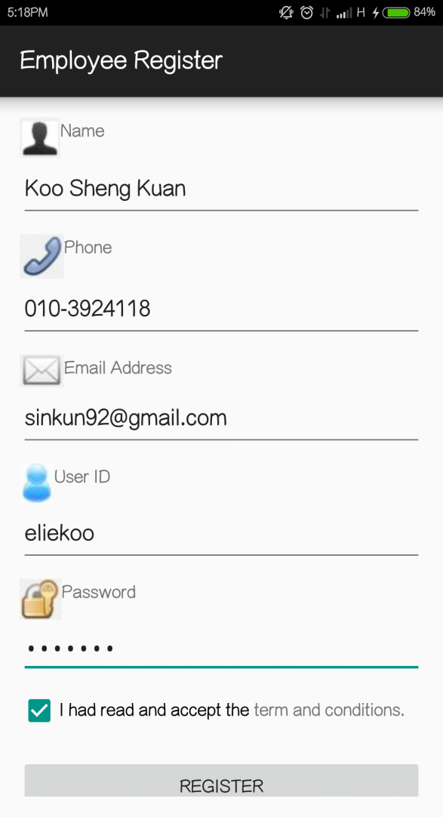
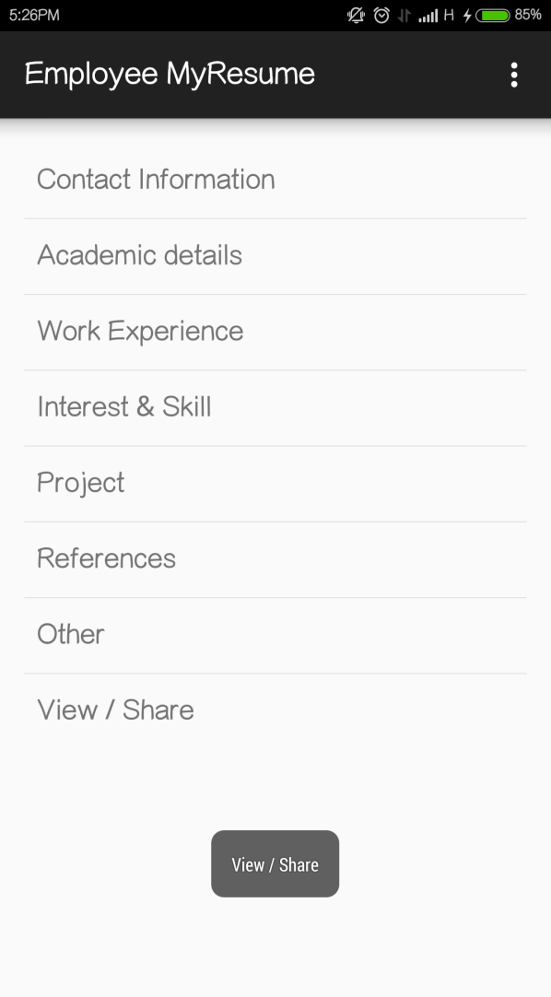
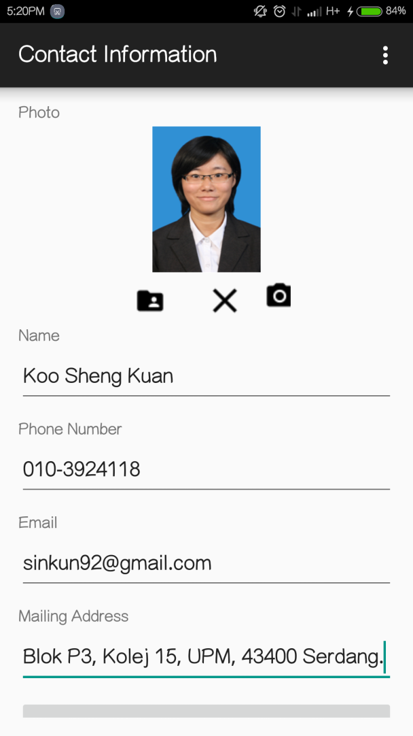
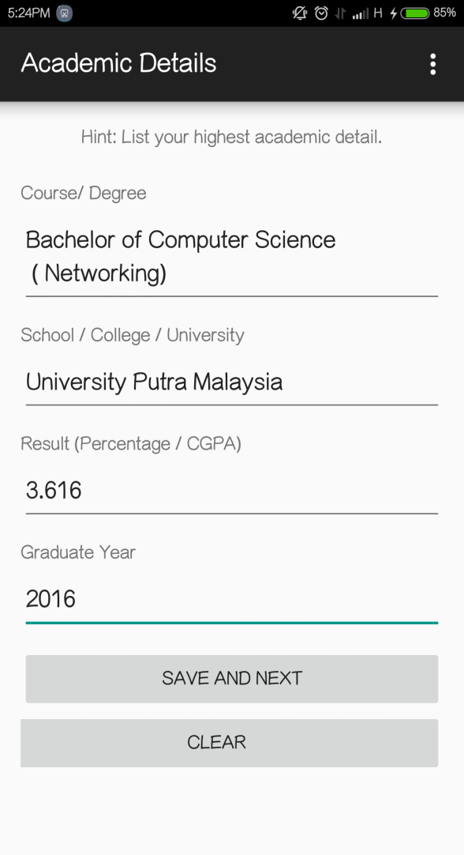

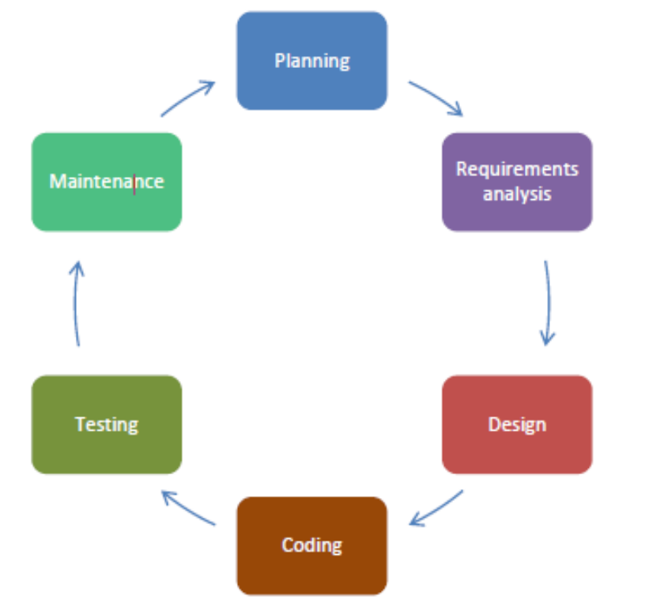




Click A Job
A simple click can change your future!
Abstract
Click A Job
- Mobile Android App
- Platform for
employment interaction
Employee
- Create, edit, share & appeal resume to third party
- Apply vacancy post
Users
Employer
- Post vacancy
- View candidates
Inconvenient
Low mobility
Limited resume format
Expensive
Problem Statement
System Design
User-friendly
Free app
Assure a quality and useful platform for
employment
Provide an efficient alternative job
employment according to related field
Objective
Methodology
Click A Job is user-friendly Android app
Enable employee to create their resume and appeal
to interested company.
It provides a solution for them to create resume and
open to opportunities for their futures.
Employer could post vacancy and employ easily.
Employment & income= lifestyle + (value, choice & empowerment)
Important: human tends to change for a better lifestyle.
In this technology era, is a trend to
search vacancy thru mobile devices.
It bring a great impact to market.
Click A Job have open opportunities for job seekers.
Conclusion
Market Potential
Koo Sheng Kuan
Dept of Communication Technology and Network
Faculty of Computer Science and Information Technology
University Putra Malaysia, 43400 UPM Serdang, Malaysia
Tel : 010-3924118
Email : sinkun92@gmail.com
Year : 2015
Assoc. Prof. Dr. Zuriati binti Ahmad Zukarnain
Dept of Communication Technology and Network
Faculty of Computer Science and Information Technology
University Putra Malaysia, 43400 UPM Serdang, Malaysia
Tel : 03-89471748
Email : zuriati@upm.edu.my
Year : 2015

