Slide 1
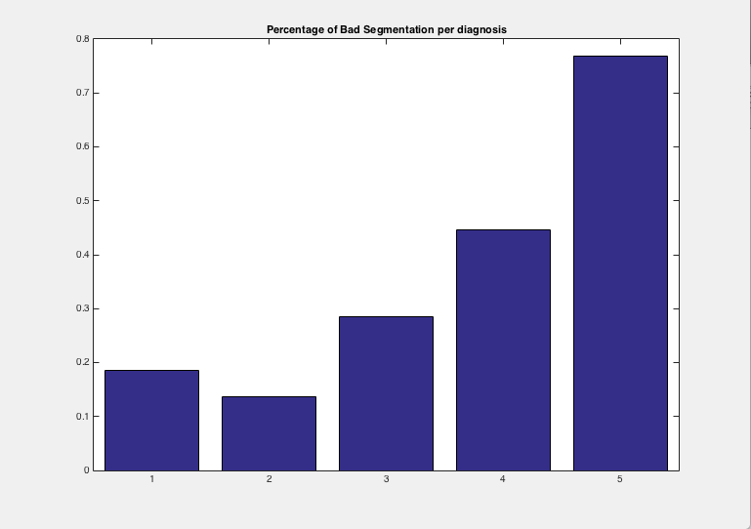
Progress so far
Segmented the sacro-ilium joint both for left and right sides of the 143 cases.
  Total 286 cases
  Successful segmentations: 205 out of 286
  Success rate: ~72%
The bad segmentations are both related to the quality of the CT as well as the diagnosis. Below a graph bar showing the percentage of bad segmentations according to the diagnosis of the radiolog.

Slide 2
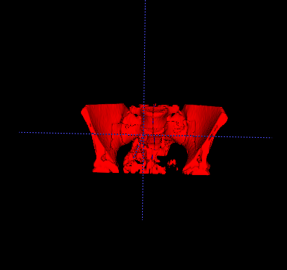
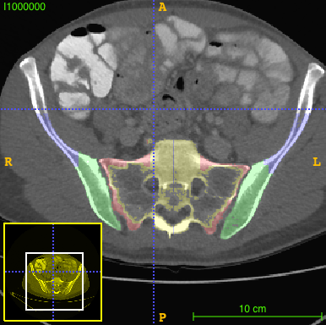
Successful segmentation
3D image of the area of the hips segmented
Axial image showing the results of a successful segmentation

Slide 3
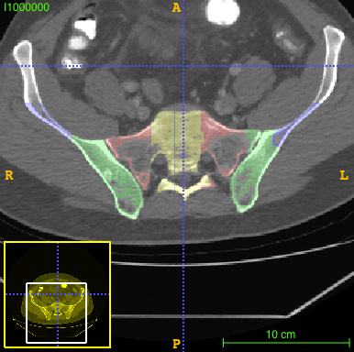
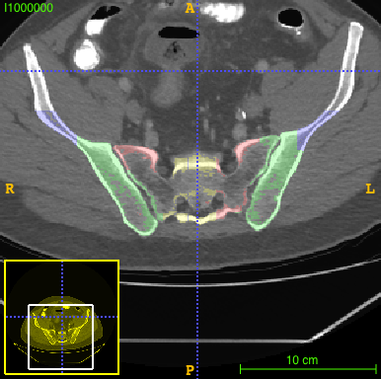
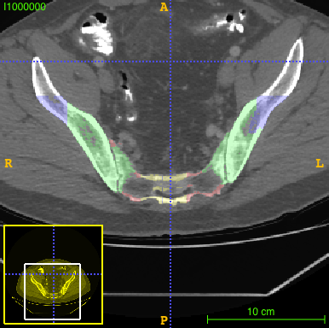
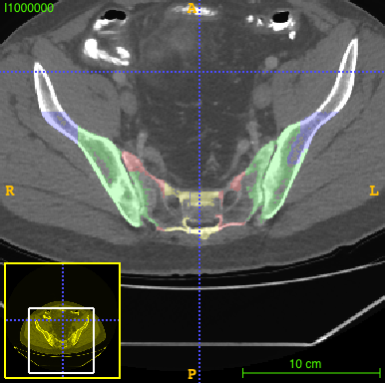
Unsuccessful segmentation
Segmentation for patient with diagnosis:
  Rt = 2
  Lt = 3

Slide 4
Classification
First acquisition of features
  Measurement of the joint
    Max/min in the x/y coordinates
    Std deviation
    Mean gray values in the joint area
    Error rate: ~40%
Second simpler acquisition of features
  Number of pixels intersected in the ilium when doing a dilatation on the sacrum.
  Segmentation total weight
  Error rate: ~24%

Slide 5
Next Steps
Classification of the inflamation
  Neural Network
  SVM? Or other more conventional ML approach

