Slide 1
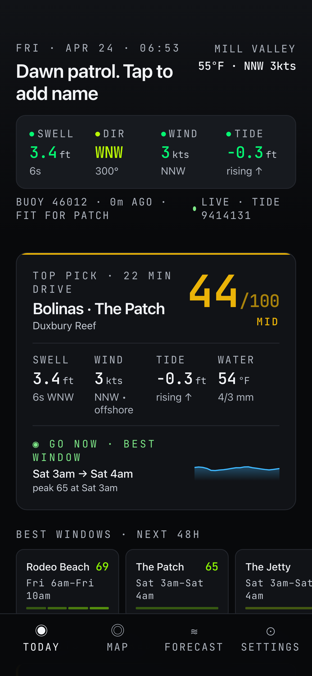
SURF VIKINGS
PORTFOLIO CASE STUDY · 2026
COVER · 01
Hyper-local NorCal surf forecasting, from thesis
to shipped PWA.
ELIEL JOHNSON
Sole designer, engineer, product lead
surfvikings.com
01 / 14

Slide 2
SURF VIKINGS
PORTFOLIO CASE STUDY
PROJECT SNAPSHOT · 02
At a glance.
PRODUCT
A progressive web app that scores 28 NorCal surf breaks hour-by-hour using free NOAA data.
DOMAIN
surfvikings.com (marketing) · surfvikings.com/app (PWA)
ROLE
Sole designer, engineer, and product lead
SURFACE AREA
Marketing site (Landing, Merch, Games, About) + PWA (Dashboard, Spot Detail, Forecast, Map, Settings)
CODEBASE
~4,100 lines of TypeScript · 7 feature components · 5 primitives · 3 server fetchers
STACK
Vite · React 18 · TS · vite-plugin-pwa · react-router-dom v7 · Playwright · Sharp · Vercel
DATA SOURCES
100% free public APIs — NDBC buoys · Open-Meteo marine · NOAA tides
STATUS
Live on custom domain, Let’s Encrypt TLS, 34 commits, installable on iOS / Android
surfvikings.com
02 / 14

Slide 3
SURF VIKINGS
PORTFOLIO CASE STUDY
THE THESIS · 03
Answer the real question.
"
A NorCal surfer’s real question isn’t "what are the conditions?" — it’s "which of my six favorite breaks, at what hour in the next 48, is worth the drive?"
PRODUCT THESIS
BRAND THESIS
A ranked, scored, time-windowed recommendation engine built on 100% free public data, with enough local intelligence baked into the spot profiles that the answer is defensible, not just aggregated.
The Norse didn’t wait for perfect conditions. They read the water and went. The app is for surfers who think the same way: committed, local, always looking for the next session.
surfvikings.com
03 / 14

Slide 4
SURF VIKINGS
PORTFOLIO CASE STUDY
ARC 01 · FORECAST ENGINE
Model the domain
before writing the UI.
src/lib/data.ts
interface Spot {
id: string
name: string
region: Region
optimalSwell: number
swellTolerance: number
offshore: number
optimalPeriod: number
tidalPreference: Tide
buoyId: string
tideStation: string
skillFloor: 1 | 2 | 3 | 4
shadowing: number
}
The work started with a PRD that defined six coastal regions (Sonoma to Santa Cruz), mapped each to a primary NDBC buoy and NOAA tide station, and spec’d a scoring algorithm weighted by swell height, period, direction, wind speed, wind direction, and tide height against per-spot optimal parameters.
The Spot type carries 12 fields per break including optimalSwell, offshore, tidal range preference, skill floor, and swell shadowing coefficients. The scoring engine (computeScore) is pure, deterministic, and testable: it takes a Spot and ForecastHour and returns a 0-100 score with per-factor breakdown.
28
6
48h
0
spots modeled
coastal regions
forecast horizon
non-free data sources
surfvikings.com
04 / 14

Slide 5
SURF VIKINGS
PORTFOLIO CASE STUDY
ARC 02 · LIVE DATA
Graceful degradation
by default.
Replaced mock data with real NDBC buoy feeds, Open-Meteo marine forecasts, and NOAA tide predictions. Built a three-state renderer: cached -> mock -> stale. The UI is never empty, never throws, and never leaves the user staring at a spinner.
CACHED
Serve from in-memory cache if fresh (<10 min)
MOCK
Render synthetic timeline while live fetch resolves
STALE
Keep last-known data, surface an OFFLINE badge
LIVE · BUOY 46012 · 0M AGO
surfvikings.com
05 / 14

Slide 6
SURF VIKINGS
PORTFOLIO CASE STUDY
ARC 03 · DESIGN SYSTEM
Color conveys quality, not state.
Red-green is the lazy default for scoring — it carries medical emergency connotations and flattens nuance. A 7-tier palette (phosphor -> amber) paired with numeric scores communicates more information with less cognitive load, and reads correctly across all color-vision profiles.
EPIC
GOOD
FAIR
MID
MEH
POOR
FLAT
80-100
60-79
50-59
35-49
30-34
15-29
0-14
#05F772
#8EF705
#BAF705
#F5A524
#F97316
#EF4444
#4B5058
surfvikings.com
06 / 14

Slide 7
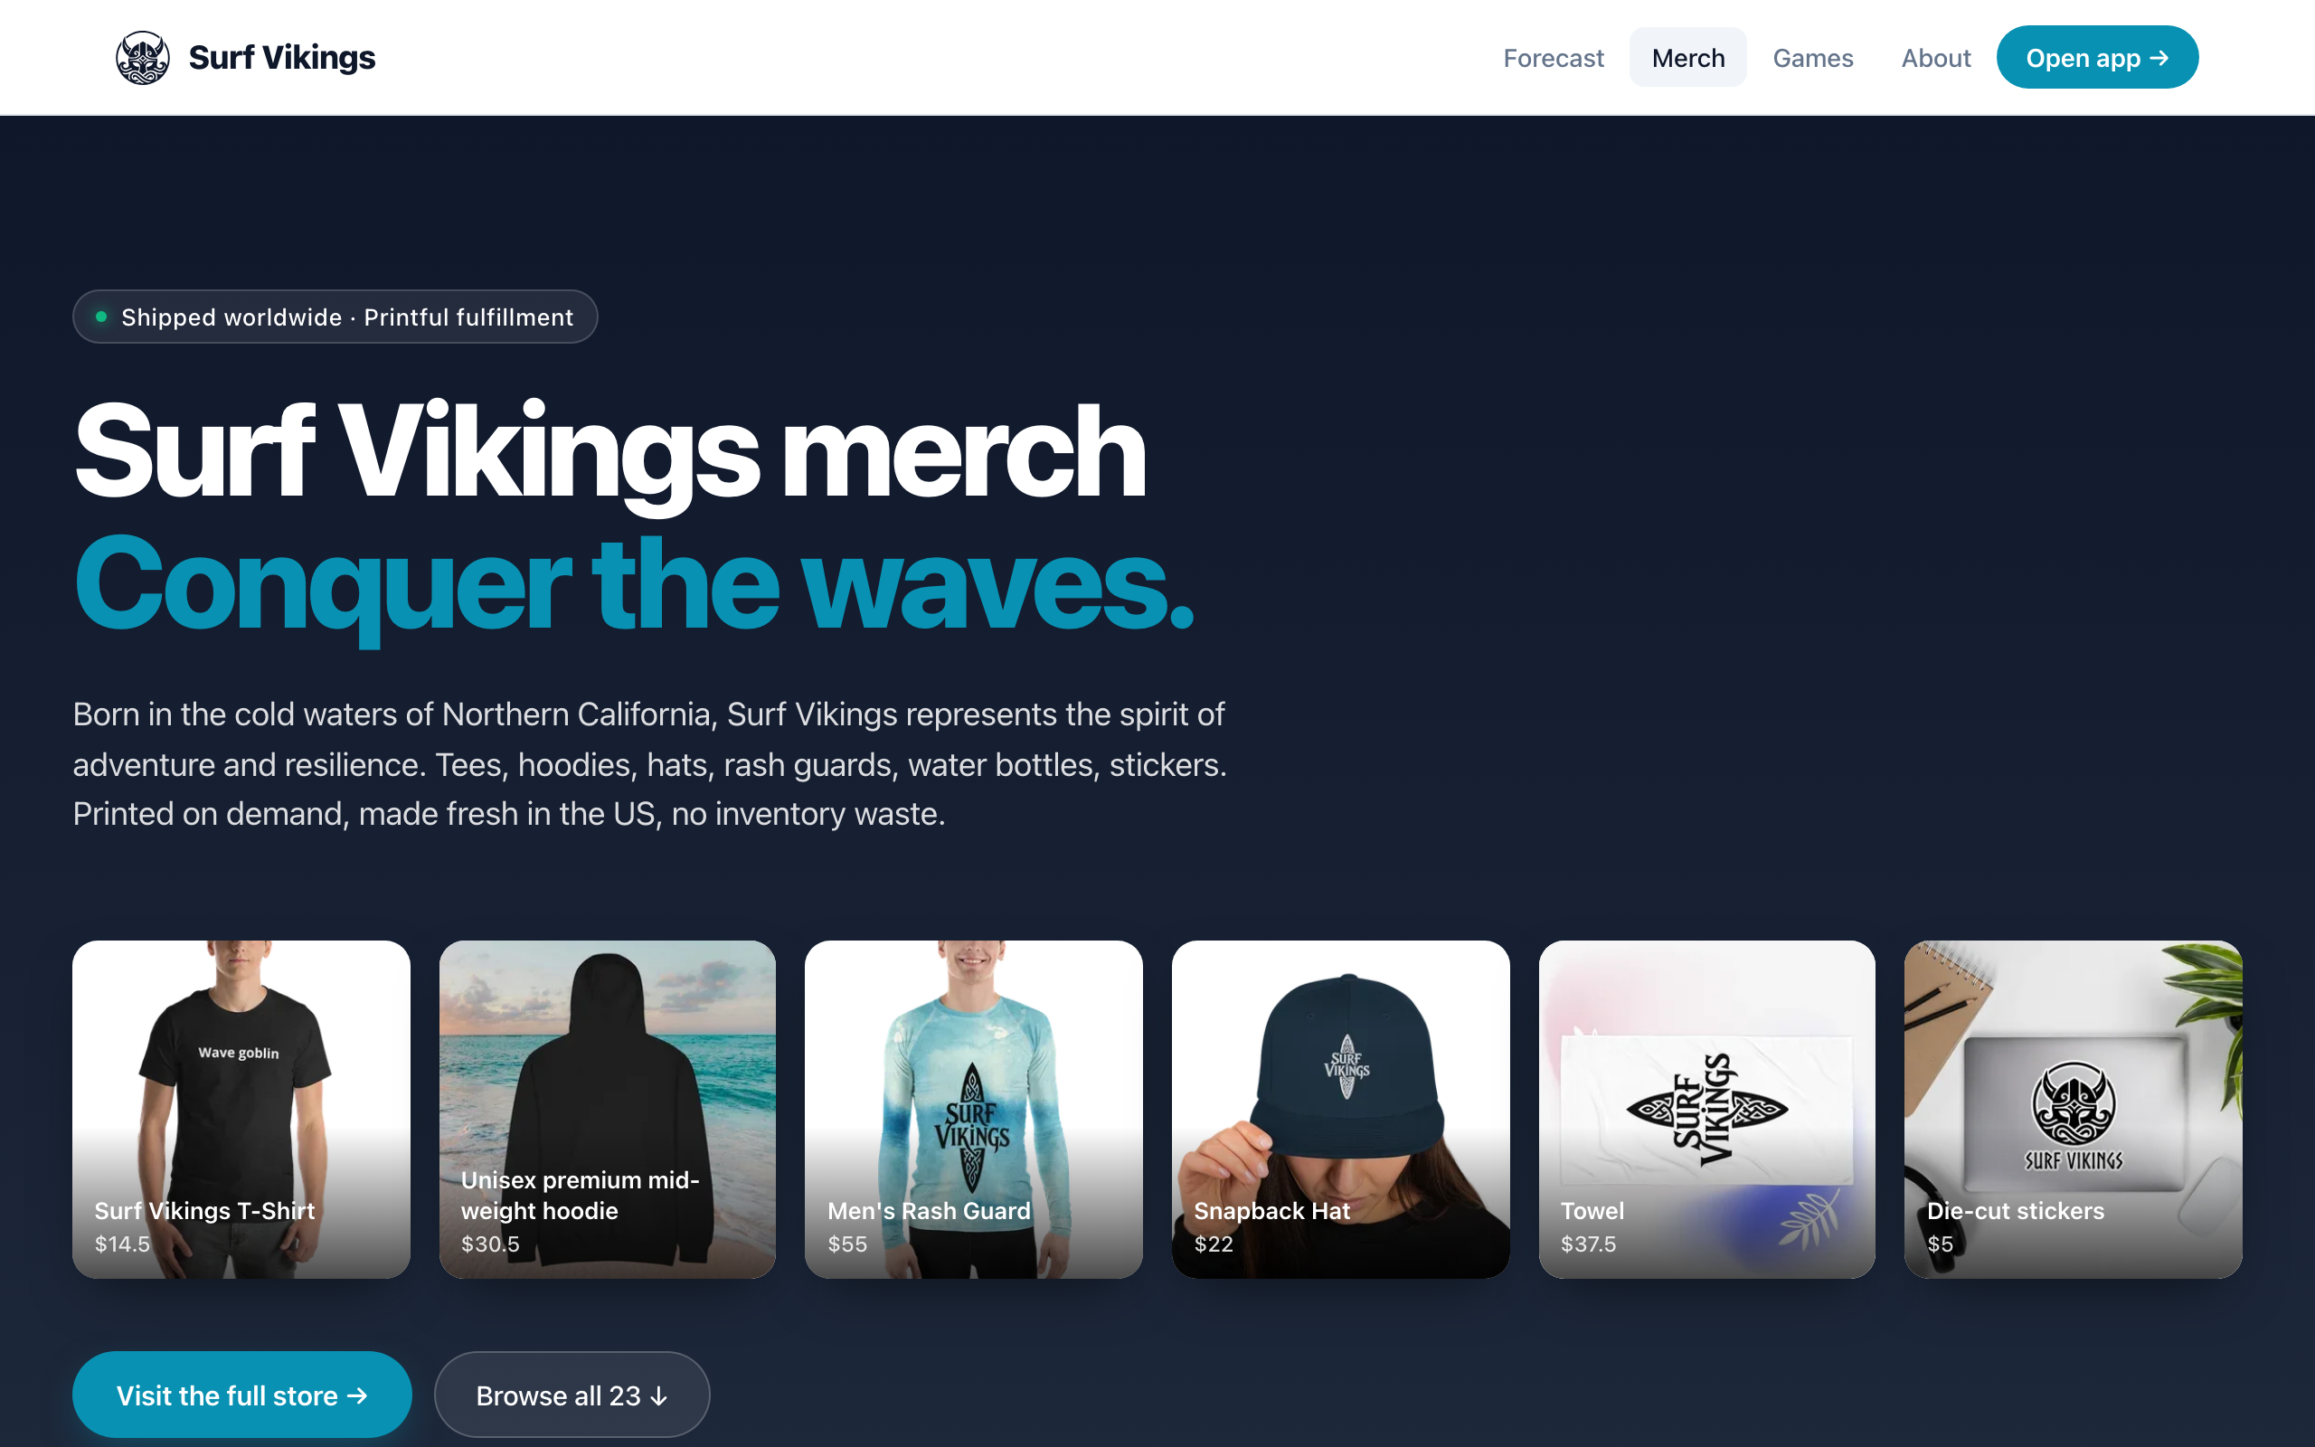
SURF VIKINGS
PORTFOLIO CASE STUDY
ARC 04 · MERCH PIPELINE
When the platform fights you,
route through what it trusts.
curl returned 403. Cloudflare bot challenge. Playwright's ctx.request.get() also 403: browser contexts don't share challenge cookies between hostnames for the request API. Fix: route fetches through page.goto(), which runs in the authenticated Chromium page context.
22 products · 0 manual edits
01
Warm the storefront to pass the HTML challenge
02
Scroll to lazy-load all product cards
~20 KB average WebP · 0 hand-written copies
03
Dedupe variants via canonical-URL regex
04
Warm the CDN origin through a dummy page.goto()
05
Download each image through the page context
06
Pipe through Sharp (600px, WebP q82)
surfvikings.com
07 / 14

Slide 8
SURF VIKINGS
PORTFOLIO CASE STUDY
ARC 04 · RESULT
surfvikings.com / merch
HERO COLLAGE + SIX-CATEGORY GRID · PLAYWRIGHT-CAPTURED · SHARP-OPTIMIZED · EDITORIAL-MERGED FROM A MAPPING TABLE
surfvikings.com
08 / 14

Slide 9
SURF VIKINGS
PORTFOLIO CASE STUDY
ARC 05 · INFRASTRUCTURE
Decouple orthogonal concerns.
Legacy surfvikings.com was a manually maintained static site on DreamHost shared hosting. Migrated to Vercel while preserving email routing at the same domain. Web hosting and email hosting are different services that happen to share a domain. DNS was the seam.
BEFORE
AFTER
HOST
DreamHost shared hosting
HOST
Vercel (auto-deploy from main)
DEPLOY
Manual uploads via Cyberduck
DEPLOY
22-second production builds
TLS
Self-managed
TLS
Auto Let’s Encrypt + HSTS
EMAIL
DreamHost
EMAIL
DreamHost (unchanged)
DIG A @ 76.76.21.21 · A www 76.76.21.21 · HTTP/2 200 · ZERO-DOWNTIME MIGRATION
surfvikings.com
09 / 14

Slide 10
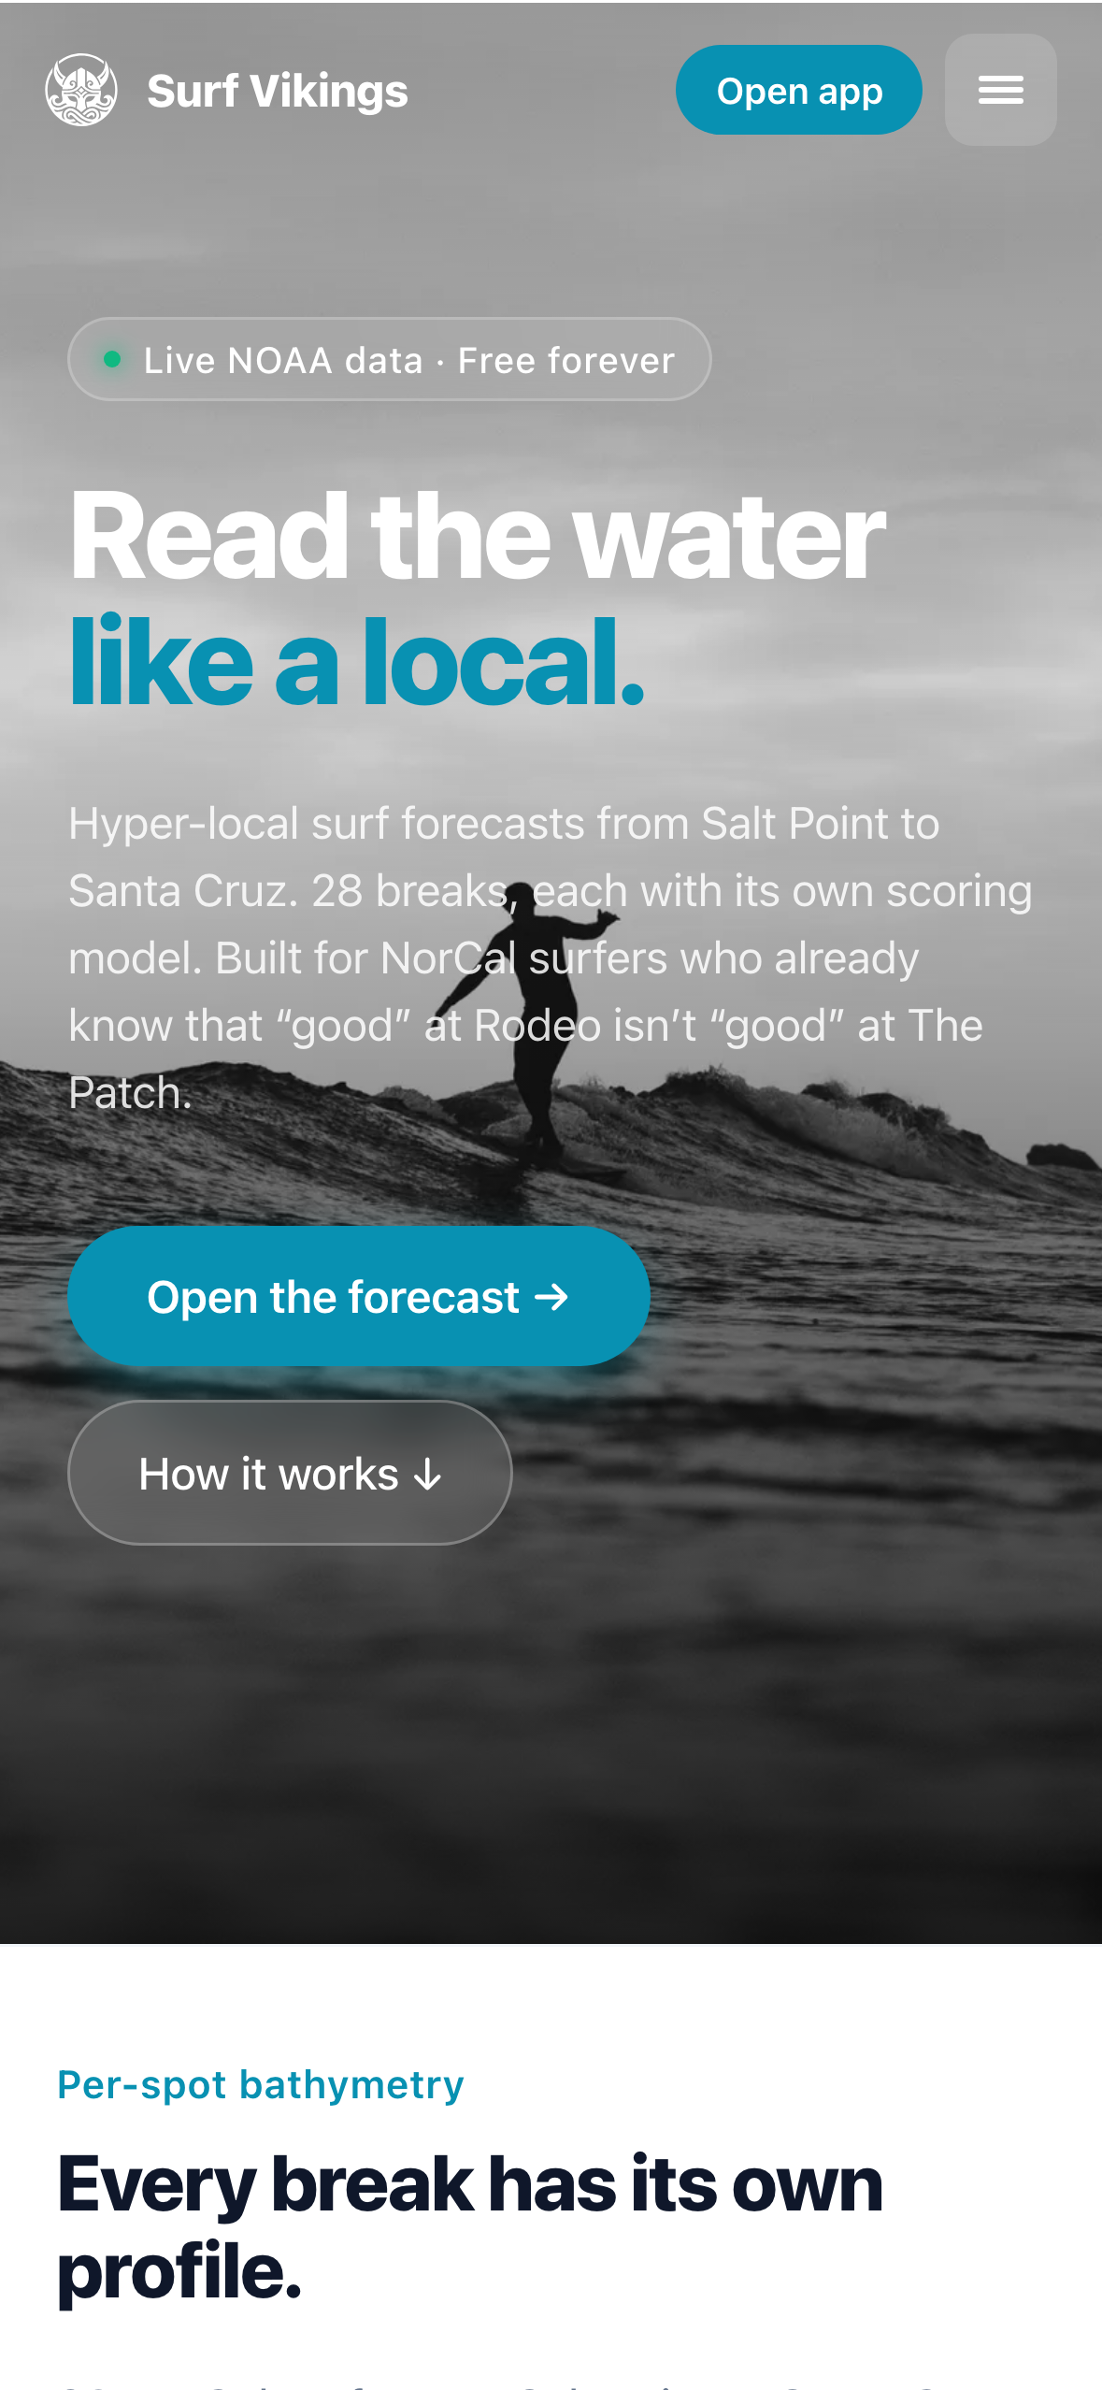
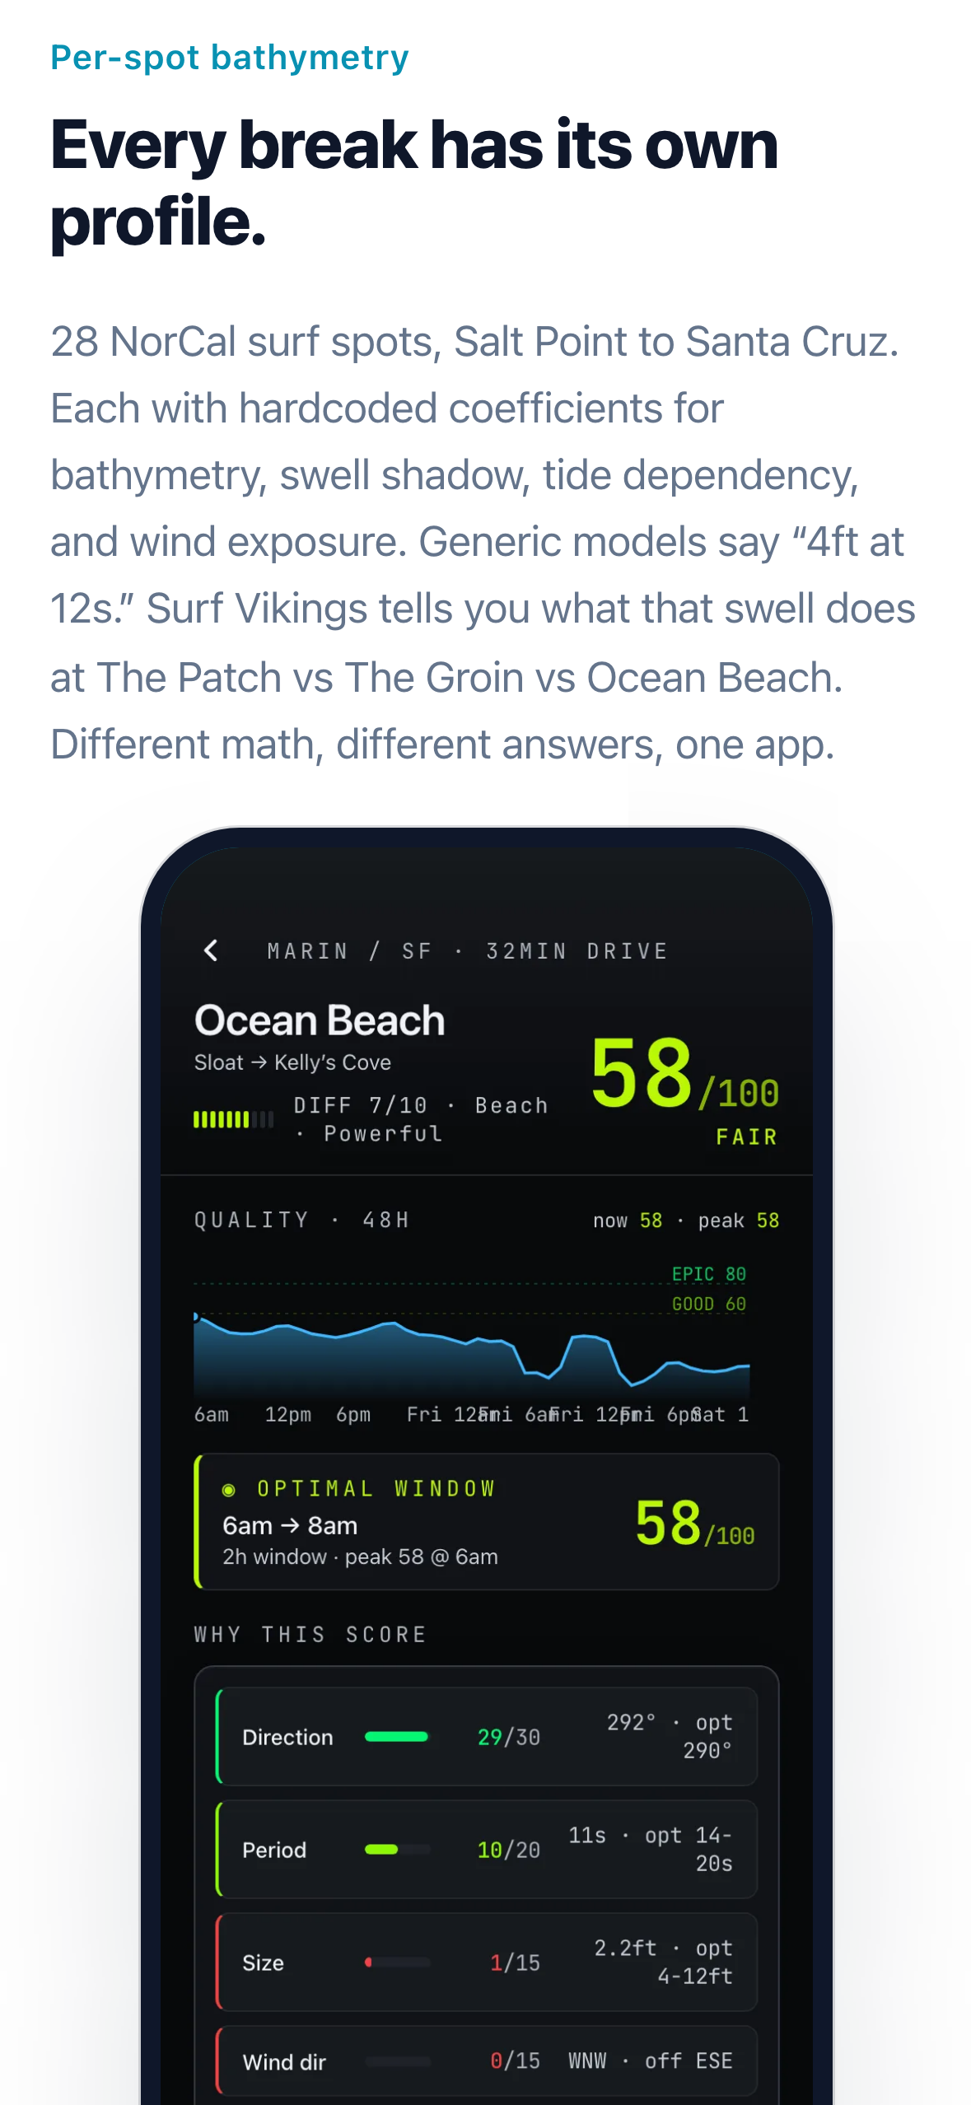
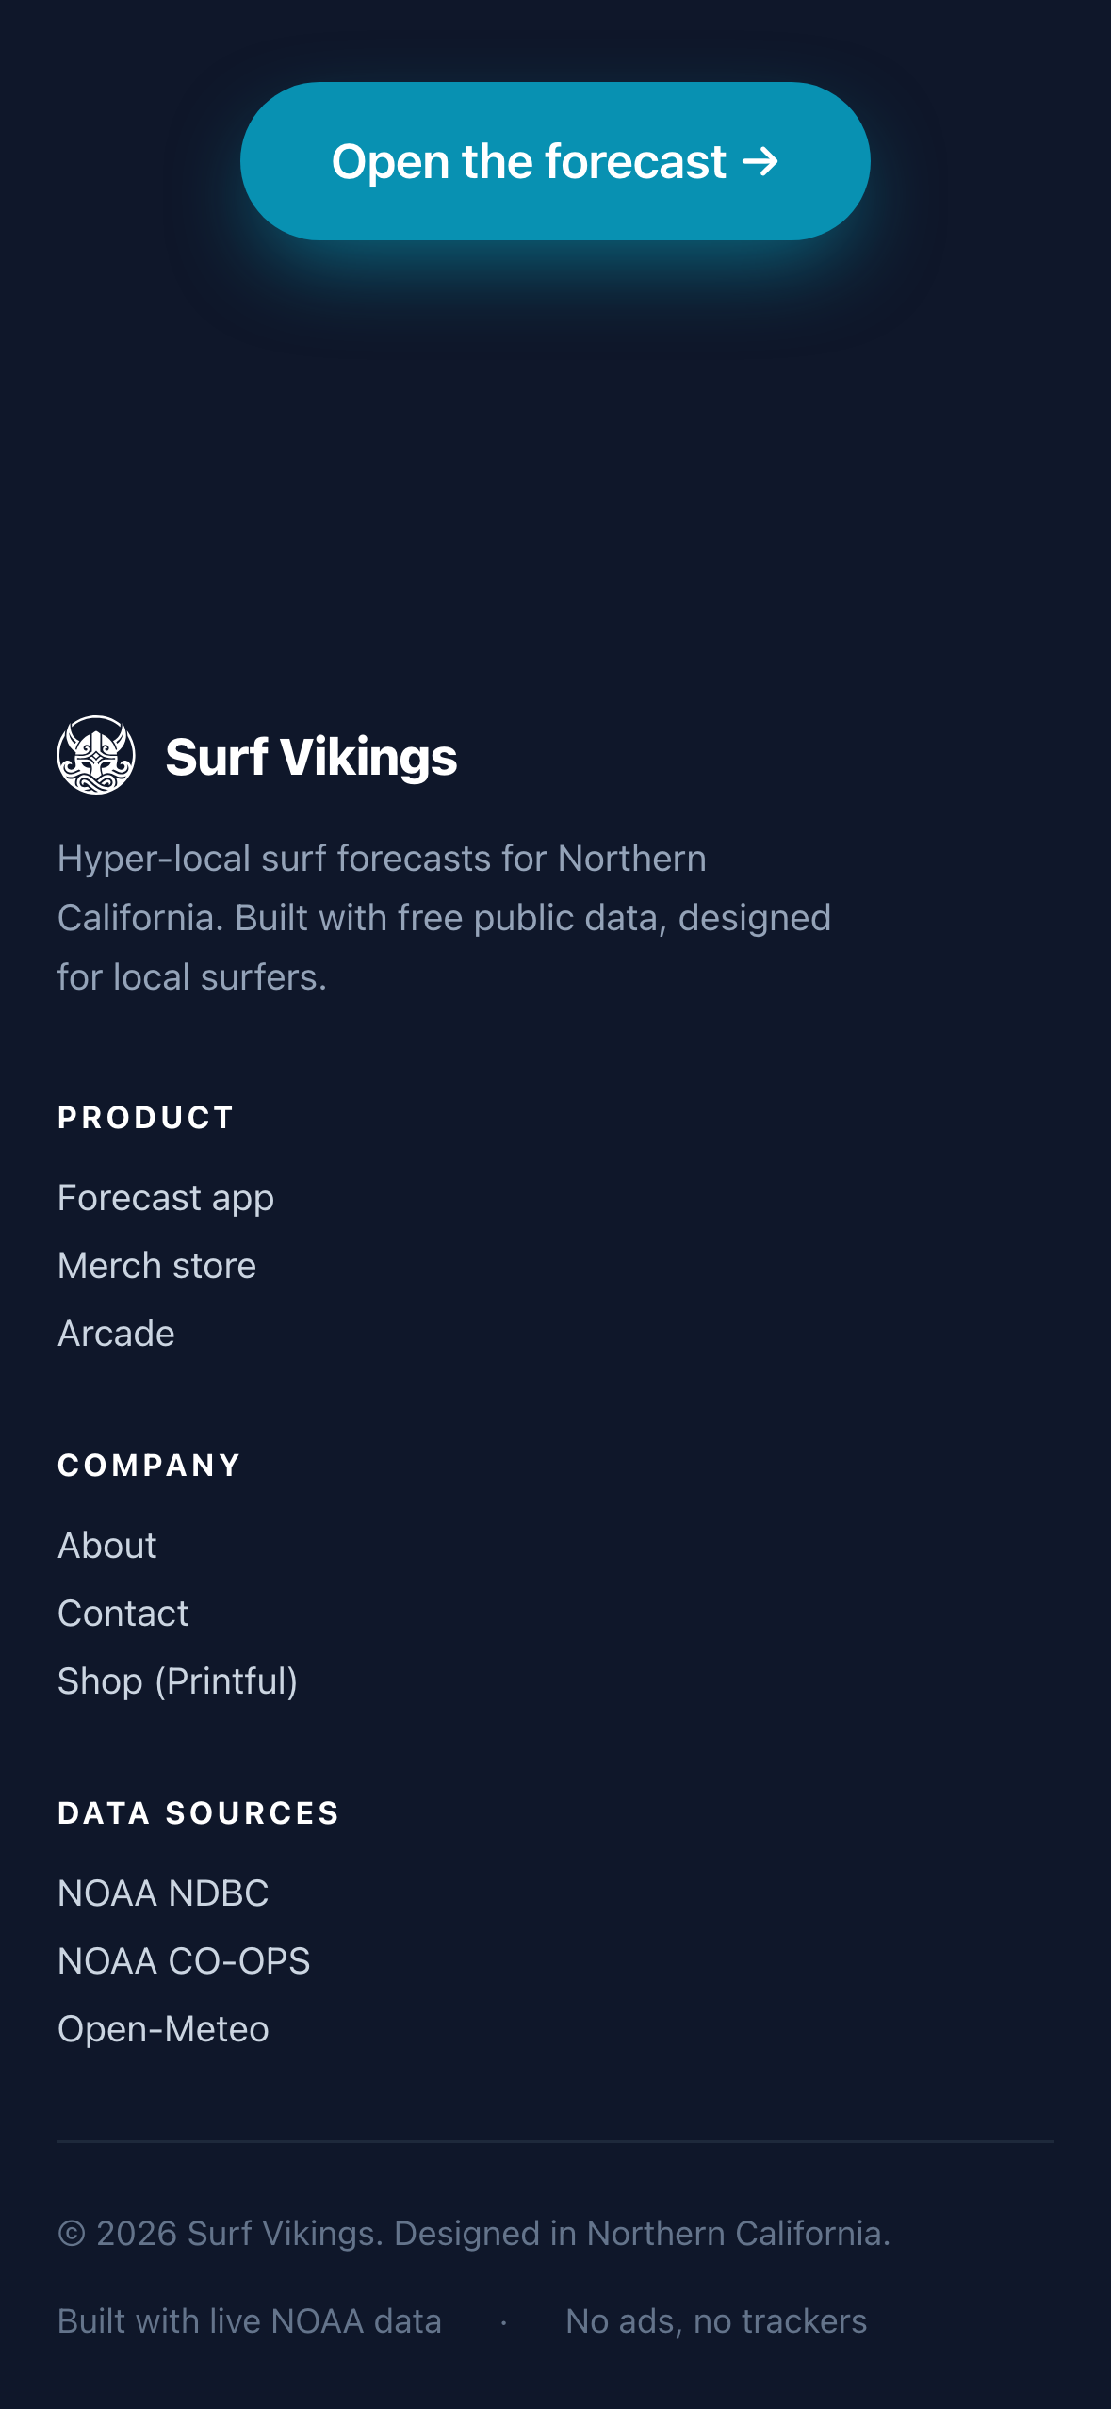
SURF VIKINGS
PORTFOLIO CASE STUDY
ARC 05 · RESPONSIVE PASS
Mobile-first, respected.
Stacked hero with visible wordmark and iOS safe-area padding
Halved hero-to-headline gap with stacked feature section
Single-column footer — no more horizontal overflow
surfvikings.com
10 / 14

Slide 11
SURF VIKINGS
PORTFOLIO CASE STUDY
ARC 06 · DASHBOARD
Platform affordances
over platform APIs.
The header was hardcoded copy left over from a static mock. Shipped in two commits: first a live clock, time-aware greeting, localStorage-backed name and location, real buoy air temp and top-spot wind. Then the bug: iOS silently suppresses window.prompt() in standalone PWA mode.
The fix wasn’t feature-detection — it was inline editing. An <input> swap replaces the prompt entirely, works identically in browser, PWA, and in-app WebView, and handles iOS keyboard niceties: enterKeyHint="done", autoCorrect="off", select-on-focus.
surfvikings.com
11 / 14

Slide 12
SURF VIKINGS
PORTFOLIO CASE STUDY
CROSS-CUTTING
Engineering principles.
01
Model the domain before writing the UI
02
Graceful degradation by default
Types exist before components render them
Three-state rendering never leaves a spinner
03
Color conveys quality, not state
04
Route through what the platform trusts
7-tier palette beats red/green stoplight
Cloudflare bypass via real Chromium, not solving
05
Decouple orthogonal concerns
06
Platform affordances over platform APIs
Web hosting and email are different services; DNS is the seam
Inline input beats window.prompt() on every target
07
Editorial systems, not editorial content
08
Iterate in commits, not in branches
Content-as-code survives scraper re-runs
34 linear commits, every change reversible
surfvikings.com
12 / 14

Slide 13
SURF VIKINGS
PORTFOLIO CASE STUDY
STACK · SCOPE · OUTCOMES
Small surface, opinionated choices.
FRONTEND
BUILD · TOOLING
DATA LAYER
INFRASTRUCTURE
Vite
React 18
TypeScript
vite-plugin-pwa
TypeScript strict
Playwright
Sharp
Node scripts
NDBC buoys
Open-Meteo marine
NOAA tides
10-min cache
Vercel hosting
DreamHost email
Let’s Encrypt
$0 / month
~4,100
34
28
48h
0
$0
LINES TS
COMMITS
SPOTS
FORECAST
3rd-party JS
HOSTING
surfvikings.com
13 / 14

Slide 14
SURF VIKINGS
PORTFOLIO CASE STUDY
CLOSER · LIVE
Surf Vikings is a hyper-local NorCal surf forecasting PWA I designed, engineered, and shipped solo. Scored 28 breaks across 150 miles of coast hour-by-hour on free public NOAA data. Shipped on a custom domain with zero-downtime migration, an installable PWA, a Printful-backed merch store with a custom Cloudflare-bypass scraper, and a personalized dashboard that works identically in browser, home-screen PWA, and in-app WebView.
LIVE
REPO
CONTACT
surfvikings.com
github.com/elieljohnson/surfvikings
eliel.johnson@gmail.com
surfvikings.com
14 / 14

