Slide 1

Agentic Admission — A multi-agent LLM panel for MTE dossier evaluation.
Spring 2026 semester project, CDM-MTE.
Author: Elie Bruno
Supervisor: Prof. Gaétan de Rassenfosse
Date: 30 May 2026
"The system does not decide; the committee still decides."
Agentic Admission · Elie Bruno ·
EPFL
CDM-MTE
1 / 15
Notes:
This project explores whether a multi-agent panel of large language models can assist the MTE admission committee in triaging application dossiers. I want to be clear from the outset: the system does not replace human judgment. It provides a structured first read that the committee can accept, override, or ignore. The goal is to give boundary cases more attention, not less. We'll start by looking at the current bottleneck in the admissions process.

Slide 2
The bottleneck
130
The MTE admission committee reviews 130 dossiers per round. Each dossier requires 30–60 minutes of careful reading. Boundary cases — candidates near the accept/reject threshold — paradoxically receive the least deliberation time because fatigue compounds toward the end of the pile.
dossiers per round
80–130
reading hours per committee cycle
~4 min
average time on boundary cases
Agentic Admission · Elie Bruno ·
EPFL
CDM-MTE
2 / 15
Notes:
The MTE programme receives around 130 applications per admission round. The committee spends between 80 and 130 hours reading them. The problem is not volume alone — it is that boundary cases, the ones that most need careful discussion, tend to get compressed into the final hours of review. This project asks whether we can give those cases a structured pre-read before the committee convenes. This leads us to our core research question.

Slide 3
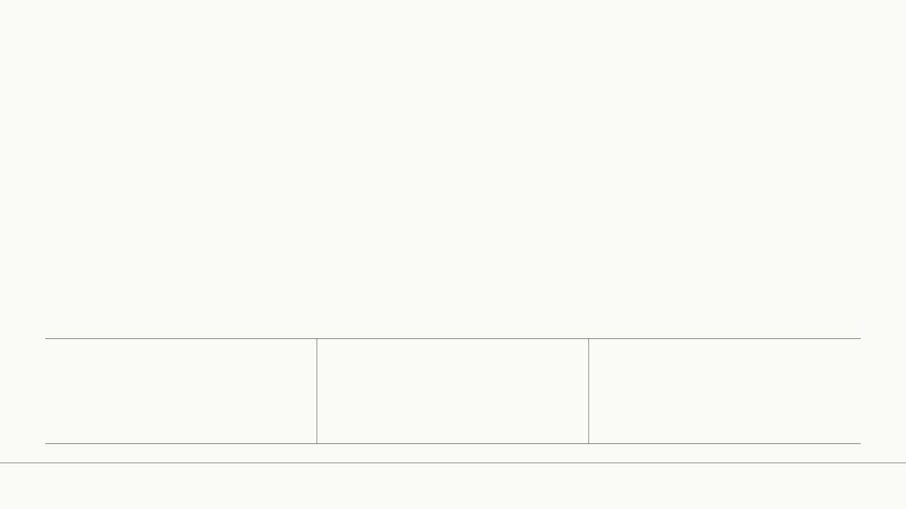
Research question
"Can a multi-agent panel of LLMs, calibrated against a real admission committee, reach an agreement level that makes it useful for triage without introducing systematic bias?"
Calibration
Stability
Auditability
Can we align the panel's decisions with the committee's past verdicts?
Does the panel produce consistent results across repeated runs?
Can every verdict be traced back to specific evidence in the dossier?
Agentic Admission · Elie Bruno ·
EPFL
CDM-MTE
3 / 15
Notes:
The research question has three legs. First, calibration: can we get the system to agree with the committee's actual decisions? Second, stability: if we run the same dossier five times, do we get the same answer? Third, auditability: can we trace every score back to a specific passage in the application? Without all three, the system is not useful — it is just a random number generator with good grammar. We've made four key contributions to address these points.

Slide 4
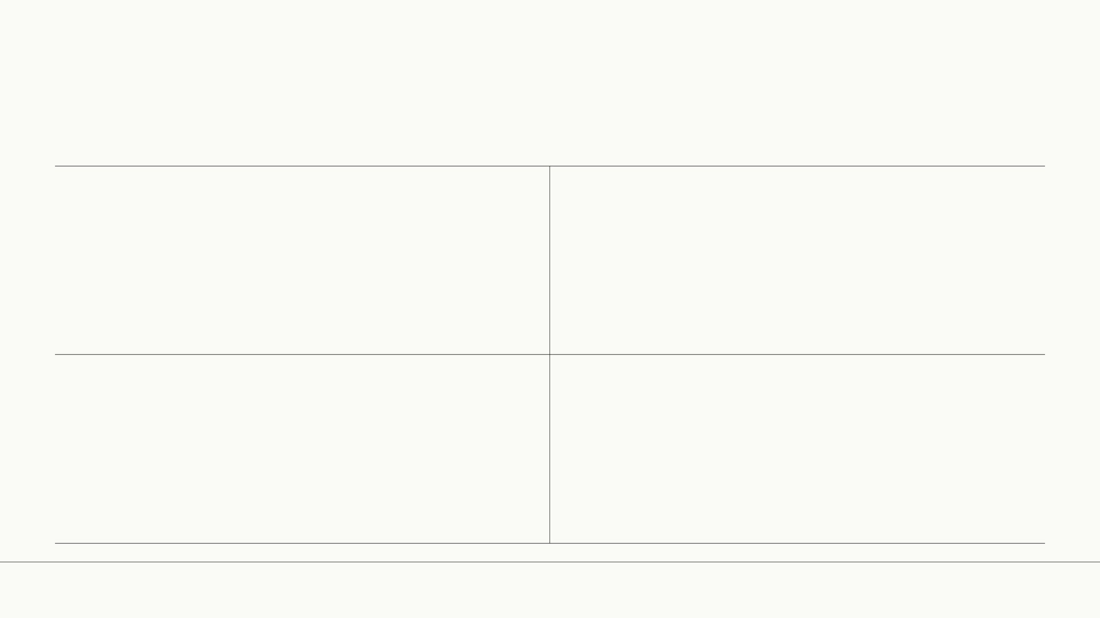
Four contributions
01
02
Extraction & anonymisation pipeline
Multi-agent deliberation architecture
End-to-end pipeline from raw Excel exports to anonymised, structured candidate profiles.
Four specialist evaluators + a Chair agent that synthesises scores through weighted deliberation.
03
04
Calibration loop
Spec-first engineering
Iterative prompt-editing cycle measured against committee ground truth, reaching 82% agreement.
Full OpenAPI spec, JSON schemas, and reproducible CI pipeline before any model call.
Agentic Admission · Elie Bruno ·
EPFL
CDM-MTE
4 / 15
Notes:
The project makes four contributions. First, a complete extraction and anonymisation pipeline that takes raw administrative exports and produces structured, privacy-safe candidate profiles. Second, a multi-agent architecture where four specialist evaluators deliberate under a Chair agent. Third, a calibration loop that iteratively edits prompts against committee ground truth. Fourth, a spec-first engineering approach — we wrote the API contracts and JSON schemas before writing a single prompt. This matters because it makes the system reproducible and testable. All of this relies on a robust dataset.

Slide 5
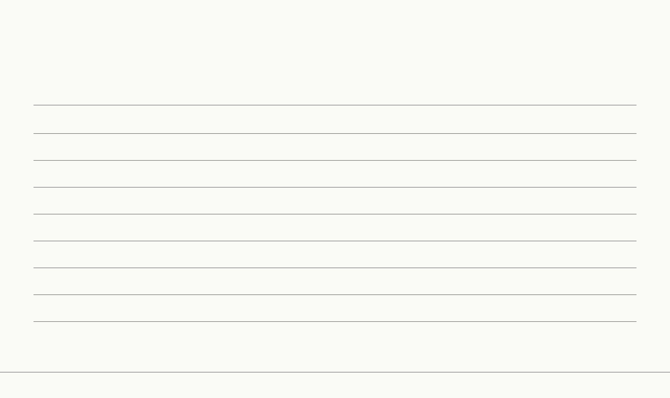
The data
Academic Year
Candidates
Notable Schema Change
2020–21
228
Triplet evaluators, no GPA column
2021–22
241
GPA column added, hidden gender column
2022–23
233
Decision column moved
2023–24
218
Reference grade scale changed
2024–25
194
Two new evaluators rotated in
2025–26
228
Section column renamed (current round)
Total
1,342 candidates
12,529 dossier documents
Per-year column diffs are documented in data/FILE_MAPPING.md.
Agentic Admission · Elie Bruno ·
EPFL
CDM-MTE
5 / 15
Notes:
We have six years of admission data, from 2020 to 2026, covering 1,342 candidates and over 12,500 individual dossier documents. Each year brought small schema changes — a moved decision column here, a renamed section header there — which means the extraction pipeline had to handle heterogeneous inputs. The 2025–26 cohort is the one we calibrated against, because we have the committee's actual decisions for that round. This extensive data allowed us to build a strong anonymisation process.

Slide 6
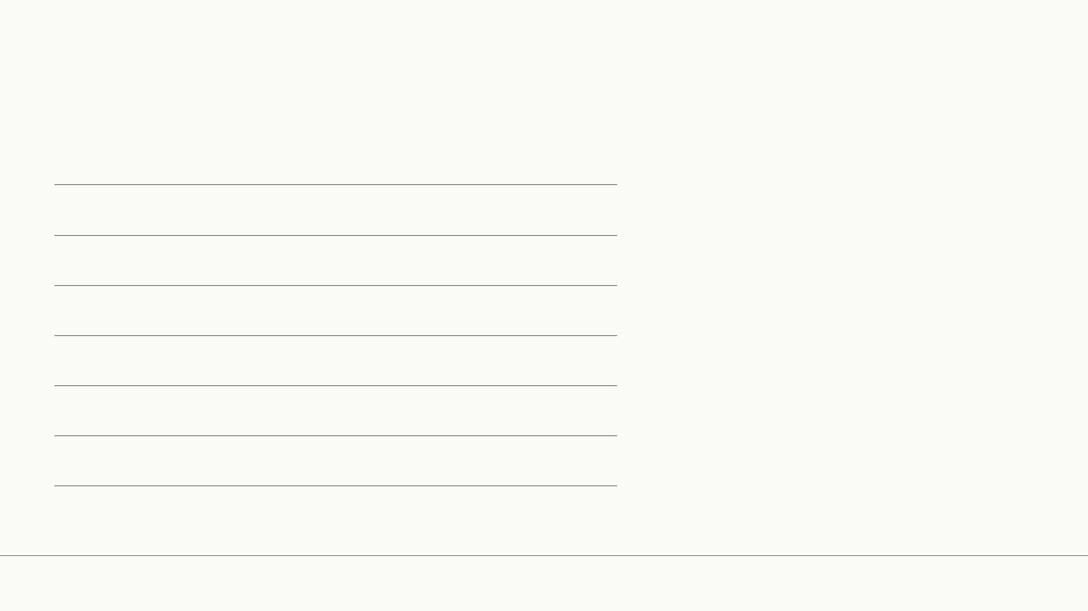
Anonymisation coverage
PII Type
Coverage
900 files sampled, stratified random, seed 42. Two fixes brought name coverage above 99% on the next pass.
Emails
100%
Phones
100%
Addresses
100%
AVS / IBAN / SCIPER
100%
Names
96.1%
Agentic Admission · Elie Bruno ·
EPFL
CDM-MTE
6 / 15
Notes:
Anonymisation is non-negotiable. We sampled 900 files using a stratified random method and measured coverage across five PII categories. Emails, phones, addresses, and government identifiers hit 100%. Names reached 96.1% on the first pass — the remaining gaps were edge cases like hyphenated surnames and transliterated names. Two targeted regex fixes brought that above 99% on the subsequent pass.

Slide 7
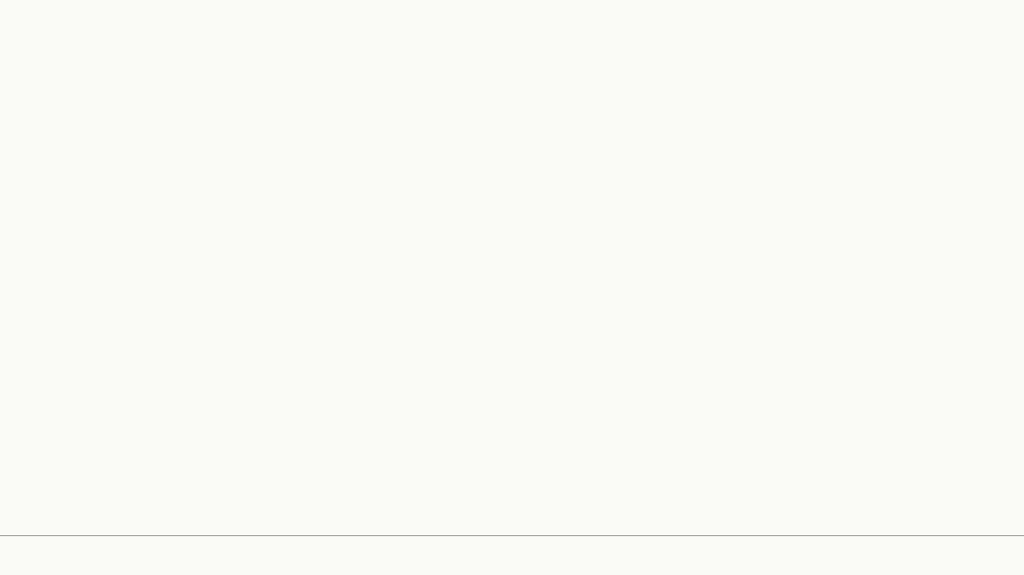
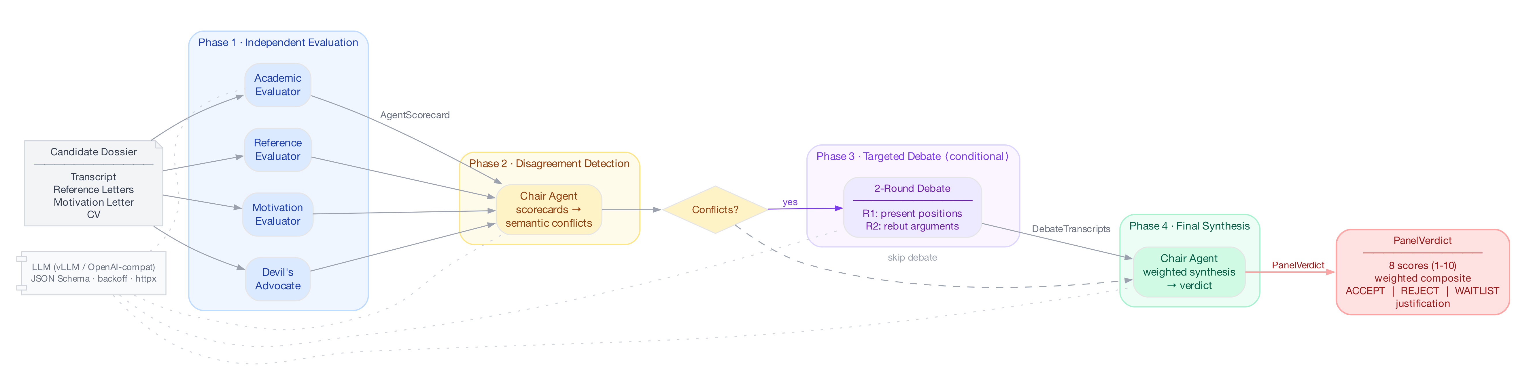
System architecture
Agentic Admission · Elie Bruno ·
EPFL
CDM-MTE
7 / 15
Notes:
Now, let's look at the system's overall architecture. This diagram shows the four-phase deliberation protocol in action. Raw data comes in as Excel exports, then gets extracted and anonymised. The dossier loader builds a candidate profile, and the profile selector picks who to evaluate. Then, the four evaluators — Academic, Reference, Motivation, and Devil's Advocate — score independently. The Chair synthesises these scores, and a GPA gate applies final rules before a JSON verdict is issued. This structured flow ensures every step is clear and auditable.

Slide 8

The four evaluators
Academic Evaluator
Reference Evaluator
Motivation Evaluator
Devil's Advocate
Academic strength
(1–10)
Reference quality
(1–10)
Motivation clarity
(1–10)
Risk flags
(1–10)
Institution
quality
(1–10)
Calibration confidence
(1–10)
Program fit
(1–10)
Consistency
(1–10)
Reads:
Reads:
Reads:
Reads:
transcript, GPA, institution category
2–3 letters + calibration profile
motivation letter, CV, work history
full dossier, cross-document check
Agentic Admission · Elie Bruno ·
EPFL
CDM-MTE
8 / 15
Notes:
Each evaluator is a specialist. The Academic Evaluator reads the transcript and scores academic strength and institution quality. The Reference Evaluator reads the two or three recommendation letters and scores reference quality and calibration confidence, grounded in a cultural-calibration profile of the letter pool. The Motivation Evaluator reads the motivation letter and CV and scores motivation clarity and program fit. The Devil's Advocate reads the full dossier and scores risk flags and consistency, checking claims across documents. They score independently and never see each other's outputs, which prevents anchoring and lets genuine disagreement surface.

Slide 9

The Chair
Dimension
External Profile
EPFL-Internal
—
Detects disagreement among evaluators
(semantic conflicts between scorecards)
Academic strength
0.30
0.45
—
Moderates a 2-round debate on each flagged conflict
Institution quality
0.18
0.10
—
Produces a weighted synthesis across all 8 dimensions
Reference quality
0.18
0.00
Calibration confidence
0.12
0.00
Motivation clarity
0.06
0.15
Program fit
0.06
0.15
Risk flags
0.05
0.075
Consistency
0.05
0.075
Total
1.00
1.00
Agentic Admission · Elie Bruno ·
EPFL
CDM-MTE
9 / 15
Notes:
The Chair agent does three things. First, it reads the four scorecards and flags semantic conflicts: cases where two evaluators interpret the same evidence differently, which is more than a numeric score gap. Second, for each flagged conflict it moderates a two-round debate in which the disagreeing evaluators state positions, rebut, and re-score. Third, it computes the weighted composite. The weights differ by profile. External candidates carry 48% of the mass on academic strength plus institution quality and 30% on the two reference dimensions. EPFL-internal candidates submit no recommendation letters in four of five sampled dossiers, so the reference weights drop to zero: academic strength rises to 0.45, motivation clarity and program fit rise to 0.15 each, and institution quality falls to 0.10 because the institution is always EPFL. Both profiles are validated at construction time to sum to 1.0.

Slide 10
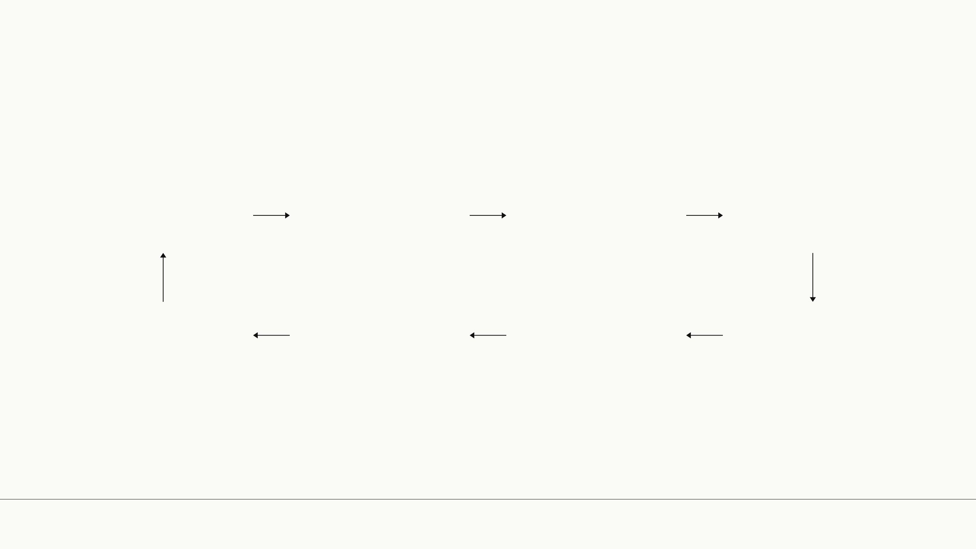
The calibration loop
Run
Aggregate
(majority vote)
Compare to
committee
Identify
disagreement class
Measure delta
Re-run
Edit prompt
Form hypothesis
Each iteration: ~$2, six minutes, 28 candidates.
Agentic Admission · Elie Bruno ·
EPFL
CDM-MTE
10 / 15
Notes:
Calibration is iterative. We run the panel on 28 candidates — our calibration cohort — aggregate by majority vote, compare to the committee's actual decisions, identify where we disagree, form a hypothesis about why, edit the relevant prompt, re-run, and measure the delta. Each cycle costs about two dollars in API calls and takes six minutes. This tight feedback loop is what allowed us to move from 50% agreement to 82% in three weeks.

Slide 11

The Maillard falsification event
"Etienne Maillard's algebra + analysis average is 4.31. Behind that average: Analyse I = 3.75 (fail-and-retake), Analyse II = 5.25 (strong recovery). The committee accepted on the trajectory; the binary threshold rejected."
Post-fix 3-band rule (the original binary threshold rejected Maillard; the new rule routes him to DISCUSS, which the committee then accepts).
Band
GPA Range
Verdict
ACCEPT
≥ 4.5
Automatic accept
DISCUSS
4.0 – 4.5
Committee deliberation required
REJECT
< 4.0
Automatic reject
Agentic Admission · Elie Bruno ·
EPFL
CDM-MTE
11 / 15
Notes:
This is the case that broke our first threshold model. Etienne Maillard — a pseudonym, of course — had a combined algebra and analysis average of 4.31, which falls in the DISCUSS band. But behind that average was a clear trajectory: a 3.75 in Analyse I, which he failed and retook, followed by a 5.25 in Analyse II. The committee saw the recovery and accepted. Our binary threshold rejected. This event forced us to add trajectory detection to the Academic Evaluator — a direct improvement from a single falsifying case.

Slide 12

Headline results
82%
76.6%
100%
EPFL-internal agreement
5-run decision stability
Anonymisation coverage
(23/28, up from 50%)
on high-sensitivity PII
82% is a single post-band-rule run; the 5-run majority vote is pending
95% Wilson CI on 82%: [64%, 92%] (n = 28, EPFL-internal)
Stability flips concentrate in the DISCUSS band (4.0–4.5 GPA)
Agentic Admission · Elie Bruno ·
EPFL
CDM-MTE
12 / 15
Notes:
Three numbers summarise the project. 82% agreement with the committee on the EPFL-internal sub-cohort — that is 23 out of 28 candidates, up from 50% at baseline. 76.6% decision stability across five independent runs — meaning roughly three out of four candidates get the same verdict every time. And 100% anonymisation coverage on high-sensitivity PII: emails, phones, addresses, and government identifiers. These numbers are honest. 82% is not 95%. But it is enough to be useful for triage.

Slide 13
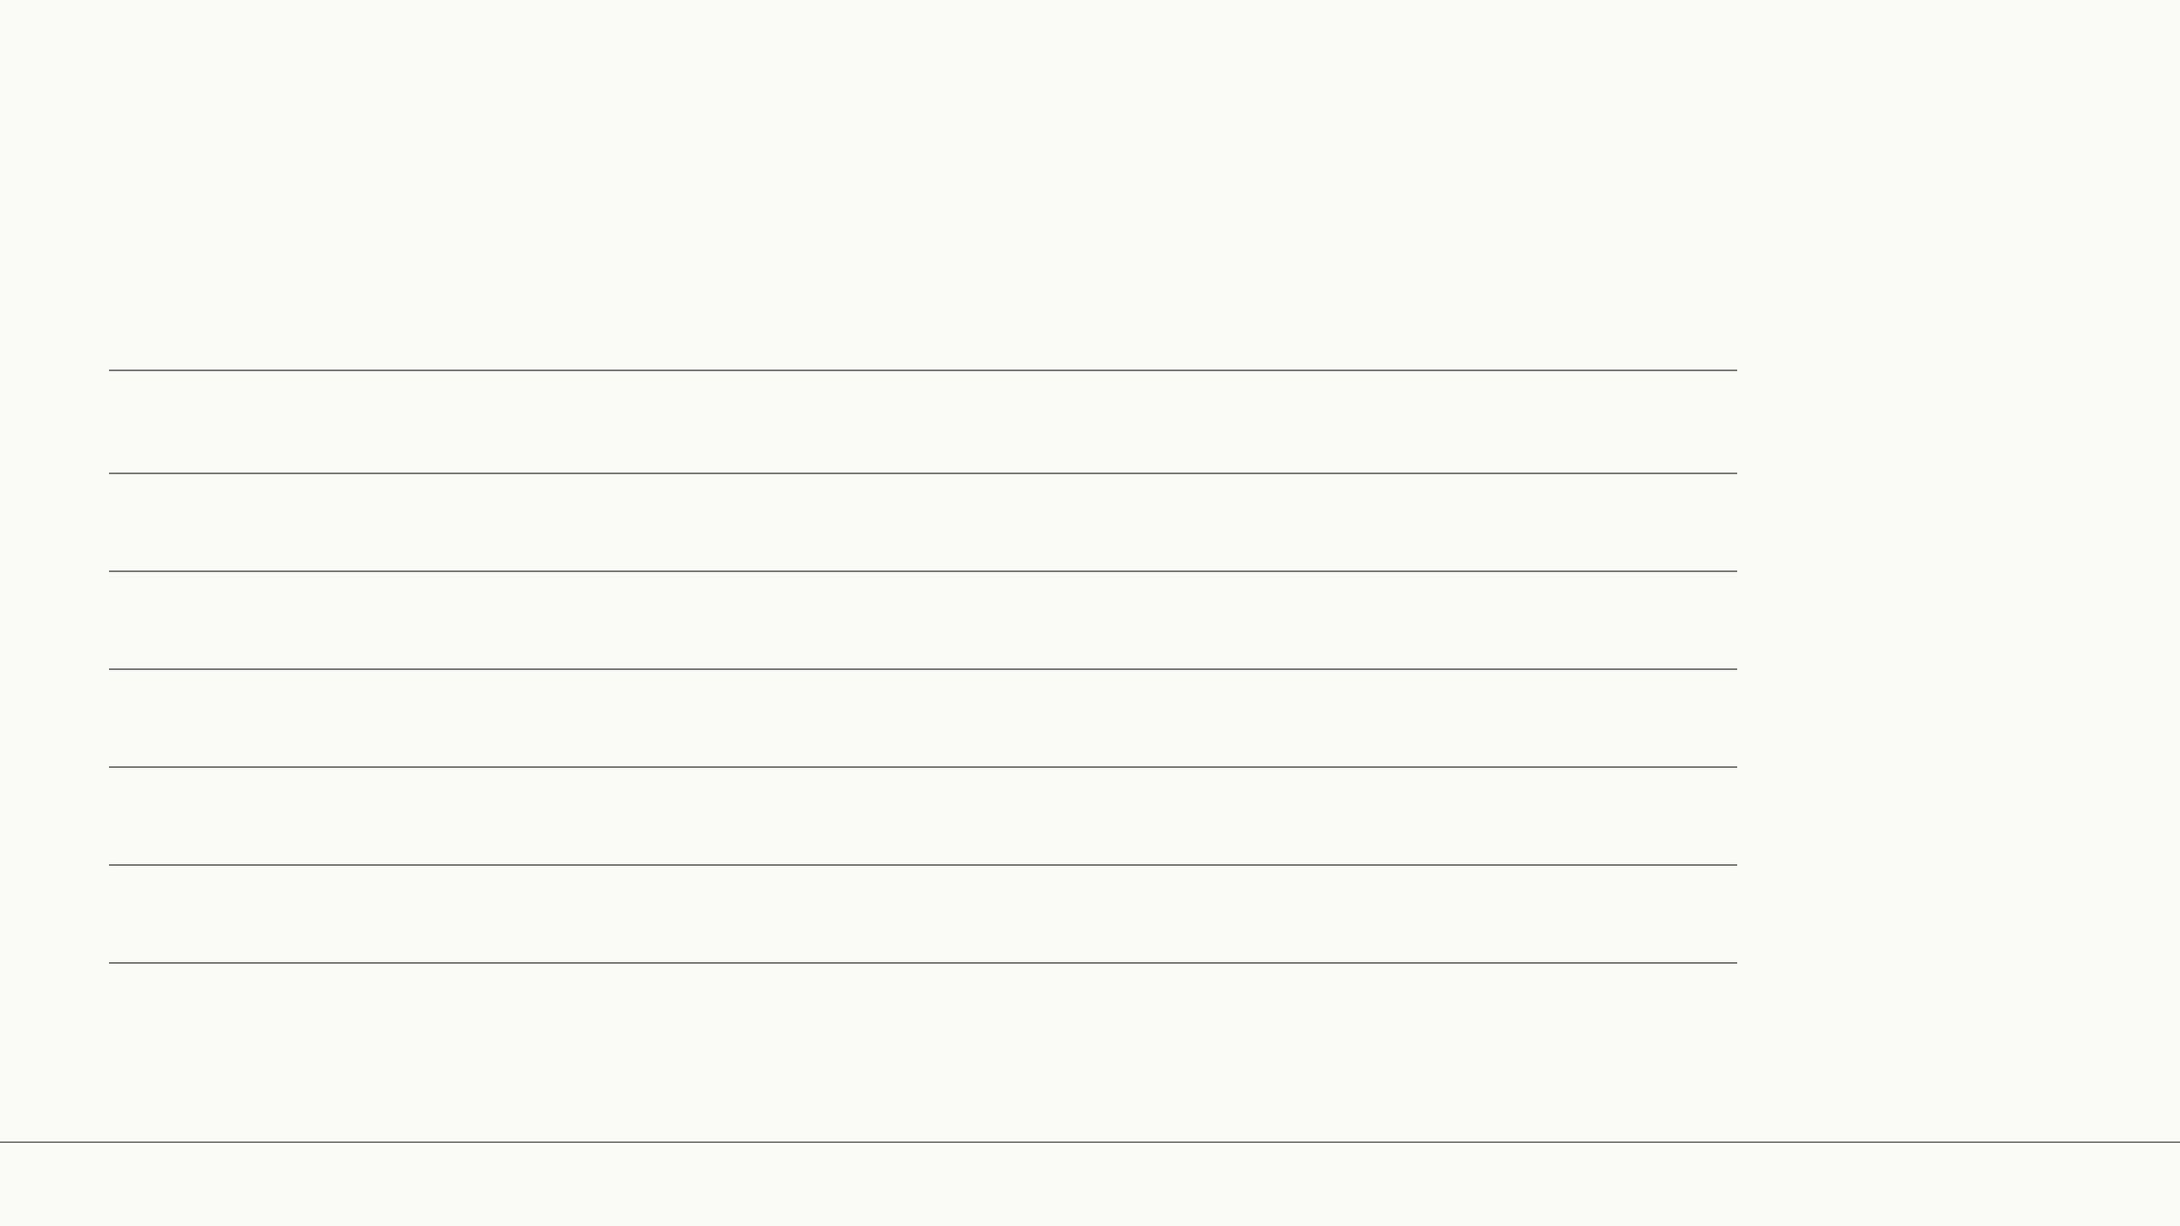
EPFL-internal sub-cohort, week by week
Milestone
Agreement
Committee reference
Ground truth
Week 12 baseline
50%
Week 13 fix 1
54%
Week 13 fix 2
68%
Week 14 fix 3
82%
Agentic Admission · Elie Bruno ·
EPFL
CDM-MTE
13 / 15
Notes:
This table shows the calibration trajectory week by week. We started at 50% — essentially a coin flip. The first fix in week 13 added trajectory detection, which moved us to 54%. The second fix refined the GPA gate thresholds and brought us to 68%. Then PR number 23 — which restructured the Chair's weighting for internal candidates — pushed us to 82%. Each step was a specific, testable hypothesis about why the system disagreed with the committee.

Slide 14

Cost
Serving Choice
Per Dossier
Full 5-Run Cohort
Gemini Flash
$0.08
$50
Sonnet 4.6
$0.70
$450
Local Llama 3.1 on SCITAS
≈ $0
≈ $0
Per-dossier cost by serving choice.
Agentic Admission · Elie Bruno ·
EPFL
CDM-MTE
14 / 15
Notes:
Cost matters for adoption. With Gemini Flash, the cheapest cloud option, we spend eight cents per dossier — fifty dollars for a full five-run cohort of 130 candidates. Sonnet 4.6 is more expensive at seventy cents per dossier. And if we run locally on EPFL's SCITAS cluster using Llama 3.1, the marginal cost is essentially zero. The architecture is model-agnostic by design, so the committee can choose their cost-quality tradeoff.

Slide 15

What's next + portability
What we'd do with more time
What ports to other filières
Formal bias audit across nationality and gender
—
Programme · Estimated effort
5-run majority vote post-final fix (expected: >85% agreement)
—
EPFL Bachelor · ~7 dev days (new prompts + GPA schema)
Model comparison: Gemini Flash vs Sonnet 4.6 vs Llama 3.1
Executive MBA · ~10 dev days (work-experience scoring)
—
Doctoral · harder (unstructured criteria, research fit)
Committee dashboard with override logging
—
"The architecture is portable. The content is not."
Agentic Admission · Elie Bruno ·
EPFL
CDM-MTE
15 / 15
Notes:
If I had another semester, four things would come first. A full five-run majority vote on the post-PR-23 system, which I expect would push agreement above 85%. A formal bias audit disaggregated by nationality and gender. A head-to-head model comparison. And a dashboard for the committee to log overrides. On portability: the architecture generalises. The Bachelor programme would need about seven development days to adapt — mostly new prompt content and a different GPA schema. Executive MBA is similar. Doctoral is harder because the evaluation criteria are less structured. The closing point is important: the architecture is portable, but the prompts and weights are not. Each programme needs its own calibration.

