Slide 1


MotorIST project, SIRS
Elie Bruno,
Flavien Valea,
Tanguy Vésy

Slide 2




Owner/s
Car
Mechanic
Manufacturer

Slide 3
Goals
[SR1: Confidentiality] The car configurations can only be seen by the car owner.
[SR2: Integrity 1] The car can only accept configurations sent by the car owner.
[SR3: Integrity 2] The car firmware updates can only be sent by the car manufacturer.
[SR4: Authentication] The car manufacture cannot deny having sent firmware updates.

Slide 4
SRA-Multiple users-Audit
Security challenge
[SRA1: data privacy] One user cannot know the configuration of the other user, but may know some current information of the car.
[SRA2: authorization] An unauthorized user cannot change the configuration of the other user.
[SRA3: authenticity] It must be possible to audit the car and verify which configuration actions were performed by which users.

Slide 5
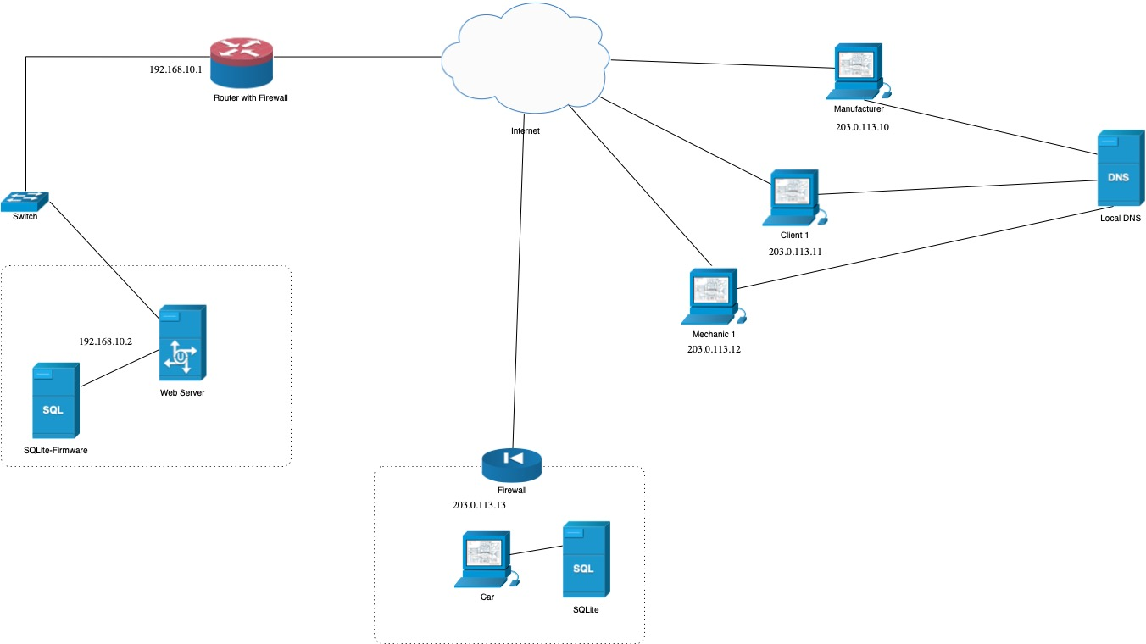

Manufacturer
Owner/s
Mechanic
WebServer
Car
All connection
are TLS !!!

Slide 6
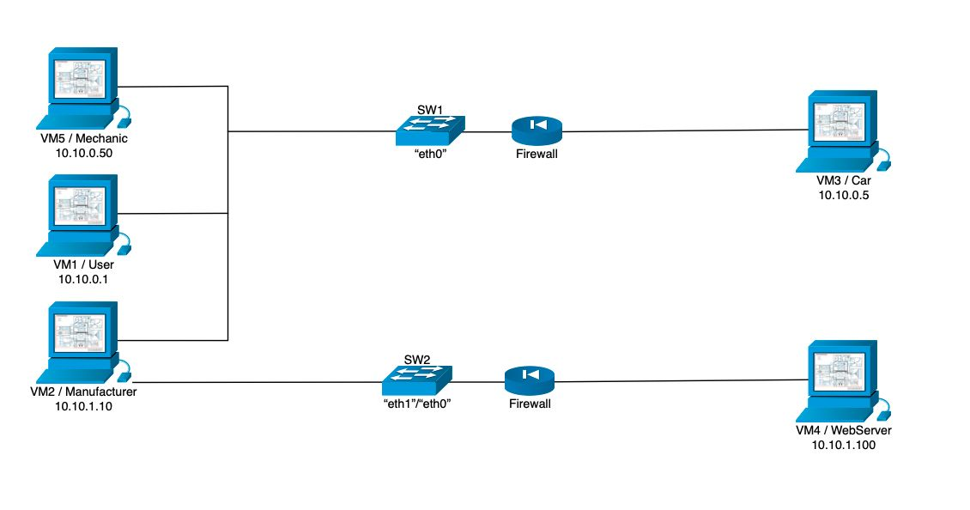
Mechanic
Car
Owner/s
All connection
are TLS !!!
Manufacturer
Webserver

Slide 7
Hybrid cryptographic scheme
AES-256/GCM for data encryption (fast, symmetric),
RSA to securely encrypt the AES key (asymmetric),
ECDSA + SHA3-256 for integrity and authenticity (digital signatures).
adds timestamp and nonce for freshness
It uses BouncyCastle to provide certain algorithms and maintain compatibility.

Slide 8
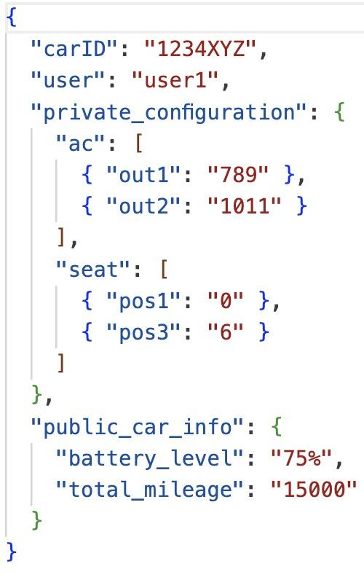
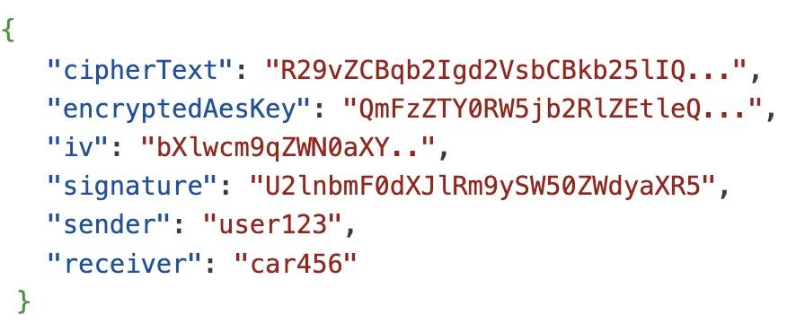
The secure document format

Slide 9

Key Distibution
Each entity has its own pair of private and public RSA and EC key given by the manufacturer when the car was build
In a real case we would have opted for a manual distribution

Slide 10
Deal with the challenges..
[SR1: Confidentiality] The car configurations can only be seen by the car owner.
[SR2: Integrity 1] The car can only accept configurations sent by the car owner.
[SR3: Integrity 2] The car firmware updates can only be sent by the car manufacturer.
[SR4: Authentication] The car manufacture cannot deny having sent firmware updates.
The car and user have both a pair of RSA and EC keys that guarantee the confidentiality and the integrity of the configurations sent to the car

Slide 11
Deal with the challenges..
[SR1: Confidentiality] The car configurations can only be seen by the car owner.
[SR2: Integrity 1] The car can only accept configurations sent by the car owner.
[SR3: Integrity 2] The car firmware updates can only be sent by the car manufacturer.
[SR4: Authentication] The car manufacture cannot deny having sent firmware updates.
The manufacturer also has it’s own private key that is trusted and the message is sent with a timestamp + nonce. The manufacturer signs the message.

Slide 12
Security Challenge A
Security challenge
[SRA1: data privacy] One user cannot know the configuration of the other user, but may know some current information of the car.
[SRA2: authorization] An unauthorized user cannot change the configuration of the other user.
[SRA3: authenticity] It must be possible to audit the car and verify which configuration actions were performed by which users.
The user can not know the configuration of another user because he doesn’t have his private key. He can know public information about the car because he is a user “mock info”

Slide 13
Security Challenge A
Security challenge
[SRA1: data privacy] One user cannot know the configuration of the other user, but may know some current information of the car.
[SRA2: authorization] An unauthorized user cannot change the configuration of the other user.
[SRA3: authenticity] It must be possible to audit the car and verify which configuration actions were performed by which users.
The car knows the keys of the user and based on that accept the change or not.

Slide 14
Security Challenge A
Security challenge
[SRA1: data privacy] One user cannot know the configuration of the other user, but may know some current information of the car.
[SRA2: authorization] An unauthorized user cannot change the configuration of the other user.
[SRA3: authenticity] It must be possible to audit the car and verify which configuration actions were performed by which users.
The car database stores encrypted all the message that were received as well as the signature

Slide 15
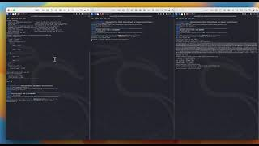
DEMO

